Slide 1
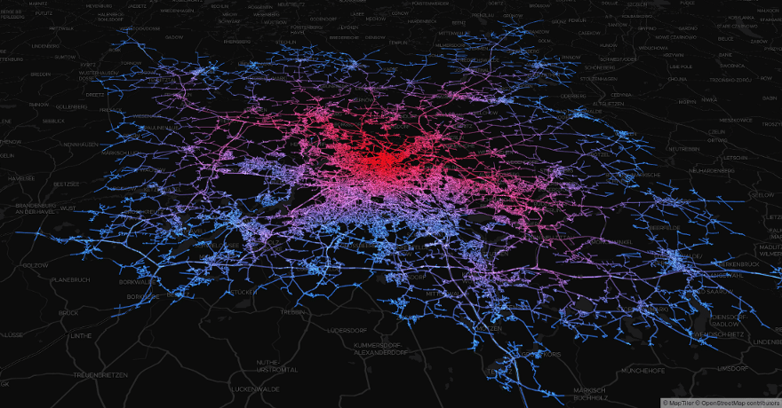
Applications of Analytics
Stephen Downes
October 18, 2021

Slide 2
Motivations for Analytics
We can look at the motivations for learning analytics to develop a sense of what to expect from the technology. Institutions may desire, for example (Kay, Korn & Oppenheim, 2012):
  responses to economic and competitive pressures
  agility of analysis
  good practice in modern enterprise management.
  intelligent personalised services
  visualization of patterns and trends in large-scale data
This is not ‘technology in search of an application’. Quite the opposite.

Slide 3
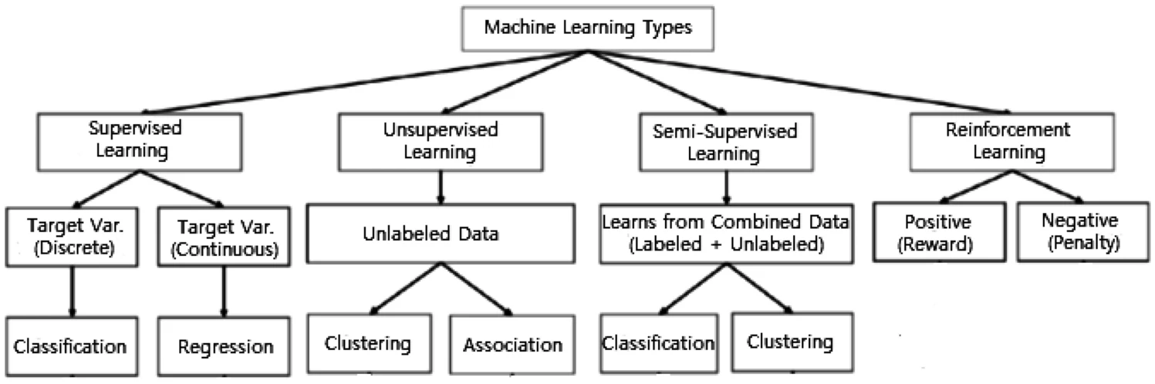
Types of Analytics
environment-driven approach
a task-driven approach
a data-driven process
hybridization
https://link.springer.com/article/10.1007/s42979-021-00592-x/figures/2

Slide 4
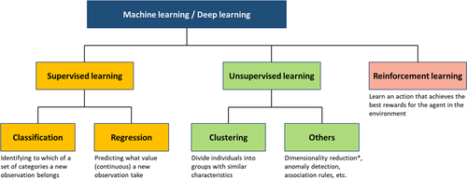
What AI / Analytics Can Do
Modern analytics is based mostly in supervised machine learning and neural networks, and these in turn provide algorithms for:
  Classification
  Regression
  Clustering
  Feature extraction
  Rule learning
  Prediction
https://www.ahajournals.org/doi/full/10.1161/JAHA.119.012788

Slide 5
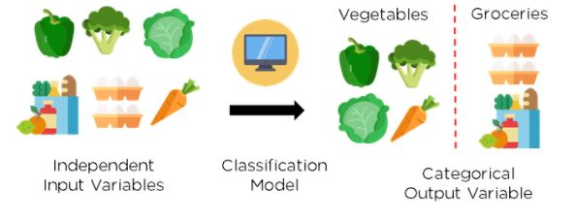
Classification
Binary classification (true-false, yes-no)
Multiclass classification (more than two class labels)
Multilabel classification (more than one label per entity)
https://www.simplilearn.com/tutorials/machine-learning-tutorial/classification-in-machine-learning

Slide 6
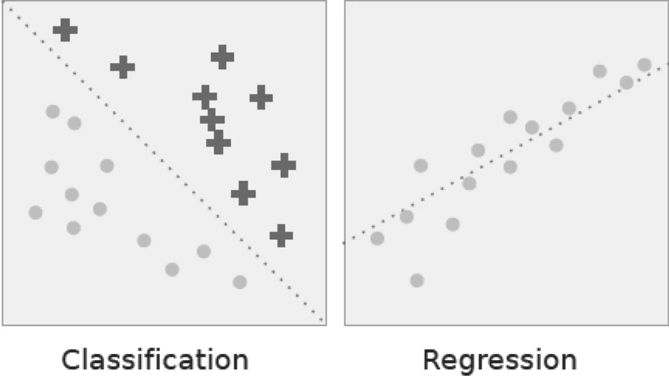
Regression
Simple and linear regression
Non-linear or polynomial
LASSO (least absolute shrinkage and selection operator) and Ridge regression
https://link.springer.com/article/10.1007/s42979-021-00592-x/figures/6

Slide 7
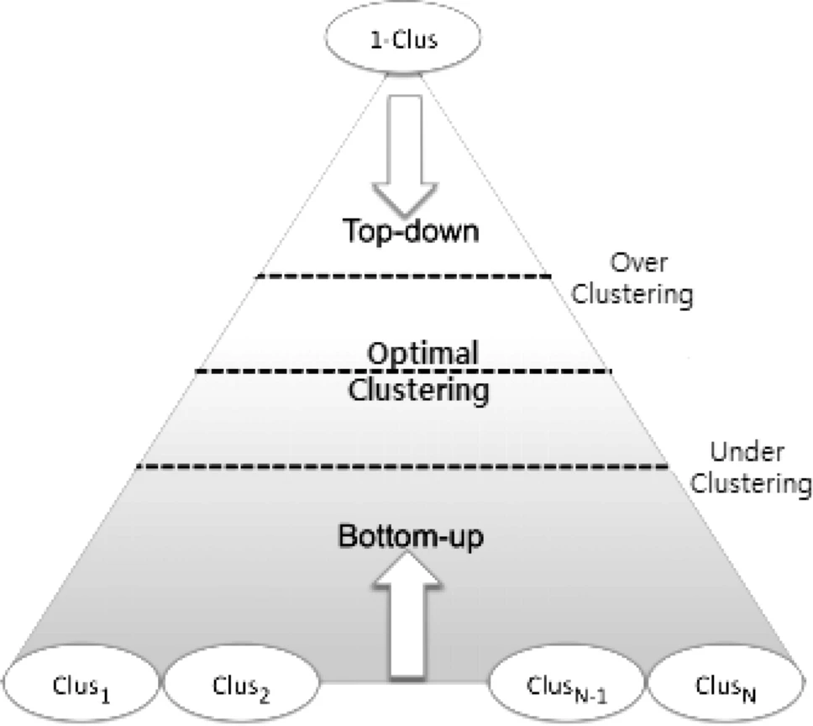
Clustering
“Identifying and grouping related data points in large datasets without concern for the specific outcome” (Sarker, 2021)
Methods:
Partitioning (features, similarity)
Density (eliminates noise)
Hierarchy & tree structure
Grids, models, constraints
more…

Slide 8
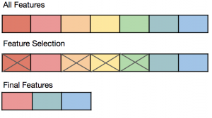
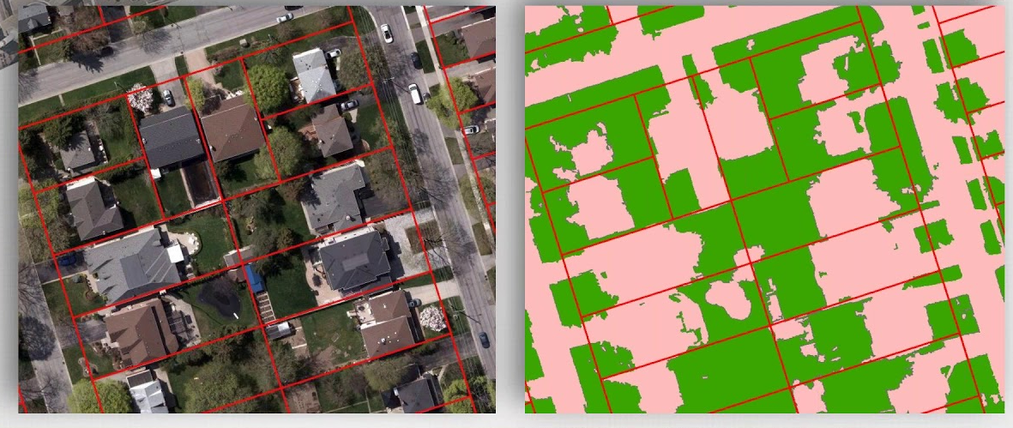
Feature Extraction
Feature selection – choosing a set of unique, relevant or salient features
Feature extraction – reduce the number of features in a dataset
https://vitalflux.com/machine-learning-feature-selection-feature-extraction/
https://www.youtube.com/watch?v=4XyRg4PrRjA

Slide 9
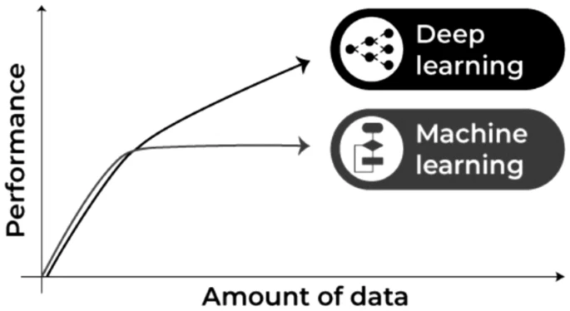
Types of Learning
Rule-learning – “to discover interesting relationships, if-then statements”
Reinforcement learning – “to learn by trial and error in an interactive environment”
Deep learning - machine learning approaches with representation learning
https://link.springer.com/article/10.1007/s42979-021-00592-x/figures/9

Slide 10

Applications of Analytics
v. 1.0 October 17, 2021
Data Mart / Data Lake
Tracking
Systems Analysis
Institutional Compliance
Student Profiles
Dashboards
Learning Recommendations
Adaptive Learning
Adaptive Group Formation
Placement Matching
Hiring
Pricing
Decision-Making
What happened?
Make it happen?
Descriptive
Prescriptive
Audio and Video Transcription
Security
Access Control
Spam Detection
Plagiarism Detection
Proctoring
Fakes Detection
Supporting Special Needs
Sentiment Analysis
Opinion Sampling
Automated Grading
Competencies Assessment
What kind of thing happened?
Make something new?
Chatbots and More
AI-Generated Content
Autogenerated Animation
Coaching
Artificial Teachers
Diagnostic
Analytics
Generative
What will happen?
Predictive
Deontic
What should happen?
Resource Planning
Learning Design
User Testing
Identify Students At Risk of Failing
Academic Advising
Precision Education
Student Recruitment
Ratings
Community Standards
Influencing Behaviour
Identifying the Bad
Amplifying the Good
Defining What’s Fair
Changing the Law
Moderating Discourse
Easing Distress
https://ethics.mooc.ca/

Slide 11
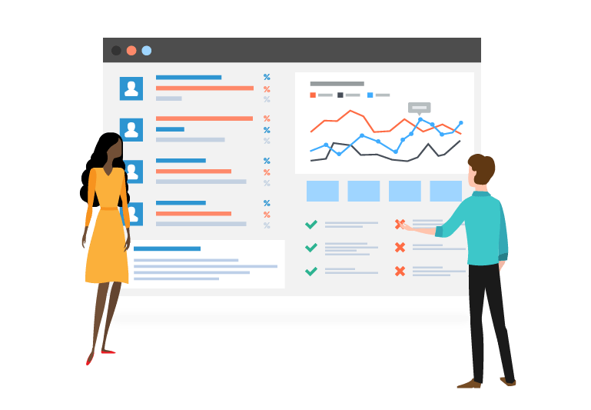
Descriptive Analytics
Description, detection and reporting, including mechanisms to pull data from multiple sources, filter it, and combine it.
Data aggregation and data mining are two techniques used
https://www.valamis.com/hub/descriptive-analytics

Slide 12
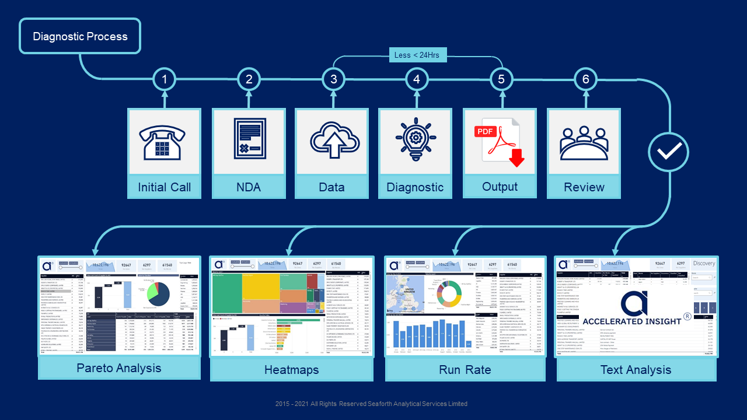
Diagnostic Analytics
Looks more deeply into data in order to detect patterns and trends.
For example, to perform recognition, classification or categorization tasks.
https://www.accelerated-insight.com/spend-analytics-diagnostics

Slide 13
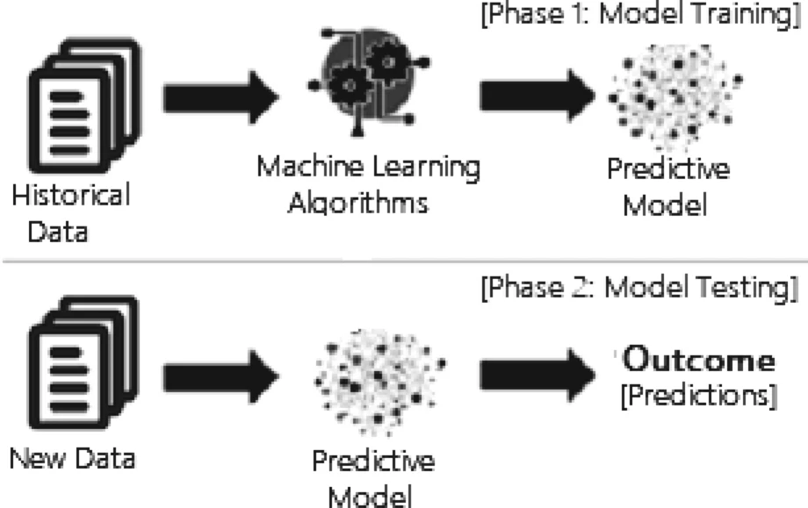
Predictive Analytics
Answer the question, what will (probably) happen, based on an identification of patterns and trends in existing data, and an extrapolation of that pattern or trend to probably future states.
https://link.springer.com/article/10.1007/s42979-021-00592-x/figures/3

Slide 14
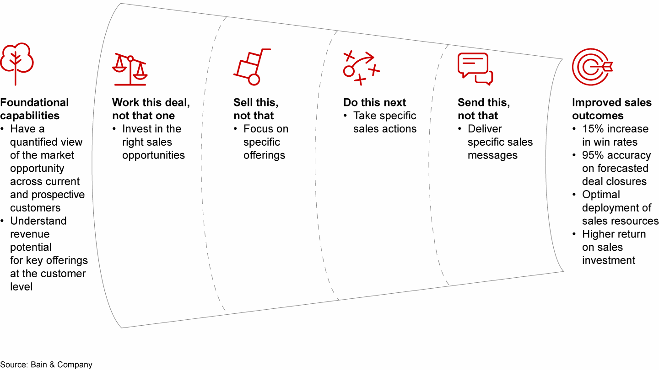
Prescriptive Analytics
Prescriptive analytics recommend solutions.
https://www.bain.com/insights/do-this-not-that-prescriptive-analytics-in-sales-and-marketing/

Slide 15
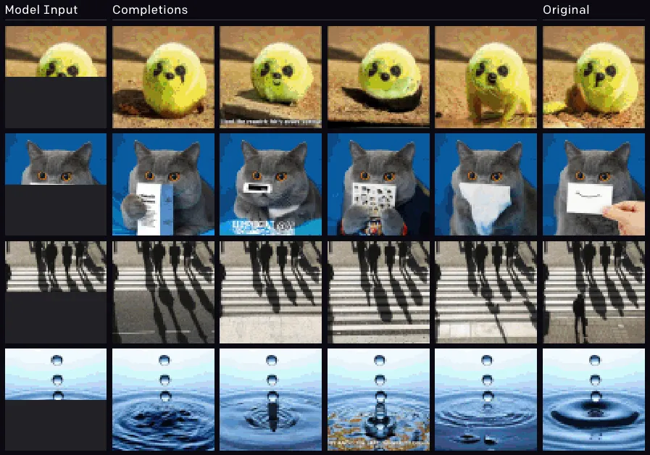
Generative Analytics
Generate original content based on parameters or properties of the data studied, combined with predictions or requirements for future data.
https://www.theverge.com/21346343/gpt-3-explainer-openai-examples-errors-agi-potential

Slide 16
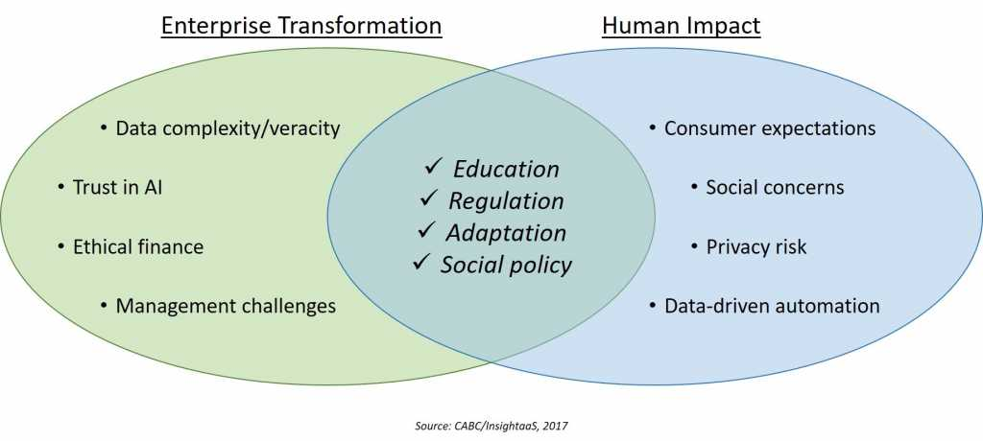
Deontic Analytics
https://insightaas.com/new-research-ai-and-advanced-analytics-connecting-culture-ethics-and-society-in-a-machine-age/
Analytics that look at expressions of sentiments, needs, desires, and other such factors in order to determine what sort of outcome would be best

