Slide 1
Bad Actors
Stephen Downes
November 1, 2021

Slide 2
Bad Actors
The concept of the ‘bad actor’ is a person who uses a technology for illegal or immoral purposes.
The definition of ‘bad actor’ can vary from culture to culture
We will focus on bad actors in AI/analytics specifically
Title slide: https://www.govtech.com/security/bad-actors-have-adapted-well-to-the-pandemic-crisis.html

Slide 3
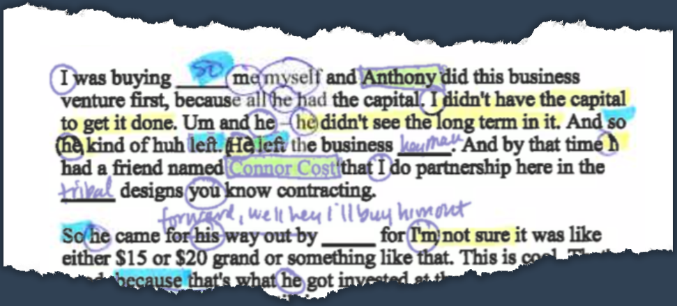
Misrepresentation
AI and analytics can be fraudulently used by pretending that they are able to do something they are not
https://www.propublica.org/article/why-are-cops-around-the-world-using-this-outlandish-mindreading-tool

Slide 4
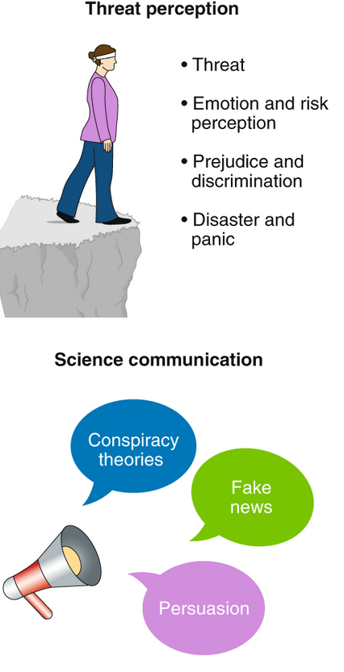
Conspiracy Theorists
person or group who promotes an alternative narrative alleging a coordinated campaign of disinformation, usually on the part of recognized authorities or institutions.
conspiracy theorists often replicate analytical methods and dissemination, and sometimes subject existing analytics for their own purposes.
https://www.nature.com/articles/s41562-020-0884-z?fbclid=IwAR3X2coFq94s4o1w99wt4SrnaRNYYW4W4AlyiXVGYrYi9nnPrcOJLV3PDhk

Slide 5
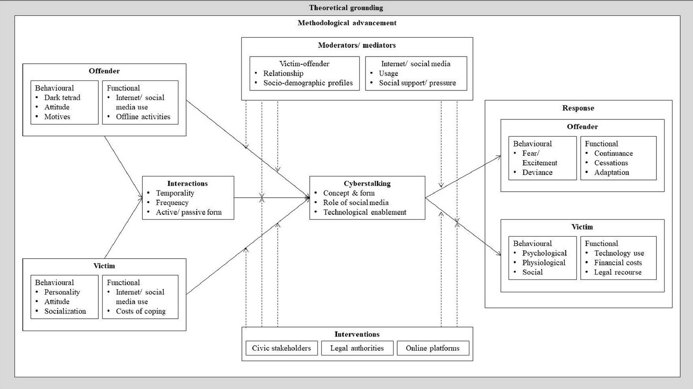
Stalkers
https://www.sciencedirect.com/science/article/pii/S004016252031252X#fig0003

Slide 6
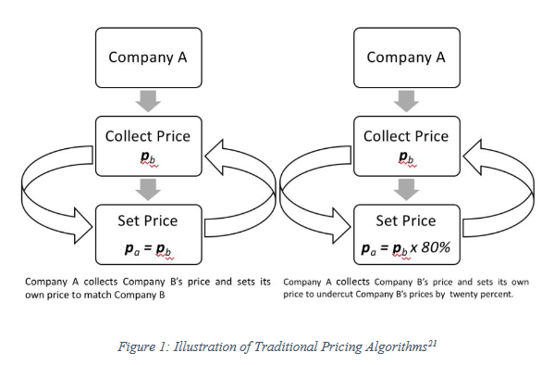
Collusion
Algorithms… consistently learn to charge supracompetitive prices, without communicating with one another.
https://papers.ssrn.com/sol3/papers.cfm?abstract_id=3213296

Slide 7
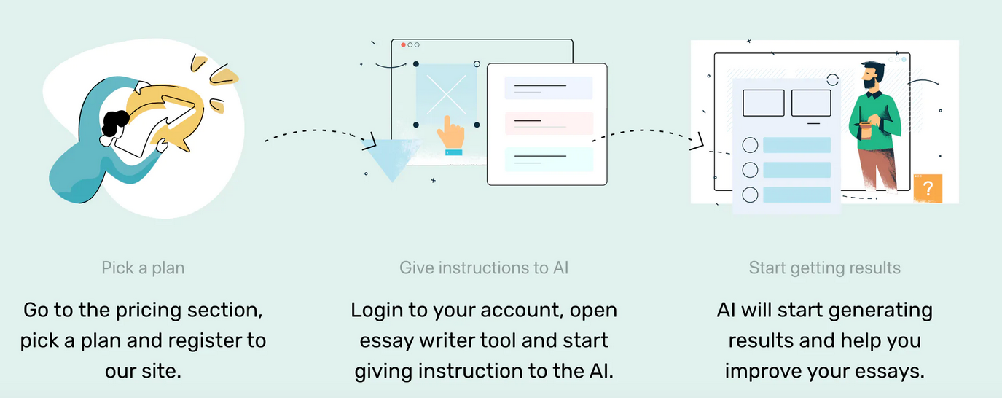
AI-Enabled Cheating
Examples:
matching students to an academic ghostwriter
Using an AI to write an essay
https://researchai.co/

Slide 8
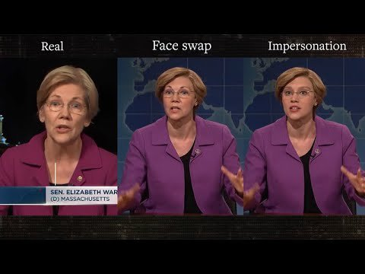
Audio/Video Impersonation
AI-generated impersonations can be used for a variety of illicit purposes, including authentication, cheating, misattribution, and more
https://www.quora.com/What-is-Deepfake-technique-in-AI

Slide 9
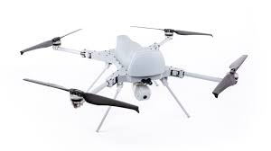
Driverless vehicles as weapons
Perhaps not an academic issue, nonetheless, of concern to academic institutions
https://www.npr.org/2021/06/01/1002196245/a-u-n-report-suggests-libya-saw-the-first-battlefield-killing-by-an-autonomous-d

Slide 10
Tailored Phishing
“Researchers found that they could use the deep learning language model GPT-3, along with other AI-as-a-service platforms, to significantly lower the barrier to entry for crafting spearphishing campaigns at a massive scale.”
https://www.wired.com/story/ai-phishing-emails/

