Slide 1
Social and Cultural Issues
Stephen Downes
November 2, 2021

Slide 2
Social and Cultural Issues
This is a class of issues that addresses the social and cultural infrastructure that builds up around analytics. These are not issues with analytics itself, but with the way analytics changes our society, our culture, and the way we learn.

Slide 3
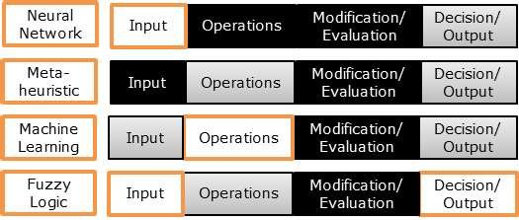
Opacity and Transparency
Opacity levels of AI algorithms at different stages (light blocks are transparent, grey blocks are semi-transparent/opaque, dark blocks are opaque)
“Decisions will need to be justified due to ethical concerns as well as trust, but achieving this has become difficult due to the `black-box' nature many AI models have adopted.”
https://www.researchgate.net/publication/329841462_Interaction_Design_for_Explainable_AI_Workshop_Proceedings

Slide 4
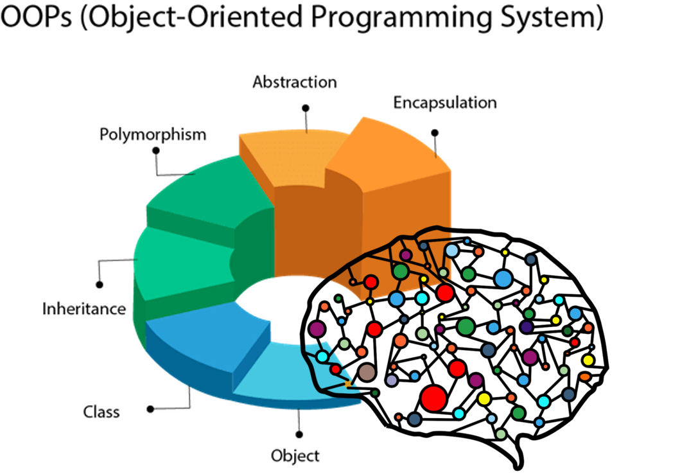
Alienation
Artificial intelligence and analytics impose themselves as a barrier between one person and another, or between one person and necessary access to jobs, services, and other social, economic and cultural needs. The process can be depersonalizing and demeaning.
https://towardsdatascience.com/a-i-and-humanitys-self-alienation-69a2fddf9b9c

Slide 5
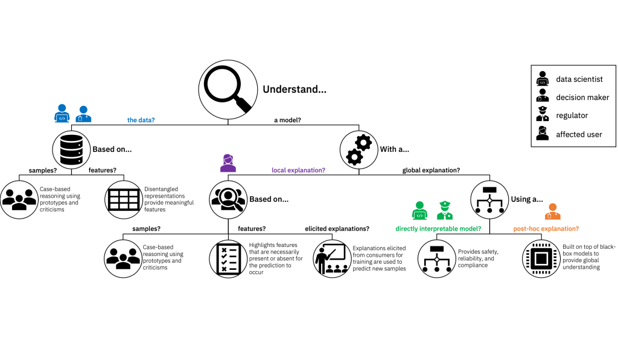
Explainability
https://www.ibm.com/blogs/research/2019/08/ai-explainability-360/
“If an AI system has a ‘substantial impact on an individual’s life’ and cannot provide ‘full and satisfactory explanation’ for its decisions, then the system should not be deployed.” (Fjeld, et.al., 2020:43)

Slide 6
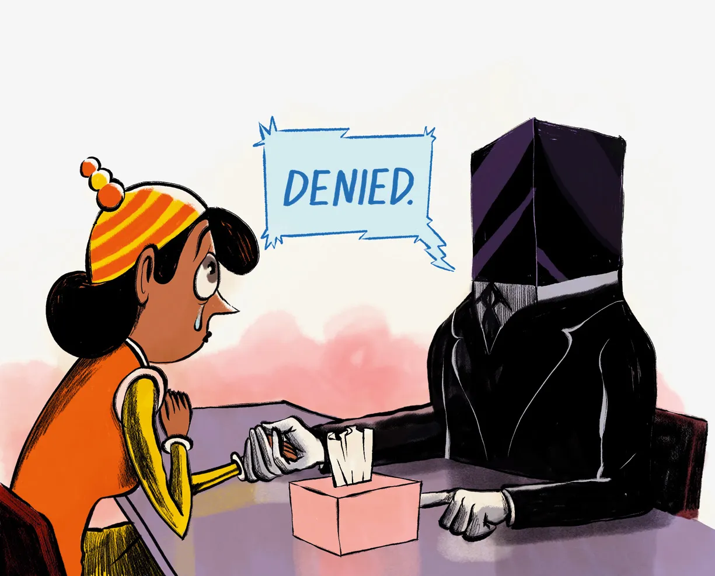
Accountability
Who is accountable for the actions of an AI? Is it:
The programmers
The data providers
The owners
The end users?
https://www.wired.com/2016/10/understanding-artificial-intelligence-decisions/

Slide 7
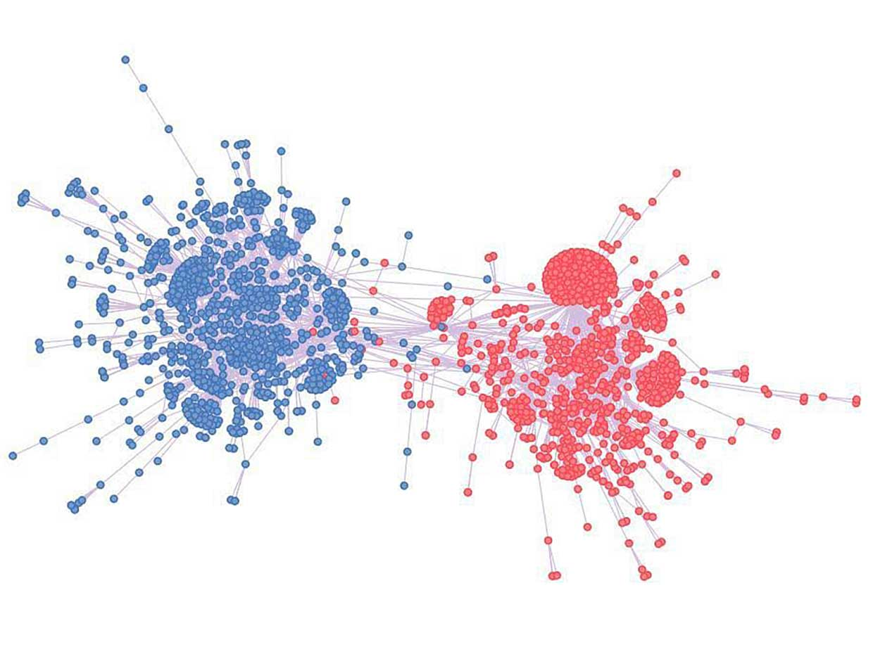
Social Cohesion and Filter Bubbles
“Eventually, people tend to forget that points of view, systems of values, ways of life, other than their own exist… Such a situation corrodes the functioning of society, and leads to polarization and conflict.”
https://spectrum.ieee.org/finally-a-means-for-bursting-social-media-bubbles

Slide 8
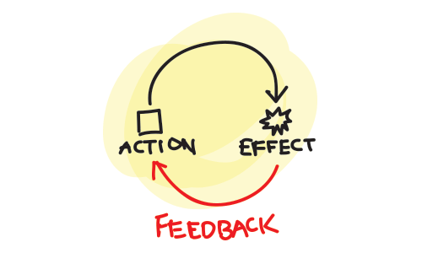
Feedback Effects
“Careful consideration of the social dynamics of predictive information will be essential to their ethical use.”
https://rossdawson.com/self-perpetuating-feedback-loops-ai-predictive-policing/
https://towardsdatascience.com/dangerous-feedback-loops-in-ml-e9394f2e8f43

Slide 9
Inclusion
New types of artificial intelligence lead to new types of interaction. In such cases, it is of particular importance to look at the impact on traditionally disadvantaged groups.
https://newsroom.cisco.com/feature-content?type=webcontent&articleId=2046211

Slide 10
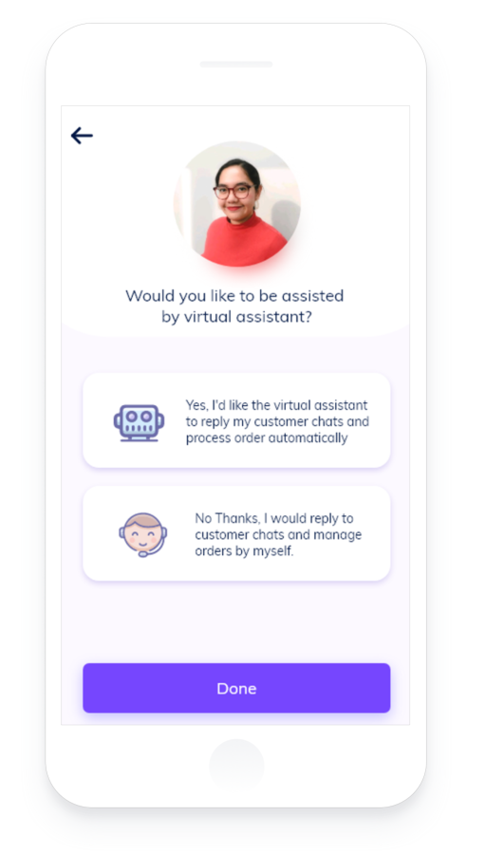
Consent
Consent:
Requires both knowledge and permission
Applies to both provider and recipient of services
Includes rights over access, use, and erasure of data, repurposed data
Refusal of Consent
May be unethical?
Remedies
How are harms identified and remedied?
What meaningful alternatives are provided?
https://link.springer.com/article/10.1007/s00146-021-01262-5

Slide 11
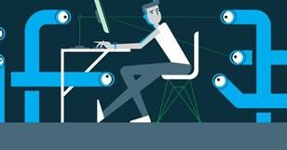
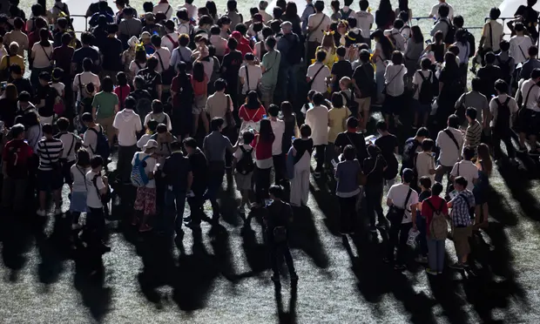
Surveillance Culture
“The substitution of algorithmic certainty for any semblance of participatory, democratic society.”
https://www.theguardian.com/books/2019/feb/02/age-of-surveillance-capitalism-shoshana-zuboff-review
http://ipsr.ku.edu/SSRC/
Surveillance Studies… is producing new and important theoretical and empirical understandings of human behavior.

Slide 12
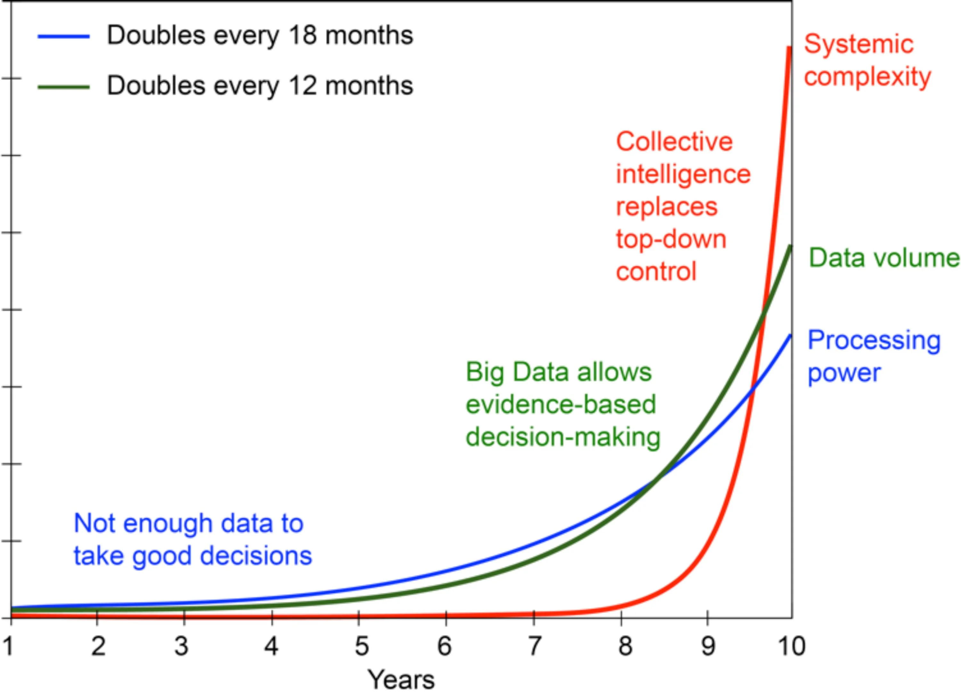
Power and Control
AI has the potential to alter social structures of power and control
Take surveillance, for example, “Surveillance is not about safety, it’s about power. It’s about control.” (Snowden)
https://www.scientificamerican.com/article/will-democracy-survive-big-data-and-artificial-intelligence/

Slide 13
Who Does What?
We are being sold a picture of a future with AI where it provides the calculations, and we provide the creativity and empathy.
But there’s no reason to believe that in the future AI will not be about to outperform humans in both.
https://twitter.com/turalt/status/1224777355878653952

Slide 14
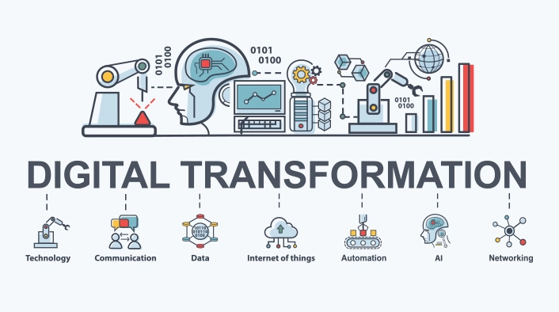
An Oppressive Economy
“Scholarship — both the content and the structure — is reduced to data, to a raw material used to produce a product sold back to the very institutions where scholars teach and learn.” (Watters, 2019)
https://er.educause.edu/articles/2020/7/dx-and-it-commodification-beyond-paas-fail

Slide 15
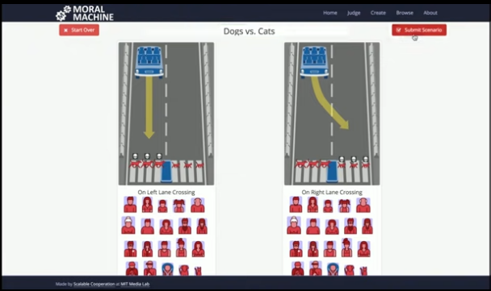
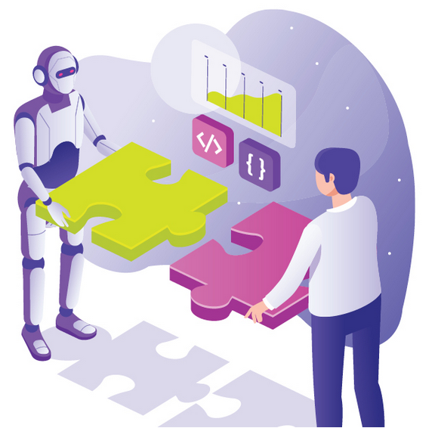
Loss of Sense of Right and Wrong
There is the sense that analytics and AI can not reason, cannot understand, and therefore cannot know the weight of their decisions. What would AI with a conscience look like?
Do right and wrong become what the machine allows it to be? This is perhaps the intuition being captured by people who are concerned that AI results in a loss of humanity.
https://www.scs.org.sg/articles/ethics-and-ai-teaching-our-machines-to-tell-right-from-wrong
http://moralmachine.mit.edu/

Slide 16
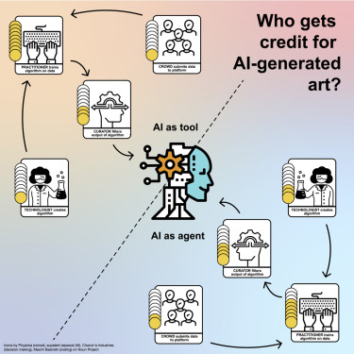
Ownership
Should AI algorithms be patented?
Can IPR restrict uses of data?
Who are the creators of AI-generated art?
What if it’s all possible art?
Could humans be blocked out of content creation?
What impact might regulation have?
https://www.sciencedirect.com/science/article/pii/S2589004220307070

Slide 17
Responsibility
“AI technologies can place further distance between the result of an action and the actor who caused it, raising questions about who should be held liable and under what circumstances. These principles call for reliable resolutions to those questions.” (Fjeld, et.al., 2020:34)
https://www.datasciencecentral.com/profiles/blogs/ai-responsibility-taming-the-algorithm

Slide 18
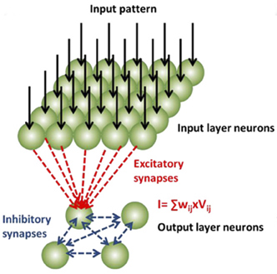
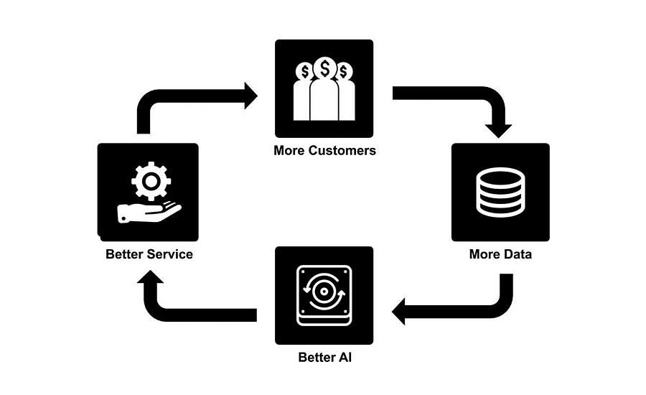
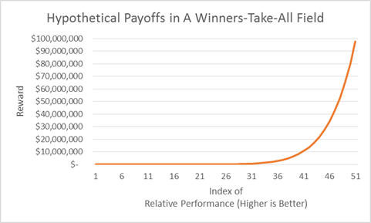
Winner Takes All
“How can the data-based monopolies of some large corporations, and the ‘winner-takes-all’ economies associated with them, be addressed? How can data be managed and safeguarded to ensure it contributes to the public good and a well-functioning economy?” (Eckersley, et.al., 2017)
https://blogs.darden.virginia.edu/brunerblog/2014/03/when-winners-take-all/

Slide 19
Winner Takes All
Focus on relative performance
Concentration of rewards
Overcrowding (aka wannabees)
Mass markets
Network effects
Lock-in and barriers to exit
Feedback loops
https://blogs.darden.virginia.edu/brunerblog/2014/03/when-winners-take-all/

Slide 20
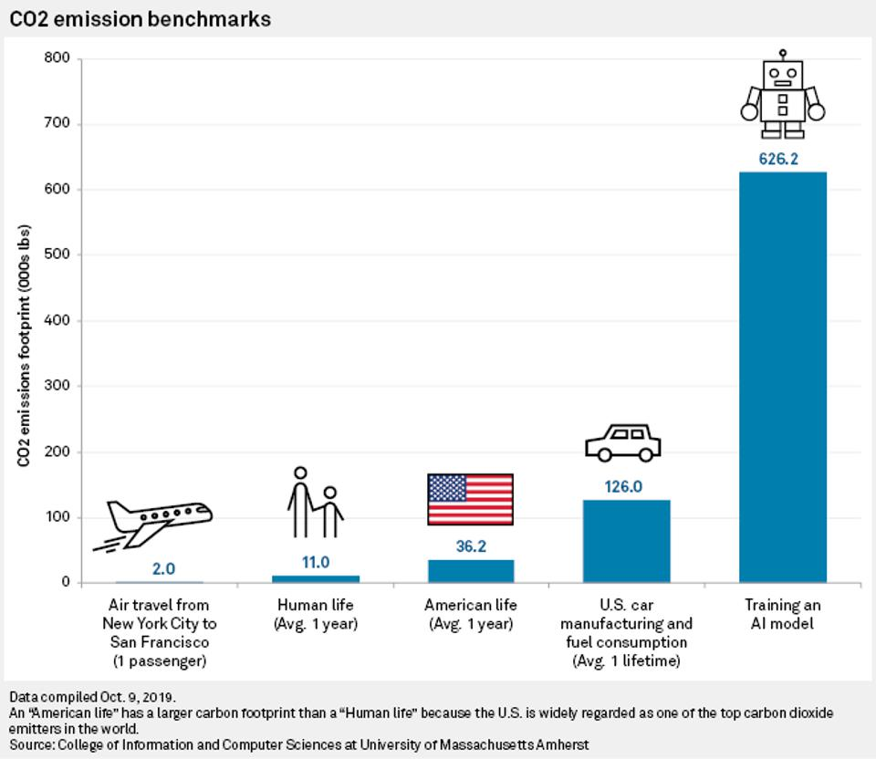
Environmental Impact
“AI-based systems are highly compute-intensive. They must process a great deal of data, expanding the need for servers and dependence on energy to cool data centers.”
https://www.forbes.com/sites/glenngow/2020/08/21/environmental-sustainability-and-ai/

Slide 21
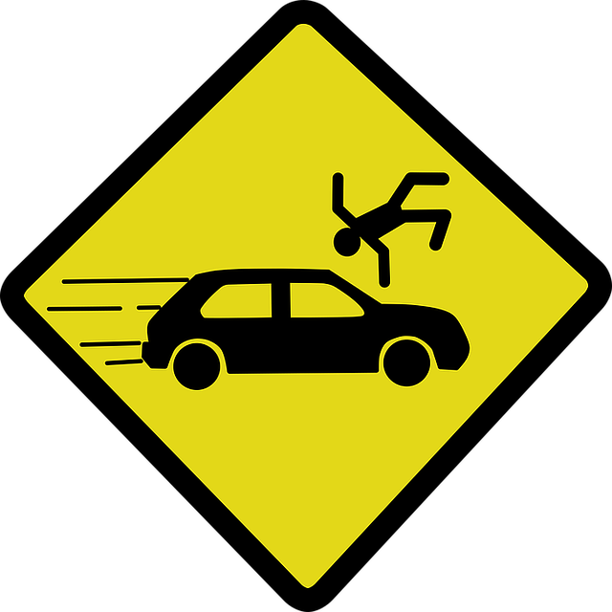
Safety
The impact on safety could be direct, as in the Uber case, or indirect, as in the case of misleading content.
Inadequate safety culture
Misdiagnosis and Errors
Blind spots
Patterns of behaviour
Vulnerability to attacks
Compliance and Regulation

