Slide 1
When It Is Fundamentally Dubious
Stephen Downes
November 2, 2021

Slide 2
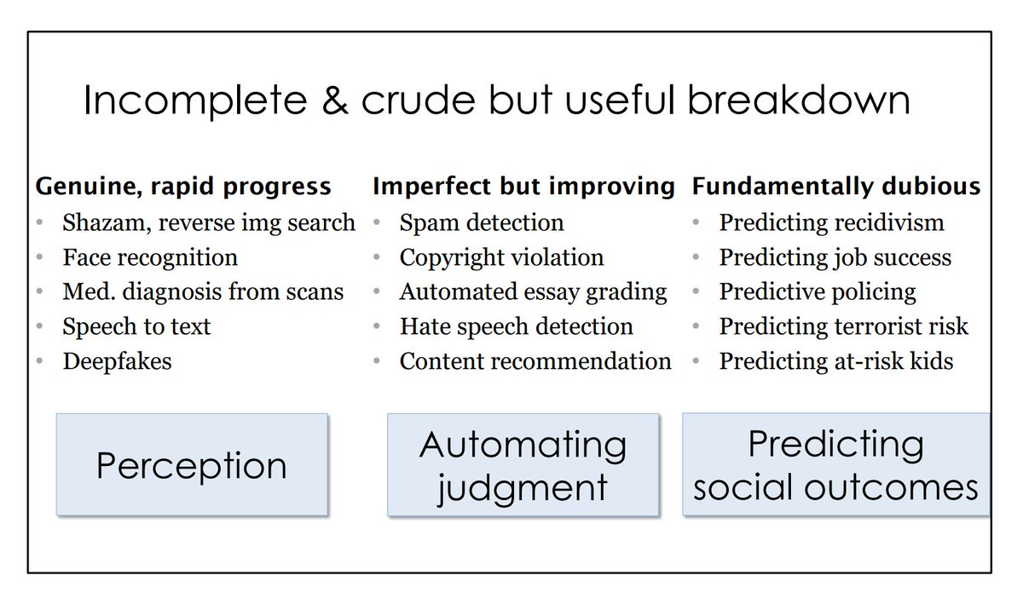
When It Is Fundamentally Dubious
Some uses of AI and analytics are fundamentally dubious
In such cases, the ethical question of such use at all arises
https://www.cs.princeton.edu/~arvindn/talks/MIT-STS-AI-snakeoil.pdf

Slide 3
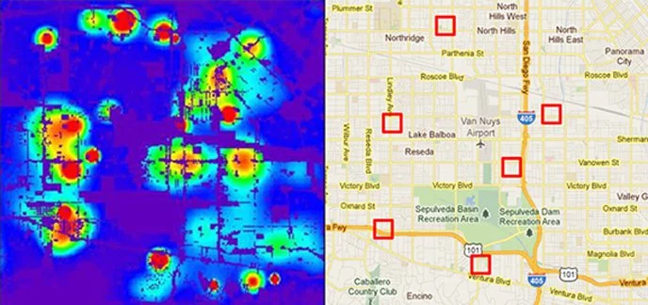
Predicting Criminals
“…puts students and families at risk of being unfairly targeted before they've done anything wrong”
https://www.smithsonianmag.com/innovation/artificial-intelligence-is-now-used-predict-crime-is-it-biased-180968337/ “Historical data from police practices, critics contend, can create a feedback loop through which algorithms make decisions that both reflect and reinforce attitudes about which neighborhoods are ‘bad’ and which are ‘good.’”

Slide 4
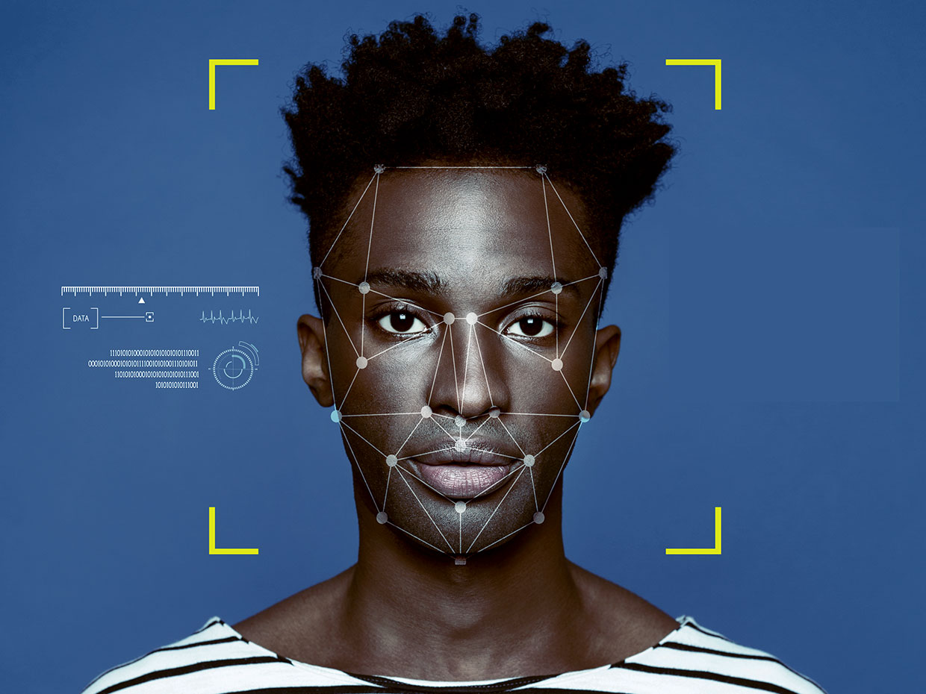
Racial Profiling
It is arguable that there is no ethical application of analytics to identify specific races for special treatment.
https://spectrum.ieee.org/do-you-have-the-right-complexion-for-facial-recognition#toggle-gdpr Biased facial recognition system disproportionately labels minority UCLA students and faculty as criminals

Slide 5
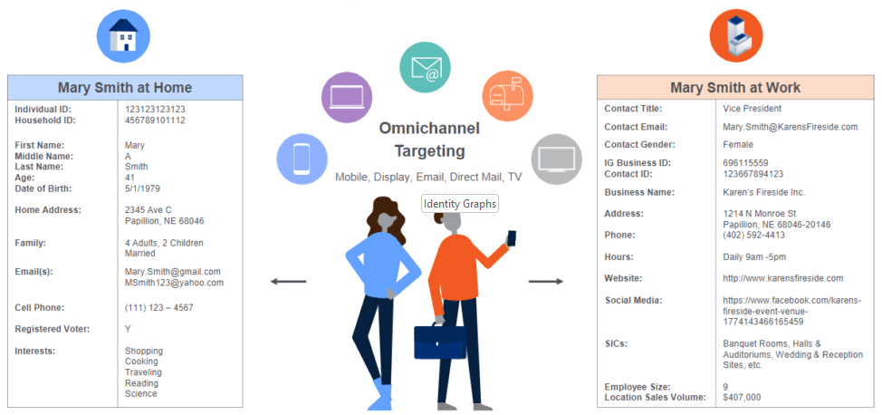
Identity Graphs
https://www.data-axle.com/resources/blog/solving-the-identity-graph-gap-through-robust-identity-resolution/

Slide 6
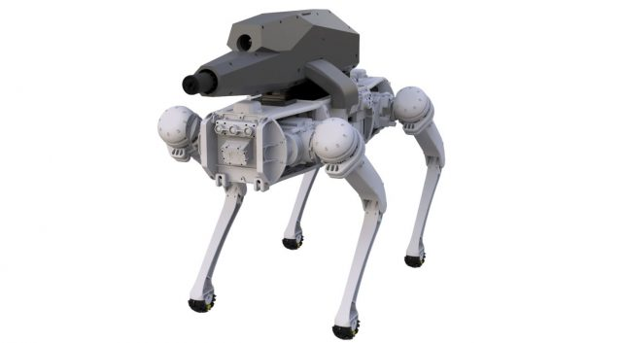
Autonomous Weapons
Examples:
Armed robot ‘dogs’ being used as security guards
Autonomous drones being used in armed conflict
https://www.thedefensepost.com/2021/10/13/robot-dog-assault-rifle/
https://www.popularmechanics.com/military/weapons/a36559508/drones-autonomously-attacked-humans-libya-united-nations-report/

Slide 7
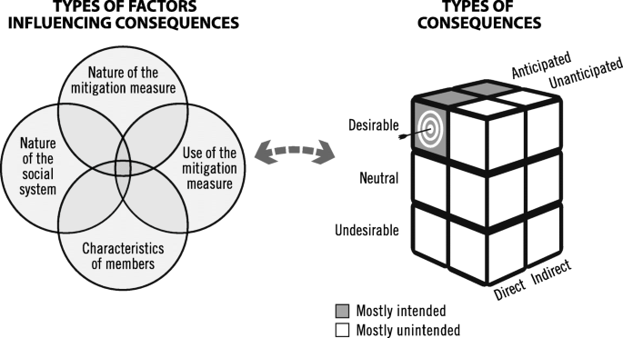
When We Don’t Know What the Consequences Will Be
For example, the suggestion that colleges should put smart speakers in student dormitories – “we simply have no idea what long-term effect having conversations recorded and kept by Amazon might have on their futures.”
https://bmcmedresmethodol.biomedcentral.com/articles/10.1186/s12874-020-01200-x

