Slide 1
Obligations and Duties
Stephen Downes
November 5, 2021

Slide 2
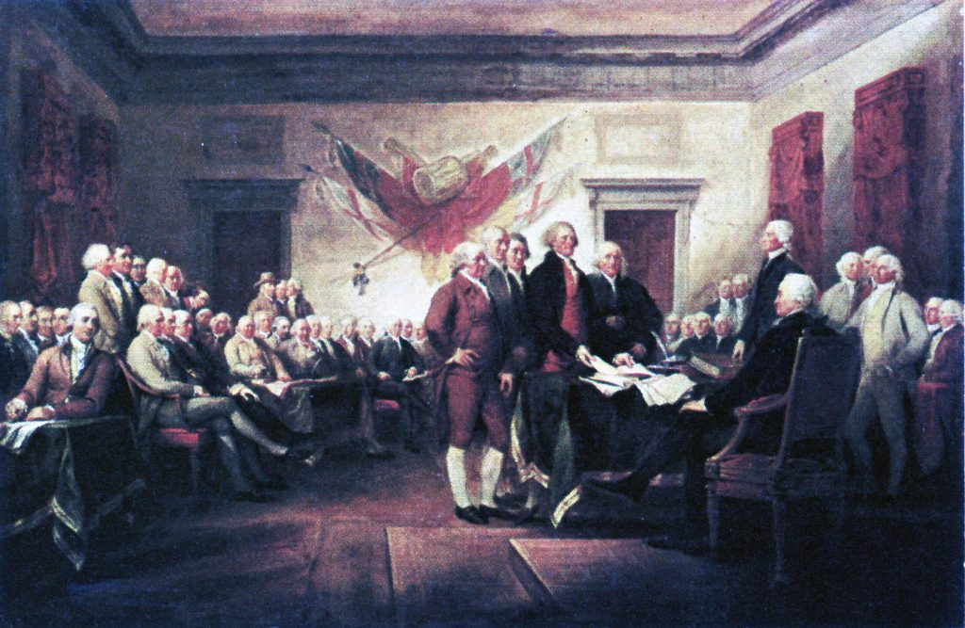
Obligations and Duties
To whom do we owe obligations and duties?
In this presentation we look briefly at the different entities to which different codes argue that we owe allegiance, loyalty, or some other sort of obligation or duty.
https://brewminate.com/obligation-to-society-loyalty-to-community/
Title image: https://www.fraserinstitute.org/studies/assessing-the-duty-to-consult

Slide 3
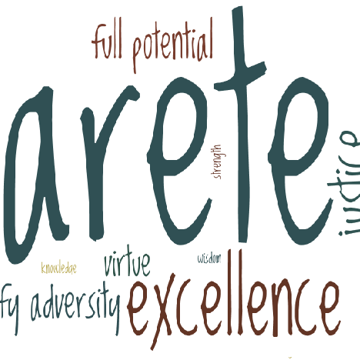
Self
Most ethical codes abnegate serving or benefitting oneself, and where the self is concerned
And yet, many of the ethical principles described in the code could be construed as the cultivation of a better self
And some principles might be thought of as promoting some desirable attributes of self
Processes include self-care, self-denial, self-respect
https://garyachapman.wordpress.com/2018/11/16/why-arete/
https://quod.lib.umich.edu/e/eebo/A65294.0001.001?view=toc

Slide 4
Less Fortunate
Not very frequently referenced in codes of ethics, but:
Hammurabi’s Code is the edict, “the strong may not oppress the weak" (Gilman, 2005:4n3).
Peter Singer’s (2009) The Life You Can Save
The resistance to considering such matters is telling
https://www.reddit.com/r/wholesomememes/comments/fr6o1b/it_is_the_duty_of_those_more_fortunate_and/

Slide 5
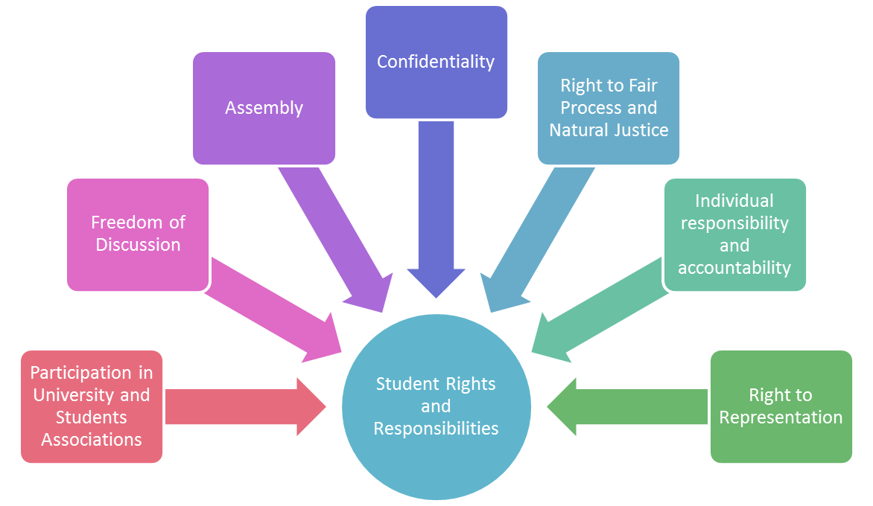
Students
Codes for teachers or academics often specify obligations or duties to students, though in different ways:
Le code Soleil assigns a three-fold responsibility to teachers: to train the individual, the worker, and the citizen.
The National Education Association code urges teachers to “strive to help each student realize his or her potential as a worthy and effective member of society” (NEA, 1975)
Student rights are often depicted as conditional
https://carleton.ca/studentaffairs/student-rights-and-responsibilities/

Slide 6
Children
FTC: widespread “collection of personal information from even very young children without any parental involvement or awareness”
IEEE: provisions on safety and security, confidentiality, and whistle-blowing, noting specifically that “Adults have a responsibility to ensure that this unequal balance of power is not used for their personal advantage” (IEEE, 2017).
Duty to report
https://peelcas.org/diversity-equity-and-inclusion/events-listing/event/2021/03/09/peel-cas-events/a-community%27s-duty-to-report

Slide 7
Parent or Guardian
Parents stand in two roles in codes of ethics.
to act as a proxy for children with respect to matters of consent (Kay et al. 2012).
as special interests that need to be protected
for example, an Indian code of ethics advises teachers to “refrain from doing any thing which may undermine students’ confidence in their parents or guardians”
Duties to one’s own parents not mentioned in codes of ethics cited

Slide 8
Family
None of the ethical codes cited reference a duty to family (either one’s own or to families in general)
Yet there is a sense that there is an ethical value along the lines of ‘family first’
http://pridenews.ca/2020/01/24/family-success-duty-responsibility-member/

Slide 9
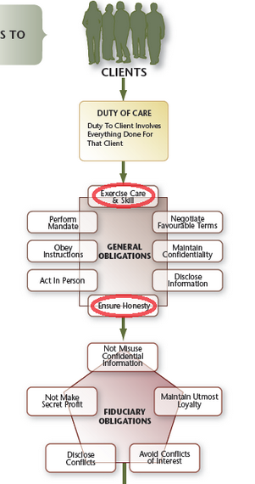
Client
In many ethical codes the first and often only duty is to the client
“special obligations between one party, often with power or the ability to exercise discretion that impacts on the other party, who may be vulnerable” (Wagner Sidlofsky, 2020).
In health care the needs of the client are often paramount.
There is ambiguity in the concept of client
E.g. is the duty to the client because the client is the one paying the bills?
https://www.oreablog.com/index.php/recap-duties-to-clients-and-customers/

Slide 10
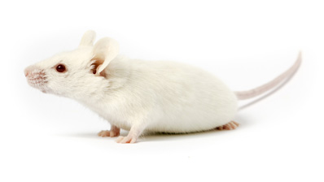
Research Subject
Research ethics codes commonly describe a duty of the researcher to the research subject
In the field of data research and analytics this principle is often retained. Also in marketing, journalism.
The Open University code asserts that “students should be engaged as active agents in the implementation of learning analytics (OU, 2014:4.3.2).

Slide 11
Employer
Public service employees are not surprisingly obligated to their employer.
The same sometimes holds true in the case of ethical codes for teachers.
The same may apply for employees in the private sector, especially in IT, journalism
https://www.greenwaldllp.com/law-clips/employees-duty-loyalty/

Slide 12
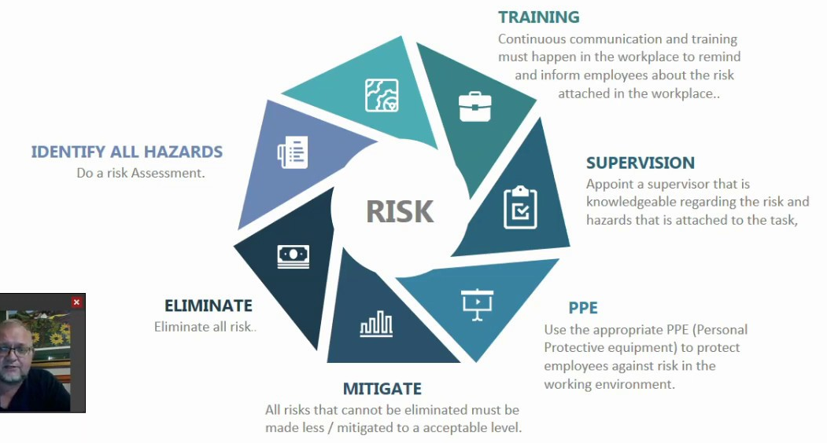
Employee
No corresponding duty to employee appears in the ethical codes
Duties to employees are specified in labour codes
It is the employer’s duty to manage all risk in the workplace
https://www.youtube.com/watch?v=djDYObcKfKE

Slide 13
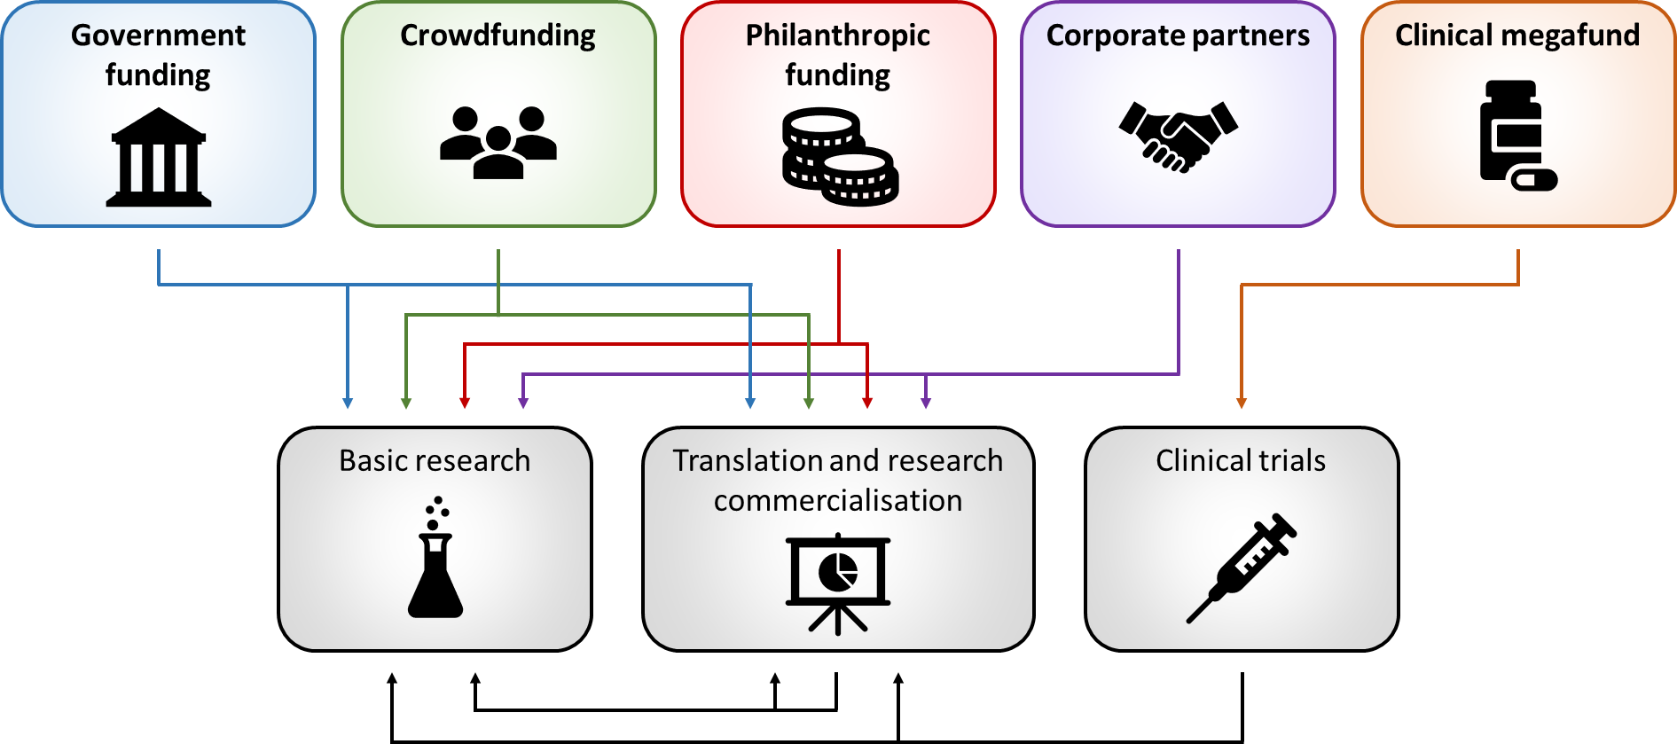
Funder
Even funders may make a claim on the duties of the researcher (Dingwell, et.al., 2017).
https://researchwhisperer.org/2020/08/18/alternative-funding/

Slide 14
Colleagues
The same may apply for employees in the private sector.
“If the majority of members of a profession follow the standards, the profession will have a good reputation and members will generally benefit.” (Weil, 2008).
E.g. https://www.weber.edu/ppm/Policies/9-6_FacultyResponsibilitiesColle.html

Slide 15
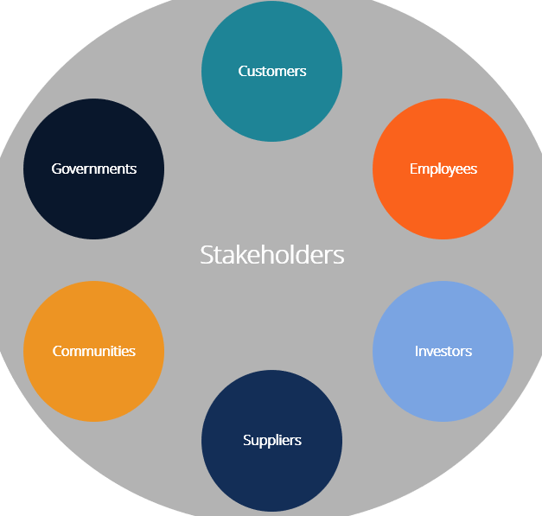
Stakeholders
The term ‘stakeholders’ is sometimes used without elaboration to indicate the presence of a general duty or obligation
‘Stakeholder’ expands on the concept of ‘stockholder’ and is intended to represent a wider body of interests to which a company’s management ought to be obligated (SRI, 1963).
https://en.wikipedia.org/wiki/Stakeholder_theory
https://bohatala.com/types-of-stakeholders-and-their-roles /

Slide 16
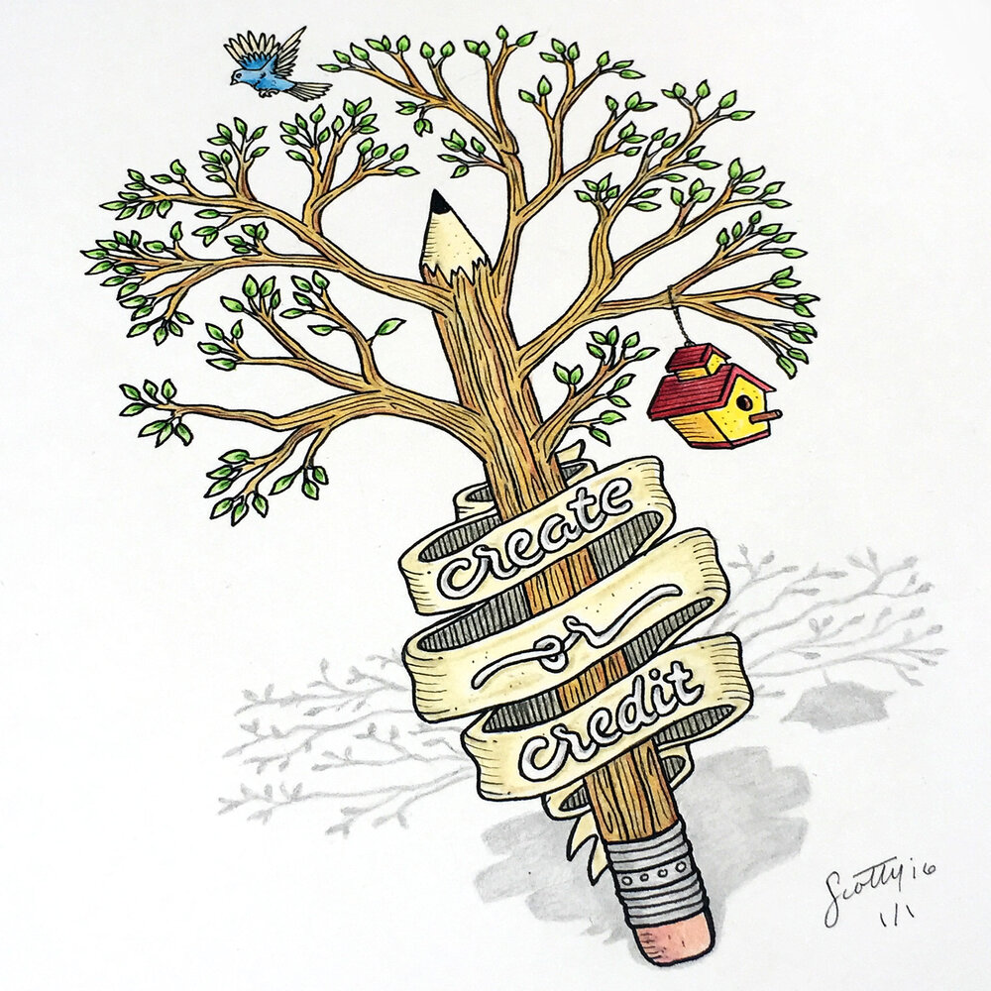
Publishers and Content Producers
Librarians are subject to special obligations to publishers, according to some codes.
This responsibility is extended in other fields as a prohibition against plagiarism (EUI, 2019; BACB, 2014; SPJ, 2014; NUJ, 2011; NYT, 2017; etc.) and taking credit for the work of others (AITP, 2017; IEEE, 2020; BACB, 2014; etc.).
https://www.perspective-collective.com/side-hustlers-perspective/stop-plagiarism

Slide 17
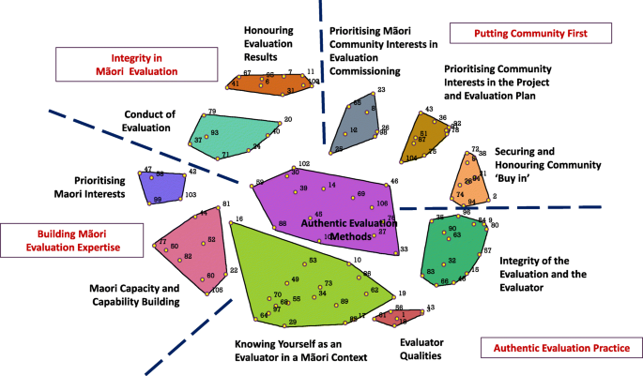
Specific Cultural Groups
This appears nowhere in any of the codes of ethics
However, it can be identified in specific contexts
E.g. The duty to consult with indigenous peoples
https://equityhealthj.biomedcentral.com/articles/10.1186/s12939-019-1094-z
https://www.culturalsurvival.org/publications/cultural-survival-quarterly/free-prior-and-informed-consent-protecting-indigenous
https://www.fraserinstitute.org/studies/assessing-the-duty-to-consult

Slide 18
Society
References to a responsibility to society are scarce, but they do exist.
BERA (2018) argues for a responsibility to serve the public interest
The ‘Nolan principles’, (CSPL, 1995) state “Holders of public office are accountable to the public
the last two of the Computer Ethics Institute’ Ten Commandments’ recommend computer professionals “think about the social consequences” and to “ensure consideration and respect for other humans” (CEI, 1992).
https://www.gesonline.com/about/corporate-social-responsibility
CSR

Slide 19
God, Law, King and Country
There is not an ethical duty to obey an unethical law, but…
Some codes nonetheless include respect for the law
IATP used to say “I shall uphold my nation and shall honor the chosen way of life of my fellow citizens”
cited (in EDUCAUSE Review) as recently as 2017 (Woo, 2017).

Slide 20
Environment
The environment is rarely mentioned in ethical codes
obligations to “society, its members, and the environment surrounding them” (ACM, 2018)
“societal and environmental wellbeing - including sustainability and environmental friendliness, social impact, society and democracy” (AI HLEG, 2019).

