Slide 1
Bases for Values and Principles
Stephen Downes
November 6, 2021

Slide 2
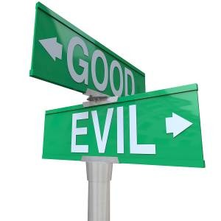
Bases for Values and Principles
What grounds these codes of ethics?
On what basis do their authors assert that this code of ethics, as opposed to some hypothetical alternative, is the code of ethics to follow?
https://quizlet.com/350128493/chapter-5-code-of-ethics-flash-cards/

Slide 3
Bases for Values and Principles
A typical explanation might be that “An individual’s professional obligations are derived from the profession and its code, tradition, society's expectations, contracts, laws, and rules of ordinary morality” (Weil, 2008), but a closer examination raises as many questions as it answers.
https://www.metsagroup.com/en/about-us/code-of-conduct/Pages/default.aspx

Slide 4
Universality
https://universality.io/?lang=en
Many codes simply assert that the principles embodied in the code are universal principles.
Universality may be seen as a justification for moral and ethical principles; if the principle is believed by everyone, then arguably it should be believed here.
https://en.wikipedia.org/wiki/Moral_universalism

Slide 5
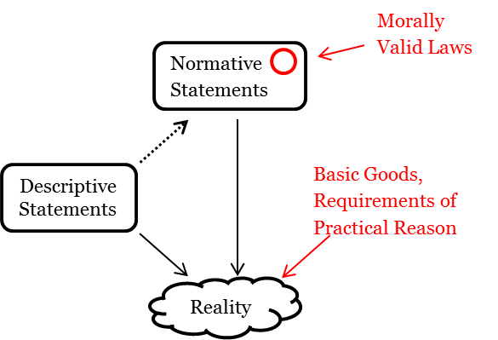
Fundamental Rights
The High-Level Expert Group on Artificial Intelligence cites four ethical principles, “rooted in fundamental rights, which must be respected in order to ensure that AI systems are developed, deployed and used in a trustworthy manner” (AI HLEG, 2019)
Nonetheless, it is not clear what these fundamental rights are.
https://hughmccarthylawscienceasc.wordpress.com/2015/01/03/a-summary-of-john-finniss-theory-of-natural-law/
https://courses.lumenlearning.com/suny-hccc-worldhistory2/chapter/natural-rights/

Slide 6
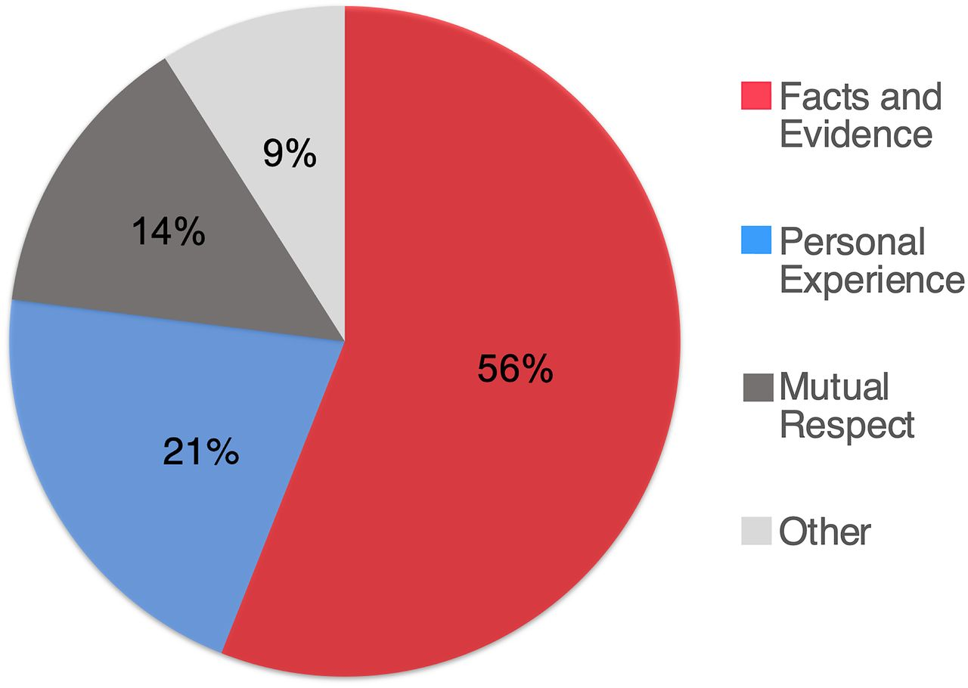
Fact
Arguments drawing from statements of fact about the world are sometimes used to support ethical principles.
Against such assertions of fact the “is-ought” problem may be raised.
https://fordhaminstitute.org/national/commentary/moral-facts-and-common-core
Personal experiences bridge moral and political divides better than facts https://www.pnas.org/content/118/6/e2008389118

Slide 7
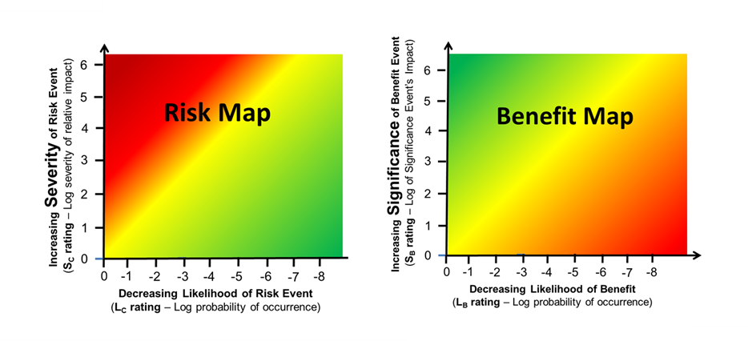
Balancing Risks and Benefits
The AI4People declaration states “An ethical framework for AI must be designed to maximise these opportunities and minimise the related risks” (Floridi, et.al., 2018:7).
This results in a different calculation in each application.
It also requires an understanding of what the consequences actually are.
And perhaps ethics isn’t really a case of balancing competing interests.
https://www.outsourcedpharma.com/doc/using-system-risk-structures-to-understand-and-balance-risk-benefit-trade-offs-0001

Slide 8
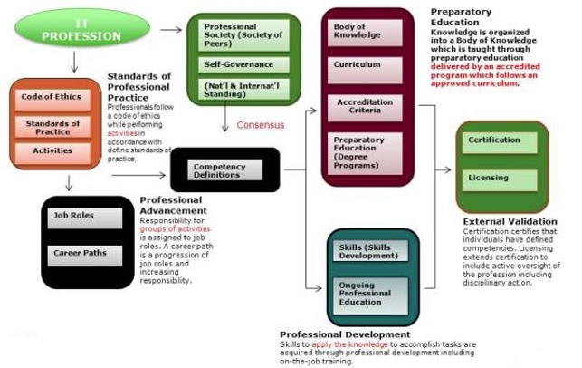
Requirements of the Profession
A requirement is a statement about what a person must believe, be or do in order to accomplish a certain objective or goal.
Such principles may be expressed in two ways:
Derived from some other pre-existing ethical principle
Conditional, based on what is entailed by joining a profession.
Model of an IT Profession
https://www.computer.org/volunteering/boards-and-committees/professional-educational-activities/model-of-a-profession

Slide 9
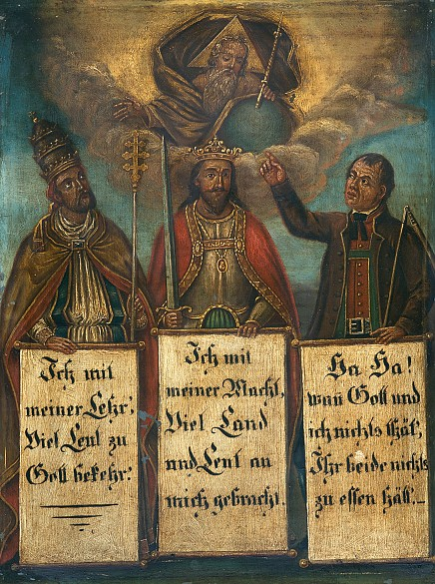
Social Good or Social Order
For example: the primary function of journalism, according to the statements, is to inform the public and to serve the truth, because “public enlightenment is the forerunner of justice and the foundation of democracy” (SPJ, 2014).
A basis in social order, however, invites relativism.
‘Social order’ can be construed to mean national interest.
https://www.hiig.de/en/social-order-in-the-digital-society/

Slide 10
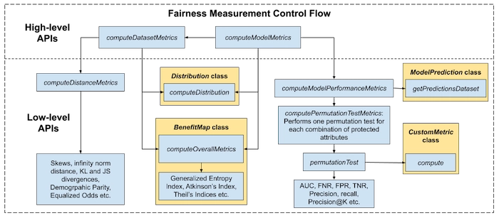
Fairness
A principle of ‘fairness’ is frequently cited with no additional support or justification. But what is fairness?
Objectivity – e.g. “it is essential that we preserve a professional detachment, free of any whiff of bias” (NYT, 2018).
Non-arbitrary – the same principle (or law, or rule) is applied to all
Free from abuse or infringement of right
Equitable and non-discrimiatory
https://amplitude.com/blog/increasing-fairness-machine-learning
https://sdtimes.com/ai/the-linkedin-fairness-toolkit-launched-to-measure-fairness-in-large-scale-ai-apps/

Slide 11
Epistemology
The advancement of knowledge and learning is often considered to be in and of itself a moral good.
A value is therefore adduced if it supports knowledge and truth-seeking
Or a decision is (more) ethical if it is informed by knowledge and evidence
Alternatively, one may simply deny that knowledge and learning are moral goods
Seneca, for example, argued “This desire to know more than is sufficient is a sort of intemperance” (Letter 88:36).
“curiosity killed the cat”
“some things are not meant to be known”
https://plato.stanford.edu/entries/skepticism-moral/

Slide 12
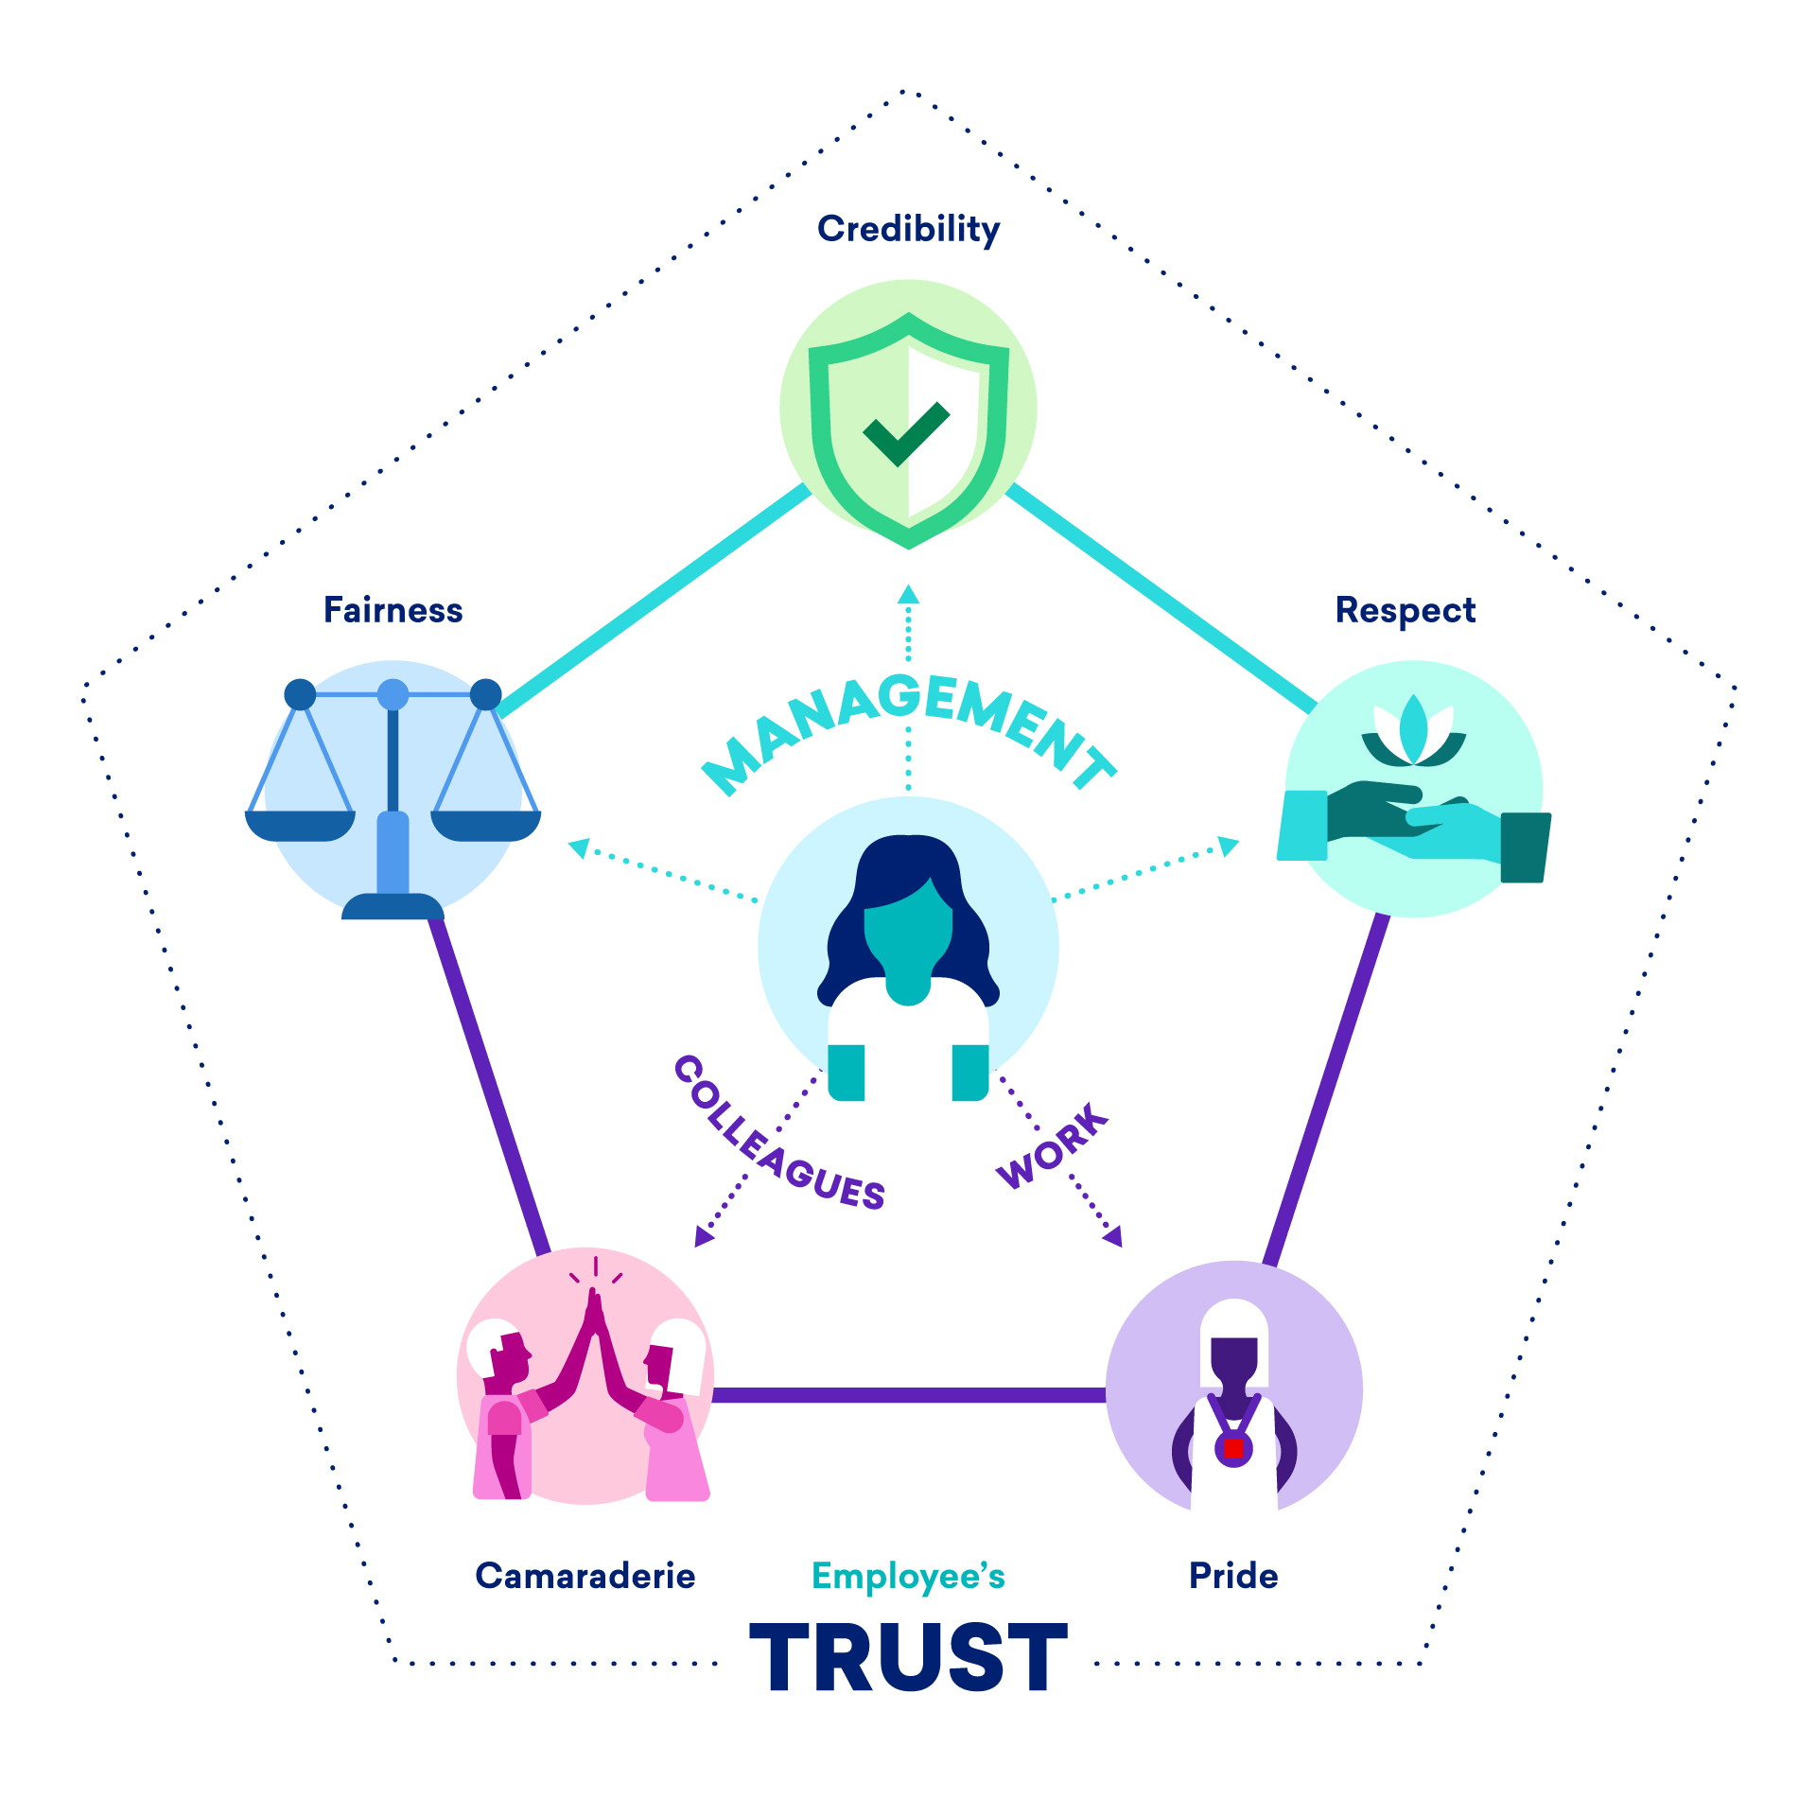
Trust
In order to do any number of things, you need trust, or some of the components of trust. As a result, the elements of trust in themselves can be cited as justification for moral principles.
But:
it could be argued that trust is too fragile a foundation for moral principles
it may be argued that trustless systems are in fact morally superior
https://www.greatplacetowork.ca/en/about-us/trust-model

Slide 13
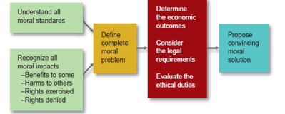
Defensibility
Another way to define an ethical principle’ is to say that it is descriptive of ‘conduct that you (or your organization) would be willing to defend’.
May involve reference to the work of predecessors
May involve reference to a cost, burden or onus
https://3668083.app.netsuite.com/core/media/media.nl?id=1968060&c=3668083&h=f9a29297360581078d7c&_xt=.pdf

Slide 14
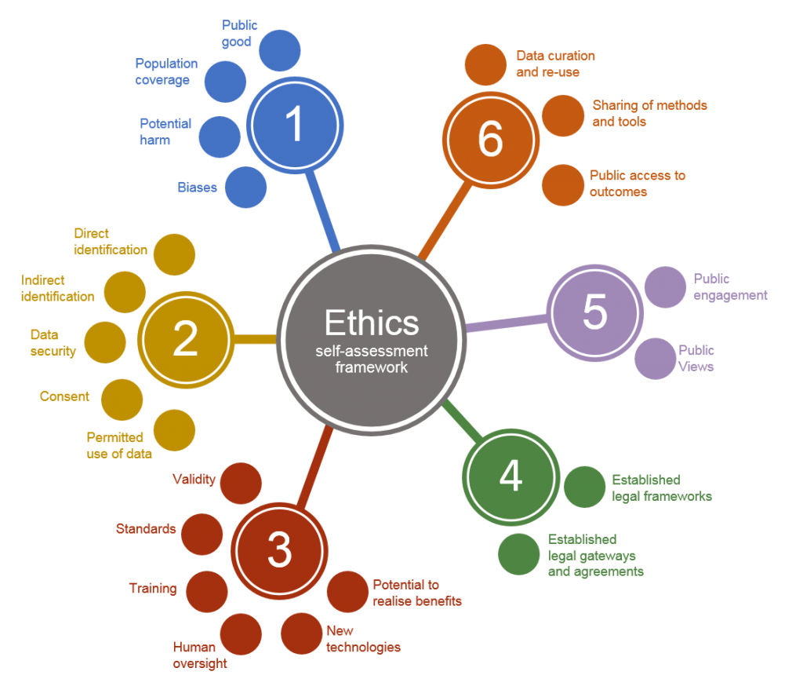
Moral Reasoning Generally
The distinction between checklists and process
And between conforming to a standard and creating one
The distinction between consideration and rationalization
The question of standards of evidence and forms of argument
https://uksa.statisticsauthority.gov.uk/the-authority-board/committees/national-statisticians-advisory-committees-and-panels/national-statisticians-data-ethics-advisory-committee/ethics-self-assessment-tool/

