Slide 1
Social Contracts
Stephen Downes
November 16, 2021

Slide 2
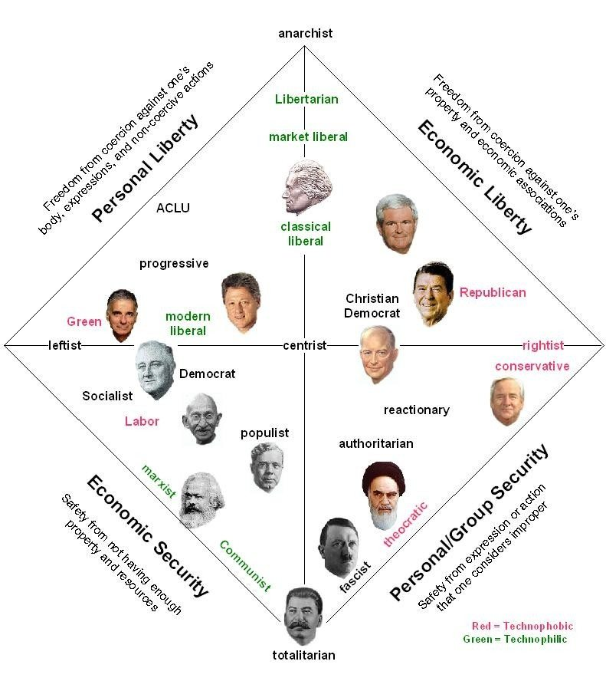
Social Contracts
The core idea is that ethics results from agreement within a community
Major components:
The process or method by which agreement is reached
Determining the contents of the resulting agreement
Motivation to abide by the agreement
https://www.quora.com/What-is-the-social-contract-theory-2
Title image: https://themillennialexec.com/why-social-contracts-matter-in-the-modern-workplace/

Slide 3
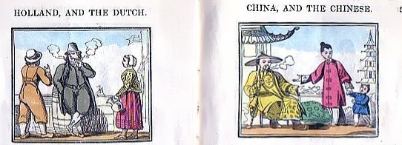
Mores
“Mores are not deliberately invented or thought of or worked out by some people in the society. They emerge gradually out of the customary practices of the people, largely without conscious choice or intention.” They are similar to folkways or social norms.
https://www.yourarticlelibrary.com/sociology/mores-strongest-social-norms-meaning-and-characteristics/35066 https://en.wikipedia.org/wiki/Mores https://openoregon.pressbooks.pub/ccj230/chapter/1-3-folkways-mores-taboo-behaviors/

Slide 4
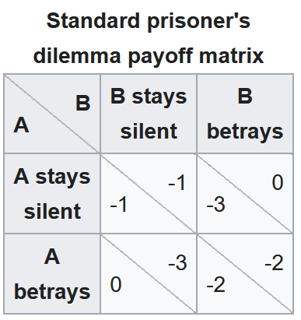
Prisoners’ Dilemma
Each prisoner is given the opportunity either to betray the other by testifying that the other committed the crime, or to cooperate with the other by remaining silent.
https://en.wikipedia.org/wiki/Prisoner%27s_dilemma
https://books.google.ca/books/about/Prisoner_s_Dilemma.html?id=JZk2x841s2AC&redir_esc=y

Slide 5
Prisoners’ Dilemma (Cont.)
Suppose you live in a society that has highly polluting cars. You can install a device that will stop the pollution from your car, but it will cost some money. If others use the device, then the air will be clean (your car isn’t going to make the air very dirty by itself). Therefore, if others use the device, then it is in your interests not to, in order to save money. On the other hand, if others aren’t using the device, then the air will be dirty even if you use it.

Slide 6
Morality as Agreement
Morality consists in the set of rules, governing how people are to treat one another, that rational people will agree to accept, for their mutual benefit, on the condition that others follow those rules as well.
James Rachels, The Elements of Moral Philosophy p. 150
In other words, every Nash equilibrium is morally right. https://www.investopedia.com/terms/n/nash-equilibrium.asp https://www.cs.ubc.ca/~kevinlb/teaching/cs430%20-%202011-12/lectures/Lect08.pdf

Slide 7
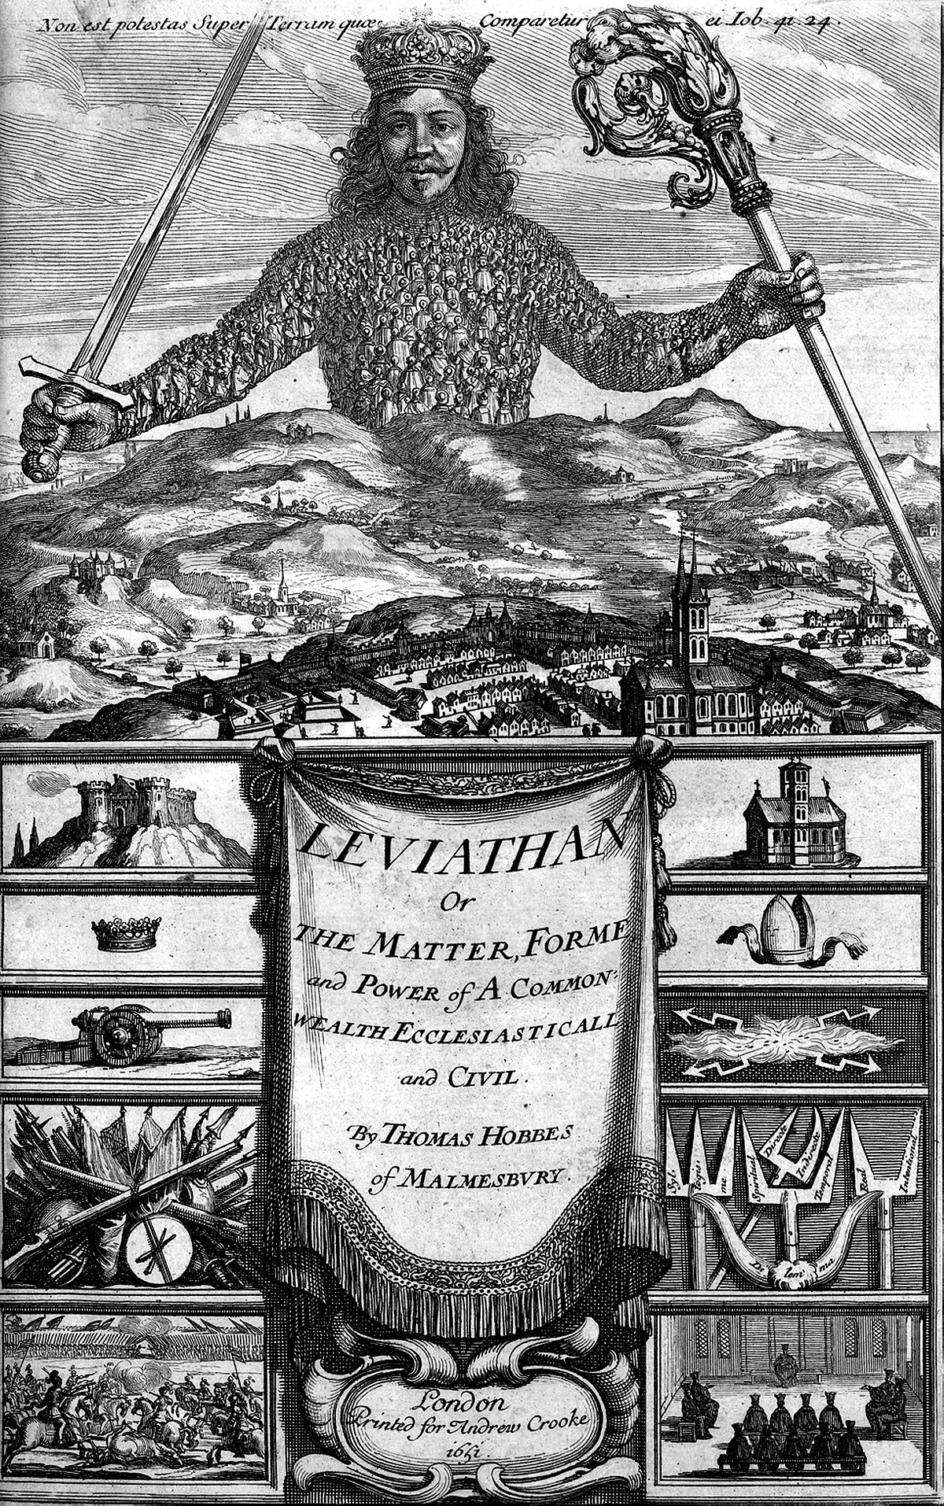
Thomas Hobbes
Hobbes argues that we willingly cede power to the monarch in order to escape the state of nature in which no rules exist and where, as he says, there are "No arts; no letters; no society; and which is worst of all, continual fear, and danger of violent death: and the life of man, solitary, poor, nasty, brutish and short." (Hobbes, 1986)

Slide 8
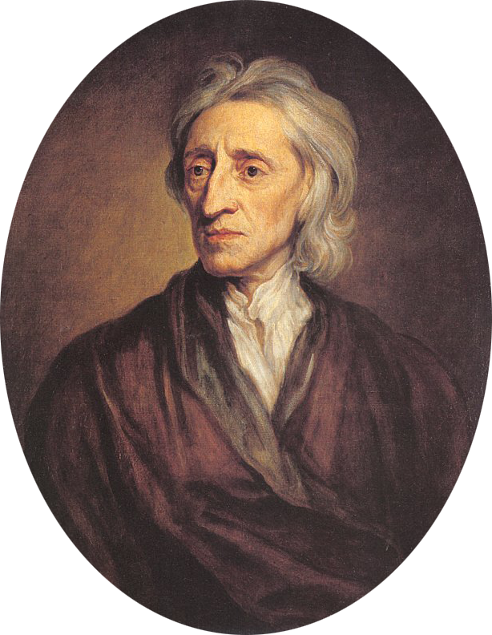
John Locke
John Locke depicts the contract as a mechanism to defend the rights of citizens against the sovereign, and in particular, to protect their right of property, which they acquire by removing goods from the state of nature and adding their own labour to them. Failing this, writes Locke, the recourse is either legitimate revolution to overthrow the sovereign, or emigration to unoccupied land. (Locke, 1821)

Slide 9
Jean-Jacques Rousseau
“Man is born free,” writes Rousseau at the beginning of the Social Contract, “yet everywhere he is in chains.” Rousseau depicts a ‘state of nature’ quite opposite to Hobbes, where people lived in peace and plenty, and the net effect of society was to constrain this freedom and enslave people to serve the individual will of the master. The objective of the social contract is to ascertain ‘the general will’ expressed by the unanimity of citizens. (Rousseau, 1950)
http://outlookafghanistan.net/topics.php?post_id=11589

Slide 10
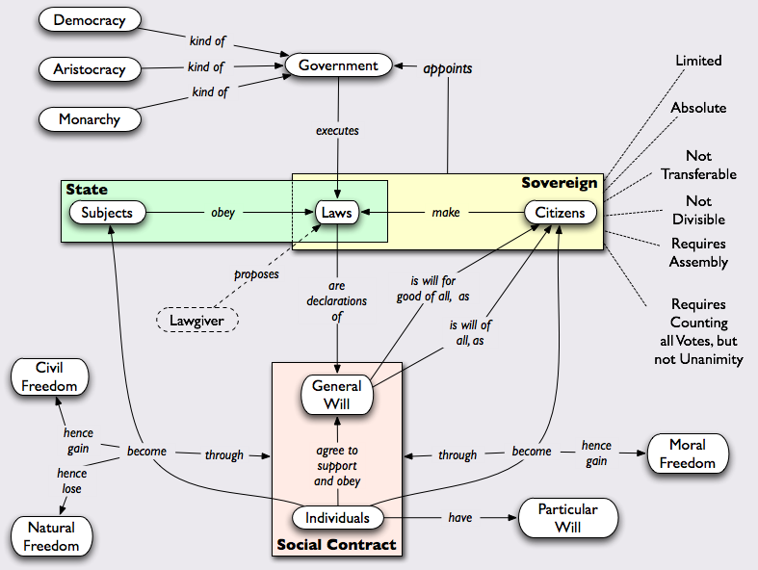
Elements of the Social Contract
A combination of state and sovereign, rights, freedom and will
https://www.pinterest.it/pin/39688040449977807/

Slide 11
Enforcement
The question of police powers
Forms of sanction or punishment
“It gives government too much power to make laws under the guise of protecting the public. Specifically, governments may use the cloak of the social contract to invoke the fear of a state of nature to warrant laws that are intrusive.”
https://opentextbc.ca/ethicsinlawenforcement/chapter/social-contract-theory/
https://philosophynow.org/issues/116/The_Social_Contract_A_License_to_Steal

Slide 12
Consent
“Almost all the governments which exist at present or of which there remains any record in story have been founded originally, either on usurpation or conquest, or both, without any pretense of a fair consent or voluntary subjection of the people”
David Hume:
questions their adequacy as historical accounts of the origins of government
Questions the validity of the ‘consent’ claimed by such theories
We may as well assert that a man, by remaining in a vessel, freely consents to the dominion of the master, though he was carried on board while asleep and must leap into the ocean and perish the moment he leaves her.”

Slide 13
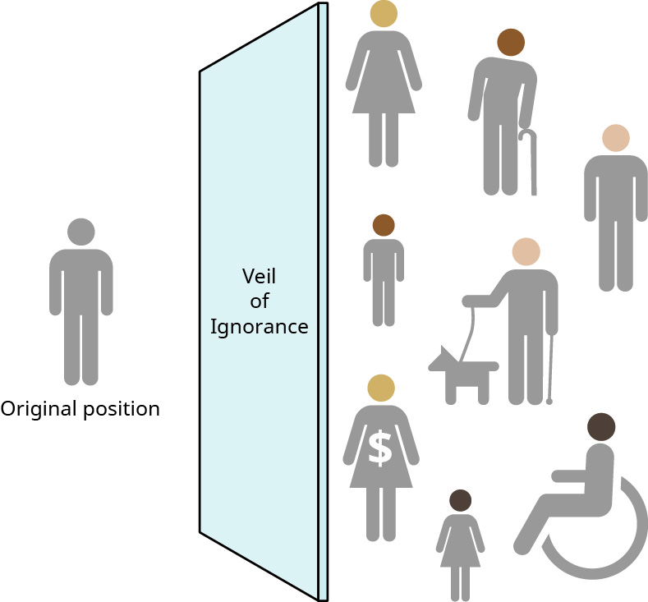
John Rawls
Method: veil of Ignorance
What we would want:
Rules that treat us as all equal
A range of basic rights and freedoms for everyone
Prosperity, so there’s enough for all
https://medium.com/@linkdaniel/a-theory-of-justice-an-introduction-to-john-rawls-208594ba3b75
https://home.csulb.edu/~cwallis/382/readings/160/TheoryofJustice.html

Slide 14
Fairness
“The “fairness” principle was defined as equitable and impartial treatment of data subjects by AI systems.”
“The principle of “equality” stands for the idea that people, whether similarly situated or not, deserve the same opportunities and protections.” (Fjeld, et.al., 2020:49)
Is fairness something that can be addressed algorithmically? Eg. FairSight: Visual Analytics for Fairness in Decision Making. https://arxiv.org/pdf/1908.00176.pdf
We care so much about fairness that we are willing to sacrifice economic well-being to enforce it. The Problem with Too Much Fairness https://coffeeandjunk.com/fairness/

Slide 15
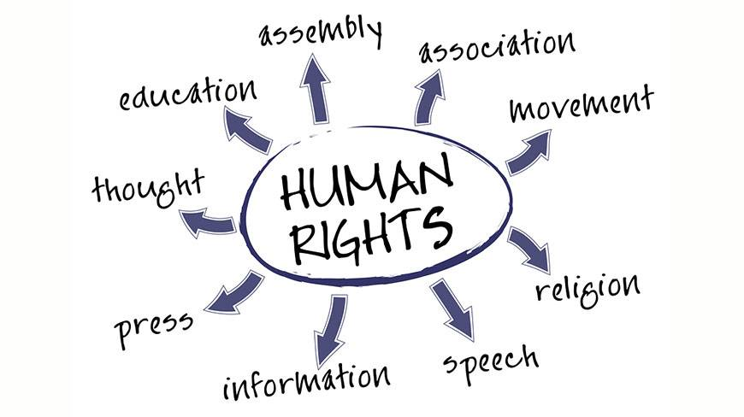
Rights
“Simply by existing in the world, you are entitled to certain basic rights: your human rights.”
Bill of Rights
Charter of Rights and Freedoms
Universal Declaration of Human Rights
https://bchumanrights.ca/human-rights/what-are-human-rights/
https://www.un.org/en/about-us/universal-declaration-of-human-rights

Slide 16
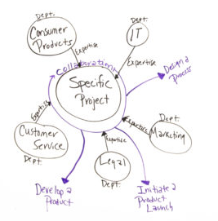
Two Kinds of Order
Michael Polanyi distinguishes between a spontaneous order as “a system of mutual adjustment” and a deliberately established corporate order
Friedrich Hayek speaks of spontaneous order as a “self-generating or endogenous order” in contrast to a “directed social order”
https://www.projectmanager.com/training/setup-self-directed-teams
https://www.econstor.eu/bitstream/10419/141284/1/859159086.pdf
https://oll.libertyfund.org/page/hayek-on-kinds-of-order-in-society

Slide 17
Invisible Hand Theory
Modern social scientists have, by contrast, tended to neglect the individual decision-making that must be present in the formation of group action in the ‘public sector.’ In their rejection of the contract theory of the state as an explanation of either the origin or the basis of political power, a rejection that was in itself appropriate, theorists have tended to overlook those elements within the contractarian tradition that do provide us with the ‘bridge’ between the individual-choice calculus and group decisions” (Buchanan and Tullock 1999 [1962]: xvi).
https://www.econstor.eu/bitstream/10419/141284/1/859159086.pdf

Slide 18
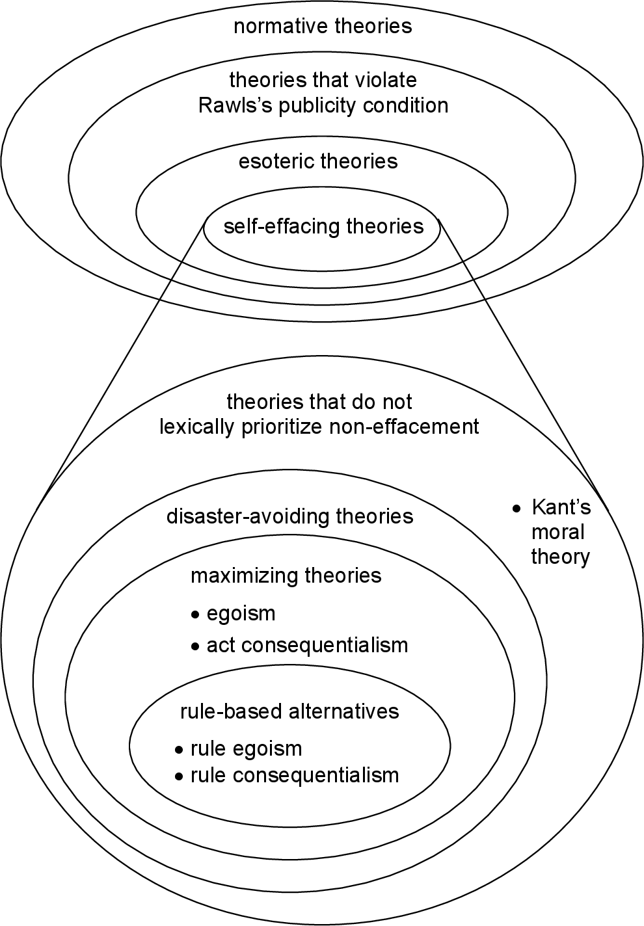
Market Failure
David Gauthier: Rational justification for minimal set of rules
Based on a principle of rational self-interest
contractarianism as a response to cases “when everyone follows self-interest would be harmful to everyone”
shows the collective rationale of moral rules as a device to secure “the ‘cooperative’ outcome”
“to be rational is to be disposed to act in a way that maximizes the satisfaction of one’s interests”
https://www.semanticscholar.org/paper/SELF-DEFEAT%2C-PUBLICITY%2C-AND-INCOHERENCE%3A-THREE-FOR-Eggleston/cf48750795fb333403173f0e9a0eb38f31299542 Self-effacing consequentialism
David Gauthier, Morals by Agreement (1986) https://philpapers.org/rec/GAUMBA
https://reasonandmeaning.com/2015/04/12/david-gauthiers-moral-contractarianism/

Slide 19
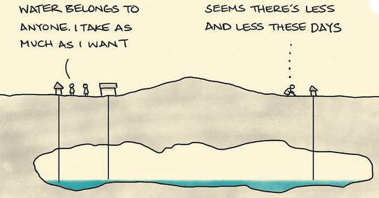
Tragedy of the Commons
The idea that rational individual decision-making will harm resources held in common
Garrett Hardin 1968 - https://www.hendrix.edu/uploadedFiles/Admission/GarrettHardinArticle.pdf

Slide 20
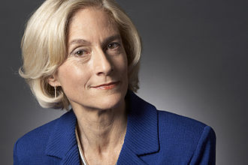
Marsha Nussbaum
Critique of social contract theory
“the social contract tradition, especially in its Rawlsian form, cannot give justice to disabled people.”
“the social contract cannot supply global justice beyond the nation-state.”
“the social contract tradition cannot render justice to animals.”
Nussbaum “is interested in how a view that finds human dignity expressed in a variety of life activities translates into demands of justice.”
https://www.h-net.org/reviews/showpdf.php?id=30492
https://www.newyorker.com/news/q-and-a/martha-nussbaum-on-metoo

Slide 21
The Fragility of Goodness
Martha Nussbaum: "More people and more beings deserve justice than those who make the rules. Just because you aren't self-reflective doesn't mean you don't have a dignity that demands re‐ spect. There is more to life than profiting off of each other; for human beings, fellowship and compassion are ends in themselves, too."

Slide 22
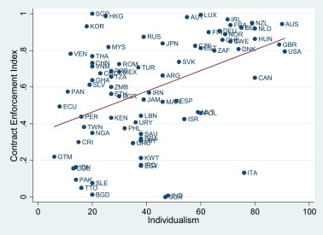
Contracts and Individualism
Presumption of radical individualism and self-interest
But:
We cannot all be self-sufficient
We have preferential attachments
Also:
Presumption that the only obligations we have are those that are freely chosen
But sometimes we can’t fulfill the contract
Thus, needs to account for a way of ‘living outside the moral community’
Individualism, democracy, and contract enforcement
https://www.sciencedirect.com/science/article/abs/pii/S092911991630373X

Slide 23
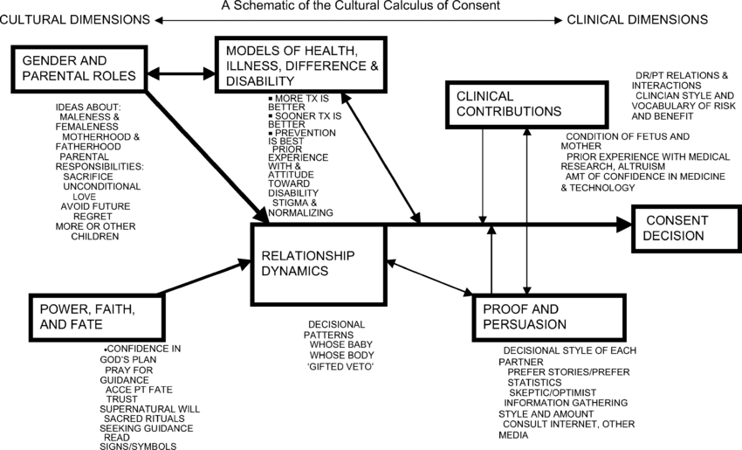
Individualism
“This analysis can perhaps be described by the term ‘methodological individualism.’ Human beings are conceived as the only ultimate choice-
Makers in determining group as well as private action. Economists have explored in considerable detail the process of individual decision-making in what is somewhat erroneously called the ‘market sector.’”
(Buchanan and Tullock 1999 [1962]: xvi)
https://www.researchgate.net/publication/7732826_The_Cultural_Calculus_of_Consent
James Buchanan and Gordon Tullock, The Calculus of Consent http://files.libertyfund.org/files/1063/Buchanan_0102-03_EBk_v6.0.pdf

Slide 24
Individualism and Collectivism
Collectivism incorporates concern:
Concern for the impact of one’s actions on other people
Sharing of material and non-material resources
Susceptibility to social influence (think: peer pressure)
Self-presentation and facework
Sharing of outcomes (think: collective responsibility)
Feeling of involvement in other people’s lives
Harry Hui and Harry Triandis - https://www.researchgate.net/publication/247723185_Individualism-Collectivism - A_Study_of_Cross-Cultural_Researchers

Slide 25
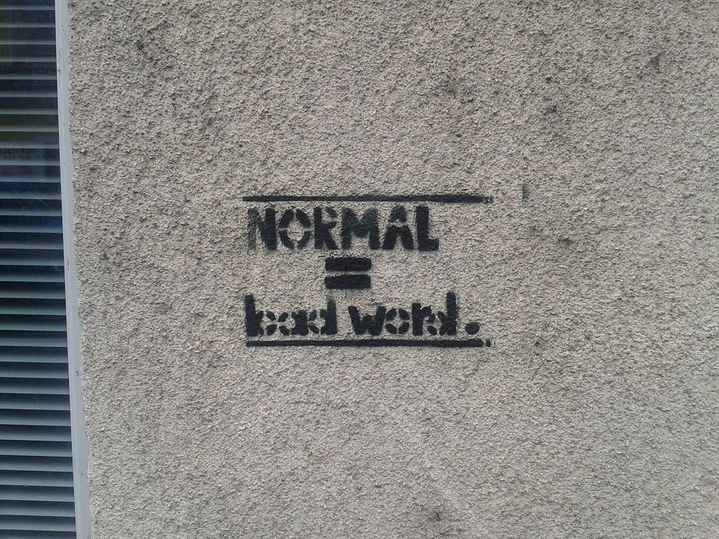
Creating Ethics Collectively
Martha Finnemore and Kathryn Sikkink identify three stages in the life cycle of a norm:
Norm emergence: Norm entrepreneurs seek to persuade others
Norm cascade: A norm has broad acceptance and reaches a tipping point
Norm internalization: The norm has acquired a "taken-for-granted" quality
https://en.wikipedia.org/wiki/Social_norm

Slide 26
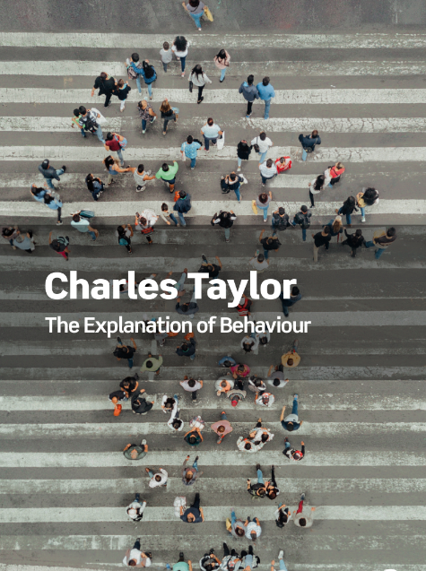
Communitarian Ethics
Communitarian thinkers in the 1980s such as Michael Sandel and Charles Taylor argued that Rawlsian liberalism rests on an overly individualistic conception of the self
Taylor argued that a more realistic understanding of the ‘self’ recognizes the social background against which life choices gain importance and meaning. https://www.cbc.ca/radio/ideas/the-1991-cbc-massey-lectures-the-malaise-of-modernity-1.2946849
E.g. Charles Taylor, To Follow a Rule
https://pages.stolaf.edu/ein/themes/communitarianism/
https://en.wikipedia.org/wiki/Charles_Taylor_(philosopher)

Slide 27
Ubuntu
“Ethics in ubu-Ntu is the measure of one’s relationality with others, the environment, and all other interdependent parts.”
“The perceived infallibility and supremacy of rationality, especially as administered through machines, exacerbates marginalization.”
https://montrealethics.ai/research-summary-from-rationality-to-relationality-ubuntu-as-an-ethical-human-rights-framework-for-artificial-intelligence-governance/ https://carrcenter.hks.harvard.edu/files/cchr/files/ccdp_2020-009_sabelo_b.pdf

Slide 28
Criticisms of Ubuntu
It entrenches some of the existing and unchallenged discriminatory practices that are based on age, gender and social standing
It enforces group solidarity at the expense of individual wellbeing.
it tends to enforce conformity
It reinforces and perpetuates existing imbalances in power relations
https://www.commonsensemedia.org/movie-reviews/tracks
https://www.educ.cam.ac.uk/research/programmes/restorativeapproaches/seminartwo/LEPHALALA%20%20UBUNTU-RA%20-%20PAST%20PRESENT.pdf

