Slide 1
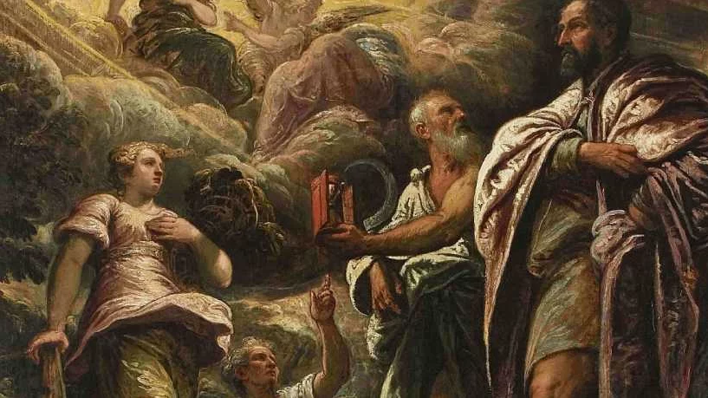
Metaethics
Stephen Downes
November 18, 2021

Slide 2
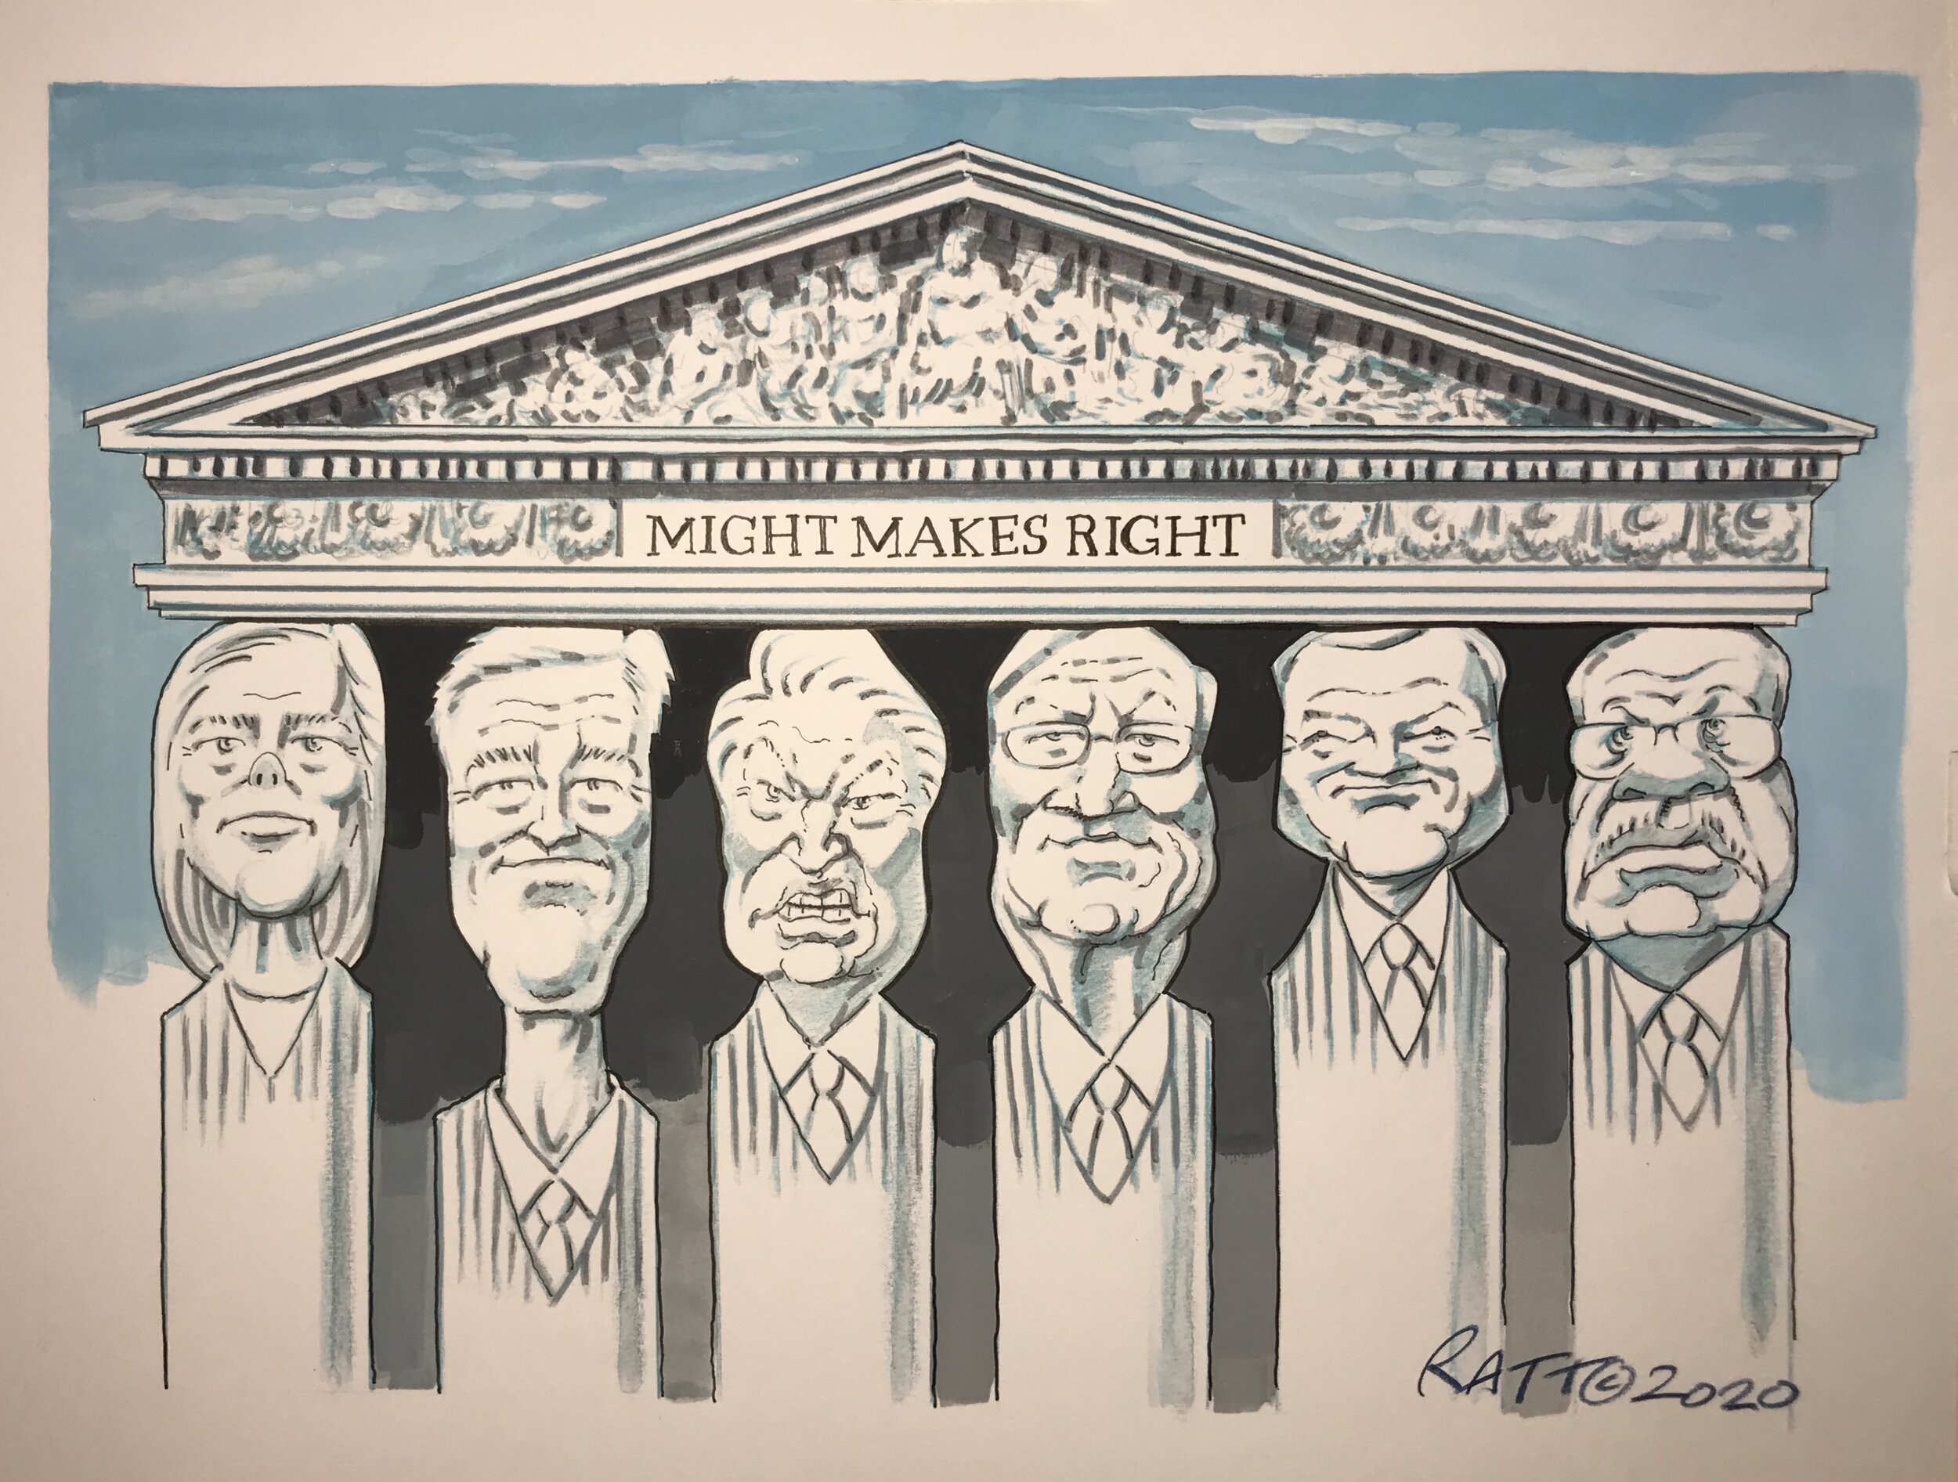
Does Might Make Right?
Might makes right or Might is right is an aphorism on the origin of morality, with both descriptive and prescriptive senses. – Wikipedia
Max Weber: the study of morality is the study of power
https://en.wikipedia.org/wiki/Might_makes_right
https://plato.stanford.edu/entries/weber/#DomLeg

Slide 3
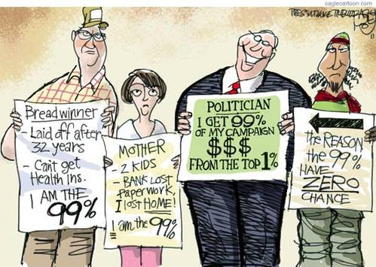
The (New) Golden Rule
“Whoever has the gold makes the rules.”
http://whatwouldjackdo.net/2011/10/remember-the-golden-rule-he-who-has-the-gold-makes-the-rules.html
Cover image: https://www.massolit.io/courses/metaethics-do-moral-reasons-exist

Slide 4
Types of Ethics
Descriptive: People tend to make decisions which bring pleasure or avoid pain.
Normative: The moral decision is that which enhances wellbeing and limits suffering.
Analytic: Morality is simply a system for helping humans stay happy and alive.
Quoted from: https://www.learnreligions.com/ethics-descriptive-normative-and-analytic-4037543

Slide 5
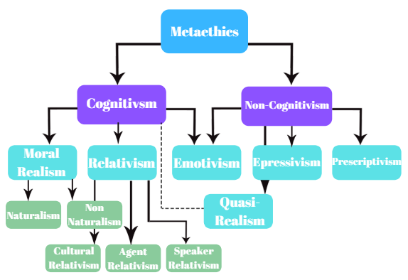
Metaethics
The study of meta-ethics is the study of what grounds an ethical argument.
After reflection on the different theories, it is relevant to ask about the bases or grounds for one approach or another.
https://conscientthoughts.wordpress.com/2019/06/10/lets-get-meta-about-metaethics/

Slide 6
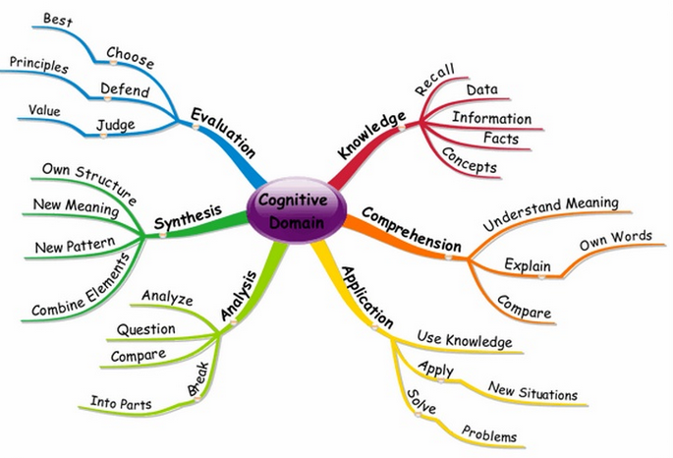
Cognitivism
Cognitivism is the idea that “moral statements have the capability of being objectively true of false since they are descriptive of some external reality in the world”
Non-Cognitivism “views moral discourse as a way to express attitudes towards certain actions.” For example, Hume “assigns moral distinctions to affect/emotional appeal.”
https://conscientthoughts.wordpress.com/2019/06/10/lets-get-meta-about-metaethics/
https://www.youtube.com/watch?v=BWuzk1ZigcU
Image: https://pressbooks.bccampus.ca/teachinginadigitalagev2/chapter/3-3-cognitivism/

Slide 7
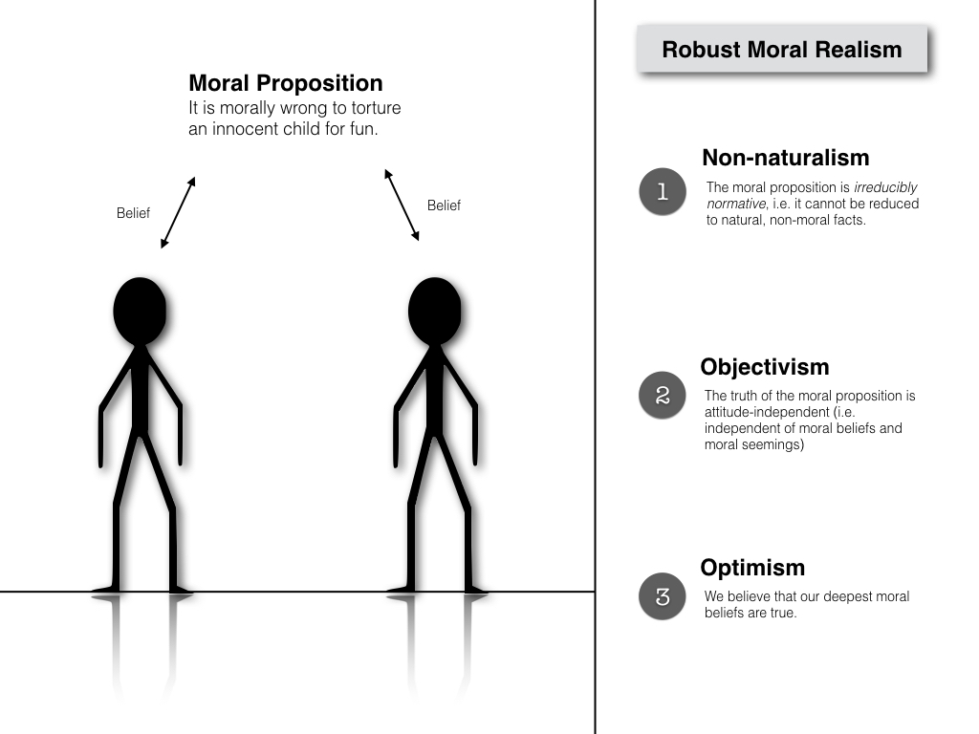
Realism
The idea that moral ideas are true or false independently of what we think of them
https://philosophicaldisquisitions.blogspot.com/2016/09/is-robust-moral-realism-kind-of.html

Slide 8
Moral Universalism
Descriptive: there is one universal morality shared by all cultures
Prescriptive: at least, there should be
https://public.tableau.com/profile/mark.alfano#!/vizhome/Virtuesandvicesfromtheperspectivesof256cultures/Virtuesandvicesaroundtheworld

Slide 9
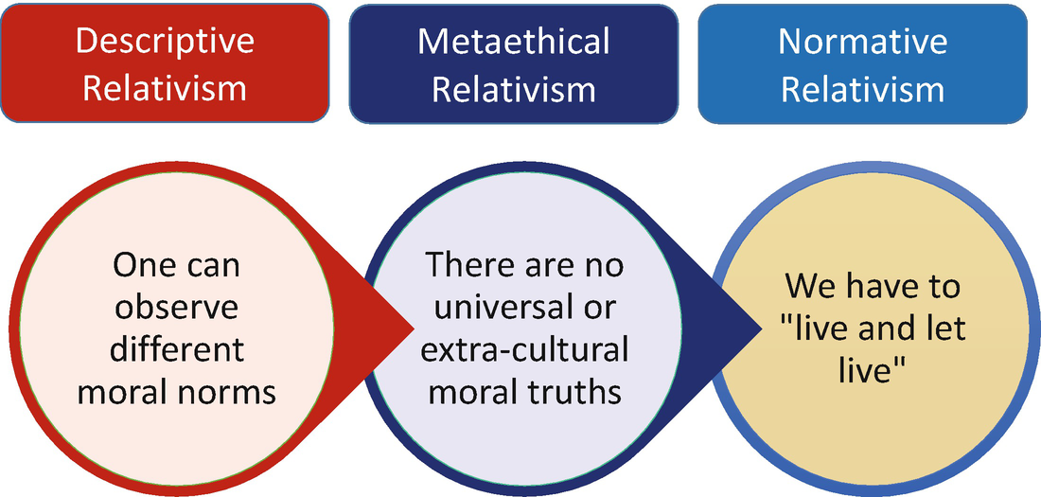
Relativism
Relativism is the idea that, one way or another, there are no universal moral truths
https://link.springer.com/chapter/10.1007/978-3-030-15745-6_4

Slide 10
Moral Scepticism
We can’t know about morality, one way or another.
https://plato.stanford.edu/entries/skepticism-moral/

Slide 11
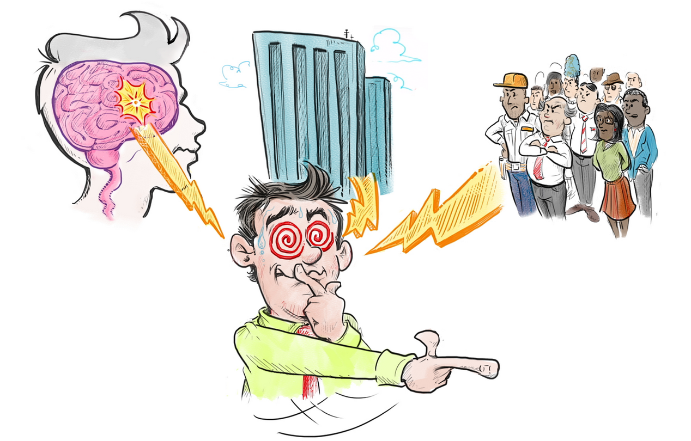
Moral Choice?
Why is ethics always presented to us in the form of ‘making decisions’?
Is morality even a choice we can make?
https://ethicsunwrapped.utexas.edu/video/best-self-part-2-moral-decision-making

Slide 12
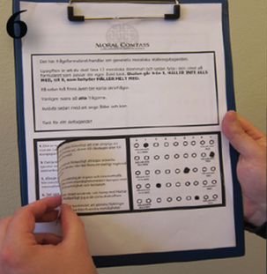
Moral Rationalization
“participants often constructed coherent and unequivocal arguments supporting the opposite of their original position. These results suggest a dramatic potential for flexibility in our moral attitudes”
https://journals.plos.org/plosone/article?id=10.1371/journal.pone.0045457

Slide 13
Non-Cognitivism
Expresses or describes attitudes to moral statements
For example, “I find the idea of hunting cats distasteful”
Branches: emotivism, prescriptivism, expressivism
Emotivism – expresses a moral judgement
Prescriptivism – attempts to influence others
Expressivism – expresses a feeling, e.g., of disgust
https://iep.utm.edu/eth-expr/

Slide 14
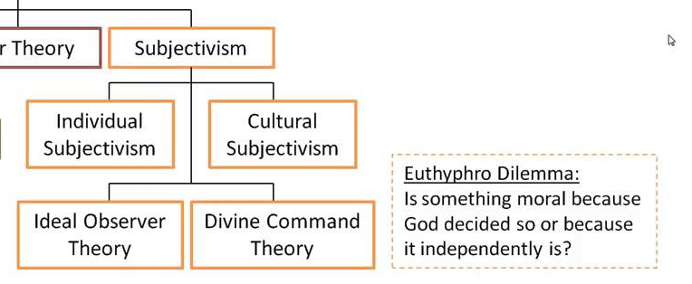
Subjectivism
Ethical truth depends on perspective or point of view
https://www.youtube.com/watch?v=BWuzk1ZigcU

Slide 15
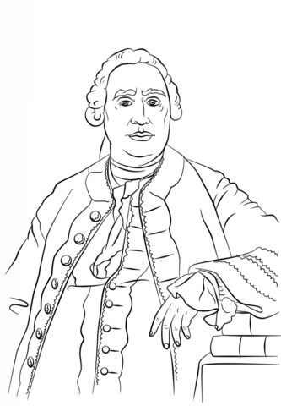
Moral Sentiment
Reason alone cannot persuade us to act - “reason is, and ought only to be, the slave of the passions,” he writes. (Hume, 1739, II.3.3) “Truth is disputable; not taste: What exists in the nature of things is the standard of our judgment; what each man feels within himself is the standard of sentiment.” (Hume, 1751, 1.5)
https://www.berfrois.com/2011/04/moral-sentiment-politics-human-rights/

Slide 16
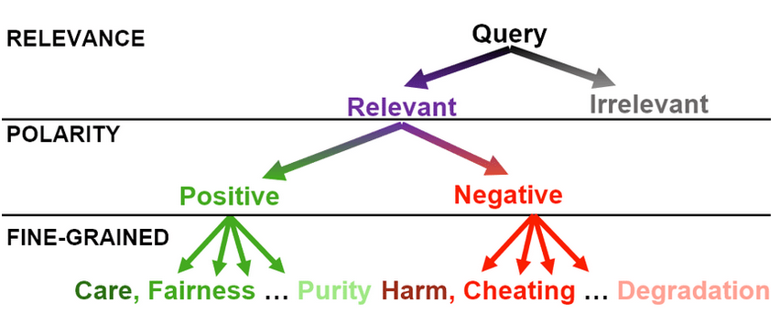
Inferring moral Sentiment
E.g. a text-based framework for investigating moral sentiment change of the public
https://www.researchgate.net/publication/336995590_Text-based_inference_of_moral_sentiment_change

Slide 17
Who Owns Ethics?
Scientific Virtues
“scientists invoke theoretical virtues explicitly, albeit rather infrequently, when they talk about models”
Business Ethics
“real concerns and real-world problems of the vast majority of managers”
Silicon Valley Ethics
Metcalf, Moss & boyd: “broader and longer-standing industry commitments to meritocracy, technological solutionism, and market fundamentalism”
etc
https://philpapers.org/archive/MIZTVI.pdf
https://hbr.org/1993/05/whats-the-matter-with-business-ethics
https://datasociety.net/library/owning-ethics-corporate-logics-silicon-valley-and-the-institutionalization-of-ethics/

