Slide 1
Care as a Legal Concept
Stephen Downes
November 25, 2021

Slide 2
Care as a Legal Concept
Duty of care: The responsibility or legal obligation of a person or organization to avoid acts or omissions that could likely cause harm to others.
Standard of care: Standard of care is only relevant when a duty of care has been established. The standard of care speaks to what is reasonable in the circumstances. If one does not owe a duty of care, there is no need to meet any standard of care.
Reasonable person: A person who is thought to be careful and considerate in their actions.
https://www.cpha.ca/duty-care-checklist

Slide 3
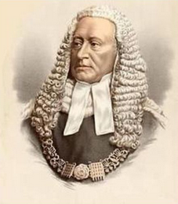
Lord Atkin’s Principle
People must take reasonable care not to injure others who could foreseeably be affected by their action or inaction
Every man ought to take reasonable care that he does not injure his neighbour
Quoted from https://en.wikipedia.org/wiki/Donoghue_v_Stevenson (snail in a bottle case)
http://sites.thomsonreuters.com.au/journals/files/2018/07/Justice_Peter_Applegarth_2016-90-ALJ-711.pdf
https://slideplayer.com/slide/12102735/

Slide 4
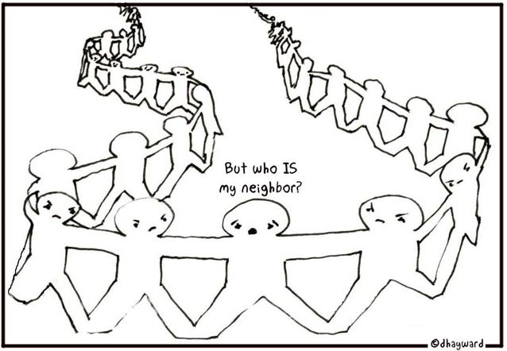
Neighbours
“The rule that you are to love your neighbour becomes in law, you must not injure your neighbour” – Lord Atkin
Who is your neighbour? Everyone? No.
“Questions of proximity and deliberation as to the fairness, justice and reasonableness of the imposition of a duty of care should be considered.”
https://www.lawteacher.net/free-law-essays/tort-law/neighbour-principle.php
https://cxgentlemen.wordpress.com/2012/10/15/the-neighbour-principle/

Slide 5
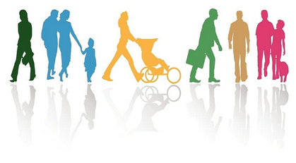
Special Relationships
A duty of care exists
“if it could be shown that a special relationship subsisted between the parties” e.g. “where it is plain that the party seeking the information or advice was trusting the other to exercise such a degree of care as the circumstances required”
However, “recognising the need to protect professionals whose work inherently poses susceptibility to negligence claims.”
https://www.lawteacher.net/free-law-essays/tort-law/neighbour-principle.php
https://www.amazon.ca/Care-Virtue-Special-Relationships-Character/dp/384737320X

Slide 6
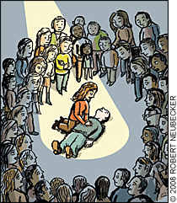
Good Samaritan Laws
Bystanders are mostly not required to provide assistance (expections exist, e.g. in Vermont, Quebec or on Seinfeld)
The intent is generally to protect bystanders who render aid, even if they were negligent (but not if they were grossly negligent)
They do not protect professionals where a duty of care exists
https://www.lhsfna.org/good-samaritan-laws-what-exactly-do-they-protect/
https://www.aafp.org/fpm/2008/0400/p37.html

Slide 7
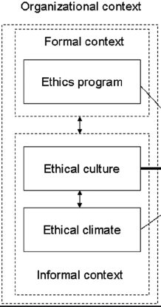
Ethics as a Context
Ethics has the same purpose as other standards, namely:
To standardize profession's work
Protect public, serve client, support other standards, etc.
Similar development
Begins with common sense
Modified based on experience of profession
Never final (since experience continues)
Needs practical context to make sense
Each profession is defined by a certain sort of judgment
Judgment can only be exercised in a context.
http://ethics.iit.edu/teaching/professional-ethics#4
https://www.researchgate.net/publication/254097714_Understanding_Unethical_Behavior_by_Unraveling_Ethical_Culture

Slide 8
The Basis in Ethics for a Duty of Care in Law
For Cranmer & Nhemachena, ‘moral duties trigger how we ought, should or are expected to behave’ (2013 p.141). Furthering this, Johnstone notes that duty comes from the deontology ethical theory and this sees duty as ‘the basis of morality and holds...that some acts are obligatory’ (1994 p. 65).
“Duty of care may be considered a formalisation of the social contract, the implicit responsibilities held by individuals towards others within society.” (Wikipedia)
http://oro.open.ac.uk/49091/3/Duty%20of%20care%20-%20Cornock.pdf
https://en.wikipedia.org/wiki/Duty_of_care

Slide 9
Duty of Care in Business
“Duty of care refers to a fiduciary responsibility held by company directors which requires them to live up to a certain standard of care. This duty—which is both ethical and legal—requires them to make decisions in good faith and in a reasonably prudent manner.”
https://www.investopedia.com/terms/d/duty-care.asp

Slide 10
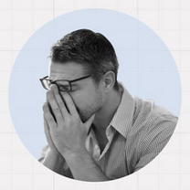
Levels of Duty of Care
Intentional Injury: the injured person has a right to recover damages
Negligence: acts creating a foreseeable risk of injury to others
Recklessness: acting with utter disregard for the safety of others.
Strict Liability: cases involving manufacturing defects in products
https://www.investopedia.com/terms/d/duty-care.asp

Slide 11
Roles and Ethics
“the role an individual assumes in society (such as “engineer” or “physician,” when it is a voluntary role, or “grandmother” when it is not) oftentimes has a corresponding moral value, or moral obligations that can go beyond or differ from what is seen as ordinary morality.
“We can old many roles simultaneously in society, and these roles are constantly shifting and being negotiated by society and by ourselves.”
“Roles are not always contracts, nor are they simply means of protecting others.”
Andre, Judith. “Role Morality as a Complex Instance of Ordinary Morality.” American Philosophical Quarterly 28:1 (January 1991) 73-80. https://www.jstor.org/stable/20014357

Slide 12
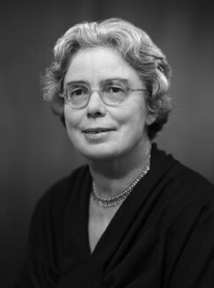
Rules, Roles and Relations
Dorothy Emmet (1966):
Analysis of causal, functional explanations of roles
Depersonalization of role relations “is not only to misconstrue their nature and their importance in human society, but also to miss the subtlety and sophistication of their interpretation and realisation in action.”
https://prabook.com/web/dorothy.emmet/3757344
https://www.academia.edu/5745220/Robert_Merton_and_Dorothy_Emmet_Deflated_Functionalism_and_Structuralism

Slide 13
The Role of the Teacher
Herbert Kohl:
Thinking of the role of a teacher the way anyone might perform it (which is for the most part impersonal)
Thinking of it from the perspective of how a specific person performs it
Being a teacher for Kohn is not simply a job, it is a vocation (Blum, 1994, p. 107)
The Discipline of Hope “is grounded in the relationship between teacher and student; it dwells on the mutuality between the two as they teach each other.”
https://www.betterworldbooks.com/product/detail/discipline-of-hope-learning-from-a-lifetime-of-teaching-0684814129

Slide 14
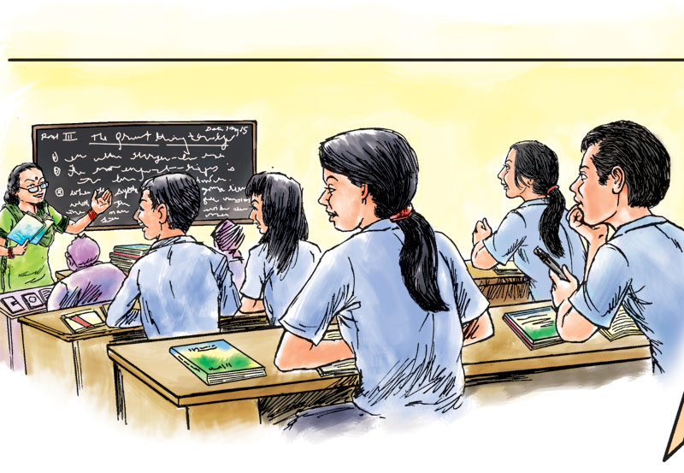
Teachers and Ethical Codes
Codes of ethics provide an incomplete depiction of teacher deontology
Extensive corporatist content in the codes is negative and confusing
For teacher education, codes of ethics have important limitations
“Regulatory codes can draw attention away from other, possibly richer ways of conceptualizing how professionals can and should negotiate the ethical demands and complexity of professional life.”
Maxwell & Schwimmer, 2016
https://www.sciencedirect.com/science/article/abs/pii/S0742051X16301433

Slide 15
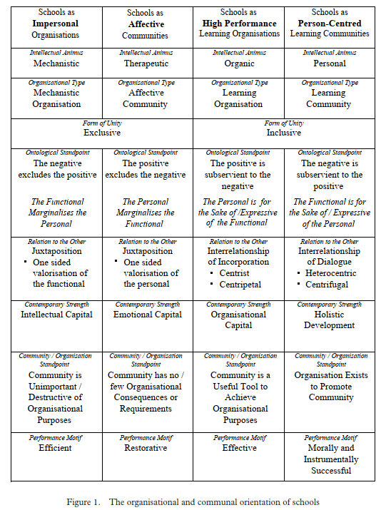
School as Person-Centered
Michael Fielding argues for “a person-centred approach in which the purposes of educational organisations are accomplished, not by abandoning their distinctively educational aspirations, but rather by transforming their organisational forms and capacities into the vibrancy and creativity of inclusive educational communities.”
https://www.researchgate.net/publication/248975866_The_Human_Cost_and_Intellectual_Poverty_of_High_Performance_Schooling_Radical_Philosophy_John_MacMurray_and_the_Remaking_of_Person-Centred_Education

Slide 16
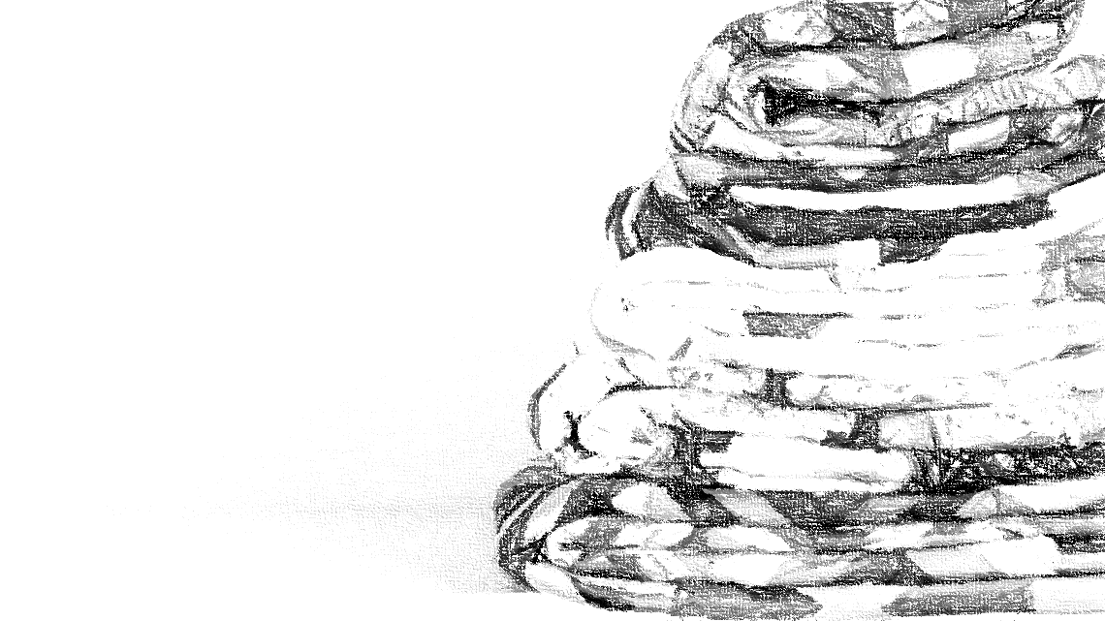
The Burden of Care
“This burden falls on traditionally marginalized workers, and because caring is often thought of as ‘women's work’, the bulk of the burden falls on them.”
We need to recognise where the burden of care falls in higher education. Lorna Campbell, Wonkhe, 2020/03/07 https://wonkhe.com/blogs/we-need-to-recognise-where-the-burden-of-care-falls-in-higher-education/

Slide 17
Care as a Legal Concept
Starts out as a principle of good neighbours
Becomes a legal responsibility
Creates specific rules for special relationships
Thought of as a context-specific ‘standard’
Care in shifting roles, shifting responsibilities
Legal principles have important limitations
Impersonal organizations vs personal communities
A growing burden on care workers

