Slide 1
Care and Relationships
Stephen Downes
November 27, 2021

Slide 2
Personal Responsibility
Personal responsibility isn’t sufficient for democracy (Tronto, 2013, p. 45) (substitute for Harold Lasswell’s (1936) succinct definition of politics, as “who gets what, when and how,” one that sees it a way to divide up responsibilities: who is responsible for caring for what, when, where, and how. )
“Accounts of responsibility stress its ties to the freedom of a subject to act and to the consequences of such action… of assigning blame for past judgments and actions…. feminists have begun to develop a model that is forward-looking and accounts for how to make change rather than simply to assign blame (Card 1996).” (Tronto, 2013, p. 51)
Title Image: https://cetc.org.au/blog/relationship-based-care-is-key-to-recovery-and-change/
https://www.drzimmerman.com/tuesdaytip/personal-responsibility-success

Slide 3
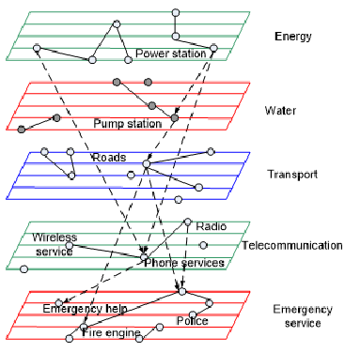
Interdependence as a Condition
Feminist ethics of care argue that to value care is to recognize the inevitable interdependency essential to the existence of reliant and vulnerable beings (Kittay and Feder 2002; Engster 2005). Interdependency is not a contract, nor a moral ideal— it is a condition. Care is therefore concomitant to the continuation of life for many living beings in more than human entanglements— not forced upon them by a moral order, and not necessarily a rewarding obligation.
María Puig de la Bellacasa (2017) Matters of Care, p. 70. https://syllabus.pirate.care/library/Maria%20Puig%20de%20La%20Bellacasa/Matters%20of%20Care%20(171)/Matters%20of%20Care%20-%20Maria%20Puig%20de%20La%20Bellacasa.pdf

Slide 4
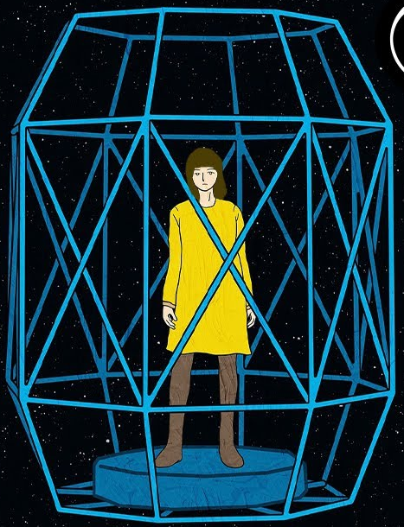
The Living Other
Noddings: “The living other is more important than any theory. This is a central idea in an ethic of care. It is pre-theoretical, rooted in natural caring.”
‘Diminishment’ – “when she either chooses or is forced to act in a way that rejects her internal call to care… people and organizations can deliberately or carelessly contribute to the diminishment of others' ethical ideals… by teaching people not to care, or by placing them in conditions that prevent them from being able to care (Noddings, 1984, 116-119).
http://mehrmohammadi.ir/wp-content/uploads/2020/09/The-Challenge-to-Care-in-School-Nel-Noddings.pdf
https://en.wikipedia.org/wiki/Nel_Noddings

Slide 5
Relational, Responsive Beings
Gilligan: “The ethics of care starts from the premise that as humans we are inherently relational, responsive beings and the human condition is one of connectedness or interdependence.”
“Morality is grounded in a psychological logic, reflecting the ways in which we experience ourselves in relation to others.”
“The origins of morality lie in human relationships as they give rise to concerns about injustice and carelessness.”
Noddings: “Caring, 'rooted in receptivity, relatedness, and responsiveness' is a more basic and preferable approach to ethics
https://ethicsofcare.org/carol-gilligan/
https://en.wikipedia.org/wiki/Nel_Noddings

Slide 6
How Empathy and Receptivity Fail
Lou Agosta and Alex Zonis, 2020, Empathy: A Lazy Person's Guide
Cited in https://louagosta.com/2020/08/07/empathy-and-hermeneutics/

Slide 7
The Relational in Teaching, Caring
Nel Noddings: “The relational sense of caring forces us to look at the relation.
It is not enough to hear the teacher’s claim to care. Does the student recognize that he or she is cared for? Is the teacher thought by the student to be a caring teacher?”
“Caring does not reside entirely in the attitude and intentions of the carer. We must ask about the effects on the cared-for. If A claims to care for B, but B denies that A cares, then the relation between A and B is not one of caring.” (Noddings, 1998, p. 130)
http://www.uvm.edu/~rgriffin/NoddingsCaring.pdf
http://ai-makurdi.org/wp-content/uploads/2020/05/100.-Philosophy-of-Education-Dimensions-of-Personality-by-Nel-Noddings-1.pdf

Slide 8
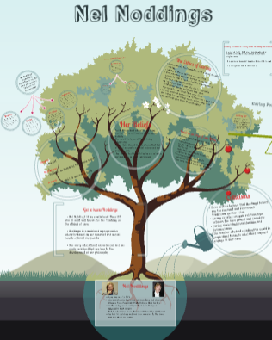
The Caring Relation
… is attentive, “engrossment” (Noddings, 1984)
… is receptive to “what the cared-for is feeling and trying to express”
… is not merely diagnostic, not measuring against some kind of ideal
… moves and motivates the career
https://ieag.org.nz/assets/Uploads/Noddings-2012-1.pdf
http://www.uvm.edu/~rgriffin/NoddingsCaring.pdf
https://en.wikipedia.org/wiki/Nel_Noddings https://prezi.com/fg12ticpgz_u/nel-noddings/

Slide 9
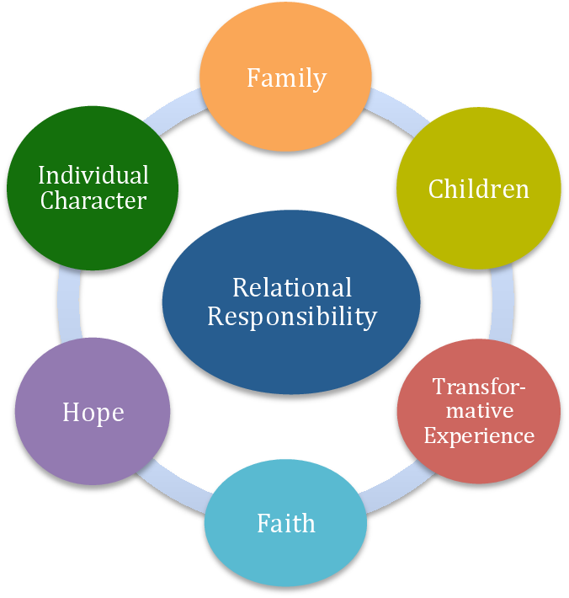
Relational Responsibilities
Tronto: Relational responsibilities… “grow out of relationships and their complex intertwining” (2012: 303).
“[s]ome form of relation – either presence, biological, historical, or institutional ties, or some other form of ‘interaction’ – exists in order to create a relation and, thus, a responsibility” (2012: 306).
https://journals.sagepub.com/doi/pdf/10.1177/1464700119842560

Slide 10
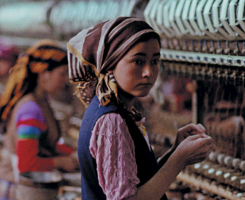
Social Connection Model
“Iris Marion Young’s (2006) ‘social connection model’ of responsibility argues that all agents who contribute by their actions to the structural processes that produce injustice have responsibilities to work to remedy these injustices.” (Tronto, 2013, p. 72)
Iris MarionYoung, 2005, Responsibility and Global Justice: A Social Connection Mode. Anales de la Cátedra Francisco Suárez, 39 (2005), 709-726. https://revistaseug.ugr.es/index.php/acfs/article/viewFile/1040/1235

