Slide 1
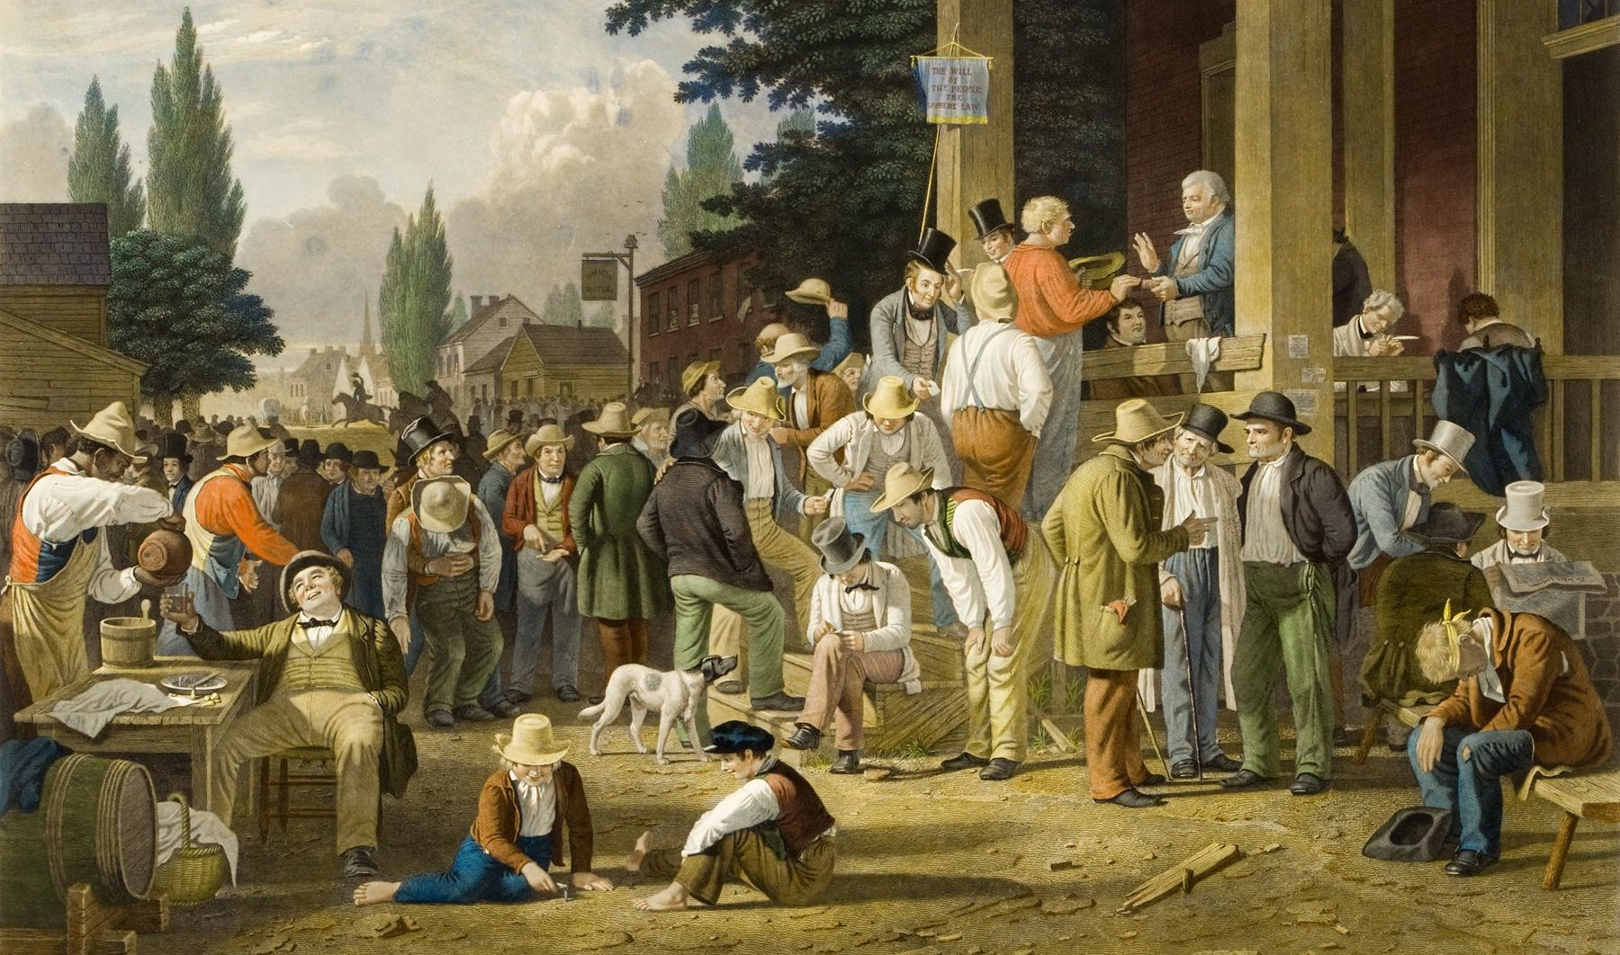
Caring Democracies
Stephen Downes
November 27, 2021

Slide 2
Unequal Relationships
Sarah Lucia Hoagland argues that the relationships in question, such as parenting and teaching, are ideally relationships where caring is a transitory thing designed to foster the independence of the cared-for, and so end the unequal caring relationship.
Unequal relationships, she writes, are ethically problematic, and so a poor model for an ethical theory. Hoagland argues that on Noddings' account of ethical caring, the one-caring is placed in the role of the giver and the cared-for in the role of the taker. The one-caring is dominant, choosing what is good for the cared-for, but gives without receiving caring in return. The cared-for is put in the position of being a dependent
https://en.wikipedia.org/wiki/Nel_Noddings
Title Image: https://erraticus.co/2021/01/15/authentic-democracy-voting-populism-democratic-reform/

Slide 3
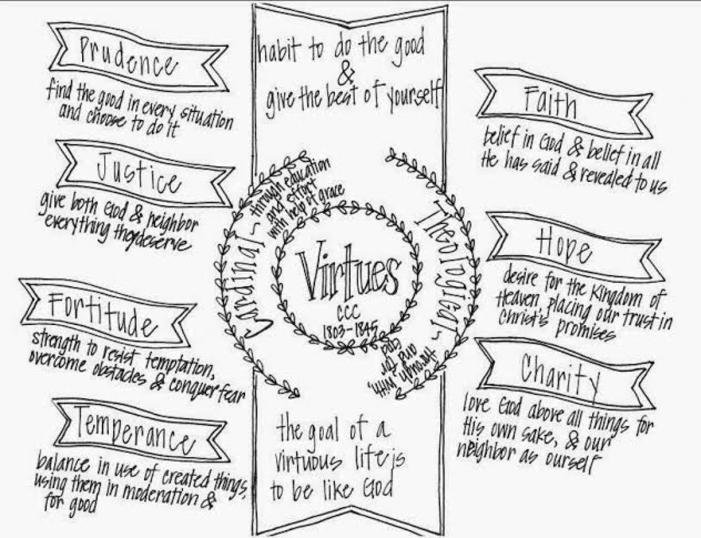
Moral Interdependence
The American tradition tends to “regard virtues as personal possessions, hard-won through a grueling process of character building.”
Contrast with John Dewey: virtues as “working adaptations of personal capacities with environing forces”
Noddings: “How good (or bad) I can be depends in substantial part on how you treat me.”
https://letterpile.com/religion/Virtues-Why-do-we-need-it-What-do-we-need-it-for
http://www.uvm.edu/~rgriffin/NoddingsCaring.pdf

Slide 4
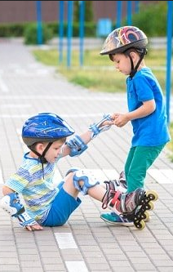
The Duty to Act
“Ethical caring is a natural outgrowth of natural caring, but, unlike Kant’s ranking of duty as primary and inclination as secondary, in the ethics of care the inclination to care is primary.”
“This impulse is obligatory in anyone who aspires to the sense of self as a moral, caring person.” (Britannica)
https://www.britannica.com/topic/ethics-of-care https://parentingscience.com/helpful-kids-and-rewards/

Slide 5
The Extent of the Duty
Noddings: “Universal caring is impossible. Conflict and guilt are inescapable risks of caring.” (Mackness)
Tronto: “Virginia Held’s most recent account of her ethics of care treats the global as a meaningful level for care in addition to the level of the intimate interactions of the household.”
“if NGOs can create connections that foster care, that is nothing but good.”
“As long as the nation state remains the container within which care is allocated, then global unjust inequalities of care will exist.”
https://jennymackness.wordpress.com/2021/06/08/nel-noddings-a-feminine-approach-to-ethics-and-moral-education-notes/
Joan Tronto http://www.wpsanet.org/papers/docs/Tronto%20WPSA%20paper%202013.pdf

Slide 6
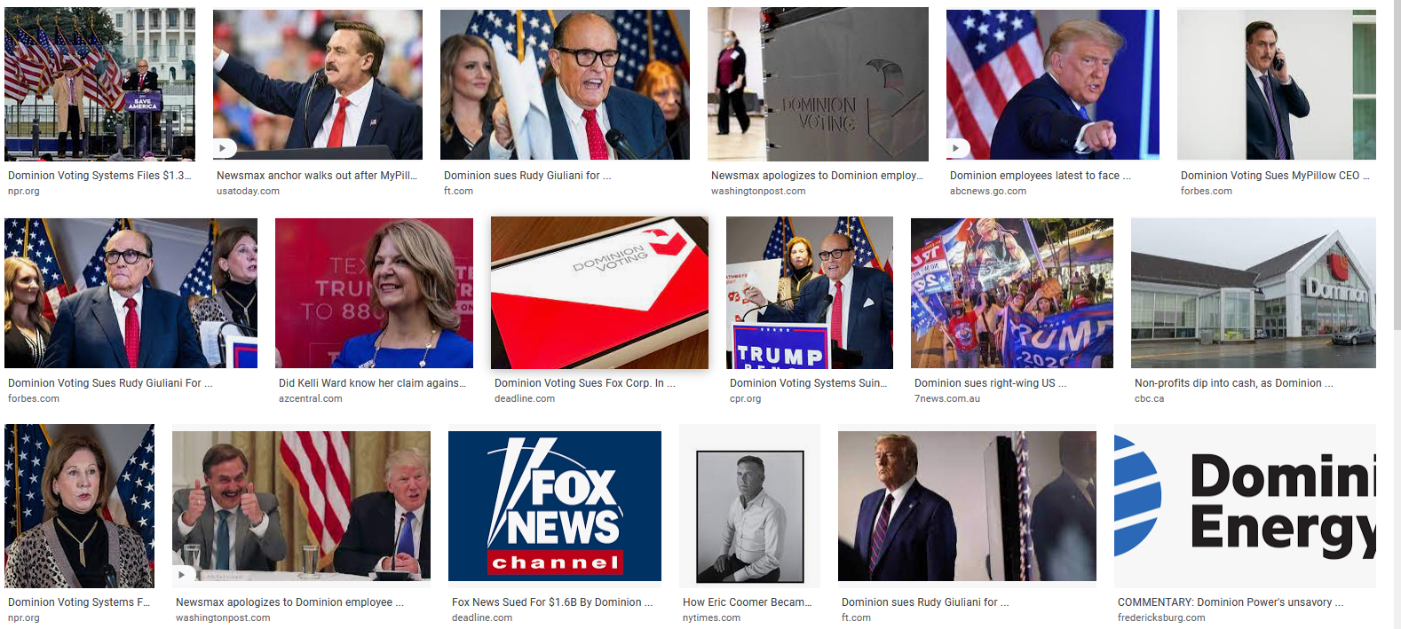
Community
bell hooks: “To build community requires vigilant awareness of the work we must continually do to undermine all the socialization that leads us to behave in ways that perpetuate domination.” (Teaching Community, p. 36)

Slide 7
Markets
Joan Tronto: “The market passes of bootstraps and charity allow self-interested behavior to allocate care responsibilities. They do so, however, only by uneven processes where those with greater resources get more care.
Furthermore, at the end of the day, given the way the market seems timeless, it becomes impossible to think structurally about past injustice in the face of market ideals.
In these ways, the market passes undermine an underlying commitment to freedom, equality, and justice.” (2013, p. 136)

Slide 8
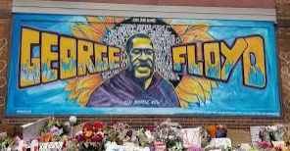
Injustice
Cultural injustice if it involves giving access to those who could not otherwise access the learning experience, while redesigning the learning experience with those minorities in mind, recognizing their culture in it, or going further to address the root causes of cultural misrecognition with re-acculturation.
Political injustice if it goes beyond giving access to those who could not otherwise access the learning experience; it might involve those normally without access in the redesign or overhaul of the learning experience, emphasizing equitable representation and “parity of participation” or it might go further to address root cases of political misrepresentation through re-framing and parity of rights.
OEP address:
Economic injustice if it involves giving access to those who could not otherwise access the learning experience, while leaving the learning experience unchanged – i.e. redistributing who has access, or going further and restructuring to address the root causes of economic maldistribution.
Authors: Maha Bali, Catherine Cronin, Rajiv S. Jhangiani, 2020, Framing Open Educational Practices from a Social Justice Perspective https://jime.open.ac.uk/articles/10.5334/jime.565/

Slide 9
Social Justice
Means “dismantling institutionalised obstacles that prevent some people from participating on a par with others, as full partners in social interaction” (Nancy Fraser 2010: 16).
Fraser, 2005: Social justice as
an outcome where “all the relevant social actors […] participate as peers in social life”
a process in which procedural standards are followed “in fair and open processes of deliberation”
Charitonos, et.al., 2020, https://jime.open.ac.uk/articles/10.5334/jime.563/
Fraser, 2005 https://sicologias.files.wordpress.com/2015/01/13-fraser-n-reframing-justice.pdf
Duque (image) https://www.lmspulse.com/2020/open-education-and-social-justice/

Slide 10
Social Justice Model
https://jime.open.ac.uk/articles/10.5334/jime.584/

Slide 11
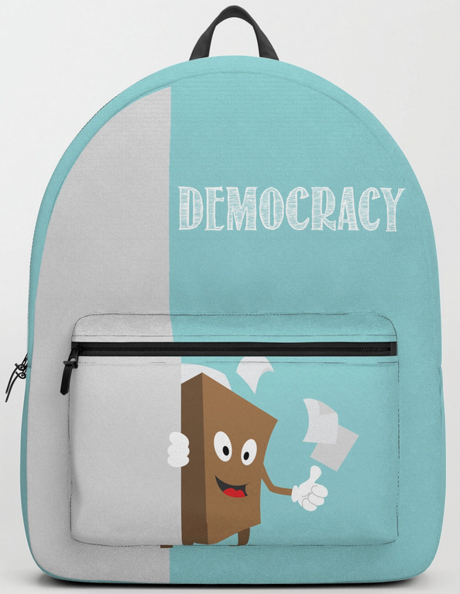
Caring Democracies
Tranto: changes that we have to make to transform into a caring democracy
giving people a voice in the allocation of caring responsibilities
recognize vulnerability, rather than autonomy, as a better way to understand our basic equality.
“Freedom cannot simply mean the ability to choose… accounts of freedom that rest upon the absence of domination are preferable to those that do not.”
adding a fifth phase to caring… “caring with.”
Joan Tronto, 2013 Caring Democracies, https://we.riseup.net/assets/448799/Joan+C.+Tronto+Caring+Democracy+Markets%2C+Equality%2C+and+Justice+%282013%2C+NYU+Press%29.pdf
http://www.wpsanet.org/papers/docs/Tronto%20WPSA%20paper%202013.pdf

