Slide 1
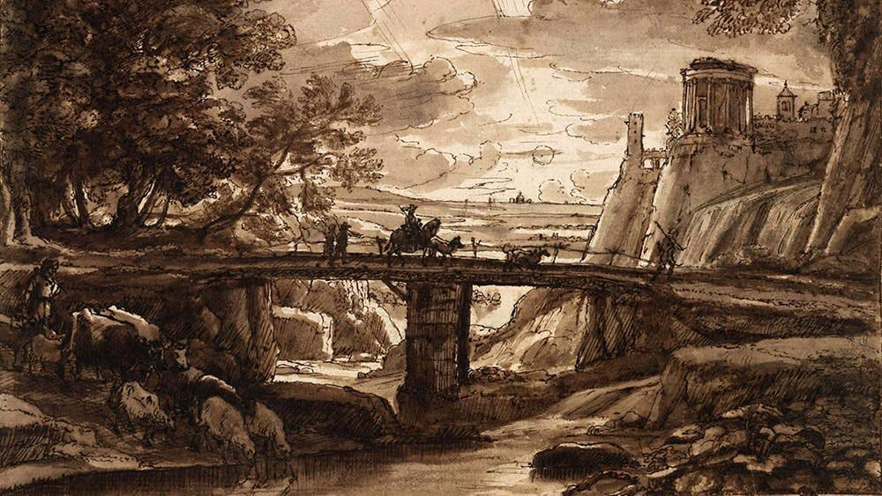
Objections to Care Theory
Stephen Downes
November 29, 2021

Slide 2
Objections to Care Theory
Drawn from wider literature and especially the Internet Encyclopedia of Philosophy (IEP)
Positions the ethics as a traditional philosophical theory that demands argumentation and defense
Title image: https://cravepainting.com/blog/landscape-drawing-exercises

Slide 3
Women’s Nature
Care “linked to ‘woman’s nature’ in a way that calls upon and reinforces gender-based stereotypes”
It may still be “epistemically, ethically, and politically imprudent to associate women with the value of care” (Tong and Williams 2018).
https://press.rebus.community/intro-to-phil-ethics/
Image: https://www.google.com/search?q=women%27s+nature

Slide 4
Employment Obligations
The employee (e.g. a flight attendant) must force their own feelings into the background
This risks blurring the distinction between “real” and “inauthentic” feelings (Sandra Lee Bartky, 1990)
https://archive.org/details/femininitydomina00bart
https://www.tiktok.com/@amandamoseguera

Slide 5
Care Ethics as Slave Morality
Care ethics is a kind of slave morality valorizing the oppression of women (Puka, 1990; Card, 1990; Davion, 1993)
Nietzsche: “oppressed peoples tend to develop moral theories that reaffirm subservient traits as virtues.”
https://www.iep.utm.edu/care-eth/
https://www.betterhelp.com/advice/morality/what-is-slave-morality/

Slide 6
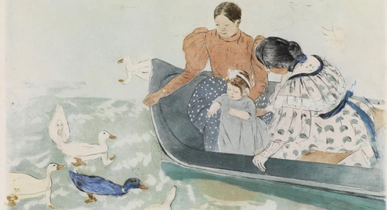
Studies Empirically Flawed
Gilligan has been faulted for basing her conclusions on too narrow a sample, and for drawing from overly homogenous groups
https://www.iep.utm.edu/care-eth/

Slide 7
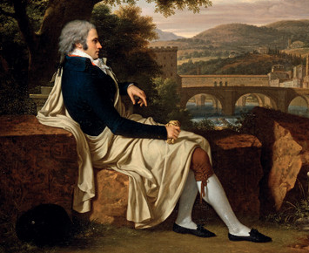
The ‘Not a Theory’ Objection
Some critics object that care ethics is not a highly distinct moral theory (e.g. “Kant’s writings… provide the care ethicists with everything they require” (John Paley, 2002))
Care ethics incorporates liberal concepts such as autonomy, equality, and justice.
https://www.iep.utm.edu/care-eth/
https://uwethicsofcare.gws.wisc.edu/wp-content/uploads/2020/03/Paley-J.-2002.pdf

Slide 8
Care Ethics as Parochial
“Care ethics obscures larger social dynamics and is overly parochial”
E.g. “Noddings’ original assertion that care givers have primary obligations to proximate others over distant others”
“Critics worry that this stance privileges elite care-givers by excusing them from attending to significant differences in international standards of living and their causes.”
https://www.iep.utm.edu/care-eth/ https://philpapers.org/rec/FRICEA

Slide 9
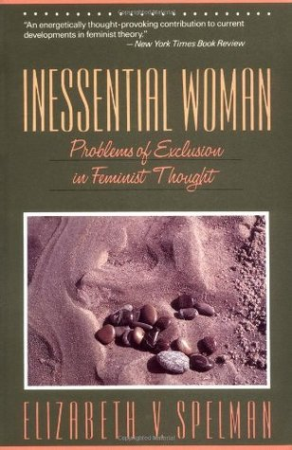
Care Ethics as Essentialist
That is, it appeals to an ‘essential nature’ of women
Hence, e.g. Spelman (1988) Care ethics have been faulted for failing to explore the ways in which women (and others) differ from one another
https://www.iep.utm.edu/care-eth/ https://philpapers.org/rec/SPEIWP

Slide 10
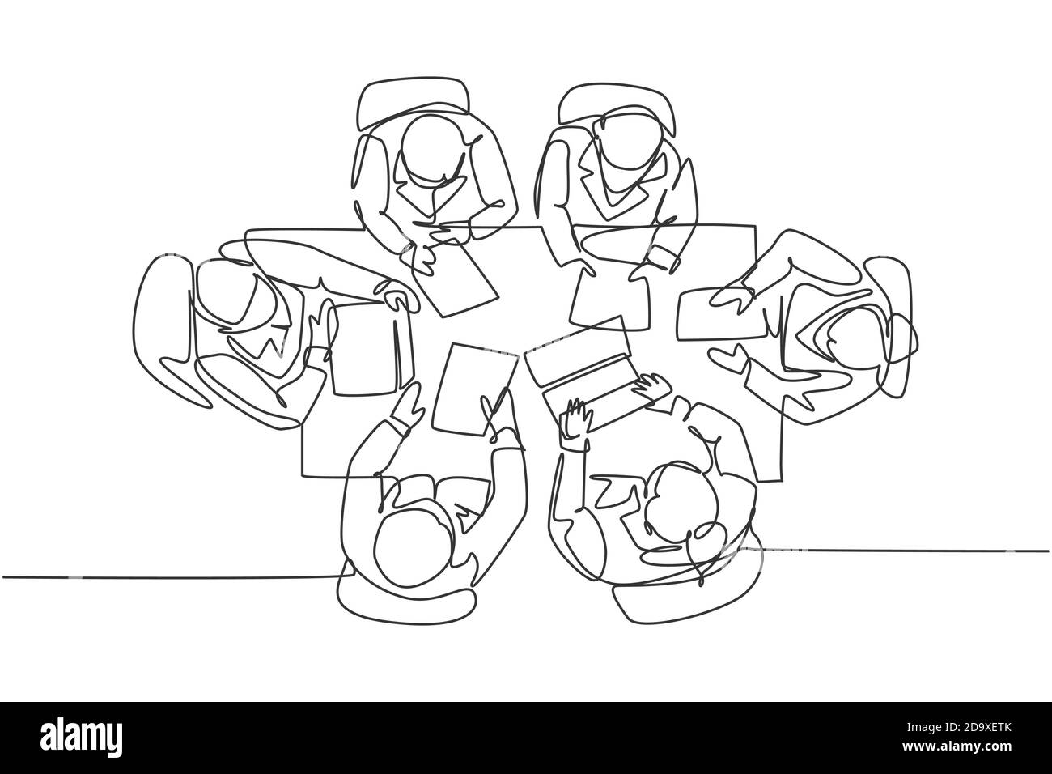
Care Ethics as Ambiguous
“Because it eschews abstract principles and decisional procedures, care ethics is often accused of being unduly ambiguous, and for failing to offer concrete guidance for ethical action”
E.g. Held 1995 “spends several chapters refuting claims that care is anti-universalist and cannot serve as an ethical theory”held on care
https://www.iep.utm.edu/care-eth/
https://www.researchgate.net/publication/231877965_The_Ethics_of_Care_Personal_Political_and_Global
https://ndpr.nd.edu/reviews/the-ethics-of-care-personal-political-global/

Slide 11
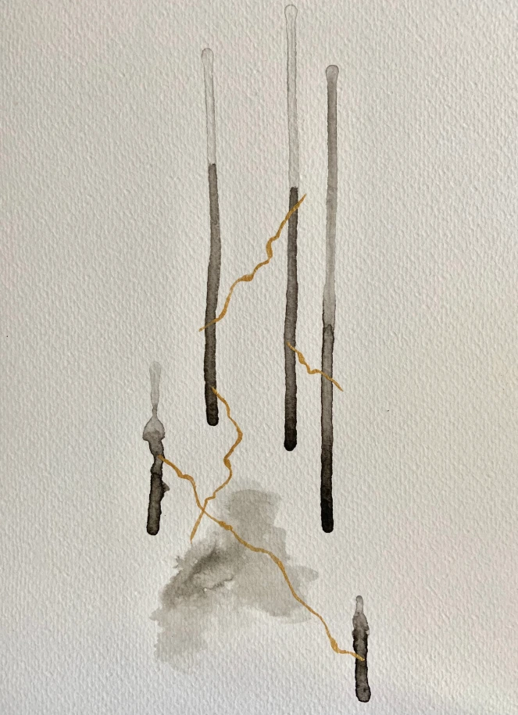
Feelings May Oppress Others
“Feelings, especially feelings that cluster around the concepts of compassion, empathy, and care, can be used as justification for great violence” (Mcgregor , 2020)
https://hookandeye.ca/2020/04/16/guest-post-what-are-we-talking-about-when-we-talk-about-care/

Slide 12
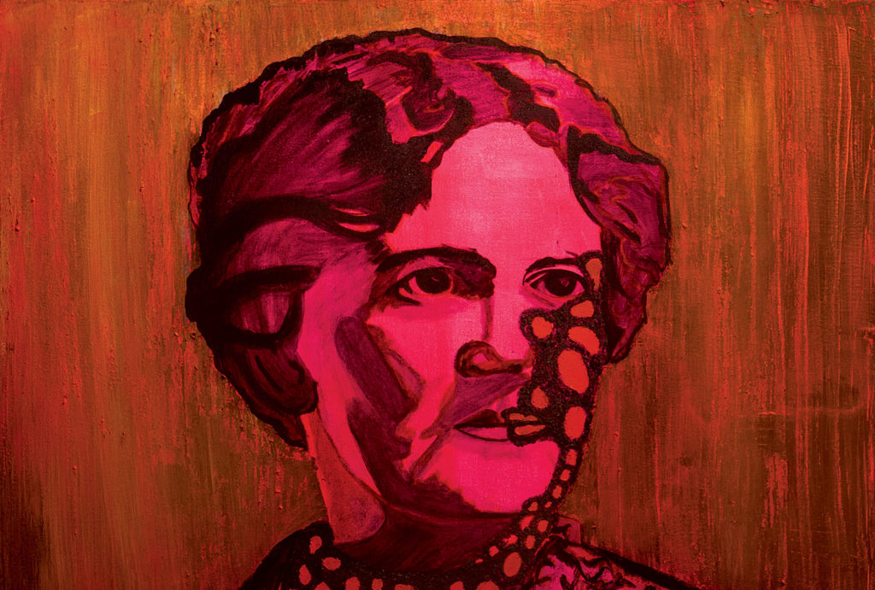
A View From Above
My own view, that the discussion of care ethics is predominately from the position of the care-giver
The needs (expressed or otherwise) of the cared-for may be much more pragmatic
Plus, it doesn’t seem reasonable to place an onus on the cared-for to stimulate urgency or motivation in the care-giver

