Slide 1
Models and Interpretations
Stephen Downes
December 9, 2021

Slide 2
Models and Interpretations
The pebbles are the model
What they stand for is the interpretation
https://puzzleaday.wordpress.com/2019/06/20/removing-pebbles/

Slide 3
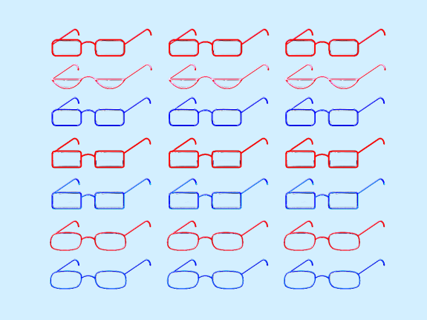
What Does a Poll Mean?
A poll is a collection of preferences for an upcoming election. But how do we know what the results mean?
Consider, e.g., the margin of error. What is that? Can we trust it?
Are polls snapshots how how people think or predictions of upcoming results?
https://fivethirtyeight.com/features/how-to-read-2020-polls-like-a-pro/

Slide 4
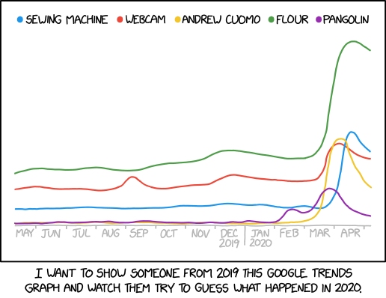
Modeling Can Be Tricky
“Today's xkcd illustrates why topic modeling can be tricky, for people as well as for machines: It's one thing to detect a new cluster of words and phrases, and something else to assign an interpretation.”
https://languagelog.ldc.upenn.edu/nll/?p=46996
https://www.explainxkcd.com/wiki/index.php/2302:_2020_Google_Trends

Slide 5
The Wrong Model
What happens when we choose the wrong model?
“My example may seem silly. So what if I chose the wrong algorithm to predict which instructors teach programming? But what if I had instead been creating a model to predict which patients should receive extra care? Then using the wrong algorithm could be a significant problem.”
By Nicholas T. Young. (2020). I Know Some Algorithms Are Biased—because I Created One. Scientific American. January 31, 2020. https://blogs.scientificamerican.com/voices/i-know-some-algorithms-are-biased-because-i-created-one/

Slide 6
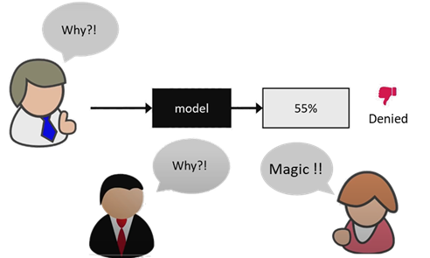
Models in AI and Analytics
“AI raises new questions: For example, the use of black-box models makes it difficult for us to determine why decisions are being made. Paradoxically, traditional limitations on accessing data on protected groups can hinder the ability to assess models properly.”
What do we even mean by ‘black box model’?
https://mailchi.mp/protocol/protocol-braintrust-the-unintended-consequences-of-unethical-ai?e=ebba0444a7
https://medium.com/swlh/explainable-ai-making-sense-of-the-black-box-32ebf2d16c61
https://en.wikipedia.org/wiki/Black_box

Slide 7
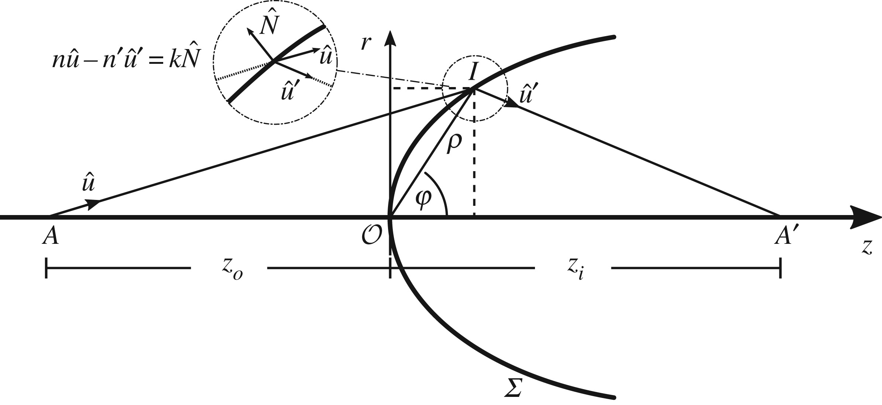
The Cartesian Revolution
Quaecumque ab Aristotele dicta essent, commentitia esse *
Nicolaus Copernicus 1473 – 1543
Gerolamo Cardano 1501 – 1576
Petrus Ramus 1515 –1572
François Viète 1540 – 1603
Tycho Brahe 1546 – 1601
Pierre de Fermat 1607 – 1665
Giordano Bruno 1548 – 1600
Galileo Galilei 1564 – 1642
Johannes Kepler 1571 – 1630
René Descartes 1596 – 1650
Blaise Pascal 1623 – 1662
Gottfried Wilhelm Leibniz 1646 – 1716
Isaac Newton 1642 – 1726
* All the things that Aristotle has said are inconsistent because they are poorly systematized and can be called to mind only by the use of arbitrary mnemonic devices. - Ramus
The Rise and Fall of Wired - https://www.downes.ca/wired/conclusion.htm

Slide 8
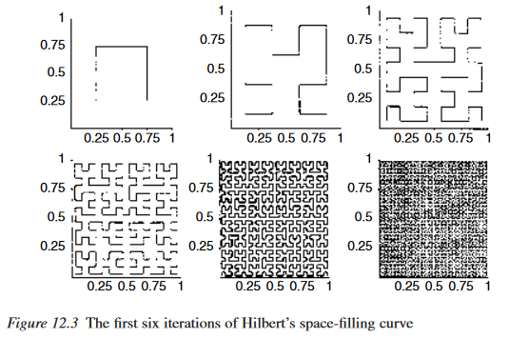
Mathematics
Idealism (Plato)
Formalism (Hilbert, Gödel)
Intuitionism (Brouwer)
Anti-Realism (Dummett)
Operationalism (Mill, Kitcher)
Conventionalism (Wittgenstein)
Computation (Turing)
http://homes.chass.utoronto.ca/~jrbrown/Brown_Philosophy_of_Mathematics.pdf

Slide 9
How We Prove Things
Proofs e.g. symbolic derivations
Intuition e.g. 2 + 2 = 4
Induction e.g. counting crows
H-D e.g. predictions / consequences
Pictures e.g. gometry
Diagonalization e.g. Gödel’s proof
Thought Experiments e.g. Einstein
James Robert brown http://homes.chass.utoronto.ca/~jrbrown/Brown_Philosophy_of_Mathematics.pdf p. 206
Image: https://www.soiladvocates.ca/why-do-we-need-to-prove-things-in-our-society/

Slide 10
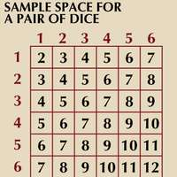
State Space and Probability
A state space is a description of all possible states of affairs in a given world.
“In his first great work, Der logische Aufbau der Welt (1928; The Logical Structure of the World), Carnap developed, with unprecedented rigour, a version of the empiricist reducibility thesis according to which all terms suited to describe actual or possible empirical facts are fully definable by terms referring exclusively to aspects of immediate experience.”
So of course we would measure the probability of dice using the state space, right? Unless perhaps the dice were rigged…
https://www.britannica.com/biography/Rudolf-Carnap

Slide 11
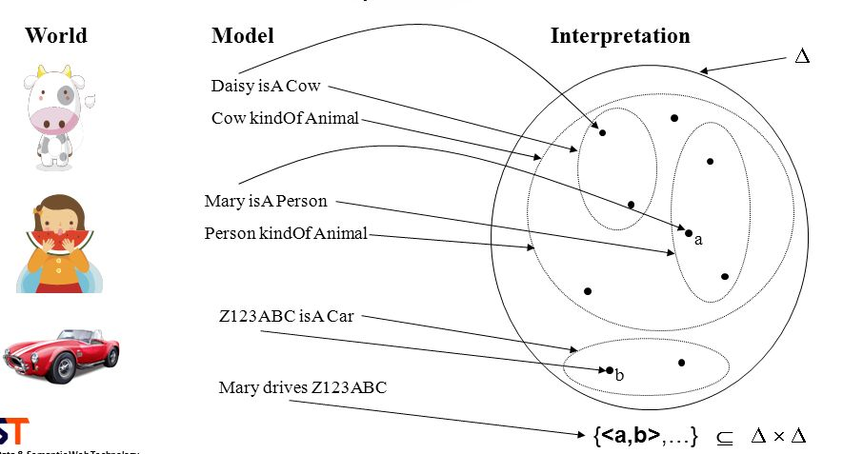
Formal Semantics
e
McKinney https://slideplayer.com/slide/10741885/

Slide 12
Representations
Neural Representations Across Species https://www.science.org/doi/10.1126/science.aaw8829
The Representative Student - https://www.downes.ca/presentation/257

Slide 13
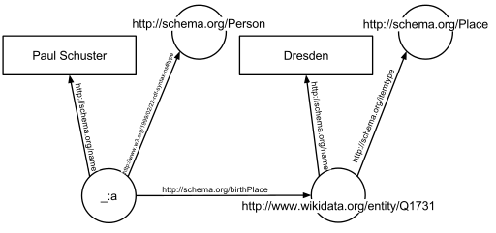
The Semantic Web
https://www-sop.inria.fr/acacia/cours/essi2006/Scientific%20American_%20Feature%20Article_%20The%20Semantic%20Web_%20May%202001.pdf
https://en.wikipedia.org/wiki/Semantic_Web
https://www.w3.org/standards/semanticweb/
https://www.youtube.com/watch?v=V6BR9DrmUQA

Slide 14
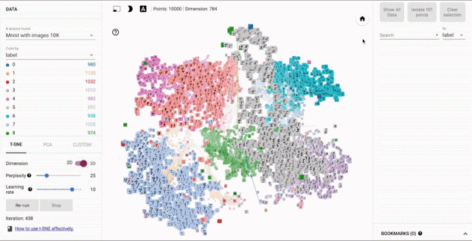
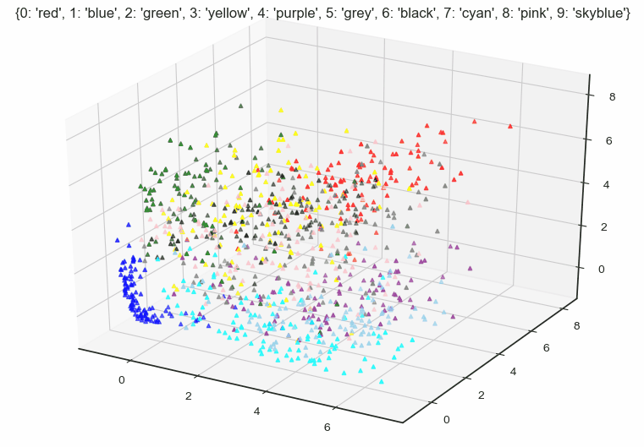
Models in AI
“An AI (artificial intelligence) model is a program that has been trained on a set of data (called the training set) to recognize certain types of patterns.”
In a neural networks specifically) we can say that the model is the set of connection weights in a trained network
https://chooch.ai/computer-vision/what-is-an-ai-model/
https://resource.revealdata.com/en/blog/what-is-an-ai-model
https://buddhirajsahu.medium.com/ai-what-is-since-when-79a25bb7b6f4

Slide 15
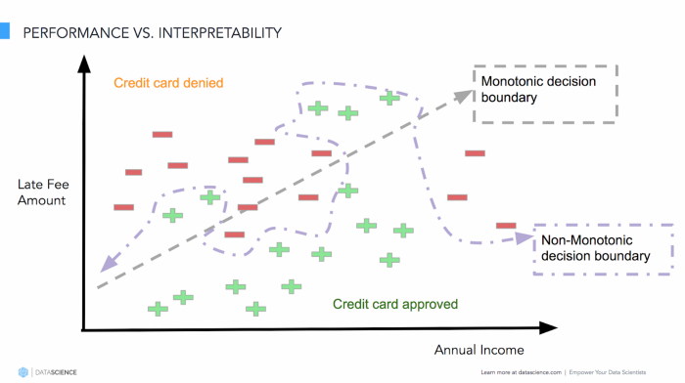
Interpretation in AI Models
Anderson: “This is a world where massive amounts of data and applied mathematics replace every other tool that might be brought to bear.”
Boyd & Crawford: “Do numbers speak for themselves? We believe the answer is ‘no’.
Significantly, Anderson’s sweeping dismissal of all other theories and disciplines is a tell: it reveals an arrogant undercurrent in many Big Data debates where other forms of analysis are too easily sidelined.”
danah boyd & Kate Crawford - Critical Questions for Big Data
https://www.dhi.ac.uk/san/waysofbeing/data/communication-zangana-boyd-2012.pdf
https://towardsdatascience.com/explainable-artificial-intelligence-part-2-model-interpretation-strategies-75d4afa6b739

Slide 16
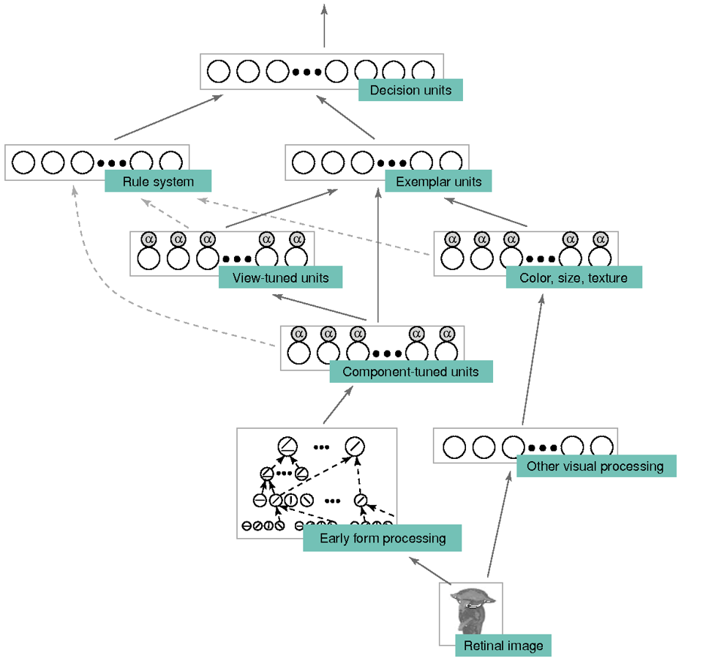
Model as Perceptual Expertise
Jonna Vance: perceptual expertise as "an enhanced capacity for perceptual recognition or discrimination with respect to some feature or category." For example, "one can be a perceptually expert recognizer or discriminator of bird species, cars, or tumors depicted in X-rays."
https://philosophyofbrains.com/2021/09/29/jonna-vance-vicious-perceptual-expertise.aspx
https://www.semanticscholar.org/paper/Computational-approaches-to-the-development-of-Palmeri-Wong/69321f0f2ec191da26b53396b539ffb66b6c2ca0 https://www.downes.ca/post/72827

Slide 17
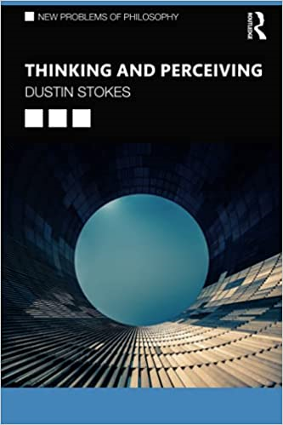
Models and Ethics
Is perceptual expertise always virtuous?
Daniel Burnston: "there is no guarantee that perceptual expertise will have a net positive contribution to the proportion of true beliefs or knowledge."
So, "are privileged epistemic agents subject to different epistemic obligations than marginalized or oppressed epistemic agents are?"
https://philosophyofbrains.com/2021/09/29/jonna-vance-vicious-perceptual-expertise.aspx
https://www.downes.ca/post/72827

Slide 18
Making Models
Defining a model inherently means asking a question, and the choice of question is critical (Seufert, et.al., 2019):
What problems are high priorities?
How will the outcome be used?
How will we respond to adverse outcomes (esp. in statistical cases)
How will the outcomes be measured?
Models are ‘trained’, yes, but the training is the result of extensive programming:
Are rigorous programming standards used
Is the program open source
http://web.eecs.utk.edu/~azh/pubs/Chattopadhyay2020CHI_NotebookPainpoints.pdf

Slide 19
Choices, Choices
Assumption | Question
Ontological choice | What ontological perspective do we choose to adopt, and why?
Ontological knowledge | How do we know about the social categories?
Semantic choice | Close-enough-possible-worlds or causal modeling? What is the justification?
Evaluation reliability | What happens to the truth value of the counterfactuals of interest
Similarity choice | How do we choose what similarity means in this context?
Comparison criteria | What are our chosen criteria for comparing the similar worlds of interests to the actual world?
Idealization | What do we miss by translating social categories into random variables?
Context | How do these categories operate in the world?
Ethical and social harm | Does our ontological preference generate harms in relation to social justice
From: http://philsci-archive.pitt.edu/19538/1/3442188.3445886.pdf

Slide 20
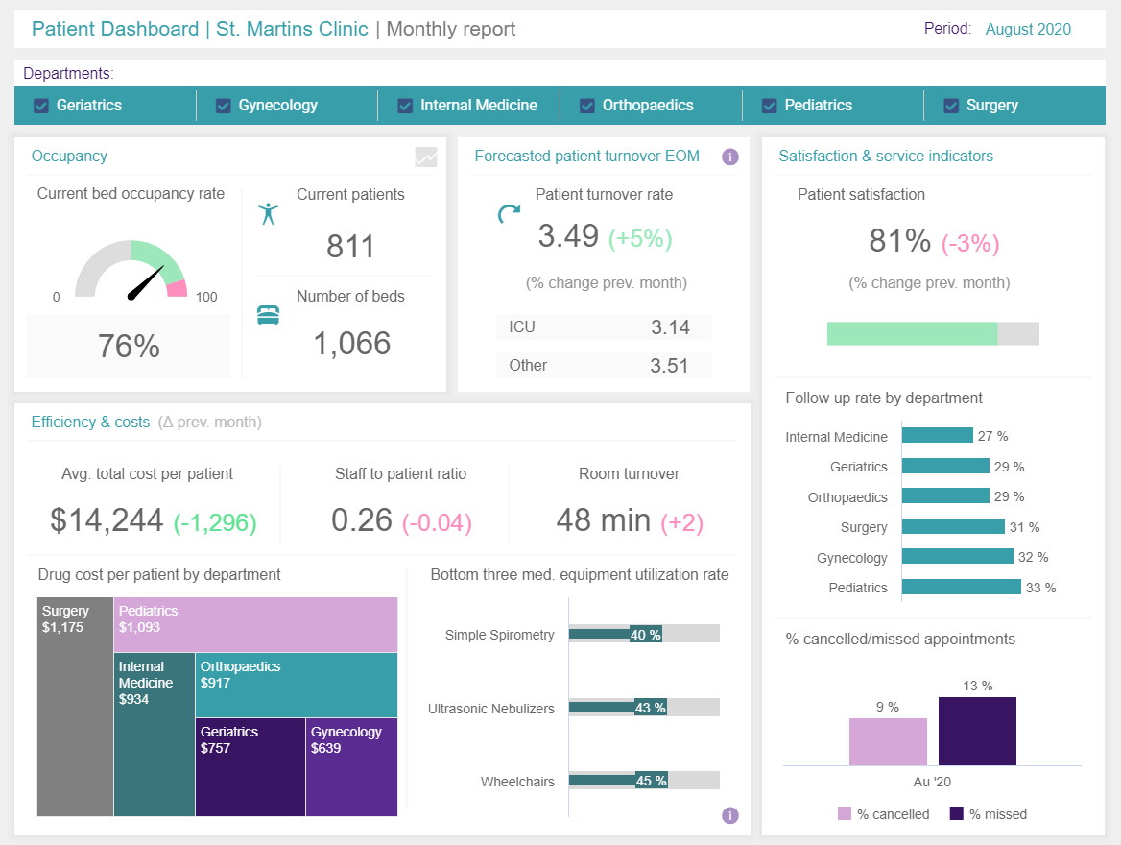
Validating Models
What choices do we make?
which problems to make high priorities
how the model will be used
what… interventions will be provided?
Standards for validation
Standards for transparency
What are the “key independent variables”?
Outcomes assessment
https://www.healthaffairs.org/doi/10.1377/hlthaff.2014.0048
Image: https://www.datapine.com/blog/big-data-examples-in-healthcare/

Slide 21
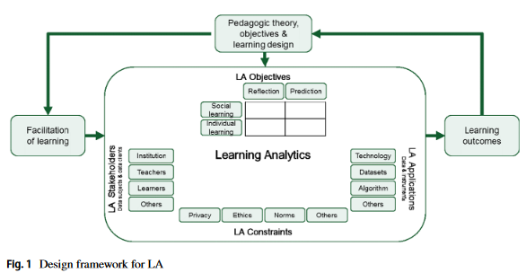
Learning Analytics Models
Dimensions
Pedagogic theory and learning design
Objective
Stakeholders
LA model
LA application: data
LA application: instruments
Competences required
Constraints
Seufert, et.al., 2019, Pedagogical Perspective on Big Data and Learning Analytics https://ibb.unisg.ch/-/media/images-2000x1125/instituteundcenter/ibb/forschung/learning-analytics.pdf?la=de&hash=EDA4D55AA5BADE6627081BFBED5B19880879A025

Slide 22
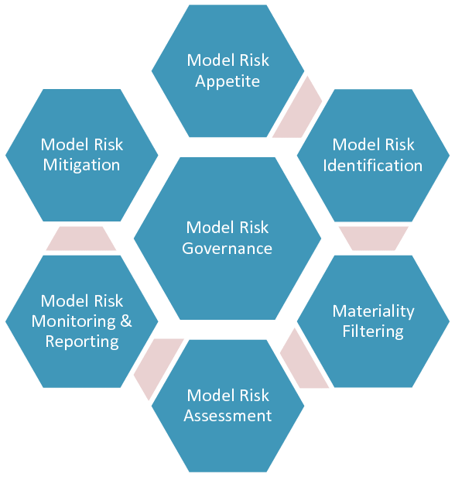
Model Risk Management
Model risks occur because:
The model may have fundamental errors
The model may be used incorrectly or inappropriately
Model risk management combines:
Model development and implementation processes
Model validation processes
Model governance process (roles, responsibilities)
Board of Governors of the Federal Reserve System https://www.federalreserve.gov/supervisionreg/srletters/sr1107a1.pdf
Image: https://www.researchgate.net/figure/The-Model-Risk-Management-Framework_fig4_277138848

Slide 23
Practices
Practice | Description
Stay in the operational field | Models can never simulate all the behavior/reactions of a system: they operate only in one limited field with a restricted number of variables. When a model is used, it is always necessary to make sure that the parameters and data inputs are part of the operation field. If not, there is a high risk of irregular outputs.
Evolve models | Models shall evolve during the project: by modification of parameter settings, by entering new data when modified (modification of assessment criteria, functions to perform, requirements, etc.), by the use of new tools when those used reach their limits.
Use several types of models | It is recommended to concurrently use several types of models in order to compare the results and/or to take into account another aspect of the system.
Keep context elements consistent | Results of a simulation shall always be given in their modeling context: tool used, selected assumptions, parameters and data introduced, and variance of the outputs.
https://www.sebokwiki.org/wiki/System_Analysis

