Slide 1
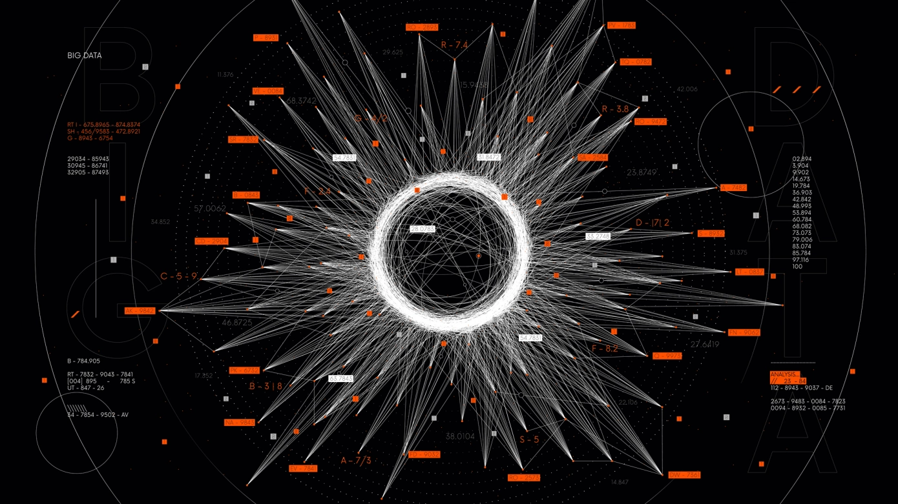
Evaluation and Impact
Stephen Downes
December 14, 2021

Slide 2
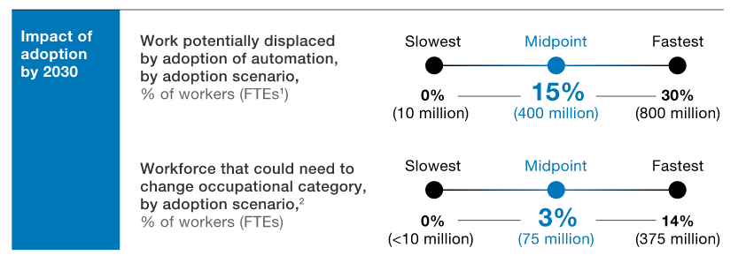
Evaluation
By evaluation here we don’t mean testing to determine whether the AI or analytics application works
Rather, we want to establish whether the use of AI in the field produced satisfactory results
https://www.mckinsey.com/featured-insights/artificial-intelligence/the-promise-and-challenge-of-the-age-of-artificial-intelligence

Slide 3
A Wider Context
Evaluation in this sense takes into account a much wider context
Factors that have nothing to do with the design and development of AI come into play
For example, “the European Union’s executive proposed legislation aimed at encouraging widespread sharing and reuse of industrial data and protected public sector data-sets — such as health data, environment, energy, agriculture, mobility, finance, manufacturing, public administration and skills.”
https://techcrunch.com/2021/12/01/data-governance-act-provisional-agreement/

Slide 4
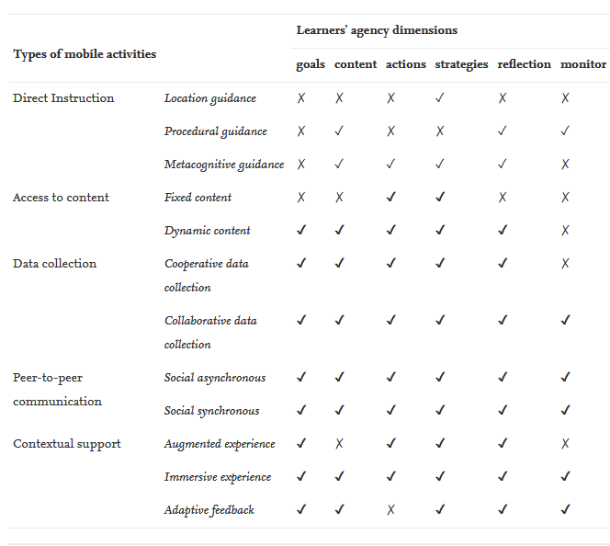
Analyzing Activities
For example: analytical framework for student activities
Goals: can learners set their own learning goals?
Action: does the learner design their own activities?
Strategy: can the learner set learning strategies?
Reflection: what are the mechanisms for reflection?
Content: do learners select their own content?
Monitoring: can learners monitor their progress?
ÁngelSuárez;Marcus Specht;Fleur Prinsen;Marco Kalza;Stefaan Terniera, 2018, A review of the types of mobile activities in mobile inquiry-based learning, Computers & Education, volume 118, March 2018 pp. 38-55
https://www.sciencedirect.com/science/article/pii/S0360131517302397

Slide 5
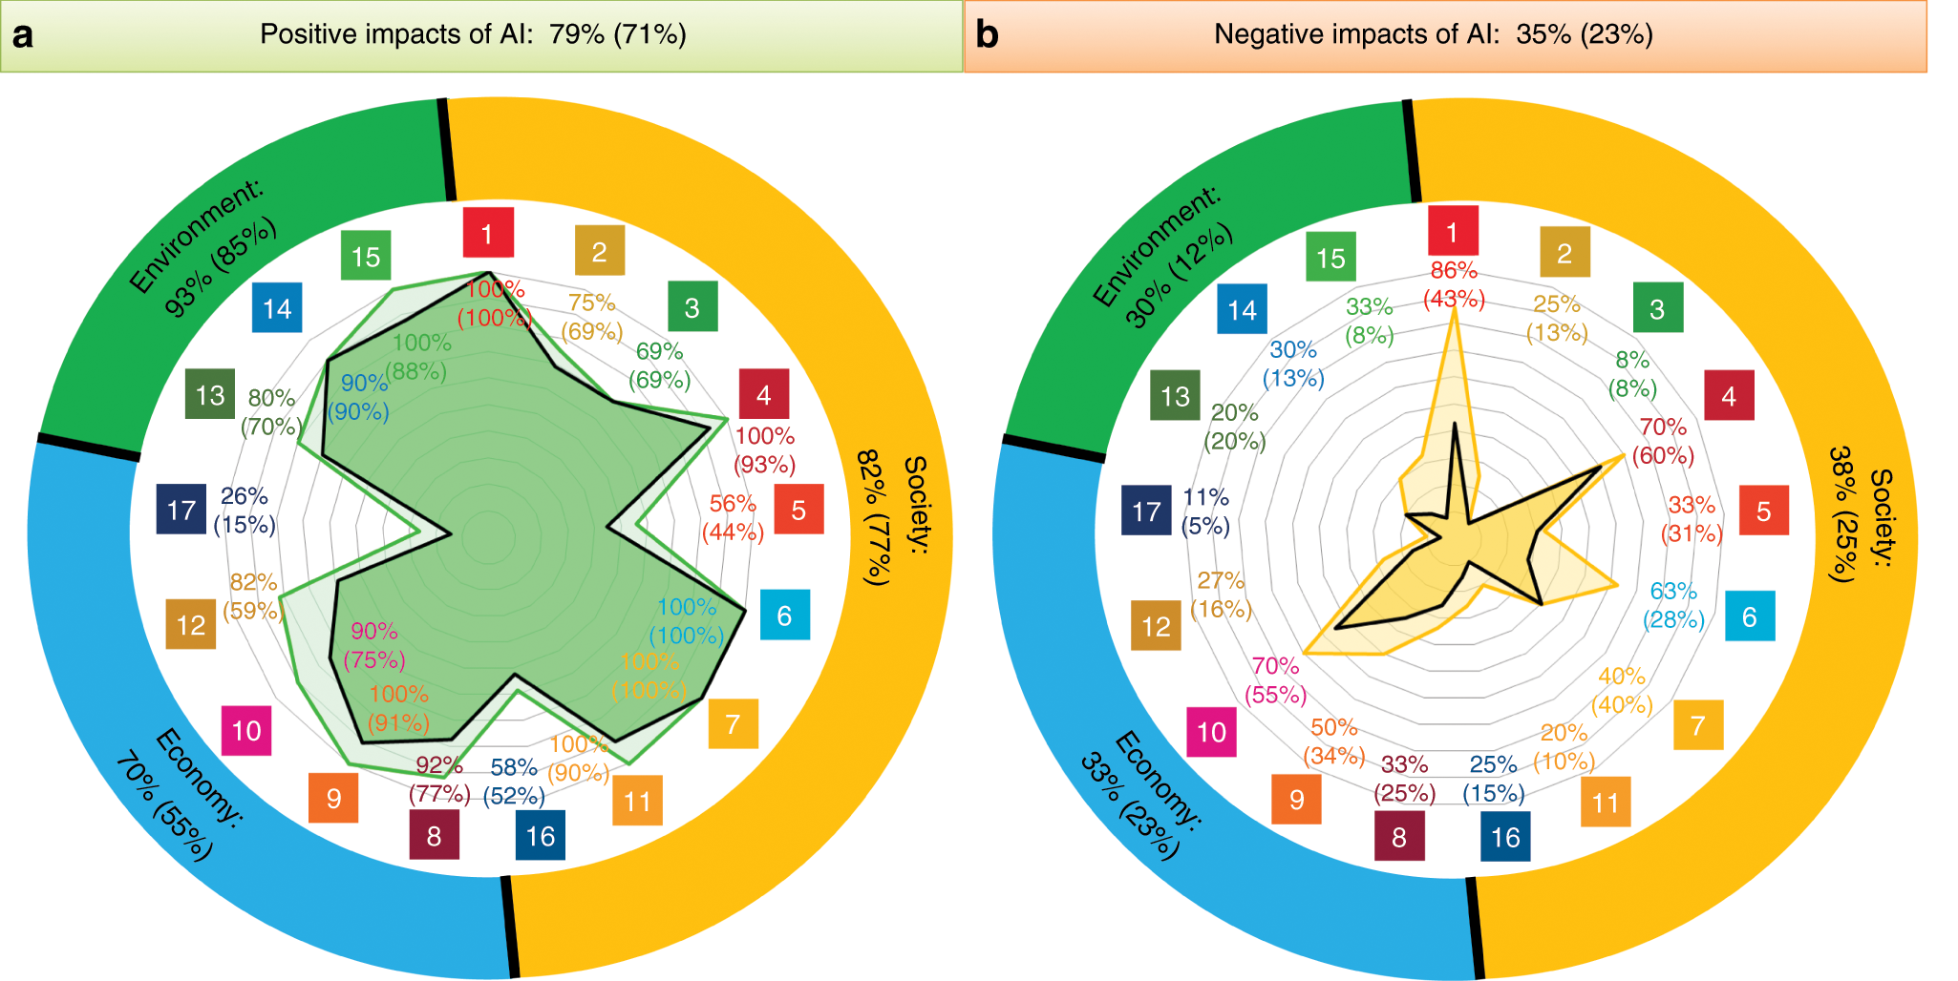
Wider Frameworks
For example, are AI and learning analytics supporting the U.N. Sustainable Development Goals?
https://www.nature.com/articles/s41467-019-14108-y

Slide 6
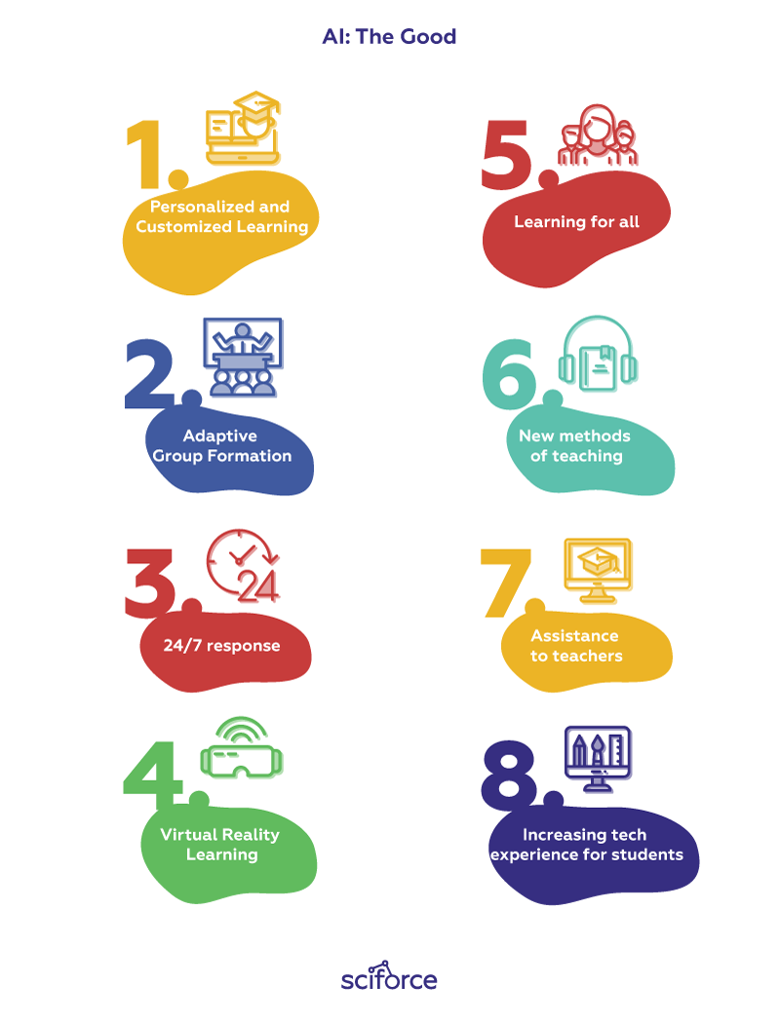
Impact
What is the ‘good’ of an analytics engine?
We might say it’s better grades or improved competencies, or even greater quality of life for students.
Perhaps it’s organizational efficiency on the part of the university. Or perhaps it’s just profit.
As danah boyd says, “How does a company have values beyond profit for shareholders?” (quoted from Kinstler, 2020).
https://medium.com/sciforce/ai-at-the-classroom-the-good-the-bad-and-the-ugly-8dd7a1b4085c

Slide 7
Undesired Impact
Awful AI Wiki - https://github.com/daviddao/awful-ai https://www.faception.com/

Slide 8
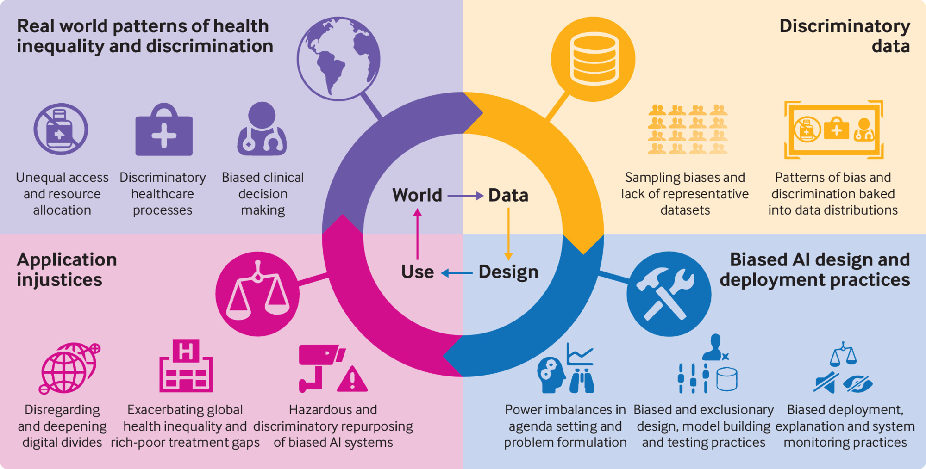
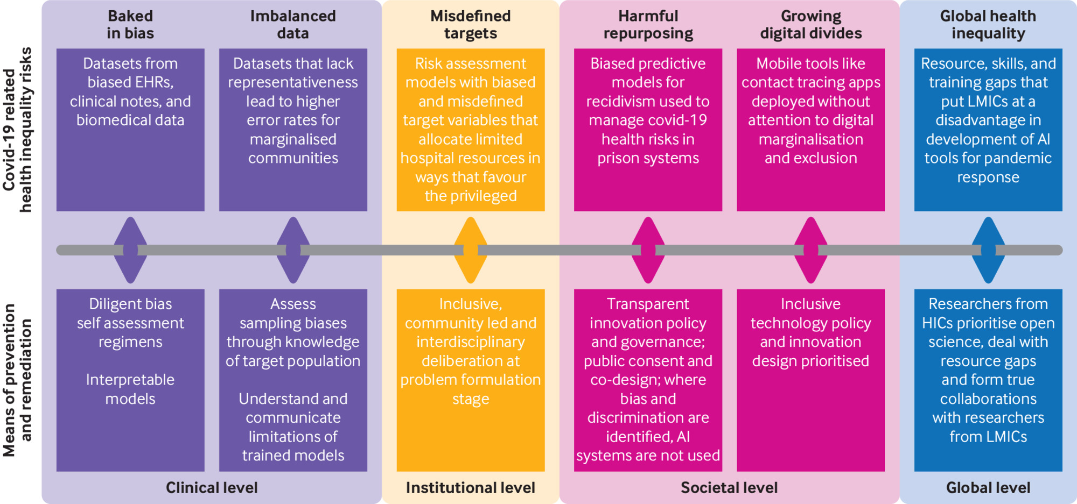
Assessing Impact as Risk
“Some documents use the terminology of potential harm and others call for the identification of risks. The emphasis, particularly among the latter category of documents, is on prevention, and impact assessments are an accountability mechanism because a sufficiently dire assessment (where risks are ‘too high or impossible to mitigate’ 79) should prevent an AI technology from being deployed or even developed.” (Fjeld, et.al., 2020:30)
https://www.bmj.com/content/372/bmj.n304

Slide 9
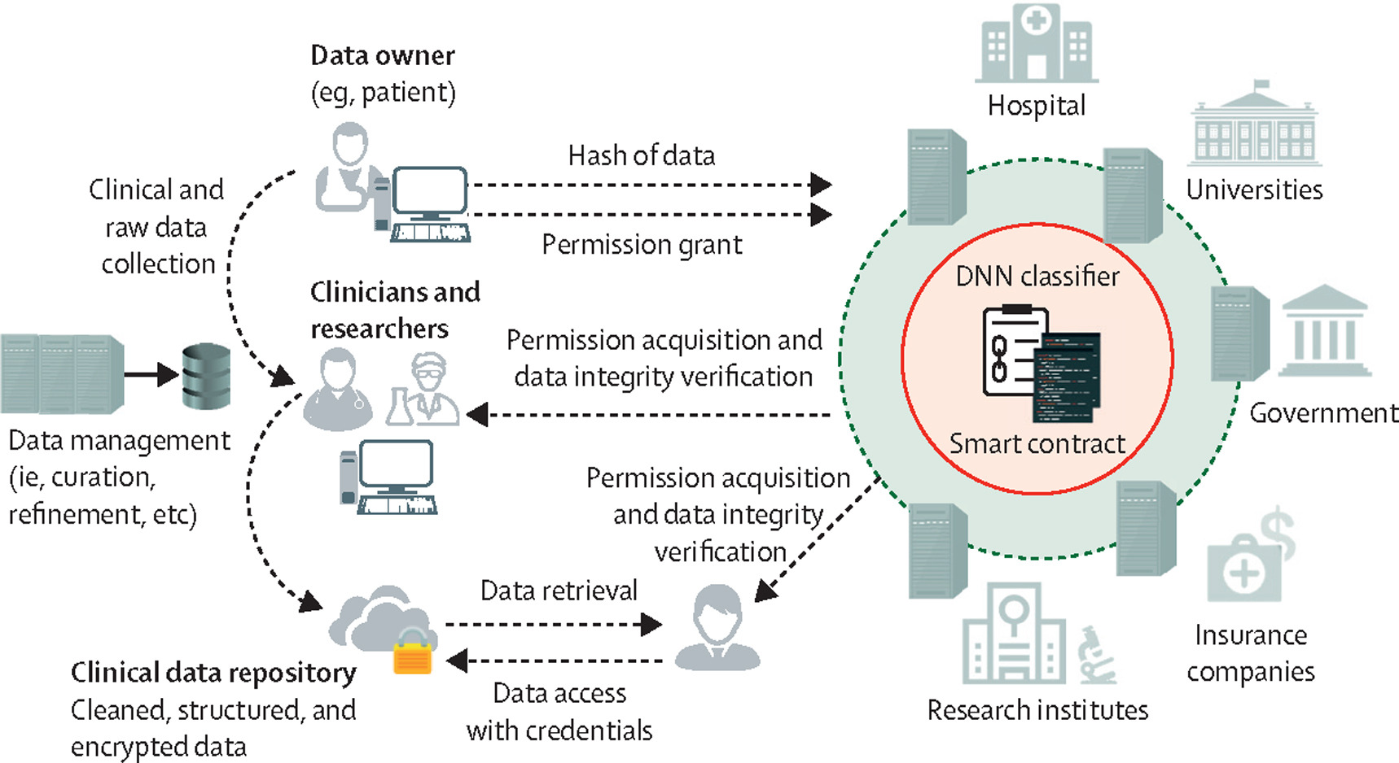
What Is The Data Trail?
“Effective learning analytics MUST lead to responsible assessment and effective use of the data trail. What do we do with the data.”
For example, absence. “Absence is a vague and undefined term in online courses. Absence in the online course does not necessarily equate to inactivity, non-performance or no progress by the student. In the online discussion forum, for example, an online learner is a reader as well as a contributor. Lurking or reading behavior is probably one of the most prominent activities in the discussion board, yet there is no reliable way to measure it meaningfully.” (Dringus, 2012)
https://www.thelancet.com/journals/landig/article/PIIS2589-7500(21)00210-7/fulltext

Slide 10
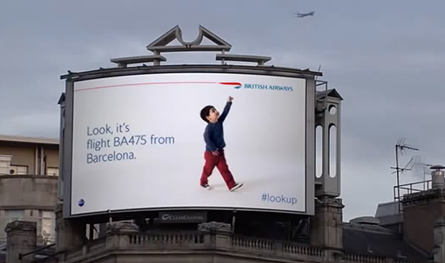
Use
Example: What makes the surveillance culture ethically questionable is the use to which surveillance is put.
“The point is that it doesn’t matter which technology is used to identify people… The whole purpose of this process is for companies — and governments — to treat individuals differently. We are shown different ads on the internet and receive different offers for credit cards. Smart billboards display different advertisements based on who we are. In the future, we might be treated differently when we walk into a store, just as we currently are when we visit websites.” (Schneier, 2020)
https://digitaldm.com/digital-home-reinventing-signs-billboards-jukeboxes/

Slide 11
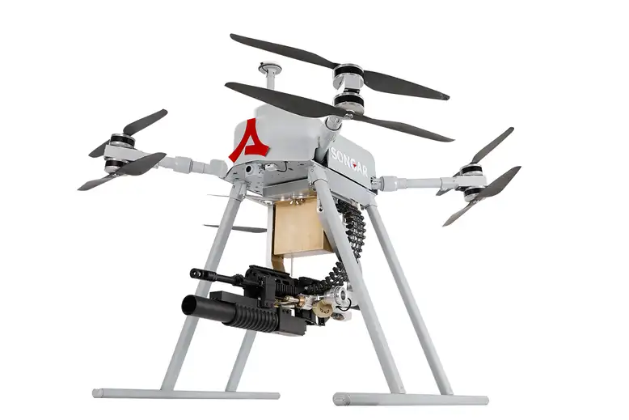
Ethical Decisions Actually Made
Evaluation considers the decisions actually made in the field:
Drones with machine guns
Cars that protect occupants first
Subsequent analysis projects what the ethics actually are in the environment
https://www.newscientist.com/article/2227168-turkey-is-getting-military-drones-armed-with-machine-guns/
Charlie Sorrel. (2016). Self-Driving Mercedes Will Be Programmed To Sacrifice Pedestrians To Save The Driver. Fast Company, October 13, 2016. https://www.fastcompany.com/3064539/self-driving-mercedes-will-be-programmed-to-sacrifice-pedestrians-to-save-the-driver

Slide 12
Impacts and Narratives
What is the impact of media manipulation and fake news? David Karpf contrasts two narratives:
on the one hand, " a story of digital wizards... capable of producing near-omniscient insights into public behavior,"
and on the other hand, a "more mundane" but more accurate story of "messy workflows, incomplete datasets, and endless trial and error."
"If the public is so easily duped, then our political elites need not be concerned with satisfying their public obligations. If real power lies with the propagandists, then the traditional institutional checks on corruption can be ignored without consequence."
https://mediawell.ssrc.org/expert-reflections/on-digital-disinformation-and-democratic-myths/

Slide 13
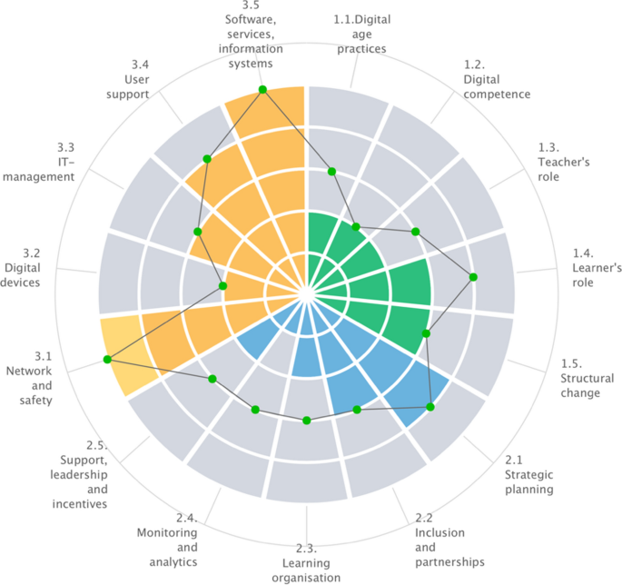
Impacts and Incentives
Reasons learning analytics are becoming more widespread Simon (2017):
Tools create less dependence on LMS analytics (Slade &Prinsloo, 2013)
Economic pressure to automate education (Taylor, 2001)
Emphasis on developing students’ 21stcentury skills (Dede, 2010)
A strong political interest in relation to how ‘data’ can inform and improve learning
Kilińskaand Thomas Ryberg, 2019 https://journals.aau.dk/index.php/pbl/article/view/2545/2970
See also: Taylor, J. C. (2001). Automating e-Learning: The Higher Education Revolution
Image: https://link.springer.com/article/10.1007/s10758-021-09514-5

Slide 14
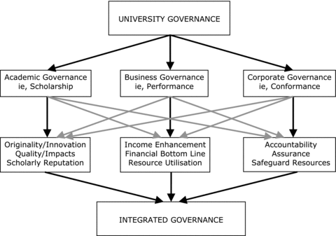
Impact and Governance
“digital policy instruments… enabling techniques of governing education to be operationalized in new ways”
Williamson, B. (2016). Digital education governance: data visualization, predictive analytics, and ‘real-time’ policy instruments. Journal of Education Policy, 31 (2), 123–141. https://doi.org/10.1080/02680939.2015.1035758
Williamson, B. (2017). Big data in education: the digital future of learning, policy and practice (1st ed.). Thousand Oaks, CA: SAGE Publications.
Image: https://onlinelibrary.wiley.com/doi/abs/10.1111/j.1467-8500.2010.00699.x

Slide 15
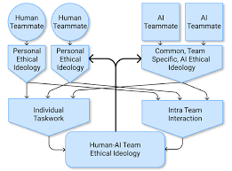
Impact and Ideology
Starting from the perspective that "implicit ideology is an unavoidable feature of pedagogy" we can "sensitise and empower lecturer and learner alike to use the tools of discourse analysis to evaluate the possible ideological content of online courses."
https://www.aies-conference.com/2021/wp-content/posters/83_%20Modeling%20and%20Guiding%20the%20Creation%20of%20Ethical%20Human-AI%20Teams.pdf
Iuliia Platonova, Ignatius G.P. Gous , 2019, The online educated or online indoctrinated human? Discourse analysis as a method to study ideologies disseminated by online courses, HTS Theological Studies, 2019/12/27 https://hts.org.za/index.php/hts/article/view/5342/13193

Slide 16
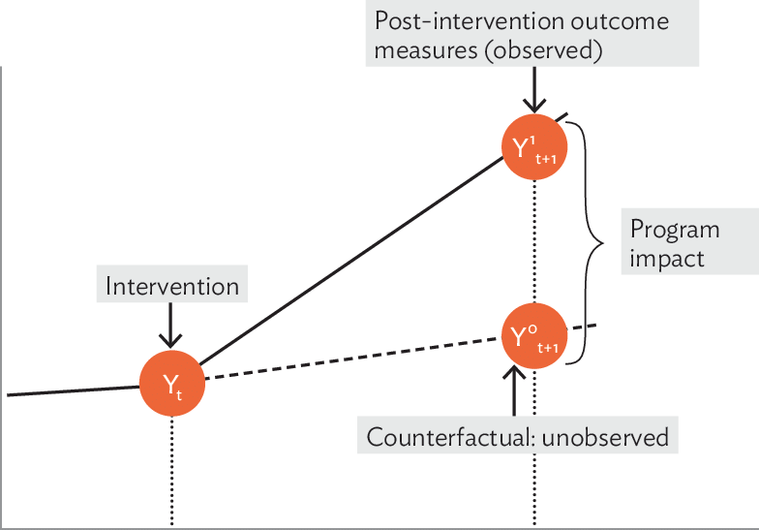
How to Evaluate Impact
“Evaluation can be ineffective and even harmful if naively done ‘by rule’ rather than ‘by thought’”. Discussion Points — Learning Analytics by thought:
Could support creative ways to reflect on the dynamics of the online experience.
Could lead to definable codes and specific descriptions from indicators
Could provide a meaningful wellness index (i.e., the general “health” of the forum).
Could lead to good self-reflection
Could lead to traceable Communities of Practice
(Dringus, 2012)
https://www.researchgate.net/publication/322694783_Impact_Evaluation_of_Development_Interventions_A_Practical_Guide

Slide 17
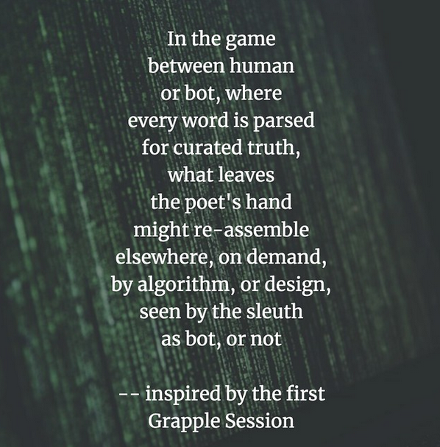
Preparing for the Impact
“How do we teach students about the impact of Artificial Intelligence on our lives with the urgency of NOW, the present, as opposed to some futuristic notion of the Rise of Machines of science fiction?”
Grapple Session: An Inquiry into AI and Ethics by Kevin's Meandering Mind | Author | dogtrax https://dogtrax.edublogs.org/2020/01/24/grapple-session-an-inquiry-into-ai-and-ethics/

