Slide 1
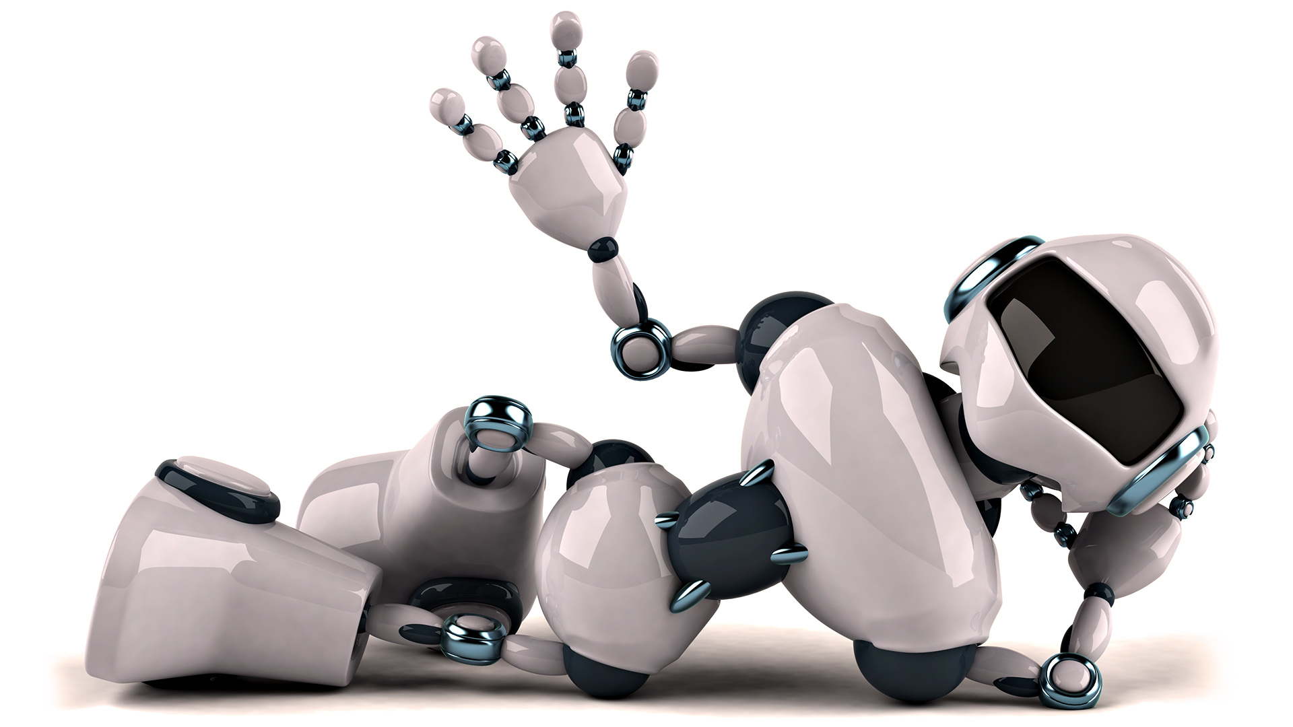
Using AI
Stephen Downes
December 16, 2021

Slide 2
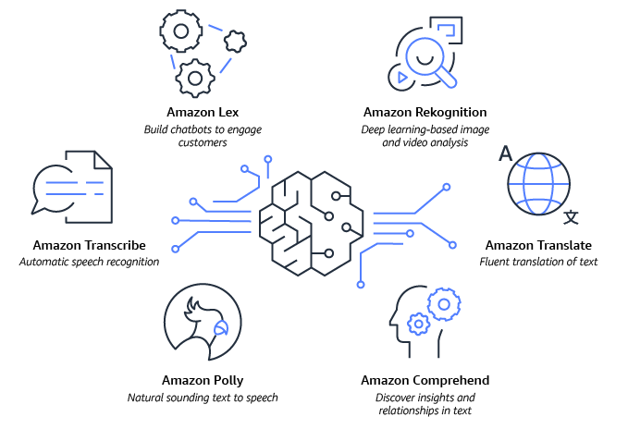
Using AI
AI has already started to enter the mainstream
Many of us have started to use AI even if we don’t realize it
And AI is having a significant impact on our lives
https://aws.amazon.com/blogs/machine-learning/announcing-the-artificial-intelligence-ai-hackathon-build-intelligent-applications-using-machine-learning-apis-and-serverless/

Slide 3
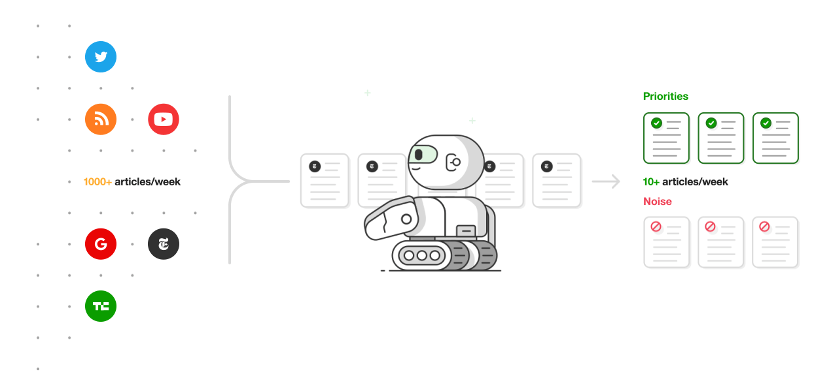
Some Examples…
Feedly Leo
Based on my own set of feeds
Trained using the examples I select
Multiple categories
Makes recommendations

Slide 4
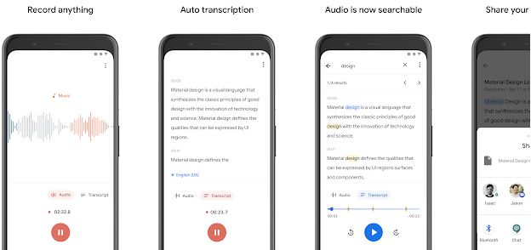
Some Examples…
Google Recorder

Slide 5
Some Examples…
Topaz AI

Slide 6
Some Examples…
Adaptive Cruise Control

Slide 7
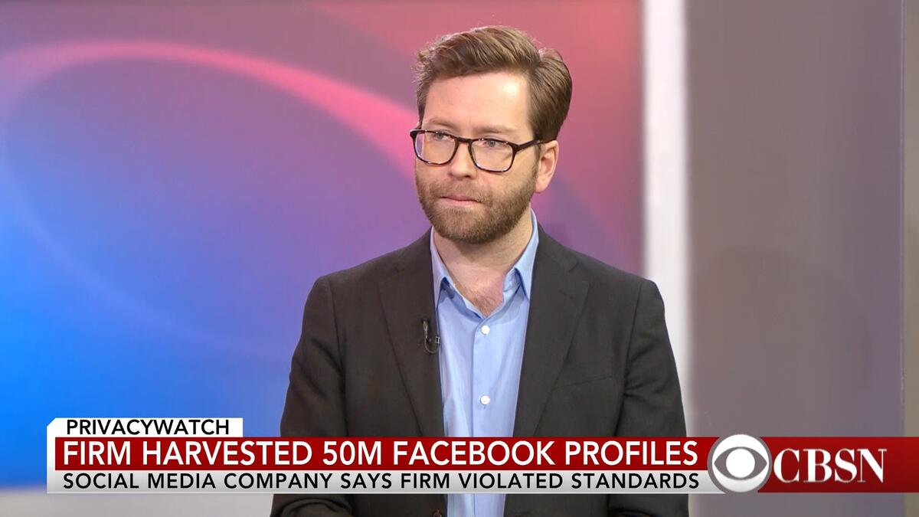
We Are Not Just Data
Most analytics treat the data subject as passive, a set of raw variables being measured by instruments
We may have something to say as well
What happens when we don’t speak out?
Image: https://www.techrepublic.com/article/we-know-what-you-want-before-you-want-it/

Slide 8
Who Speaks for Us?
Ensuring diversity in AI development teams
Ensure diversity in the training samples
Ensure humans labeling audio samples come from diverse backgrounds.
Measure accuracy levels separately for different demographic categories
Collect more training data associated with sensitive groups
Apply modern machine learning de-biasing techniques
Josh Feast. (2019). 4 Ways to Address Gender Bias in AI. Harvard Business Review Online. November 20, 2019. https://hbr.org/2019/11/4-ways-to-address-gender-bias-in-ai
Also: https://www.forbes.com/sites/arunshastri/2020/07/01/diverse-teams-build-better-ai-heres-why/
Image: https://techcrunch.com/2021/02/14/examining-the-pipeline-problem/

Slide 9
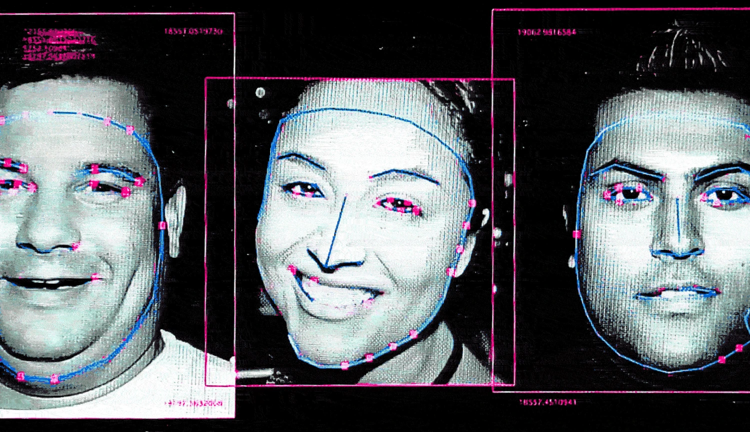
Who Speaks for Us?
A diversity of perspectives
“You can’t have a standard on facial recognition technology and not have in the room data scientists, psychologists, anthropologists, and people from around the world.” (John Havens (Director, IEEE Global Initiative on Ethics of Autonomous & Intelligent Systems), quoted in UNICEF, 2019)
https://www.nbcnews.com/tech/internet/facial-recognition-s-dirty-little-secret-millions-online-photos-scraped-n981921
“People’s faces are being used without their permission, in order to power technology that could eventually be used to surveil them, legal experts say.”
Kristian Lum and William Isaac. (2016). To Predict and Serve? Significance. Volume13, Issue 5, October 2016, pp 14-19.

Slide 10
Who Speaks for Us?
Defining success
The key questions asked here are (1) what counts as success for the World Bank's education programs, and (2) success for whom?
"The teaching of ‘life skills’, the promotion of data-capturing digital technologies and the push to evaluate teachers’ performance are, then, all closely linked to the agenda of the World Bank:
cost accounting and quantification (since returns on investment must be carefully measured)
competition and market incentives (since it is believed that the ‘invisible hand’ of the market leads to the greatest benefits)
the private sector in education and a rolling back of the role of the state (since it is believed that private ownership improves efficiency)."
Philip Kerr, Adaptive Learning in ELT, 2020/05/19

Slide 11
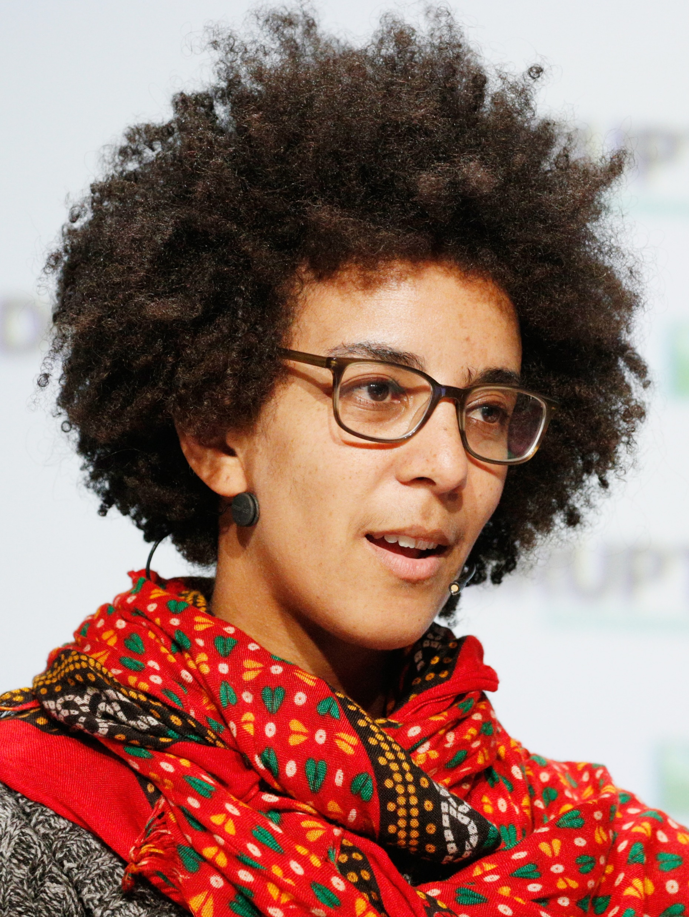
Who Speaks for Us?
The ethical perspective and the boardroom
Google launched its own independent ethics board in 2019 but shut it down less than two weeks later following controversy about who had been appointed to it. https://www.bbc.com/news/technology-47825833
Google's AI leadership came under fire in December when star ethics researcher Timnit Gebru was abruptly fired https://www.theverge.com/2021/4/21/22396112/google-ethical-ai-team-bias-harassment-timnit-gebru-firing
Google fires second AI ethics researcher following internal investigation https://www.theverge.com/2021/2/19/22292011/google-second-ethical-ai-researcher-fired

Slide 12
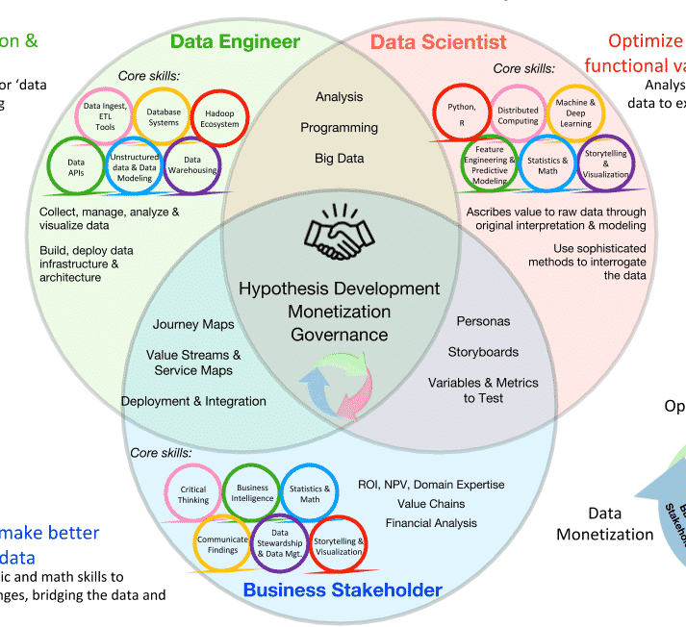
The Data Analytics Team
The team needs individuals to:
Identify the business request
Develop a specific use case
Understand the data characteristics of the use case
Program the algorithm and analyze the data
Develop reports and dashboards
Develop a prototype for models and tools
Pilot the prototype and dashboard
Scale the prototype to the enterprise level
Ensure adoption and ongoing model maintenance
(Radan, 2019: 24-25)
https://quanthub.com/advanced-analytics/

Slide 13
The Data Controller
“The data controller must ensure that use of the personal data is fair and lawful.” The data controller ensures:
the ‘data subject’ must be informed
data is only used for the purpose notified
data is kept up-to-date, accurate, and secure
any requests receive a response
Kay, D., Korn, N. & Oppenheim, C., 2012. Legal, Risk and Ethical Aspects of Analytics in Higher Education. http://publications.cetis.org.uk/2012/500
Also: https://www.wsiworld.com/blog/responsibilities-of-a-controller-processor-and-data-protection-officer-according-to-gdpr

Slide 14
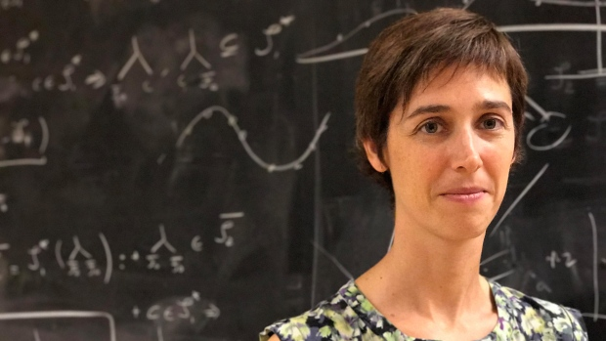
The AI Researcher
“Very few research articles on AI in education have been written by actual educators (8.9%), with the majority of authors coming from computer science and STEM backgrounds.”
Joelle Pineau
“This raises the question of how much reflection has occurred about appropriate pedagogical applications of AI.”
Artificial intelligence in education: where are the educators?
Melissa Bond, Olaf Zawacki-Richter, School Education Gateway, 2020/02/12
https://educationaltechnologyjournal.springeropen.com/articles/10.1186/s41239-019-0171-0
Image: https://www.bnnbloomberg.ca/facebook-launching-ai-research-lab-in-montreal-hires-mcgill-expert-1.857585

Slide 15
Regulators
Not just GDPR – “The research conducted in this stream critically discusses copyright, trade secrets, privacy laws, and data governance to ensure the deployment of inclusive and less biased AI systems”
Canadian Privacy Commissioner: an appropriate law for AI would:
Allow personal information to be used for new purposes
Authorize these uses within a rights based framework
Create provisions specific to automated decision-making
Require businesses to demonstrate accountability
AI+Society Initiative https://techlaw.uottawa.ca/aisociety/regulation
A Regulatory Framework for AI: Recommendations for PIPEDA Reform https://www.priv.gc.ca/en/about-the-opc/what-we-do/consultations/completed-consultations/consultation-ai/reg-fw_202011/
The Future of AI Regulation in Canada https://www.torys.com/our-latest-thinking/publications/2021/05/the-future-of-ai-regulation-in-canada

Slide 16
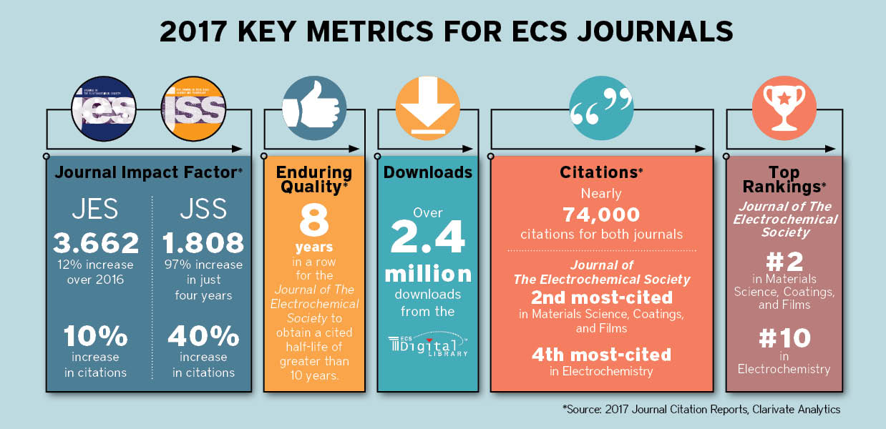
What Data Counts?
Example:
The San Francisco Declaration on Research Assessment (DORA) is… a call for the major players in academia and scholarly publishing not to use journal impact factors as a “surrogate measure” of the quality of individual scientists or their work.
Image: https://www.electrochem.org/ecs-blog/increasing-influence-of-ecs-journals/
“Universities should either sign a pledge not to misuse journal impact factors or explain why they have not, says Stephen Curry.”
https://www.researchresearch.com/news/article/?articleId=1360100

Slide 17
Citizen Science
‘Citizen Science’ implies a form of science developed and enacted by citizens themselves—and one important strand of this book will deal with the ‘contextual knowledges’ which are generated outside of formal scientific institutions.” (Irwin, 1995, p. xi)
Christopher Hoadley, 2018. Designing Citizen Science Projects. Committee on Designing Citizen Science to Support Science Learning http://hub.mspnet.org/index.cfm/33674
Steve Mellen. (2020) Europe-wide traffic survey to recruit 'citizen scientists'. BBC News. January 20, 2020. https://www.bbc.com/news/world-europe-51123760
“English academics are involved in sending out 1,500 sensors to be placed in homes in Madrid, Dublin, Cardiff, Ljubljana and Leuven. The sensors will count the number and speed of all vehicles, cyclists and pedestrians that pass them” (Mellen, 2020).

Slide 18
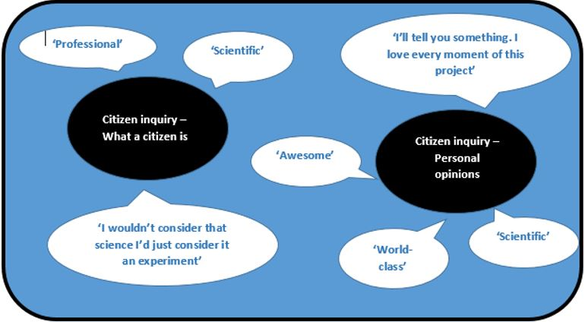
Citizen Inquiry
“It fuses the creative knowledge building of inquiry learning with the mass collaborative participation exemplified by Citizen Science, changing the consumer relationship that most people have with research to one of active engagement” (Sharples et al., 2013, p 36) (Herodotou, Scanlon & Whitelock, 2019:140)
Christothea Herodotou, Eileen Scanlon and Denise Whitelock. (2019). STEM Learning: Futures. In: Ferguson, R., Jones, A. and Scanlon, E. (eds). Educational Visions: Lessons from 40 years of innovation. Pp. 139–150. London: Ubiquity Press. https://www.ubiquitypress.com/site/books/10.5334/bcg/
Herodotou, Christothea; Sharples, Mike and Scanlon, Eileen (2017). Introducing citizen inquiry. In: Herodotou, Christothea; Sharples, Mike and Scanlon, Eileen eds. Citizen Inquiry: Synthesising Science and Inquiry Learning. Routledge. http://oro.open.ac.uk/51077/1/Chapter%201_Introducing%20citizen%20inquiry.pdf
“Citizens are engaged in all the aspects of a research project from defining the research questions to collecting, analysing and reporting data.”
http://www.open.ac.uk/blogs/per/?p=7960

Slide 19
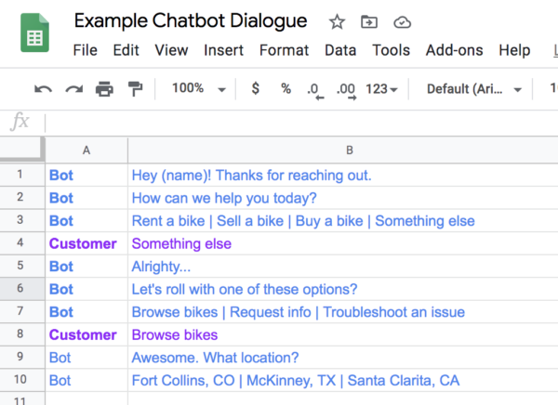
The Humans Behind Chatbots
In the case of chatbots, there can be a lot of scripting of the precise interactions to be sent to students.
"Creating scripts requires an understanding of narrative convention—such as how to initiate a conversation, take turns speaking and ask for feedback... (it) also draws on research and skills from fields including psychology, linguistics, sociology and human-computer interaction" (Koenig, 2020).
Rebecca Koenig. (2020). Meet the Humans Behind College Chatbots. EdSurge. January 22, 2020. https://www.edsurge.com/news/2020-01-16-meet-the-humans-behind-college-chatbots
Image: https://manychat.com/blog/create-a-customer-service-bot/

Slide 20
Design
“The practical application of this is the development and implementation of a process for creating algorithms in which designers are considering an audience that includes women, that includes black people, that includes Latinx people. Essentially, developers of all backgrounds would be called on to actively consider—and value—people who are different from themselves.”
Can ‘feminist design’ save hiring algorithms from bias? February 10th, 2020 Matt Shipman
https://www.futurity.org/feminist-design-hiring-algorithms-bias-2276022/

Slide 21
Relationships
Michael Wesch:
“My friends in Papua New Guinea are experts in relationships and grasp the ways that we are all connected in much more profound ways than we do. ”
“In contrast, we tend to emphasize our independence and individuality, failing to realize just how interconnected we are with each other.”
“The ultimate promise of digital technology is that it might enable us to truly see one another once again.”
Image: https://www.lowyinstitute.org/the-interpreter/australia-png-relationships-are-what-matter
Michael Wesch. (2007). The Machine is Us/ing Us (Final Version). YouTube. 8 Mar 2007. https://www.youtube.com/watch?v=NLlGopyXT_g

Slide 22
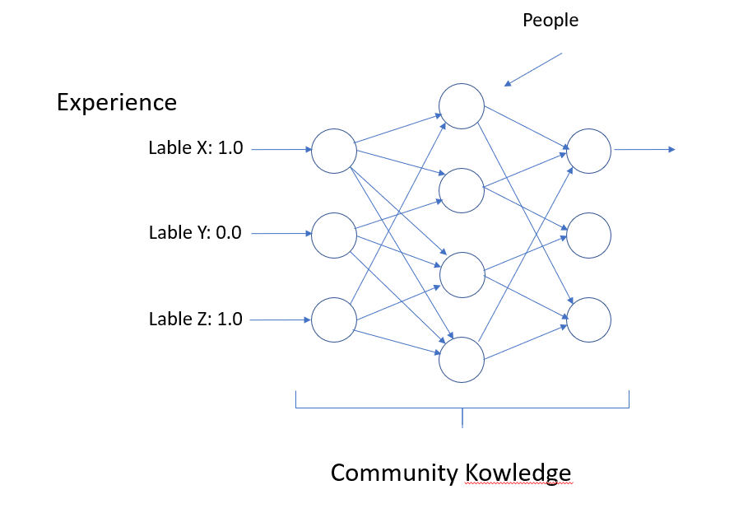
Social Networks
We provide the input
And we are also the people who connect to each other
Everything I have said about learning analytics also applies to social networks
What is the ethics of your own learning community?
Community Knowledge
https://journals.plos.org/plosone/article?id=10.1371/journal.pone.0203590

Slide 23
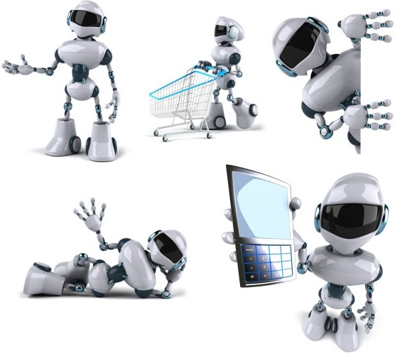
Team Players
What would make an AI ethical partner in a collaboration?
Joint activity involves at least four basic requirements. All the participants must:
Enter into an agreement, which we call a Basic Compact, that the participants intend to work together
Be mutually predictable in their actions
Be mutually directable
Maintain common ground
Ten Challenges for Making Automation a “Team Player” in Joint Human-Agent Activity. Gary Klein, David D. Woods, Jeffrey M. Bradshaw, Robert R. Hoffman, and Paul J. Feltovich. (2020). https://ieeexplore.ieee.org/stamp/stamp.jsp?arnumber=1363742

Slide 24
Inclusion
Image: https://ivado.ca/en/equity-diversity-and-inclusion/

Slide 25
The Decisions We Make As Users…
We prefer fake news…?
“A false story is much more likely to go viral than a real story, the authors find. A false story reaches 1,500 people six times quicker, on average, than a true story does.”
Meyer, 2018. Also this big MIT study: Soroush Vosoughi, Deb Roy and Sinan Aral. (2018). The spread of true and false news online. Science. 9 Mar 2018. Vol. 359, Issue 6380:1146-1151. https://science.sciencemag.org/content/359/6380/1146

Slide 26
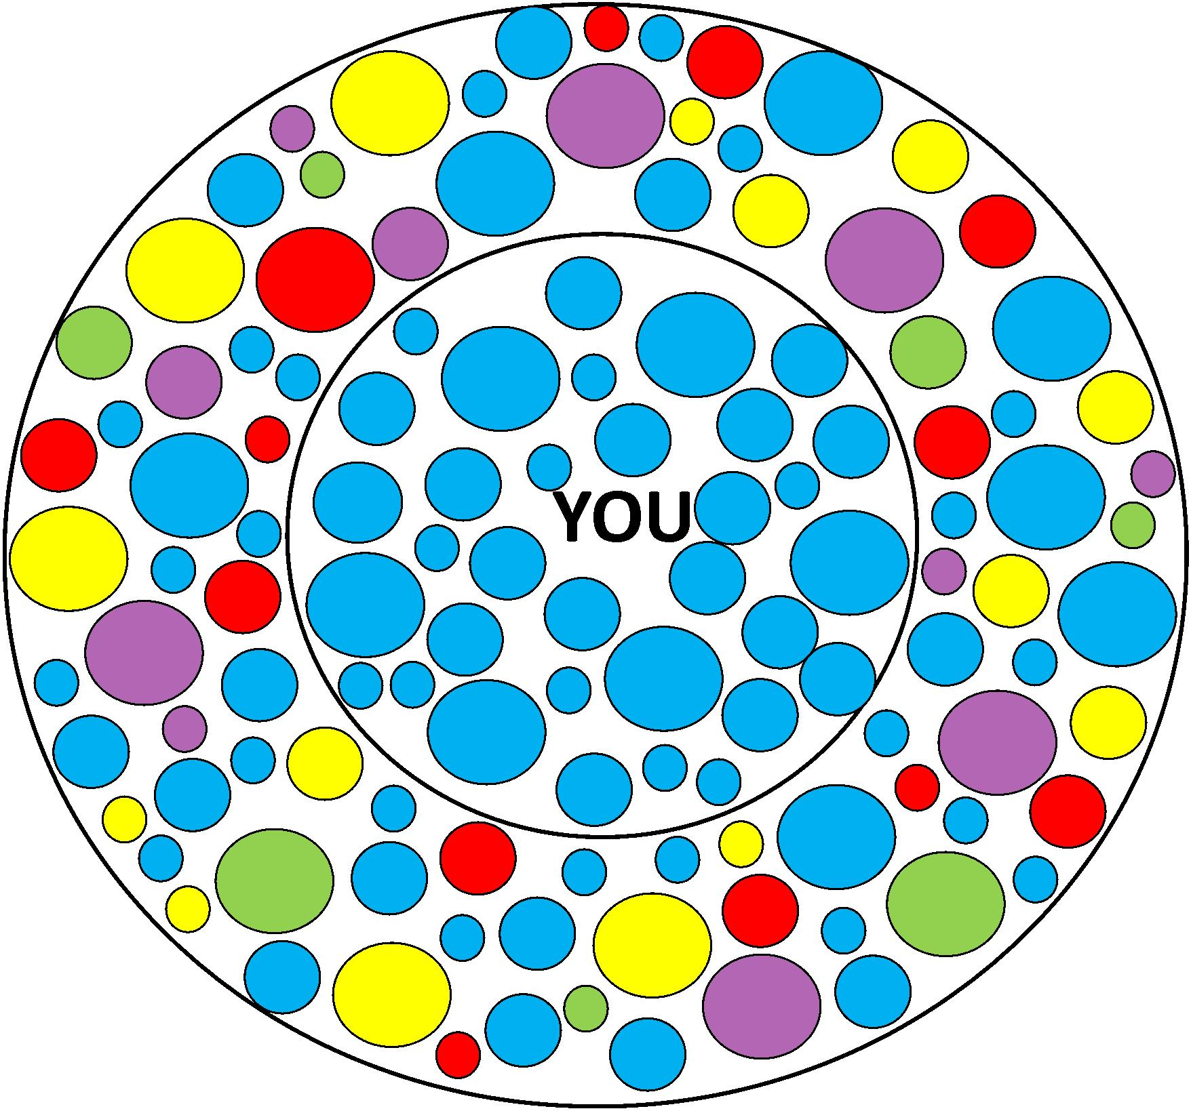
The Decisions We Make As Users…
Confirmation bias
The filter bubble, referenced previously, is as much a result of our own decisions as consumers as it is an artifact of analytics. “Even without the aid of technology, we naturally tend to surround ourselves with information confirming our beliefs” Chesney and Citron, 2018:1768).
https://oxfamapps.org/fp2p/how-bad-is-my-filter-bubble-problem-please-help-me-find-out/

Slide 27
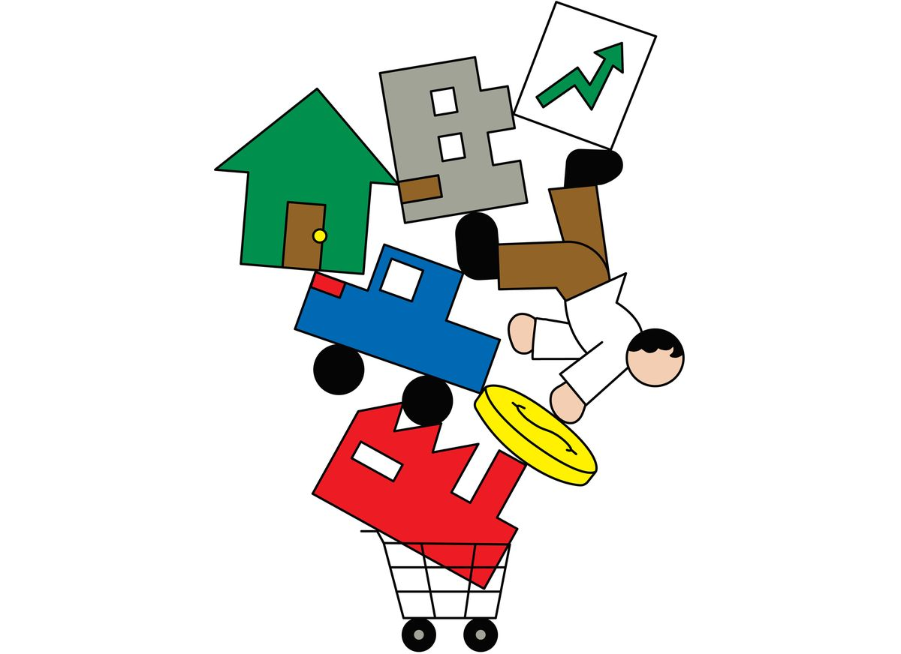
The Decisions We Make As Users…
Who makes the decisions?
Numerous critics have criticized analytics because it shifts control to a private company. Zeide (2019) writes, “These private companies may be less directly accountable to stakeholders of the educational institutions—in particular, stakeholders such as students. It is important for us to consider this authority shift, and the shift in incentives, when using these technologies.”
Image: https://www.bloomberg.com/news/features/2019-10-03/how-private-equity-works-and-took-over-everything
Yet such technologies could be equally well developed and managed by educational institutions or governments, as in fact they are in many areas of the world. Deciding who makes the decisions is a human - not AI - task.

Slide 28
The Decisions We Make As Users…
New rules about what matters
"Wikipedia authors are required to cite sources when they write or edit articles, and a severe lack of media coverage on floods and other disasters in underreported regions makes the corresponding Wikipedia articles inevitably less detailed.
Imbalance in coverage is something that exists in traditional media, online sources like Wikipedia, and therefore in automated knowledge systems. It's not just an AI thing. Here's how it happens:
Wikipedia is flooded with information — but it has a blind spot. Sierra Garcia, Grist. https://grist.org/justice/wikipedia-is-flooded-with-information-but-it-has-a-blind-spot/

Slide 29
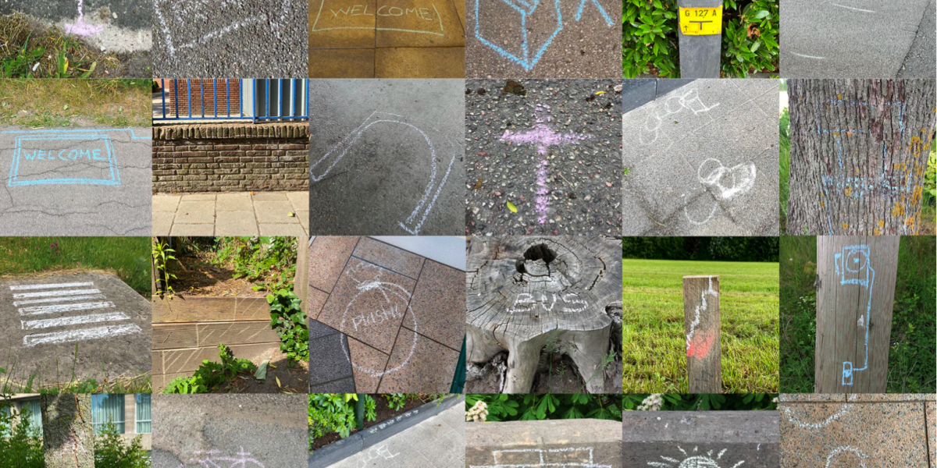
Giving Shape to Our Existence
“Artifacts mediate human existence
by giving concrete shape to their behavior and the social contexts of their existence. This kind of mediation can be described in terms of translation, whose structure involves invitation and inhibition; some forms of involvement are fostered while others are discouraged. Both kinds of mediation, taken together, describe how artifacts help shape how humans can be present in the world and how the world can be present for them.” (Verbeek, 2005: 195)
Image: https://designmuseum.nl/en/tentoonstelling/stigmergy-be-like-the-bees/
Peter-Paul Verbeek. (2005). What Things Do. The Pennsylvania State University Press, ISBN 0-271-02540-9

Slide 30
Thinking Ethically
Can robots think like ethical beings?
“Verifiably constructing a trustworthy AGI will require different methods… it will require an AGI that thinks like a human engineer concerned about ethics, not just a simple product of ethical engineering.
“Ethical cognition itself must be taken as a subject matter of engineering.”
Nick Bostrom & Eliezer Yudkowsky, 2011, The Ethics of Artificial Intelligence https://www.nickbostrom.com/ethics/artificial-intelligence.pdf

Slide 31
Can AI Understand? (1)
What would it take for us to say that an AI ‘understands’? (Mitchell, 2021)
Turing tests – but “Even simple chatbots, such as Joseph Weizenbaum’s 1960s ersatz psychotherapist Eliza, have fooled people”
Winograd schema challenge – change a sentence by one word. GPT-3 was correct on nearly 90% of the sentences in a benchmark test
WinoGrande, a much larger set of 44,000 sentences - current best programs get close to 90% correct (humans get about 94% correct)
https://arxiv.org/abs/2005.14165 https://arxiv.org/abs/1907.10641

Slide 32
Can AI Understand? (2)
“The crux of the problem, in my view, is that understanding language requires understanding the world, and a machine exposed only to language cannot gain such an understanding.”
“If we want machines to similarly master human language, we will need to first endow them with the primordial principles humans are born with. And to assess machines’ understanding, we should start by assessing their grasp of these principles, which one might call ‘infant metaphysics.’”
Melanie Mitchell https://www.quantamagazine.org/what-does-it-mean-for-ai-to-understand-20211216/

Slide 33
The Moral Status of AI/Us
Is an AI a moral agent? Does its autonomy relieve its developer of responsibility?
Rights have significance beyond their role in protecting our interests. Rights reflect our inviolable status as persons. (From Kamm, 2007, chap. 7)
Two criteria are commonly proposed as being importantly linked to moral status, either separately or in combination:
Sentience:the capacity for phenomenal experience or qualia, such as the capacity tofeel pain and suffer
Sapience:a set of capacities associated with higher intelligence, such as self-awareness and being a reason-responsive agent
‘The Ethics of Artificial Intelligence’ by Nick Bostrom
F.M. Kamm, Intricate Ethics: Rights, Responsibilities, and Permissible Harm, Oxford University Press, 2007 https://ndpr.nd.edu/reviews/intricate-ethics-rights-responsibilities-and-permissible-harm/

Slide 34
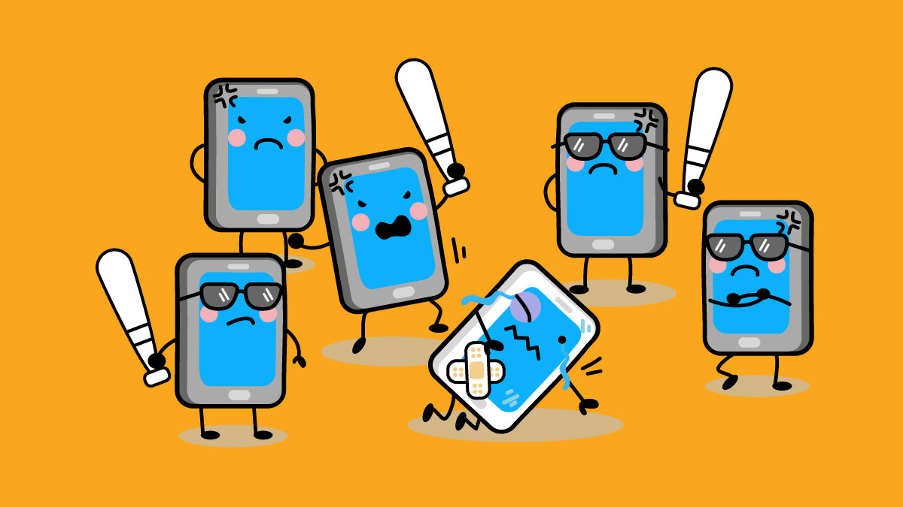
The Machine is Us/ing Us
We Are the Teachers of AI
“As pervasive as artificial intelligence is set to become in the near future, the responsibility rests with society as a whole. Put simply, we need to take the standards by which artificial intelligences will operate just as seriously as those that govern how our political systems operate and how are children are educated.”
Greg Satell. (2016). Teaching an Algorithm to Understand Right and Wrong. November 15, 2016 UPDATED November 16, 2016 https://hbr.org/2016/11/teaching-an-algorithm-to-understand-right-and-wrong
Michael Wesch. (2007). The Machine is Us/ing Us (Final Version). YouTube. 8 Mar 2007. https://www.youtube.com/watch?v=NLlGopyXT_g

