Slide 1
Regulation
Stephen Downes
December 17, 2021

Slide 2
Scope of Regulation
Ethical governance: focusing on the most pertinent ethical issues raised by AI such as fairness, transparency and privacy
Explainability and interpretability: for example, the idea of a ‘right to explanation’ of algorithmic decisions
Ethical auditing: mechanisms that examine the inputs and outputs of algorithms for bias and harms
Corrinne Cath, 2018, https://royalsocietypublishing.org/doi/pdf/10.1098/rsta.2018.0080
Map: https://docs.google.com/spreadsheets/d/1utA1ug1nKF3B4MMmC_AQeyo1IK5jH_abMK9oFHEJekk/edit#gid=0
Cover image: https://www.bloomberg.com/news/articles/2021-11-19/crypto-industry-s-solution-to-regulation-is-self-regulation

Slide 3
Explainability Revisited
The ICO and The Alan Turing Institute identify six main varieties:
Rationale: reasons behind a decision.
Responsibility: who made the AI system and how to obtain a human review
Data: What data went into the model and how was data used
Fairness: how we know the AI is unbiased and individuals are treated equitably.
Safety and performance: How are accuracy, reliability, security and robustness ensured
Impact explanation: how are effects and decisions monitored
https://www.arnoldporter.com/-/media/files/perspectives/publications/2021/06/ai-regulationstaying-ahead-of-curveschildkraut0621.pdf?la=en

Slide 4
Europe: The AI Act
Definition of AI, place of market
Risk-based approach: some AI practices are banned (Title II)
Bans tech that’s subliminal, exploits vulnerabilities, social score, real-time biometrics (subject to conditions)
Regulated compliance of high-risk AI with existing rights
Potentially risk AI must bear a CE mark of product compliance
European Commission finally presented its Proposal for a Regulation laying down harmonised rules on artificial intelligence https://eur-lex.europa.eu/legal-content/EN/TXT/?uri=CELEX%3A52021PC0206
Summary: https://www.lexology.com/library/detail.aspx?g=e6c7bcfe-7df3-4bd4-afd7-a2430d64de33
Also: https://www.fieldfisher.com/en/insights/the-eu-ai-regulation-part-1

Slide 5
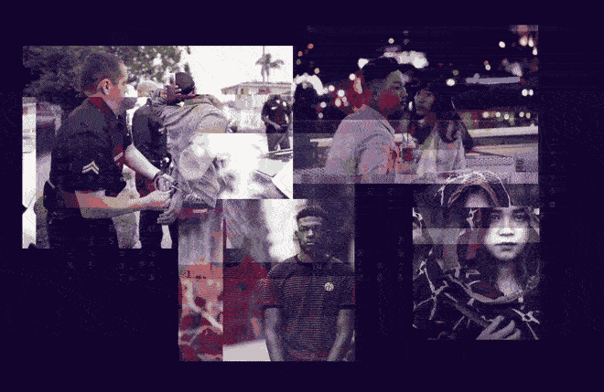
Facial Recognition Bans
Bans in Massachusetts, Maine, Minneapolis
Amazon, IBM and Microsoft will stop selling the tech
But still, investor cash is rolling in
https://www.banfacialrecognition.com/
https://techcrunch.com/2021/07/26/facial-recognition-flush-with-cash/

Slide 6
United States: NIST Plan
“American AI Initiative,” guided by five principles:
Driving technological breakthroughs;
Driving the development of appropriate technical standards;
Training workers with the skills to develop and apply AI technologies;
Protecting American values, including civil liberties and privacy, and fostering public trust and confidence in AI technologies; and
Protecting U.S. technological advantage in AI, while promoting an international environment that supports innovation.
https://www.bakermckenzie.com/-/media/files/people/chae-yoon/rail-us-ai-regulation-guide.pdf
https://www.nist.gov/system/files/documents/2019/08/10/ai_standards_fedengagement_plan_9aug2019.pdf

Slide 7
Canada: Regulatory Framework
Canadian Privacy Commissioner: an appropriate law for AI would:
Allow personal information to be used for new purposes
Authorize these uses within a rights based framework
Create provisions specific to automated decision-making
Require businesses to demonstrate accountability
AI+Society Initiative https://techlaw.uottawa.ca/aisociety/regulation
A Regulatory Framework for AI: Recommendations for PIPEDA Reform https://www.priv.gc.ca/en/about-the-opc/what-we-do/consultations/completed-consultations/consultation-ai/reg-fw_202011/
The Future of AI Regulation in Canada https://www.torys.com/our-latest-thinking/publications/2021/05/the-future-of-ai-regulation-in-canada

Slide 8
China: Social Impact
Major initiatives:
Draft guidelines on recommender systems (including the right to turn them off), requirement for user consent for use of personal data
Overall limits on tech and AI companies “that would prevent platforms from violating user privacy, encouraging users to spend money, and promoting addictive behaviors”
Strong anti-trust, anti-monopoly laws, liability for abusing a dominant market position by discriminatory pricing, concern about working conditions
https://venturebeat.com/2021/10/03/what-we-can-learn-from-chinas-proposed-ai-regulations/
https://www.globallegalinsights.com/practice-areas/ai-machine-learning-and-big-data-laws-and-regulations/china
https://montrealethics.ai/the-chinese-approach-to-ai-an-analysis-of-policy-ethics-and-regulation/

Slide 9
Global Privacy Agency: Accountability
Assess the potential impact to human rights
Test the robustness, reliability, accuracy and data security
Keep records of impact, design, development, testing and use
Disclose data protection, privacy and rights impact assessment
Disclosing the use, the data, and the logic involved in the AI
Ensure an accountable human actor is identified
And seven more
https://globalprivacyassembly.org/wp-content/uploads/2020/10/FINAL-GPA-Resolution-on-Accountability-in-the-Development-and-Use-of-AI-EN.pdf

Slide 10
Other Regulatory Areas
Data regulation
Data rights – customers and supplies need to clearly define data use rights
the GDPR and more
Intellectual property
Defining ‘authorship’ of AI-generated content
Civil wrongs (torts)
Manufacturing and design defects
Failure to warn of risks
https://www.globallegalinsights.com/practice-areas/ai-machine-learning-and-big-data-laws-and-regulations/canada

Slide 11
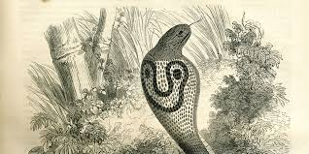
Goodhart’s Law
the idea that any metric ceases to be a valid metric the moment it becomes a target for optimization (and gets “metric-hacked”)
E.g. bounty on cobras
Works well at first
But people begin raising cobras
These are eventually released
https://en.wikipedia.org/wiki/Goodhart%27s_law
https://www.holistics.io/blog/four-types-goodharts-law/
Image: https://danikalaw.com/attribution-and-goodharts-law/

Slide 12
Regulatory Lag and Regulatory Markets
Given the pace of AI progress, laws will often be outdated by the time they’re passed.
“Regulatory markets for AI” — a system whereby governments set safety metrics (e.g. “fewer than X collisions caused by self-driving cars per Y miles driven”) and drive whole sectors of the economy to compete on those targets.
https://towardsdatascience.com/how-to-create-explainable-ai-regulations-that-actually-make-sense-8e6f35866bd8

Slide 13
Recognizing Our Limitations
People don’t understand AI
Especially octogenarian legislators
Though social science has done a lot to expose the risks
There’s a need for a constant dialogue
https://www.tandfonline.com/doi/full/10.1080/13669877.2021.1957985

