Slide 1
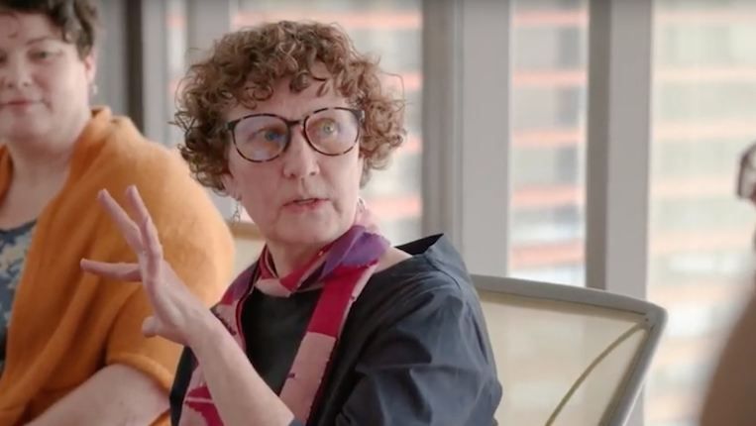
Ethical Practices: Part Five
Stephen Downes
December 22, 2021

Slide 2
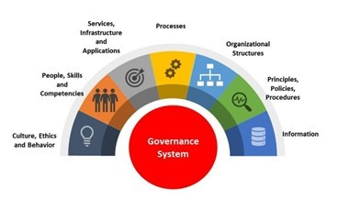
The Problem With Governance Frameworks
They’re designed for organizations, not wider society
They depend on agreement and shared presumptions
They are not actually based in ethics
Humans
https://www.linkedin.com/pulse/cobit-2019-review-framework-its-major-concepts-gr%C3%A9gory-franc/

Slide 3
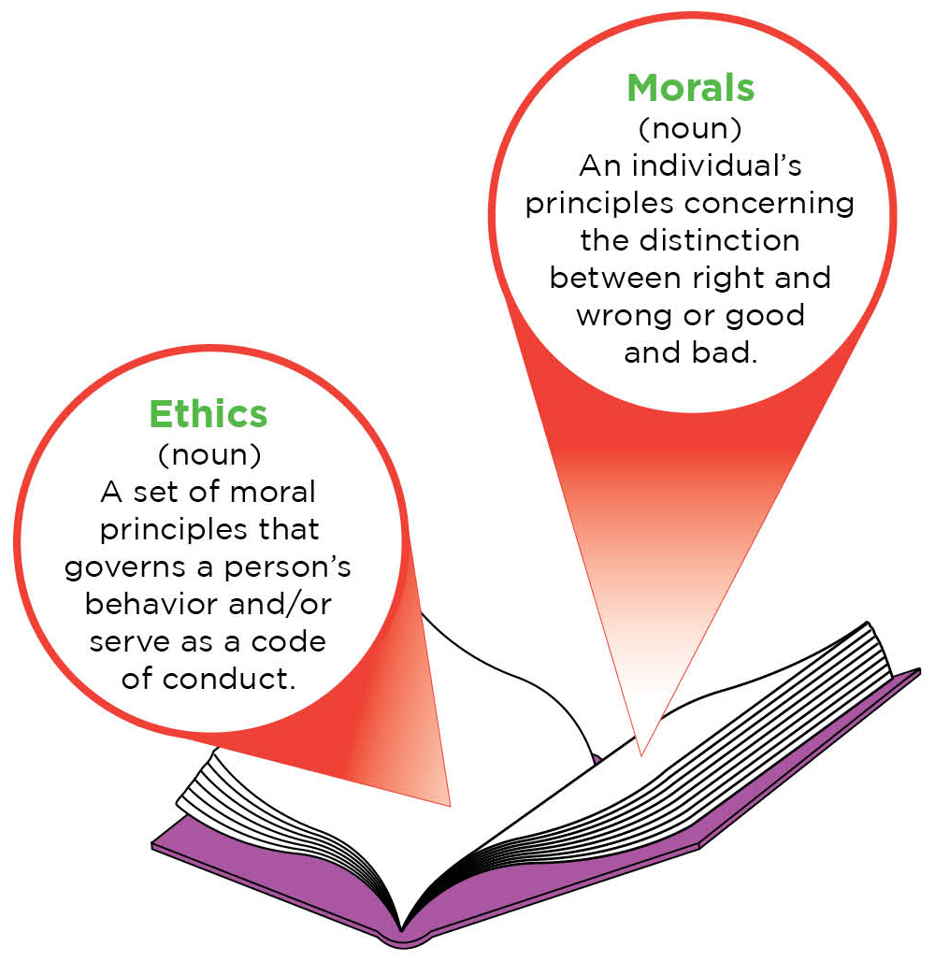
Activation of Ethical Practices
What not to do…?
The HBR Approach
Knowledge Translation
Knowledge Mobilization
Connective Action
Title image: https://www.wlu.ca/academics/research/partnerships/partner-with-a-researcher/knowledge-mobilization.html

Slide 4
What Not to Do…?
Per Harvard Business Review…
the academic approach:
“Should we…” Vs. the Business approach: “how can we do it without making ourselves vulnerable to ethical risks?””
the on-the-ground approach
“engineers, data scientists, and product managers…. lack, the skill, knowledge, and experience to answer ethical questions systematically”
high-level AI ethics principles
“The difficulty comes in operationalizing those principles. What, exactly, does it mean to be for “fairness?”
Reid Blackman, 2020, https://hbr.org/2020/10/a-practical-guide-to-building-ethical-ai

Slide 5
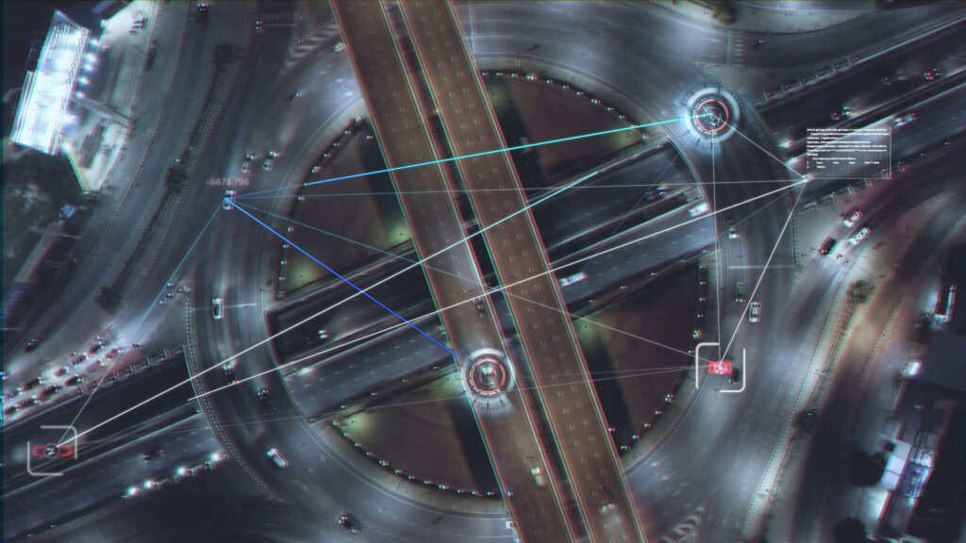
The HBR Approach
Identify existing infrastructure that a data and AI ethics program can leverage.
Create a data and AI ethical risk framework that is tailored to your industry.
Change how you think about ethics by taking cues from the successes in health care.
Optimize guidance and tools for product managers.
Build organizational awareness.
Formally and informally incentivize employees to play a role in identifying AI ethical risks.
Monitor impacts and engage stakeholders.
Reid Blackman, 2020, https://hbr.org/2020/10/a-practical-guide-to-building-ethical-ai

Slide 6
Knowledge Translation
Knowledge translation was defined at a consensus meeting of the World Health Organization in 2005 as ‘the synthesis, exchange and application of knowledge by relevant stakeholders to accelerate the benefits of global and local innovation in strengthening health systems and advancing people's health’
https://bmcpublichealth.biomedcentral.com/articles/10.1186/s12889-020-10121-9/figures/2

Slide 7
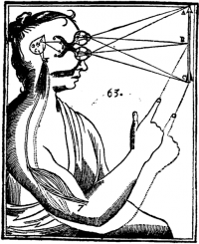
Beyond the Translation Metaphor
Three assumptions underpin the knowledge translation metaphor:
knowledge is seen as unproblematically separable from the scientists who generate it and the practitioners who may use it (the ‘objectivist’ approach to knowledge).
knowledge and practice can be cleanly separated both empirically and analytically.
practice consists more or less of a series of rational decisions on which scientific research findings can be brought to bear.
https://www.ncbi.nlm.nih.gov/pmc/articles/PMC3241522/

Slide 8
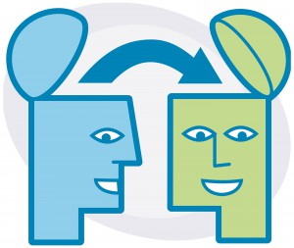
Lost in Translation
“Models and processes developed in learning analytics research are increasing in sophistication and predictive power. However, the ability to translate analytic findings to practice remains problematic.”
First, "awareness that a particular tactic or strategy is generally beneficial is often insufficient motivation for a student to adopt it," and second, the labeling of these practices is itself a challenge.
https://dl.acm.org/doi/10.1145/3375462.3375474

Slide 9
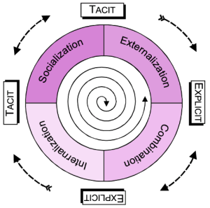
Knowledge Mobilization
making evidence accessible, understandable and useful for knowledge users
meaningful use of evidence and expertise to align research, policy and practice in order to improve outcomes
not just about disseminating information
not just about sharing, or publishing, or one-way information flow
engagement, end-user participation and attention to impact
It includes practice-based evidence from the real world, from the expertise of practitioners
https://kmbkteam.wordpress.com/2011/01/05/the-difference-between-km-knowledge-management-kmb-knowledge-mobilization/
http://www.kmbtoolkit.ca/what-is-kmb
https://www.sshrc-crsh.gc.ca/about-au_sujet/publications/KMb_-_LevinDiscussionPaper_-_E.pdf

Slide 10
From a KM Perspective
Knowledge is socially constructed and its use takes multiple forms
Bodies of consistent evidence are more powerful and effective over time than single studies
Most practitioners have a range of connections to research
sources of practices and decisions are hard to define with precision
Knowledge is always mediated in some way through various social and political processes
Knowledge by itself is not enough to change practice
The scale of impact matters but has not received very much attention.
The relationship between knowledge and use runs in both directions
Personal contact and interaction remains the most powerful vehicle for moving evidence into practice.
Not only a matter of producing more knowledge, but also of improving both the desire and capacity for its use
Dedicated effort matters.
https://www.oise.utoronto.ca/rspe/UserFiles/File/KM%20paper%20May%20Symposium%20FINAL.pdf

Slide 11
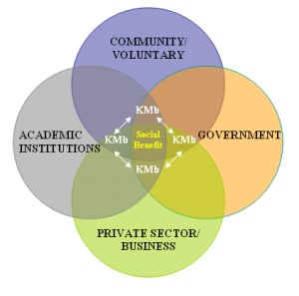
Applying Knowledge Mobilization
The need to go beyond traditional publishing
Researchers need to find an uptake for “strategies that excite them”
“need to put aside your personal agenda and to challenge your own disciplinary/sectoral approaches to become a part of something bigger.”
https://kmbkteam.wordpress.com/2011/01/05/the-difference-between-km-knowledge-management-kmb-knowledge-mobilization/
https://timreview.ca/article/1014

Slide 12
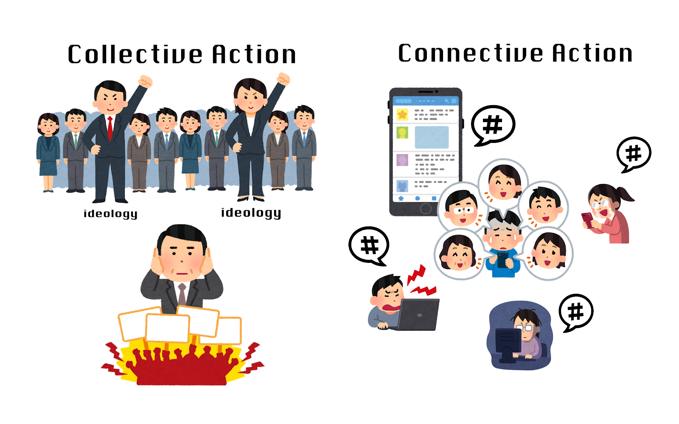
Connective Action
Forms of activism that focus on quiet acts of caring rather than amplification of a message or platform
Saidiya Hartman: a movement "driven not by uplift or the struggle for recognition or citizenship, but by the vision of a world that would guarantee to every human being free access to earth and full enjoyment of the necessities of life, according to individual desires, tastes, and inclinations."
Resistance in a minor key: Care, survival and convening on the margins, Rianka Singh, First Monday, 2020/08/11 https://firstmonday.org/ojs/index.php/fm/article/view/10631/9418
https://the-leads-asia.news/2021/02/19/drschafer-part2/

Slide 13
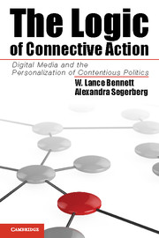
Connective Action
Key ideas:
the idea of ‘platform inclination’ as an alternative to ‘standing up to’ or ‘against’ something
the idea of producing hope rather than ‘looking for hope in the sky,’
the distinction between ‘a performance of care’ as opposed to ‘doing the work of care,’
connective action and the practice of 'communicative labour' "at the point of organizing rather than more visible forms of resistance."
https://theconversation.com/connective-action-the-publics-answer-to-democratic-dysfunction-33089

