Slide 1
Ethical Practices: Part Four
Stephen Downes
December 22, 2021

Slide 2
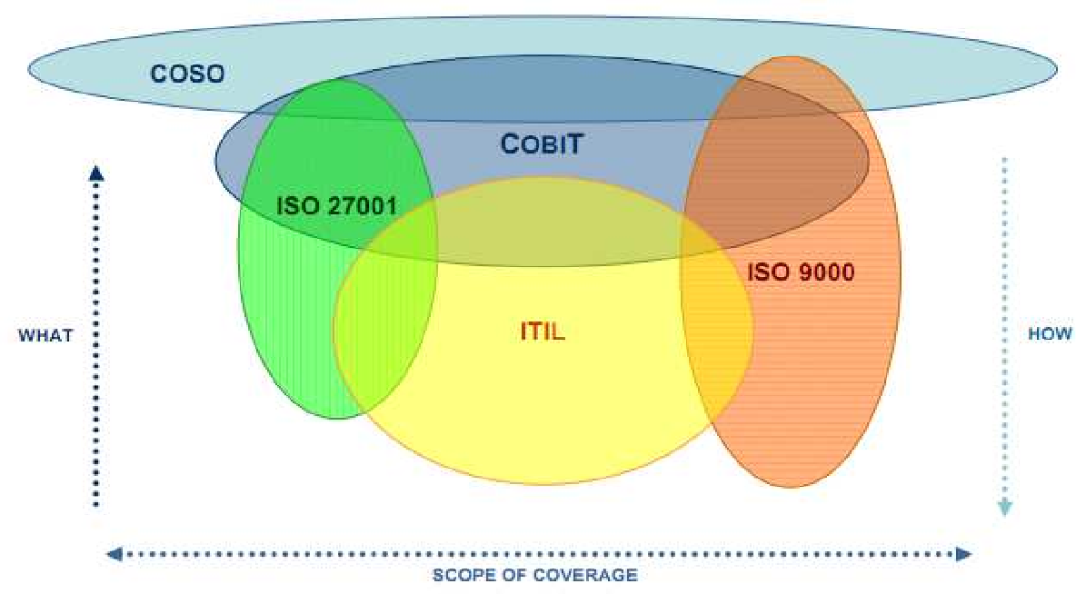
IT Governance Frameworks
“Many respected IT organizations and standards setting bodies have established frameworks to identify the ‘risks and mitigation strategies with the evolving cloud computing paradigm’”
Title image: https://hbr.org/2020/11/ethical-frameworks-for-ai-arent-enough
https://core.ac.uk/download/pdf/301361909.pdf

Slide 3
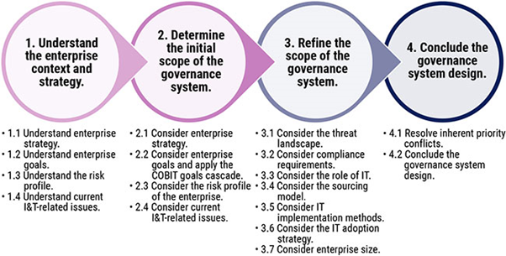
CobiT
“Control Objectives for Information and Related Technology (CobiT) is an IT governance control framework that helps organizations address the areas of regulatory compliance, risk management and aligning IT strategy with organizational goals.”
https://www.bmc.com/blogs/cobit-vs-itil-understanding-governance-frameworks/
https://www.bmc.com/blogs/cobit-2019-vs-cobit-5/

Slide 4
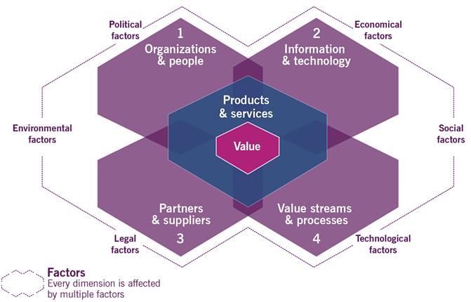
ITIL
IT Infrastructure Library (ITIL) provides a set of best practices that have become the most widely accepted approach to IT service management in the world.
“ITIL advocates that IT services must be aligned to the needs of the business and underpin the core business processes. It provides guidance to organizations on how to use IT as a tool to facilitate business change, transformation and growth.”
https://info.axiossystems.com/blog/what-is-the-itil4-service-value-system
https://core.ac.uk/download/pdf/301361909.pdf
What is ITIL? (2012, June 30). Retrieved from ITIL Offical Site:
http://www.itil-officialsite.com/AboutITIL/WhatisITIL.aspx

Slide 5
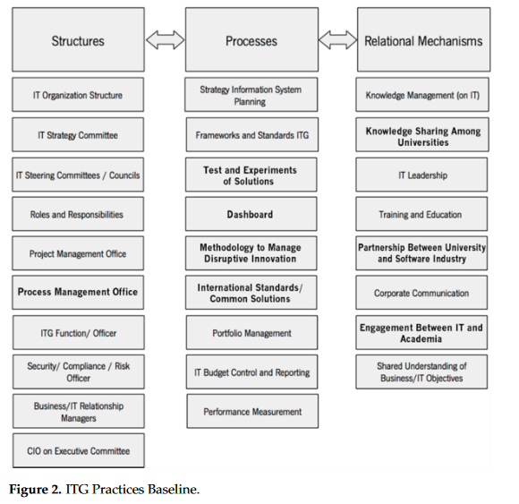
IT Governance for Higher Education
Argues: “the best configuration is one where both worlds have a federal structure, where the infrastructure, strategy, roles and procedures are centralised to avoid wasting resources and the execution and operations are decentralised.”
https://www.mdpi.com/2227-9709/8/2/26/pdf

Slide 6
IEEE P7000 Series
7000 Ethical System Design
7001 Autonomous Systems
7002 Data Privacy Process
7003 Algorithmic Bias
7004 Child and Student Data
7005 Employer Data
7006 Personal AI Agent
7007 Robotics - Ontology
7008 Robotics - Nudging
7009 Fail-Safe Design
7010 Impact on Human Well-Being
7010.1 Corporate Social Responsibility
7011 Trust-worthiness of News Sources
7012 Personal Privacy Terms
7013 Facial Recognition
7014 Emulated Empathy
7015 AI Literacy, Skills, and Readiness
Standard now available Standardization work group discontinued
https://ethicsinaction.ieee.org/p7000/

Slide 7
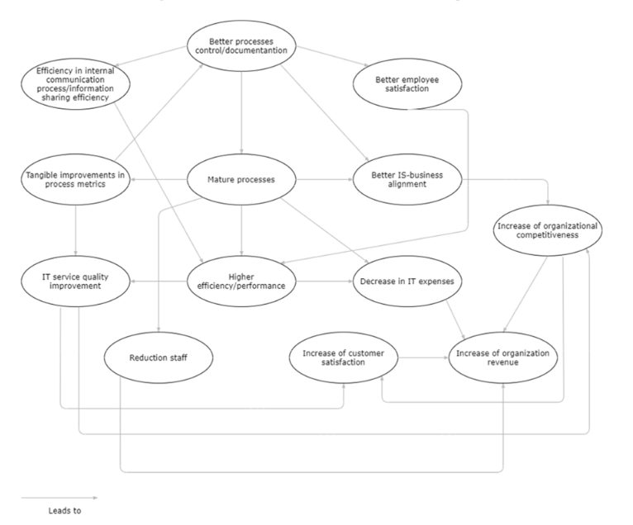
Measuring Benefits and Performance
“It is reasonable to argue that organizations should first focus on the benefits that promote (out) more other benefits rather than being promoted (in) by other benefits.”
https://www.mdpi.com/2078-2489/12/3/111/pdf p. 14

Slide 8
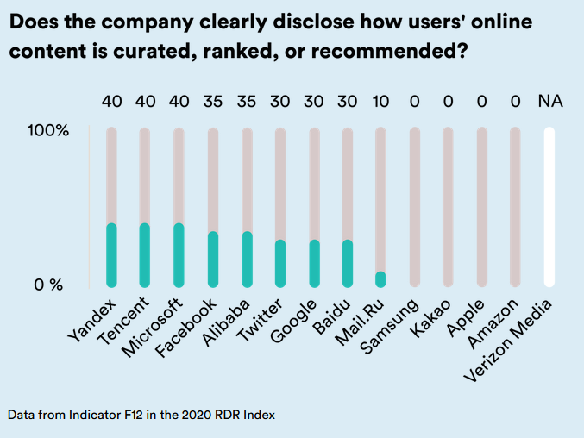
Human Rights Frameworks
“A human rights framework for algorithms that would "not just set forth standards for how to 'do no harm' or 'be ethical,' but it would help hold companies accountable for those standards, by providing mechanisms for risk assessment, enforcement, redress when harm has occurred, and individual empowerment for technology users."
https://rankingdigitalrights.org/index2020/spotlights/unaccountable-algorithms
https://www.theguardian.com/law/2019/dec/17/people-should-be-held-accountable-for-ai-and-algorithm-errors-rights-commissioner-says

Slide 9
Human Rights Impact Assessment
https://www.socialimpactassessment.com/documents/hria_guidance_and_toolbox_final_jan2016.pdf p. 8

Slide 10
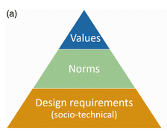
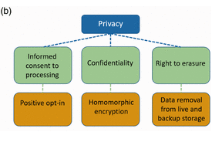
Designing for Human Rights
Halbertal (2015) three categories of violations:
Humiliation: being put in a state of helplessness, insignificance; losing autonomy over your own representation.
Instrumentalization: treating an individual as exchangeable and merely a means to an end.
Rejection of one’s gift: making an individual superfluous, unacknowledging one’s contribution, aspiration, and potential.
Quoted from: Designing for human rights in AI. Evgeni Aizenberg, Jeroen van den Hoven. August 18, 2020 https://journals.sagepub.com/doi/10.1177/2053951720949566

Slide 11
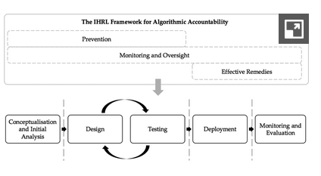
Drawing on International Human Rights Law
IHRL as a Means for Assessing Harm
Clearly Defined Obligations and Expectations That Apply Across the Algorithmic Life Cycle
Identifying roles and responsibilities attached to different entities across the full algorithmic life cycle
Operationalizing the measures necessary to ensure rights compliance
Integrating a rigorous accountability framework
https://www.cambridge.org/core/journals/international-and-comparative-law-quarterly/article/international-human-rights-law-as-a-framework-for-algorithmic-accountability/1D6D0A456B36BA7512A6AFF17F16E9B6

Slide 12
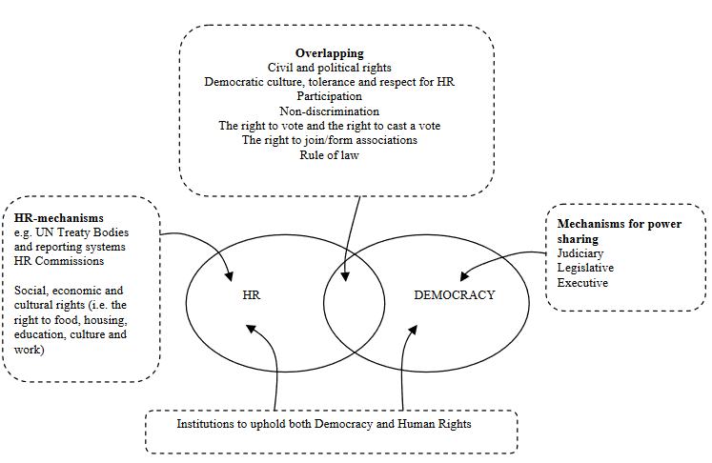
Limitations of Human Rights Frameworks
these rights may be too Western
too individualistic
too narrow in scope
too abstract to form the basis of sound AI governance.
Requires democracy: “without… securing an underlying societal infrastructure that enables human rights in the first place, any human rights-based governance framework for AI risks falling short of its purpose”
https://www.researchgate.net/publication/237390540_What_is_the_Rights_Based_Approach_all_About_Perspectives_from_International_Development_Agencies/link/00b7d52bd62368c112000000/download
Nathalie A. Smuha, 2020, Beyond a Human Rights-Based Approach to AI Governance: Promise, Pitfalls, Plea https://link.springer.com/article/10.1007/s13347-020-00403-w

Slide 13
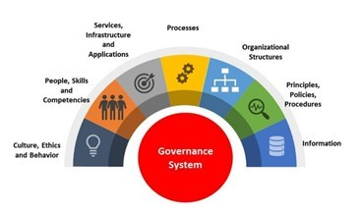
The Problem With Governance Frameworks
They’re designed for organizations, not wider society
They depend on agreement and shared presumptions
They are not actually based in ethics
Humans
https://www.linkedin.com/pulse/cobit-2019-review-framework-its-major-concepts-gr%C3%A9gory-franc/

