Slide 1
Ethical Practices: Part Three
Stephen Downes
December 22, 2021

Slide 2
Data Governance
E.g. Carrie Klein and Michael Brown use a data governance framework for ‘Ethics at the Core’
Title Image: https://towardsdatascience.com/top-5-data-governance-framework-tools-to-look-out-for-8d753ab314de
https://www.businessofficermagazine.org/features/ethics-at-the-core/

Slide 3
Types of Governance
Weill and Ross [2004] : six governance classifications available to IT organizations based on the ideal of political archetypes:
Business Monarchy – IT decisions are made by CxOs
IT Monarchy – Corporate IT professionals make IT decisions
Feudal – Decision by autonomous business units
Federal – Hybrid decision making
IT Duopoly – IT executives and one business group
Anarchy – Each small group makes decisions
https://aisel.aisnet.org/cgi/viewcontent.cgi?article=3160&context=cais
Ref: Weill, P. and J.W. Ross (2004) IT governance: How Top Performers Manage IT Decision Rights
for Superior Results, Watertown, MA: Harvard Business School Press.

Slide 4
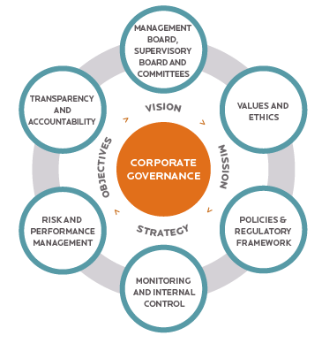
Governance Frameworks
structure and delineate power and roles
set rules, procedures, and other informational guidelines
define, guide, and provide for enforcement of these processes
shaped by the goals, strategic mandates, financial incentives, and established power structures and processes of the organization.
This is the difference

Slide 5
Data Governance Framework
https://liliendahl.com/2021/11/21/whats-in-a-data-governance-framework/

Slide 6
Aspects of Data Governance
De-Anonymisation
Tranberg: We must prohibit the de-anonymisation of anonymised data, as a German Data Ethics Commission suggested last year.
Pernille Tranberg. (2020). Why We Need to Make (Attempts of) De-Anonymisation Illegal. Data Ethics. February 6, 2020. https://dataethics.eu/why-we-need-to-make-de-anonymisation-illegal/
Tranberg, 2019: https://dataethics.eu/german-data-ethics-commission-safeguarding-digital-sovereignty-of-europe-is-ethical-responsibility/

Slide 7
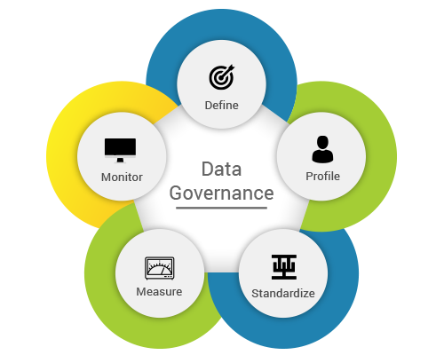
Aspects of Data Governance
Policies, Roles and Teams
data management and classification policy
data managers team consisting of representatives from departments
data request process: making it it responsive, timely, and consistent
culture: helping people value the ethical use of data
data security
Klein & brown, https://www.businessofficermagazine.org/features/ethics-at-the-core/
Image: https://www.rawsoft.com/wp-content/uploads/2019/09/Data-Governance.png

Slide 8
Aspects of Data Governance
Informed consent
Anouk Ruhaak (2020): the principle of 'informed consent' is dead
If one person gives consent, many people are affected
It's unlikely anyone is truly 'informed' when they give consent
Consent is meaningless without the ability to opt out
Ruhaak argues for an alternative, collective consent, in which our rights are managed by "a fiduciary, someone with a legal responsibility to look out for your interest, rather than their own."
https://foundation.mozilla.org/en/blog/when-one-affects-many-case-collective-consent/

Slide 9
Aspects of Data Governance
Single source of truth
This is at once a technical term for database management and also critical advice for working in a distributed environment.
No duplicate data entries or version control issues
Timely data values at the right moment
Reduced time spent validating records and data types
Improved data warehouse and intelligence
Improved communication and productivity
https://www.vistaprojects.com/blog/what-is-single-source-of-truth-ssot/
https://en.wikipedia.org/wiki/Single_source_of_truth

Slide 10
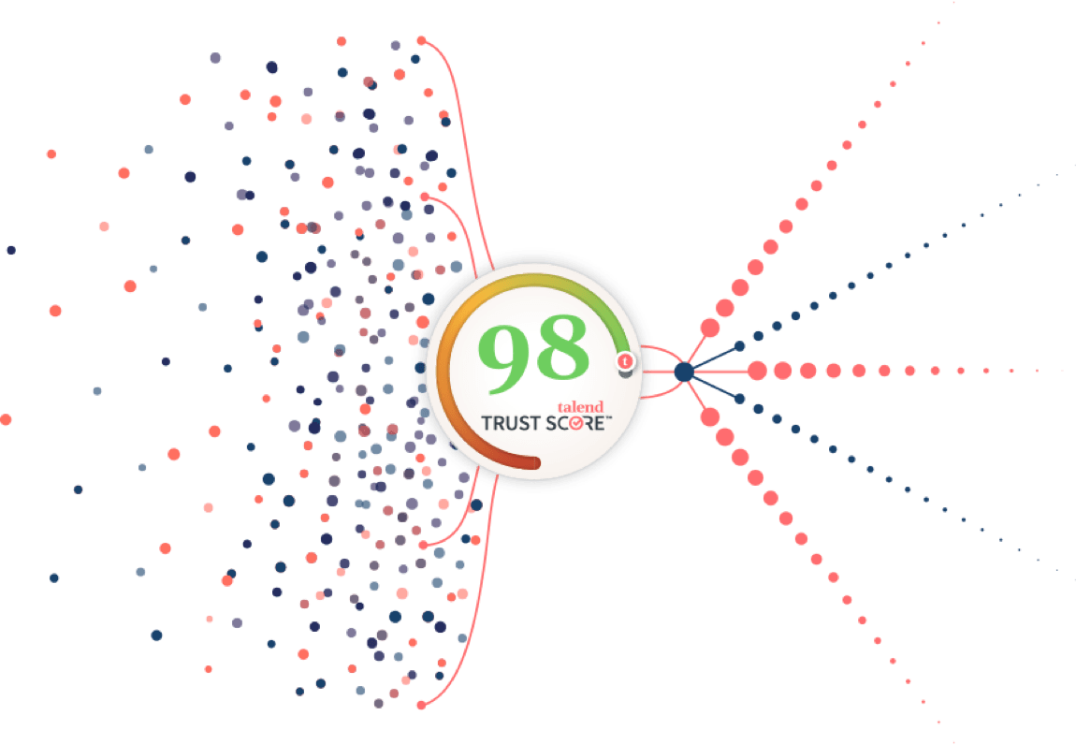
Data Governance Tools
Business glossary
Data discovery
Stewardship management
Reference data
Policy management
Data quality tools
Data mapping
Collibra
Talend
IO-TAHOE
IBM (Watson, Cognos)
Informatica
https://www.collibra.com/us/en/platform/data-governance
https://www.talend.com/products/data-integrity-governance/
https://www.iotahoe.com/platform/#section9/
https://www.ibm.com/in-en/analytics/data-governance
https://www.informatica.com/ca/

Slide 11
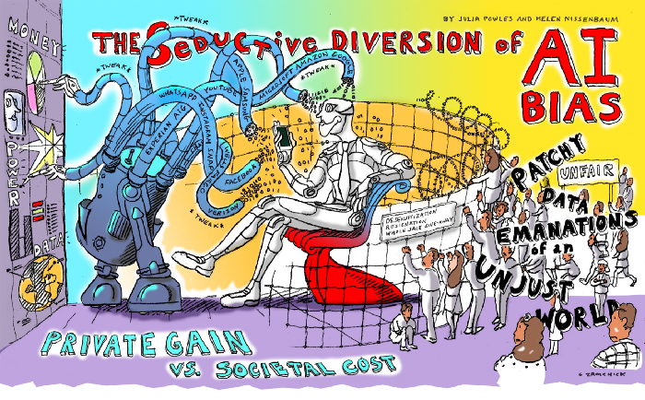
Data Governance as a Diversion
Julia Powles and Helen Nissenbaum: ‘Solving bias’ in AI data is a diversion; “recognizing and acknowledging bias can be seen as a strategic concession — one that subdues the scale of the challenge.”
https://onezero.medium.com/the-seductive-diversion-of-solving-bias-in-artificial-intelligence-890df5e5ef53

