Slide 1
Ethical Practices
Stephen Downes
December 19, 2021

Slide 2
Ethical Practices
Managing for risk
The need for practices, not principles
Some simple practices
Frameworks:
Ethical practices frameworks
Data governance frameworks
IT governance frameworks
Human Rights Frameworks
Activation of Ethical Practices

Slide 3
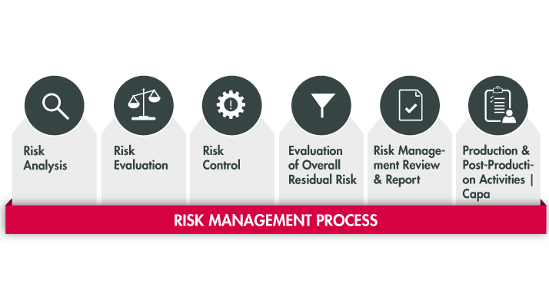
Managing for Risk
Re: the regulations
These are focused on reducing risks
Managing for risk is not ethics
Sometimes the most ethical route is the most ethical
Sometimes the safest path is the least ethical
Risks measure some parameters (like cost) but not others
https://www.plato-e1ns.com/products/e1ns-solution-packages/e1ns-solution-package-medical-technology/plato-risk-management-14971/

Slide 4
The Fog of War
It is a truism that systems of rules and principles are compromised the moment they are applied in practice. A common expression, “the fog of war”, captures the uncertainty that results when complex real-life situations are encountered.
https://www.everedgeglobal.com/news/2017-2-19-lifting-the-ip-fog-of-war/

Slide 5
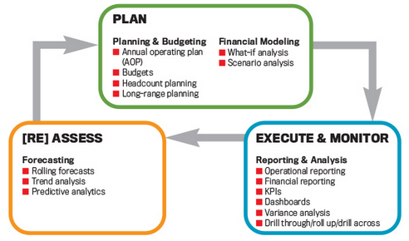
Practices, Not Principles
Thus many approaches supporting professional conduct focus on common practices rather than principles. The idea is that while the actual outcome and best decision cannot be predicted, following a standard will lead to an optimal outcome in the given situation (Courtney, Lovallo & Clarke, 2013).
https://sfmagazine.com/post-entry/november-2017-12-principles-of-best-practice-fpa/

Slide 6
The Elements of AI Practices
https://arxiv.org/pdf/2110.01167.pdf p.3

Slide 7
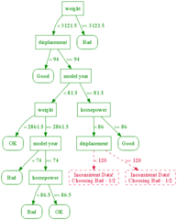
Decision Trees
poses a series of questions, user answers
points to a recommended course of action.
example, such a tree may ask:
whether an action is legal
whether it adds value
whether it is ethical. (Bagley, 20013)
however, a decision tree is essentially an application of a set of rules or principles
we can see this through the processes used to generate decision trees (Azad-Manjiri, 2014)
https://alliance.seas.upenn.edu/~cis520/wiki/index.php?n=Lectures.DecisionTrees

Slide 8
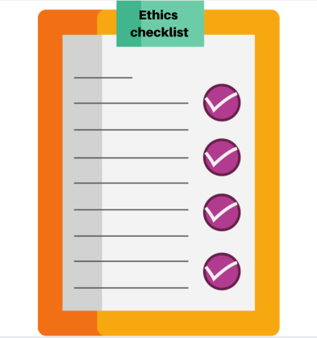
Checklists
used in the management of complicated technology
flying an aircraft
performing surgery
ensure that proponents do not omit essential steps or procedures
in ethics, a checklist might be used to ask whether all ethical matters have been considered. (University of Leicester, 2019)
they are not decision-making tools
they ensure completeness, but not accuracy.
https://reillytop10.com/previous-lists/2020-list/the-corruption-of-tech-ethics/

Slide 9
Frameworks
For more complex environments, a process-based approach is used, such as a management framework:
identify the things that ought to be done
name issues to be considered
identify people involved in considering them
note the resources to be consulted.
But the actual consideration, and the outcome of the consideration, is determined by the process.
“It’s the ability to organize thoughts into a formal framework that allows ethics to move forward instead of whirl around as a series of open-ended questions.”
Jessica Baron, https://reillytop10.com/previous-lists/2020-list/the-corruption-of-tech-ethics/

Slide 10
Organizing Multidisciplinary Practitioners
The AI industry holds a connecting position to organize multidisciplinary practitioners, including users, academia, and government in the establishment of trustworthy AI. https://arxiv.org/pdf/2110.01167.pdf p. 20

Slide 11
Elements of Good Practice
https://arxiv.org/pdf/2110.01167.pdf p.22

Slide 12
Process
Example: Fournier–Sylvester (2013) classroom conversation model:
Establish open respectful environment
Help students move beyond opinions and emotions
Help students learn to identify a weak argument (see Brown & Keeley, 2010)
Establish ground rules (see Oxfam, 2006)
Anticipate the social and political issues your students will find interesting and react to
Let all members have a voice
Decide on the role of the teacher:
Committed: Teacher expresses own view while attempting to be balanced
Objective or Academic: Teacher presents all possible viewpoints
Devil’s Advocate: Teacher adopts most controversial viewpoints, forcing students to justify their own (see Wales & Clarke, 2005)
Close the discussion; evaluate and debrief.
https://en.ccunesco.ca/-/media/Files/Unesco/Resources/2018/10/GlobalCitizenshipEducationASPnetSchools-compressed.pdf p. 12

Slide 13
Process
Example: Canadian Code of Ethics for Psychologists p.5
Identification of the individuals and groups potentially affected by the decision.
Identification of ethically relevant issues and practices, including the moral rights, values, well-being, best interests, cultural, social, historical, economic, institutional, legal or political context
Consideration of one’s own biases, external pressures, personal needs, self-interest, or cultural, etc
Development of alternative courses of action.
Analysis of likely short-term, ongoing, and long-term risks and benefits of each course of action
Choice of course of action after conscientious application of existing principles, values, and standards
Action, with a commitment to assume responsibility for the consequences of the action.
Evaluation of the results of the course of action.
Assumption of responsibility for consequences of action.
Appropriate action, as warranted and feasible, to prevent future occurrences of the dilemma
(CPA, 2017:5) https://cpa.ca/docs/File/Ethics/CPA_Code_2017_4thEd.pdf

Slide 14
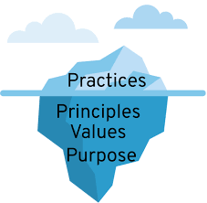
Some Types of Framework
Management Framework for Ethics
Data Governance Framework
IT Governance Framework
Human rights

Slide 15
Management Frameworks for Ethics
A management framework for ethics might suggest a series of steps to be taken. The Markkula Center for Applied Ethics at Santa Clara University offers a typical example (Velasquez, et.al., 2009):
Recognize an ethical issue
Get the facts
Evaluate alternative actions
Make a decision and test it
Act and reflect on the outcome
https://www.scu.edu/ethics/ethics-resources/ethical-decision-making/

Slide 16
Digital Catapault
Anat Elhalal​​: ​Digital Catapult​ was developed to help AI companies design and deploy ethical AI products. It consists of seven concepts:
Be clear about the benefits of your product or service
Know and manage your risks
Use data responsibly
Be worthy of trust
Promote diversity, equality and inclusion
Be open and understandable in communications
Consider your business model
(deBruijn, et.al., 2020) Also, see: https://migarage.digicatapult.org.uk/ethics/
https://migarage.digicatapult.org.uk/ethics/ethics-framework/#

Slide 17
Management Frameworks
Another framework for learning analytics is developed using the SHEILA Framework, an initiative using the Rapid Outcome Mapping Approach (ROMA), which was, according to proponents, specifically designed for policy-making derived from scientific evidence (Young, et.al., 2014).
Identify the problem
Develop a strategy
Develop a monitoring and learning plan
Where RONA differs is in the specific recognition of varying influences and interests (p.14), identifying various dimensions of complexity (p.16), and consideration of the wider political and institutional environment (p.20).
https://sheilaproject.eu/sheila-framework/create-your-framework/overview/
https://moodle.org/mod/forum/view.php?id=8044

Slide 18
https://www.comminit.com/global/content/rapid-outcome-mapping-approach-roma

Slide 19
Failure at the First Step
Ethical issues are often viewed in hindsight, as in, “how could they not have known this was unethical?”
The Santa Clara guide looks at three sorts of questions that might arise: could someone be harmed? Could the action be considered ‘good’ or ‘bad’? Is the question about more than just what is legal? But the answers “yes”, “yes”, and “yes” could be applied to just about any situation.
Image: https://www.vox.com/first-person/2019/3/27/18514886/50-years-wrong-side-of-history-future-prediction-hindsight

Slide 20
Framework = Checklist?
These frameworks are essentially checklists:
What are the relevant facts of the case?
What individuals and groups have an important stake in the outcome?
Have all the relevant persons and groups been consulted?
Have I identified creative options?
Each of these questions involves a judgement that could be made incorrectly, for example, identifying ‘relevance’, ‘importance’, and ‘creative’.

Slide 21
Data Governance
E.g. Carrie Klein and Michael Brown use a data governance framework for ‘Ethics at the Core’
https://www.businessofficermagazine.org/features/ethics-at-the-core/

Slide 22
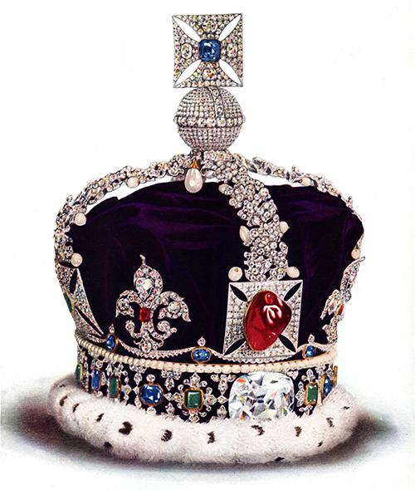
Types of Governance
Weill and Ross [2004] : six governance classifications available to IT organizations based on the ideal of political archetypes:
Business Monarchy – IT decisions are made by CxOs
IT Monarchy – Corporate IT professionals make IT decisions
Feudal – Decision by autonomous business units
Federal – Hybrid decision making
IT Duopoly – IT executives and one business group
Anarchy – Each small group makes decisions
https://aisel.aisnet.org/cgi/viewcontent.cgi?article=3160&context=cais
Ref: Weill, P. and J.W. Ross (2004) IT governance: How Top Performers Manage IT Decision Rights
for Superior Results, Watertown, MA: Harvard Business School Press.

Slide 23
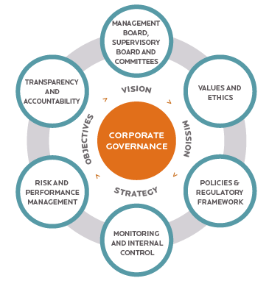
Governance Frameworks
structure and delineate power and roles
set rules, procedures, and other informational guidelines
define, guide, and provide for enforcement of these processes
shaped by the goals, strategic mandates, financial incentives, and established power structures and processes of the organization.
This is the difference

Slide 24
Data Governance Framework
https://liliendahl.com/2021/11/21/whats-in-a-data-governance-framework/

Slide 25
Aspects of Data Governance
De-Anonymisation
Tranberg: We must prohibit the de-anonymisation of anonymised data, as a German Data Ethics Commission suggested last year.
Pernille Tranberg. (2020). Why We Need to Make (Attempts of) De-Anonymisation Illegal. Data Ethics. February 6, 2020. https://dataethics.eu/why-we-need-to-make-de-anonymisation-illegal/
Tranberg, 2019: https://dataethics.eu/german-data-ethics-commission-safeguarding-digital-sovereignty-of-europe-is-ethical-responsibility/

Slide 26
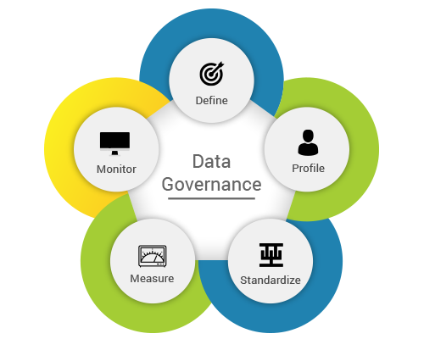
Aspects of Data Governance
Policies, Roles and Teams
data management and classification policy
data managers team consisting of representatives from departments
data request process: making it it responsive, timely, and consistent
culture: helping people value the ethical use of data
data security
Klein & brown, https://www.businessofficermagazine.org/features/ethics-at-the-core/
Image: https://www.rawsoft.com/wp-content/uploads/2019/09/Data-Governance.png

Slide 27
Aspects of Data Governance
Informed consent
Anouk Ruhaak (2020): the principle of 'informed consent' is dead
If one person gives consent, many people are affected
It's unlikely anyone is truly 'informed' when they give consent
Consent is meaningless without the ability to opt out
Ruhaak argues for an alternative, collective consent, in which our rights are managed by "a fiduciary, someone with a legal responsibility to look out for your interest, rather than their own."
https://foundation.mozilla.org/en/blog/when-one-affects-many-case-collective-consent/

Slide 28
Aspects of Data Governance
Single source of truth
This is at once a technical term for database management and also critical advice for working in a distributed environment.
No duplicate data entries or version control issues
Timely data values at the right moment
Reduced time spent validating records and data types
Improved data warehouse and intelligence
Improved communication and productivity
https://www.vistaprojects.com/blog/what-is-single-source-of-truth-ssot/
https://en.wikipedia.org/wiki/Single_source_of_truth

Slide 29
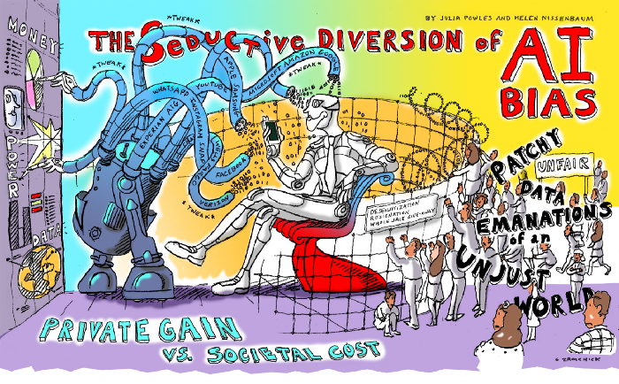
Data Governance as a Diversion
Julia Powles and Helen Nissenbaum: ‘Solving bias’ in AI data is a diversion; “recognizing and acknowledging bias can be seen as a strategic concession — one that subdues the scale of the challenge.”
https://onezero.medium.com/the-seductive-diversion-of-solving-bias-in-artificial-intelligence-890df5e5ef53

Slide 30
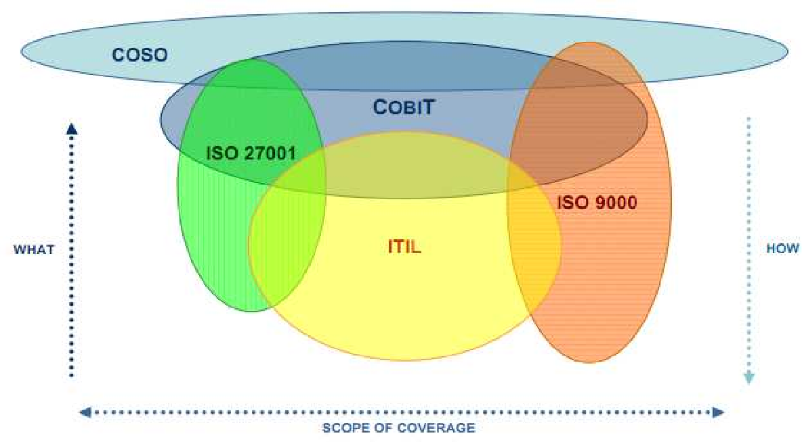
IT Governance Frameworks
“Many respected IT organizations and standards setting bodies have established frameworks to identify the ‘risks and mitigation strategies with the evolving cloud computing paradigm’”
https://core.ac.uk/download/pdf/301361909.pdf

Slide 31
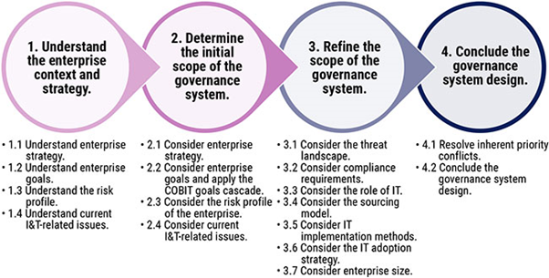
CobiT
“Control Objectives for Information and Related Technology (CobiT) is an IT governance control framework that helps organizations address the areas of regulatory compliance, risk management and aligning IT strategy with organizational goals.”
https://www.bmc.com/blogs/cobit-vs-itil-understanding-governance-frameworks/
https://www.bmc.com/blogs/cobit-2019-vs-cobit-5/

Slide 32
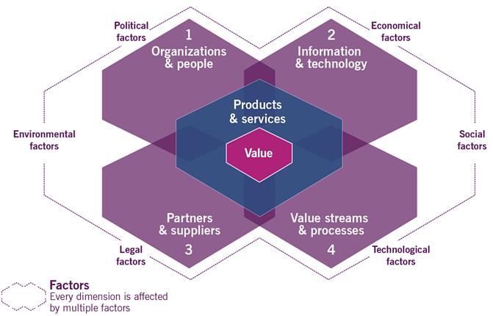
ITIL
IT Infrastructure Library (ITIL) provides a set of best practices that have become the most widely accepted approach to IT service management in the world.
“ITIL advocates that IT services must be aligned to the needs of the business and underpin the core business processes. It provides guidance to organizations on how to use IT as a tool to facilitate business change, transformation and growth.”
https://info.axiossystems.com/blog/what-is-the-itil4-service-value-system
https://core.ac.uk/download/pdf/301361909.pdf
What is ITIL? (2012, June 30). Retrieved from ITIL Offical Site:
http://www.itil-officialsite.com/AboutITIL/WhatisITIL.aspx

Slide 33
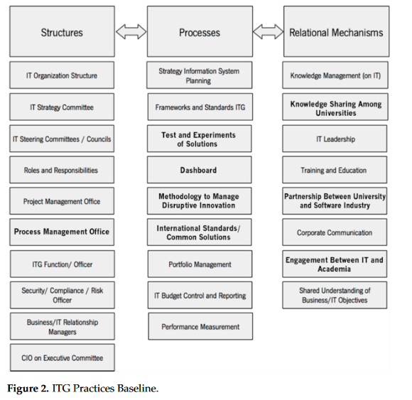
IT Governance for Higher Education
Argues: “the best configuration is one where both worlds have a federal structure, where the infrastructure, strategy, roles and procedures are centralised to avoid wasting resources and the execution and operations are decentralised.”
https://www.mdpi.com/2227-9709/8/2/26/pdf

Slide 34
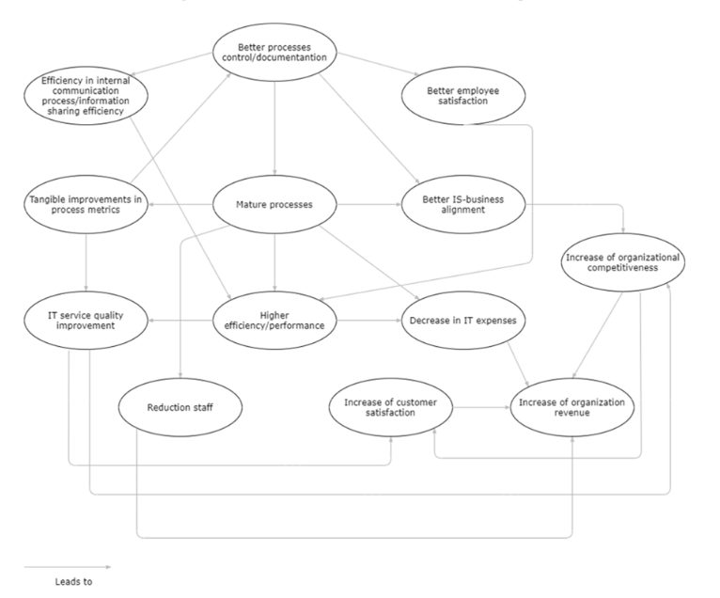
Measuring Benefits and Performance
“It is reasonable to argue that organizations should first focus on the benefits that promote (out) more other benefits rather than being promoted (in) by other benefits.”
https://www.mdpi.com/2078-2489/12/3/111/pdf p. 14

Slide 35
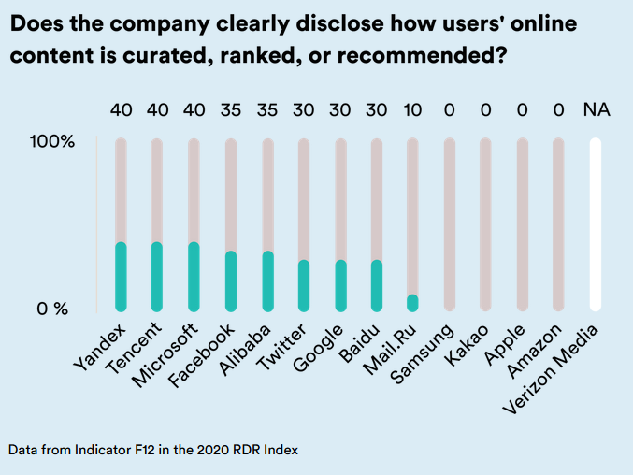
Human Rights Frameworks
“A human rights framework for algorithms that would "not just set forth standards for how to 'do no harm' or 'be ethical,' but it would help hold companies accountable for those standards, by providing mechanisms for risk assessment, enforcement, redress when harm has occurred, and individual empowerment for technology users."
https://rankingdigitalrights.org/index2020/spotlights/unaccountable-algorithms
https://www.theguardian.com/law/2019/dec/17/people-should-be-held-accountable-for-ai-and-algorithm-errors-rights-commissioner-says

Slide 36
Human Rights Impact Assessment
https://www.socialimpactassessment.com/documents/hria_guidance_and_toolbox_final_jan2016.pdf p. 8

Slide 37
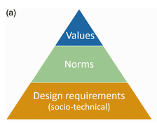
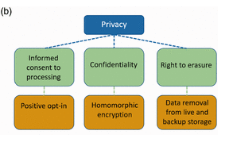
Designing for Human Rights
Halbertal (2015) three categories of violations:
Humiliation: being put in a state of helplessness, insignificance; losing autonomy over your own representation.
Instrumentalization: treating an individual as exchangeable and merely a means to an end.
Rejection of one’s gift: making an individual superfluous, unacknowledging one’s contribution, aspiration, and potential.
Quoted from: Designing for human rights in AI. Evgeni Aizenberg, Jeroen van den Hoven. August 18, 2020 https://journals.sagepub.com/doi/10.1177/2053951720949566

Slide 38
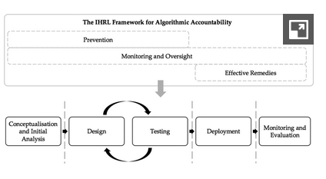
Drawing on International Human Rights Law
IHRL as a Means for Assessing Harm
Clearly Defined Obligations and Expectations That Apply Across the Algorithmic Life Cycle
Identifying roles and responsibilities attached to different entities across the full algorithmic life cycle
Operationalizing the measures necessary to ensure rights compliance
Integrating a rigorous accountability framework
https://www.cambridge.org/core/journals/international-and-comparative-law-quarterly/article/international-human-rights-law-as-a-framework-for-algorithmic-accountability/1D6D0A456B36BA7512A6AFF17F16E9B6

Slide 39
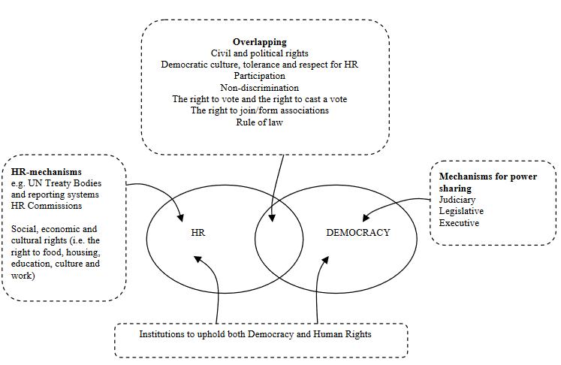
Limitations of Human Rights Frameworks
these rights may be too Western
too individualistic
too narrow in scope
too abstract to form the basis of sound AI governance.
Requires democracy: “without… securing an underlying societal infrastructure that enables human rights in the first place, any human rights-based governance framework for AI risks falling short of its purpose”
https://www.researchgate.net/publication/237390540_What_is_the_Rights_Based_Approach_all_About_Perspectives_from_International_Development_Agencies/link/00b7d52bd62368c112000000/download
Nathalie A. Smuha, 2020, Beyond a Human Rights-Based Approach to AI Governance: Promise, Pitfalls, Plea https://link.springer.com/article/10.1007/s13347-020-00403-w

Slide 40
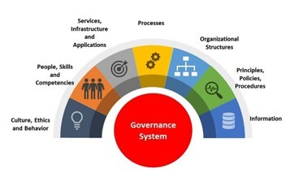
The Problem With Governance Frameworks
They’re designed for organizations, not wider society
They depend on agreement and shared presumptions
They are not actually based in ethics
Humans
https://www.linkedin.com/pulse/cobit-2019-review-framework-its-major-concepts-gr%C3%A9gory-franc/

Slide 41
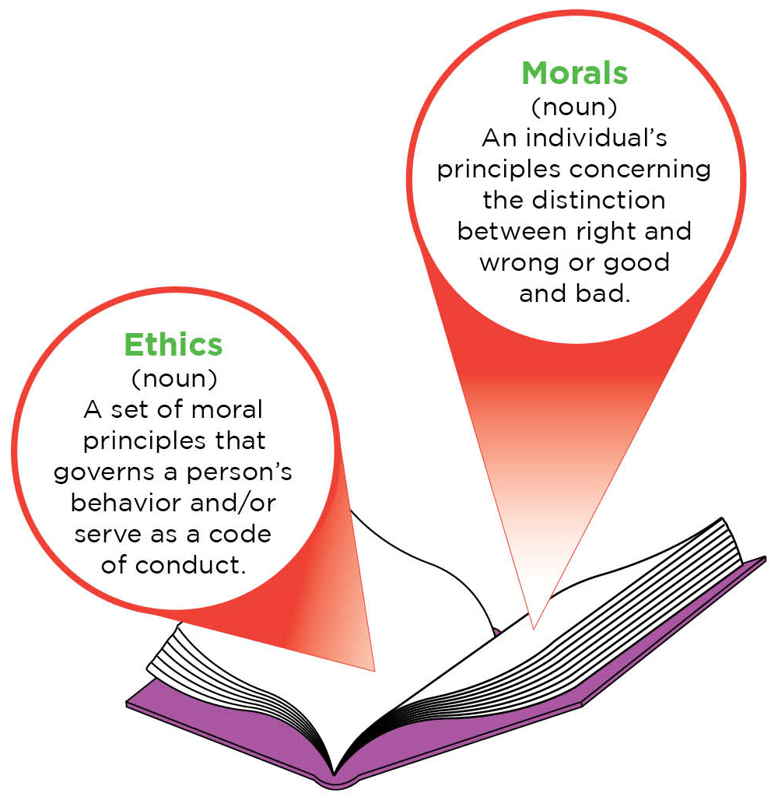
Activation of Ethical Practices
What not to do…?
The HBR Approach
Knowledge Translation
Knowledge Mobilization
Connective Action

Slide 42
What Not to Do…?
Per Harvard Business Review…
the academic approach:
“Should we…” Vs. the Business approach: “how can we do it without making ourselves vulnerable to ethical risks?””
the on-the-ground approach
“engineers, data scientists, and product managers…. lack, the skill, knowledge, and experience to answer ethical questions systematically”
high-level AI ethics principles
“The difficulty comes in operationalizing those principles. What, exactly, does it mean to be for “fairness?”
Reid Blackman, 2020, https://hbr.org/2020/10/a-practical-guide-to-building-ethical-ai

Slide 43
The HBR Approach
Identify existing infrastructure that a data and AI ethics program can leverage.
Create a data and AI ethical risk framework that is tailored to your industry.
Change how you think about ethics by taking cues from the successes in health care.
Optimize guidance and tools for product managers.
Build organizational awareness.
Formally and informally incentivize employees to play a role in identifying AI ethical risks.
Monitor impacts and engage stakeholders.
Reid Blackman, 2020, https://hbr.org/2020/10/a-practical-guide-to-building-ethical-ai

Slide 44
Knowledge Translation
Knowledge translation was defined at a consensus meeting of the World Health Organization in 2005 as ‘the synthesis, exchange and application of knowledge by relevant stakeholders to accelerate the benefits of global and local innovation in strengthening health systems and advancing people's health’
https://bmcpublichealth.biomedcentral.com/articles/10.1186/s12889-020-10121-9/figures/2

Slide 45
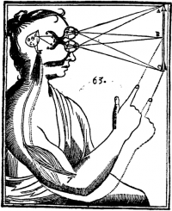
Beyond the Translation Metaphor
Three assumptions underpin the knowledge translation metaphor:
knowledge is seen as unproblematically separable from the scientists who generate it and the practitioners who may use it (the ‘objectivist’ approach to knowledge).
knowledge and practice can be cleanly separated both empirically and analytically.
practice consists more or less of a series of rational decisions on which scientific research findings can be brought to bear.
https://www.ncbi.nlm.nih.gov/pmc/articles/PMC3241522/

Slide 46
Lost in Translation
“Models and processes developed in learning analytics research are increasing in sophistication and predictive power. However, the ability to translate analytic findings to practice remains problematic.”
First, "awareness that a particular tactic or strategy is generally beneficial is often insufficient motivation for a student to adopt it," and second, the labeling of these practices is itself a challenge.
https://dl.acm.org/doi/10.1145/3375462.3375474

Slide 47
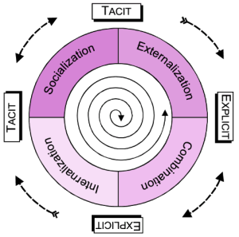
Knowledge Mobilization
making evidence accessible, understandable and useful for knowledge users
meaningful use of evidence and expertise to align research, policy and practice in order to improve outcomes
not just about disseminating information
not just about sharing, or publishing, or one-way information flow
engagement, end-user participation and attention to impact
It includes practice-based evidence from the real world, from the expertise of practitioners
https://kmbkteam.wordpress.com/2011/01/05/the-difference-between-km-knowledge-management-kmb-knowledge-mobilization/
http://www.kmbtoolkit.ca/what-is-kmb
https://www.sshrc-crsh.gc.ca/about-au_sujet/publications/KMb_-_LevinDiscussionPaper_-_E.pdf

Slide 48
From a KM Perspective
Knowledge is socially constructed and its use takes multiple forms
Bodies of consistent evidence are more powerful and effective over time than single studies
Most practitioners have a range of connections to research
sources of practices and decisions are hard to define with precision
Knowledge is always mediated in some way through various social and political processes
Knowledge by itself is not enough to change practice
The scale of impact matters but has not received very much attention.
The relationship between knowledge and use runs in both directions
Personal contact and interaction remains the most powerful vehicle for moving evidence into practice.
Not only a matter of producing more knowledge, but also of improving both the desire and capacity for its use
Dedicated effort matters.
https://www.oise.utoronto.ca/rspe/UserFiles/File/KM%20paper%20May%20Symposium%20FINAL.pdf

Slide 49
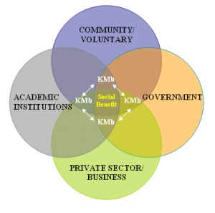
Applying Knowledge Mobilization
The need to go beyond traditional publishing
Researchers need to find an uptake for “strategies that excite them”
“need to put aside your personal agenda and to challenge your own disciplinary/sectoral approaches to become a part of something bigger.”
https://kmbkteam.wordpress.com/2011/01/05/the-difference-between-km-knowledge-management-kmb-knowledge-mobilization/
https://timreview.ca/article/1014

Slide 50
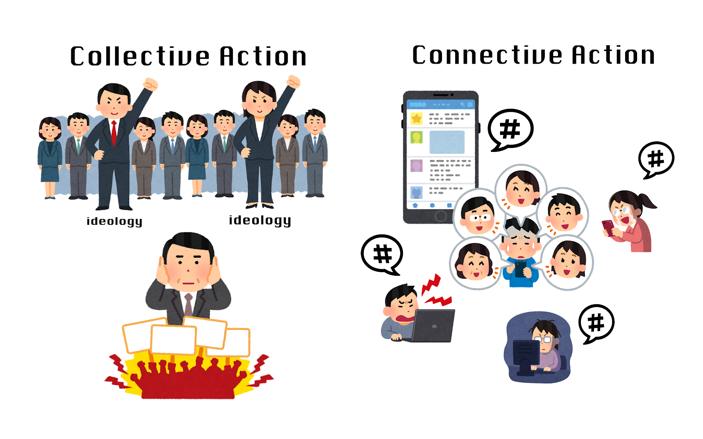
Connective Action
Forms of activism that focus on quiet acts of caring rather than amplification of a message or platform
Saidiya Hartman: a movement "driven not by uplift or the struggle for recognition or citizenship, but by the vision of a world that would guarantee to every human being free access to earth and full enjoyment of the necessities of life, according to individual desires, tastes, and inclinations."
Resistance in a minor key: Care, survival and convening on the margins, Rianka Singh, First Monday, 2020/08/11 https://firstmonday.org/ojs/index.php/fm/article/view/10631/9418
https://the-leads-asia.news/2021/02/19/drschafer-part2/

Slide 51
Connective Action
Key ideas:
the idea of ‘platform inclination’ as an alternative to ‘standing up to’ or ‘against’ something
the idea of producing hope rather than ‘looking for hope in the sky,’
the distinction between ‘a performance of care’ as opposed to ‘doing the work of care,’
connective action and the practice of 'communicative labour' "at the point of organizing rather than more visible forms of resistance."
https://theconversation.com/connective-action-the-publics-answer-to-democratic-dysfunction-33089

