Slide 1
Citizenship
Stephen Downes
December 24, 2021

Slide 2
Community and Responsibility
Stacia L. Kock , 2011, https://www.semanticscholar.org/paper/TOWARDS-INCLUSION%3A-EXPANDING-AND-CHALLENGING-Kock/769716d26f0fb251cbe8f082d05cd39906385da5

Slide 3
Political and Economic Participation…
Lockean liberalism: “pursue the good life and be free from unreasonable government interference”
Prior belief, described by de Tocqueville, that all are “born equal”
Based on competition, with presumption of fairness
Republicanism: widespread participation of citizenry
Basis of participation is a duty toward the community
Jefferson: public education necessary to develop the means and the skill
Mossberger, Tolbert & McNeal, 2008. Digital Citizenship. MIT. pp. 6-7
Title Image: https://www.cbc.ca/news/politics/citizenship-tests-immigration-pandemic-covid19-1.5815945

Slide 4
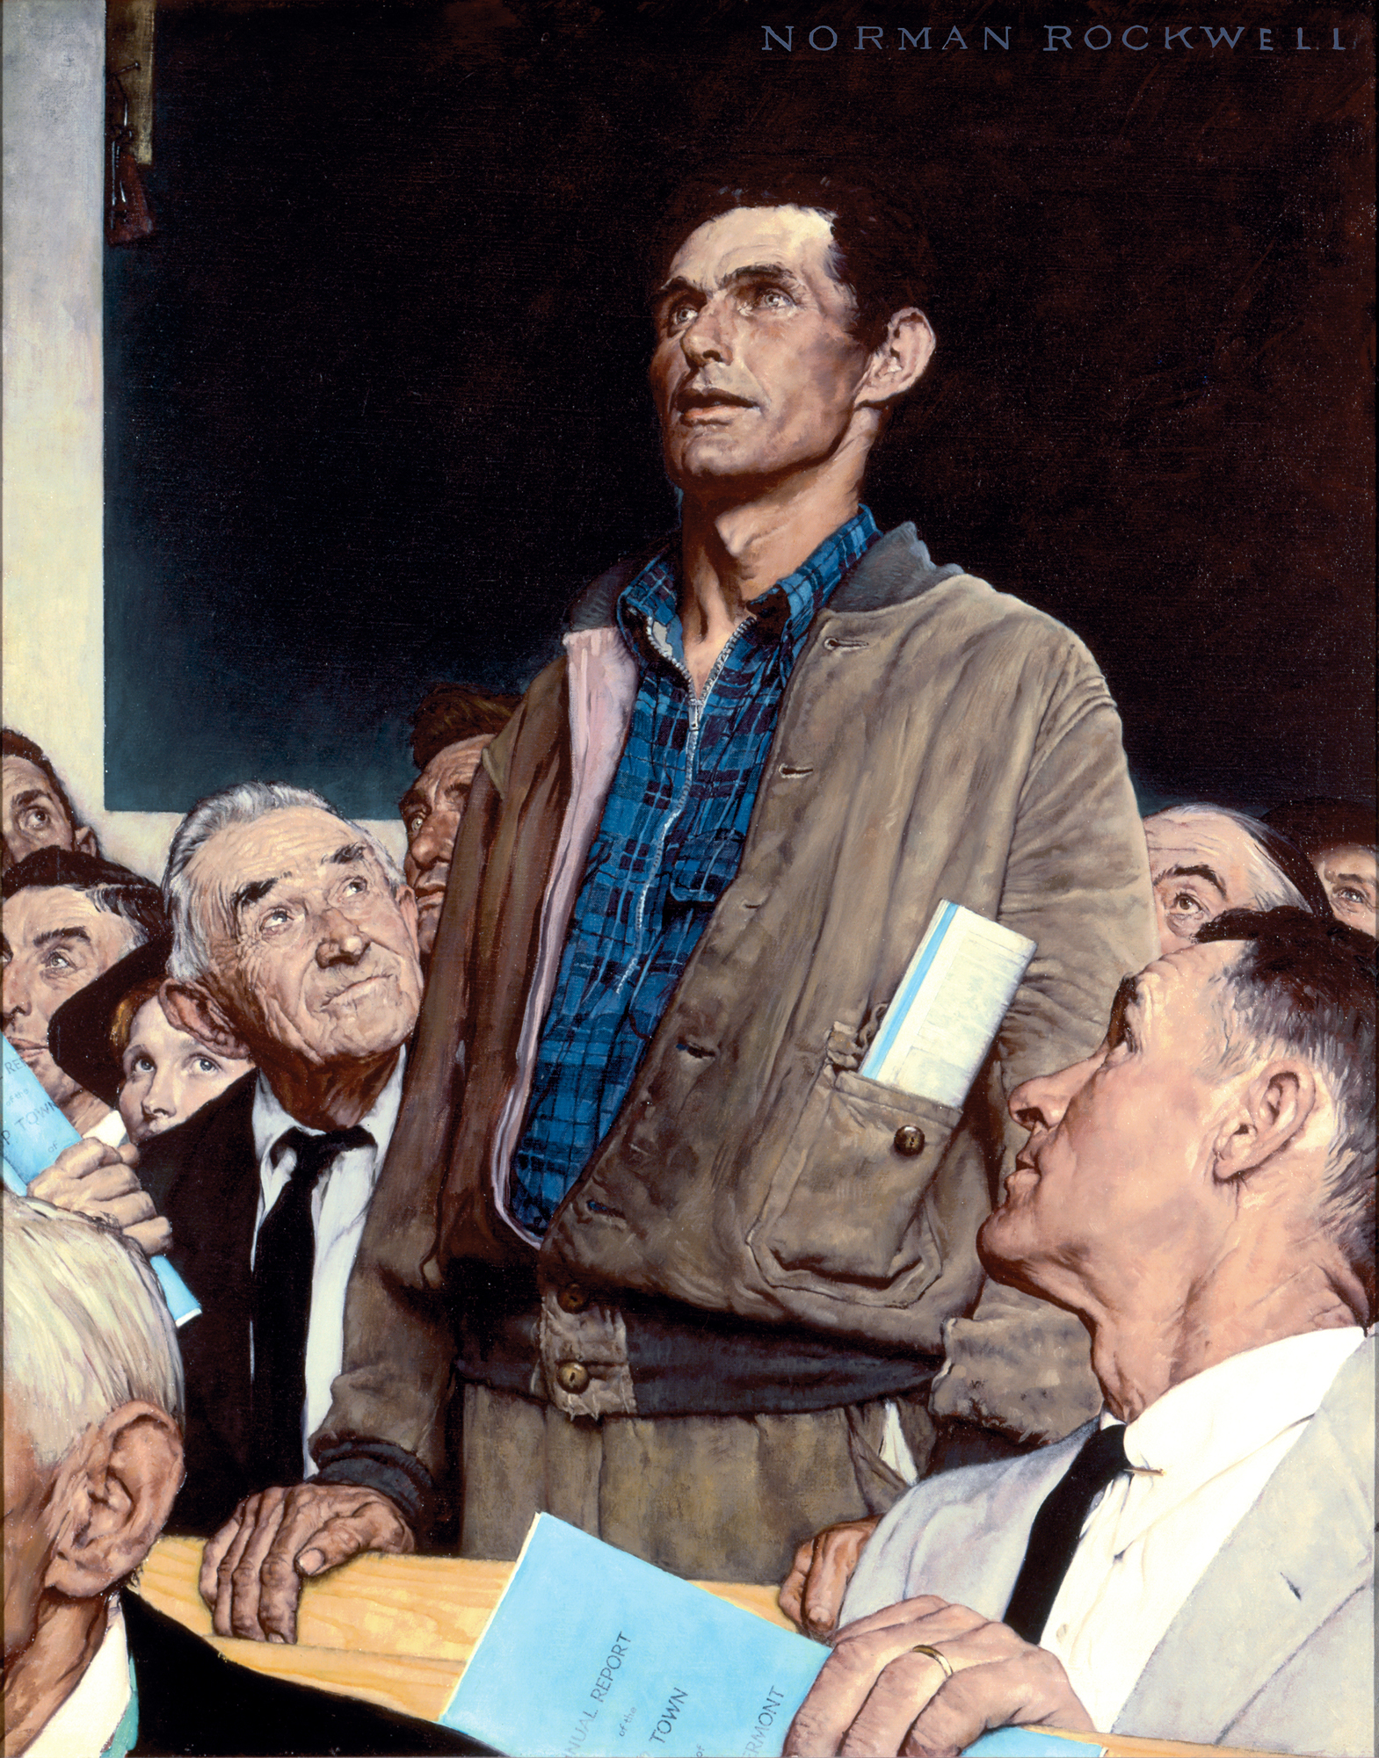
The Digital Nation
Wired, 1997: The Digital Citizen and Birth of a Digital Nation, Jon Katz
“blends the humanism of liberalism with the economic vitality of conservatism.”
“reject both the interventionist dogma of the left and the intolerant ideology of the right”
“embrace rationalism, revere civil liberties and free-market economics”
Buzzfeed, 2019: We were promised community, civics, and convenience. Instead, we found ourselves dislocated, distrustful, and disengaged.
https://www.buzzfeednews.com/article/josephbernstein/in-the-2010s-decade-we-became-alienated-by-technology
http://www.csun.edu/~vcspc00g/454/digitalcitizen1.html

Slide 5
The Idea of Citizenship
“Citizenship as an idea of its own is both crucial and crucially misunderstood, often reduced to political notions (Be heard–Vote!) or those ecological (Always Recycle!). Consider how infrequently many adults consider how the work they do, the things they buy, or the food they eat affects national or global citizenship.
“This is all big picture thinking that is, somehow, easy to miss.”
https://www.teachthought.com/the-future-of-learning/digital-leadership-2/
Image: https://giteshtrivedi.wordpress.com/2019/01/30/politics-or-citizenship-learning-in-school/

Slide 6
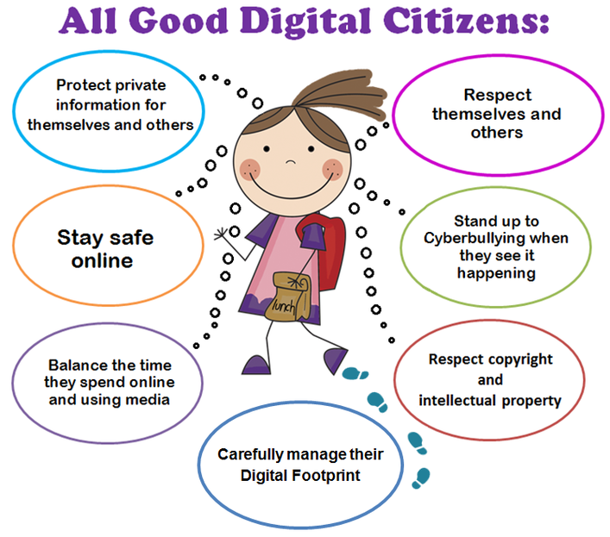
Digital Citizenship…
Terry Heick:
Citizenship: “consists of self-knowledge, interaction, and intimate knowledge of a place, its people, and its cultural history.”
Digital Citizenship: “Self-monitored participation that reflects conscious interdependence with all (visible and less visible) community members… (and) The quality of habits, actions, and consumption patterns that impact the ecology of digital content and communities.”
https://www.merriam-webster.com/dictionary/citizenship
https://www.teachthought.com/the-future-of-learning/definition-digital-citizenship/
https://www.virtuallibrary.info/digital-citizenship.html

Slide 7
Upstairs Downstairs
Mike Ribble: nine themes of digital citizenship
Back Upstairs
Duties
Commerce
Collaboration
Law
Rights & Responsibility
Security & privacy
Access
Communication
Etiquette
Fluency
Health & Welfare
Virtues
On Downstairs
Ribble, Mike. Digital citizenship in schools: Nine elements all students should know. International Society for Technology in Education, 2015.
https://files.eric.ed.gov/fulltext/EJ1018088.pdf

Slide 8
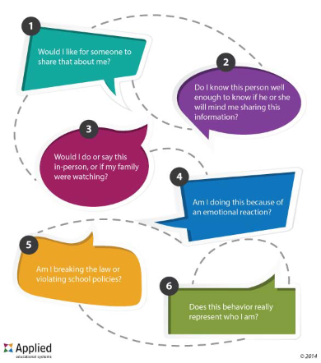
Teaching Digital Citizenship
Pulling in the direction of duties and virtues…
For example, seven key concepts from Chris Zook:
Empathy
How the Internet works
Understanding user data
Practicing digital literacy
Acknowledging the digital divide
Practicing digital wellness
Securing digital devices
https://www.aeseducation.com/blog/what-is-digital-citizenship

Slide 9
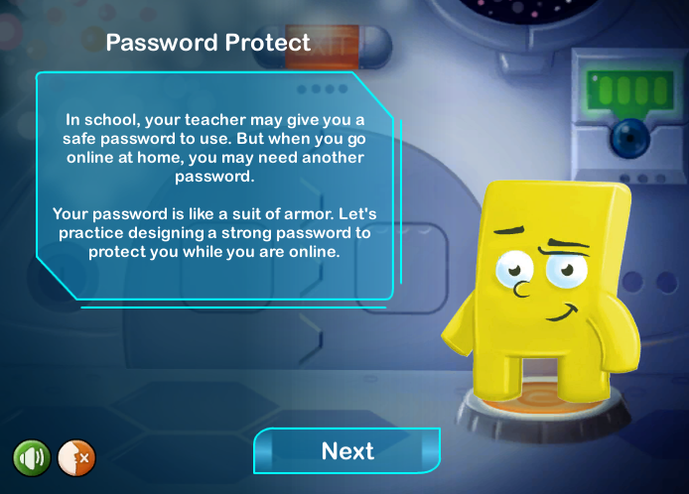
Teaching Digital Citizenship
Pulling in the direction of duties and virtues…
For example, areas of focus from Common Sense Education
Media balance and well-being
Privacy and security
Digital footprint and identity
Relationship and communication
Cyberbullying, drama, hate speech
News and media literacy
https://www.commonsense.org/education/digital-citizenship/curriculum?grades=3%2C4%2C5

Slide 10
Ethical Digital Citizens (as Duties)
What is an ethical digital citizen…?
Take Care of Technology Equipment
Explore Appropriate and Safe Sites
Copyright Law, Fair Use…
Help Prevent Cyberbullying
Self-image Is Important
Make Use of Netiquette
Always Give Credit to Original Source
Remember to Be Effective, Thoughtful, and Ethical Digital Creators
Think
https://www.educationworld.com/a_tech/responsible-student-technology-use.shtml

Slide 11
Ethical Digital Citizens (as Virtues)
Jason Ohler:
“Schools have already started unofficially addressing digital character education in the form of acceptable Internet use agreements that specify virtual behavior standards for students.”
“We need to create formal digital citizenship programs that deal with character education in the digital age deeply, directly, and comprehensively.”
https://www.tandfonline.com/doi/abs/10.1080/00228958.2011.10516720?journalCode=ukdr20
http://sshspd.pbworks.com/w/file/fetch/59899315/Character%20Education%20in%20the%20Digital%20Age.pdf

Slide 12
What Constitutes the Digital Citizen?
If a defining characteristic of a nation is that it embraces diversity of opinion, then you cannot define membership in that nation according to the opinions held by its citizens.
By analogy: Americans identify with "life, liberty and the pursuit of happiness". That is, most Americans, if asked, would embrace these values. However, embracing these values is not what defines an American. Rather, what defines an American is being born in the United States (or having legally immigrated).
https://www.downes.ca/post/117

Slide 13
From Digital Citizenship to Digital Leadership
https://www.teachthought.com/the-future-of-learning/digital-leadership-2/

Slide 14
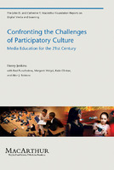
Participatory Culture
Henry Jenkins
relatively low barriers to artistic expression and civic engagement,
strong support for creating and sharing creations with others,
some type of informal mentorship whereby what is known by the most experienced is passed along to novices,
members who believe that their contributions matter, and
members who feel some degree of social connection with one another (at the least, they care what other people think about what they have created).
https://library.oapen.org/handle/20.500.12657/26083

Slide 15
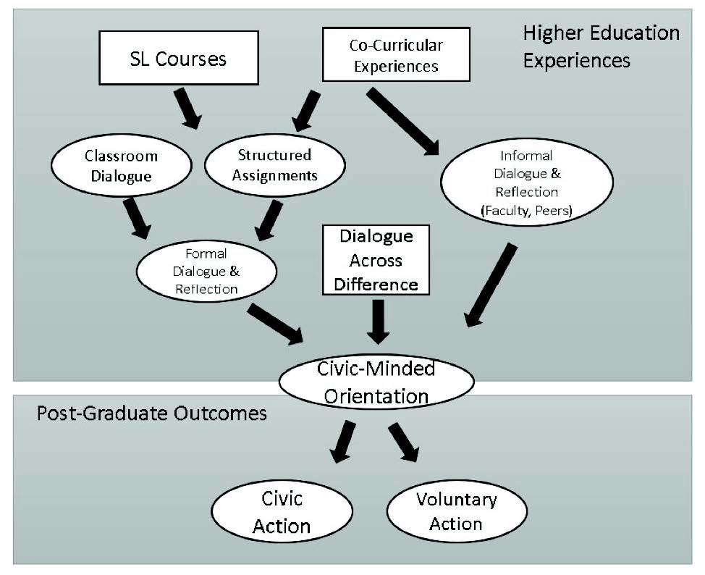
Refining Objectives…
“argues for a narrower focus on (1) respectful behavior online and (2) online civic engagement.”
“Both online respect and civic engagement were negatively related to online harassment perpetration and positively related to helpful bystander behaviors, after controlling for other variables.”
Jones & Mitchel, 2016 https://journals.sagepub.com/doi/abs/10.1177/1461444815577797
Image: https://quod.lib.umich.edu/cgi/t/text/text-idx?cc=mjcsloa;c=mjcsl;c=mjcsloa;idno=3239521.0023.105;g=mjcslg;rgn=main;view=text;xc=1

Slide 16
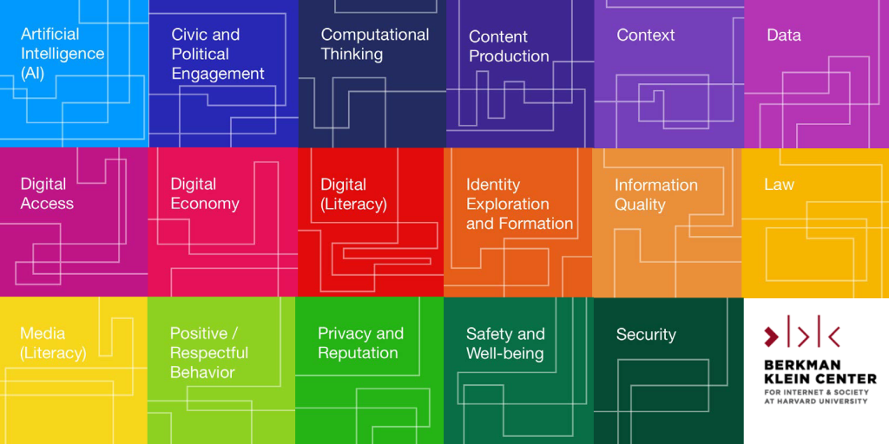
Digital Citizenship+
Digital Citizenship+ is defined as “the skills needed for youth to fully participate academically, socially, ethically, politically, and economically in our rapidly evolving digital world.”
https://cyberbullying.org/digital-citizenship-research

Slide 17
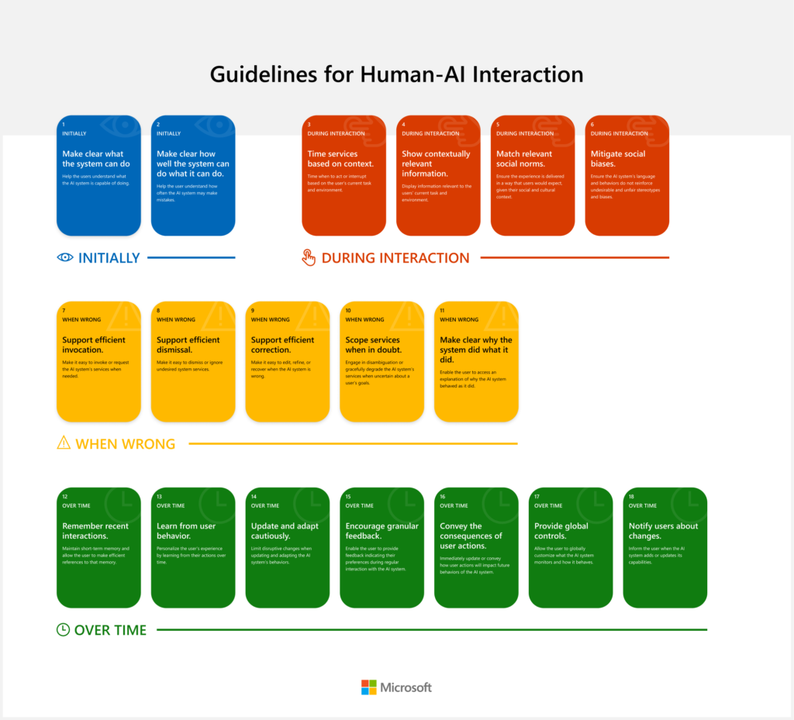
Human-AI Interaction
The concept of ethical AI is going to come down to something like describing AI as an ethical citizen
We have a tendency to describe this in terms of virtues and duties
But ultimately, it comes down to how well AI and humans can interact with each other
Microsoft: Guidelines for Human-AI Interaction - https://www.microsoft.com/en-us/research/project/guidelines-for-human-ai-interaction/ Report: https://www.microsoft.com/en-us/research/publication/guidelines-for-human-ai-interaction/

