Slide 1
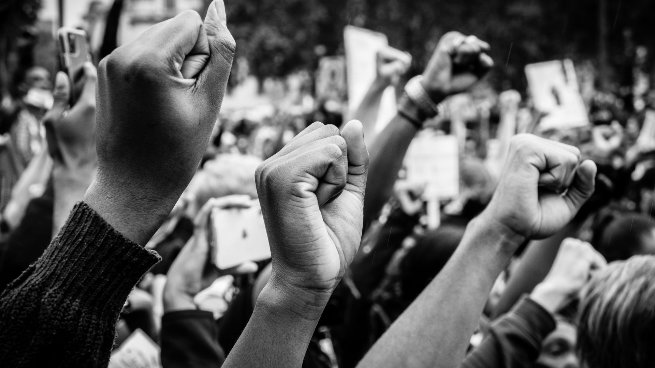
Democracy
Stephen Downes
December 24, 2021

Slide 2
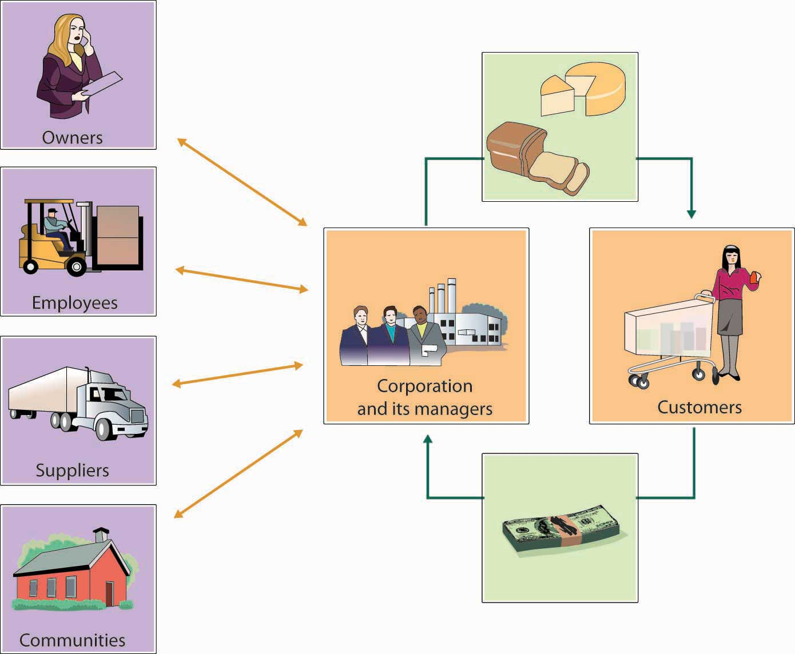
Corporate Citizenship
Right now, most AI is produced by, and represents the interests of, corporations
But corporations (especially digital corporations) haven’t been very good citizens
That’s why we fear their AIs won’t be either
https://saylordotorg.github.io/text_exploring-business-v2.0/s06-05-corporate-social-responsibilit.html

Slide 3
Corporations as Bad Citizens
“The power of corporations is frequently misused, usually to the advantage of the financial and managerial elite. Employees, communities, consumers, the environment, and the public interest in general are elbowed aside in corporate decision-making, unless the corporation can make money by taking them into account. Corporations are managed aggressively to maximize shareholder return. As a result, the risks they run—whether of oil spills in the Gulf or of financial crises erupting from Wall Street—are often unrecognized until too late. The executives who run American corporations do not generally think of themselves as having obligations to the public. The social contract of American corporations is pretty thin.”
Kent Greenfield , 2015, The Atlantic https://www.theatlantic.com/politics/archive/2015/02/if-corporations-are-people-they-should-act-like-it/385034/

Slide 4
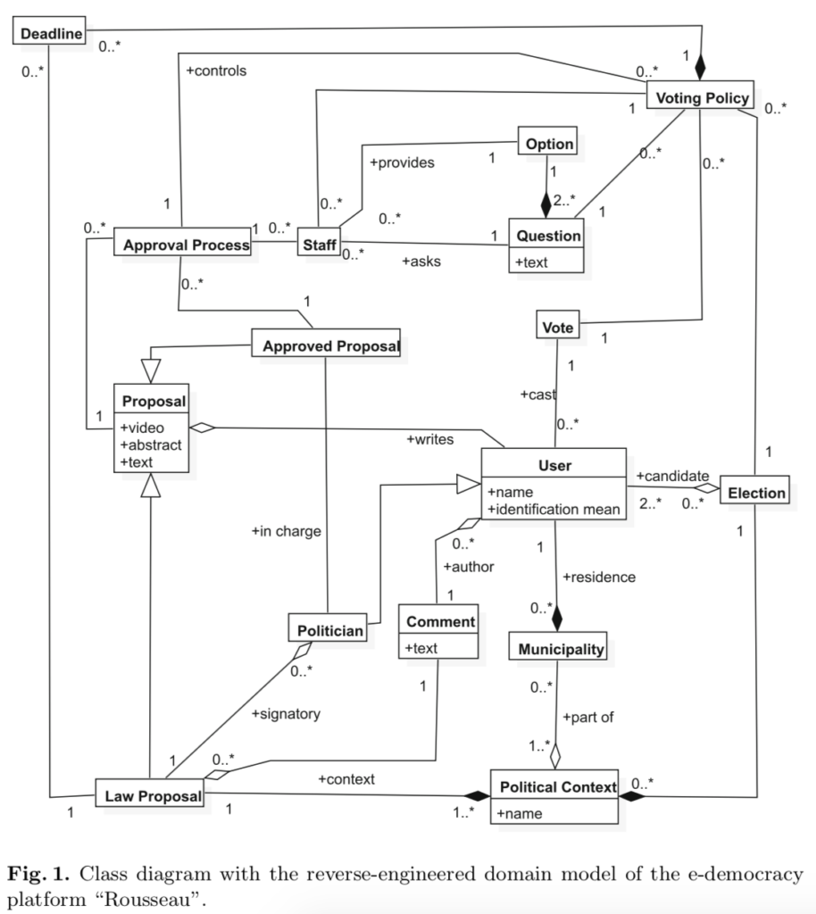
Towards Platform Democracy
“Platforms working with governments, civil society, can have experienced and neutral facilitators deploy these new processes for the toughest policy questions.”
“Policy decisions will then be made by the impacted populations and informed by key stakeholders, often leading to a strong public mandate (which may even help defend against partisan or authoritarian overreach).”
Aviv Ovadya, Oct. 18, 2021, Towards Platform Democracy: Policymaking Beyond Corporate CEOs and Partisan Pressure https://www.belfercenter.org/publication/towards-platform-democracy-policymaking-beyond-corporate-ceos-and-partisan-pressure Image: https://arielsheen.com/index.php/2019/04/15/review-of-democratic-process-and-digital-platforms-an-engineering-perspective/

Slide 5
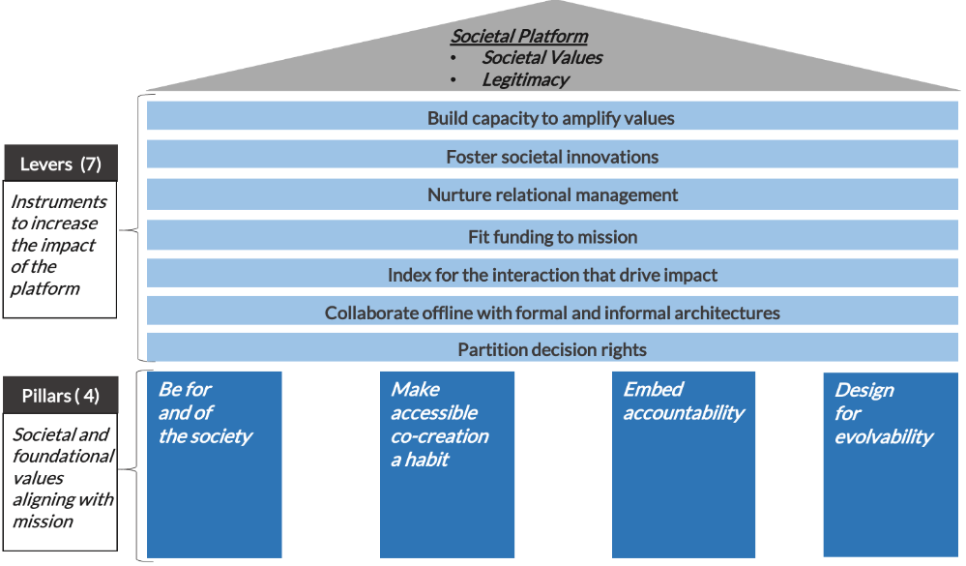
Platform Governance
Bias interactions to deliver impact
Embed accountability
Design for evolvability
https://networkweaver.com/principles-for-ecosystem-governance/

Slide 6
Design as Participation
Kevin Slavin says in Design as Participation, "You're Not Stuck In Traffic--You Are Traffic.“
Joi Ito: “Instead of trying to control or design or even understand systems, it is more important to design systems that participate as responsible, aware and robust elements of even more complex systems.”
https://jods.mitpress.mit.edu/pub/design-as-participation/release/1
https://joi.ito.com/weblog/2017/12/20/resisting-reduction.html

Slide 7
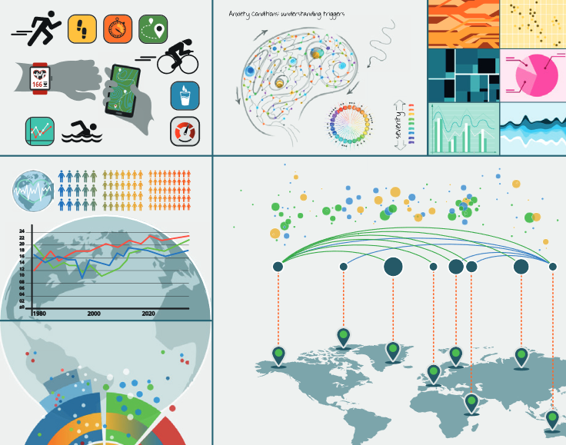
Access and Inequality
From OLDaily: “We've been engaged recently in a project to define and assess data literacy, and topics related to this were in my mind as I attended the AI Policy Community of Practice (AIPCoP) discussion this afternoon. These topics overlap in the concept of data feminism, a "way of thinking about data science and data ethics that is informed by the ideas of intersectional feminism." This open access book provides one way of approaching the topic; it's a collection of 26 papers discussing data literacy, the role of data visualization in media, and its relation to inequality in society.”
Data Visualization in Society - https://www.downes.ca/post/71408
Martin Engebretsen, Helen Kennedy, Amsterdam University Press, 2020/09/25

Slide 8
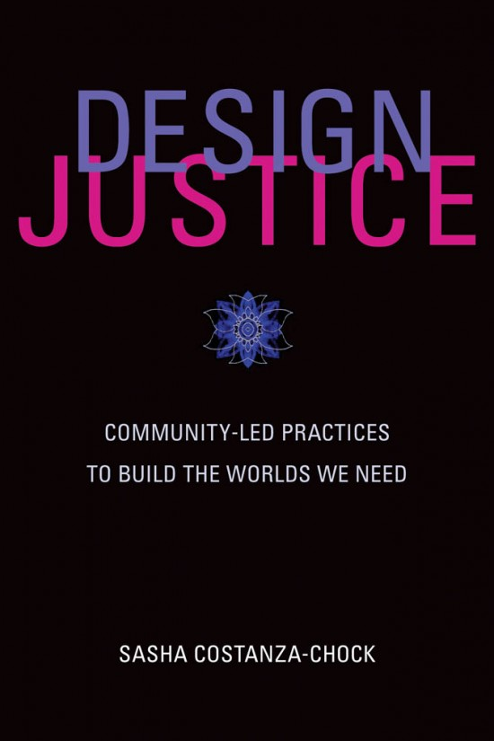
Community Leadership & Design Justice
“Universalist design principles and practices erase certain groups of people—specifically, those who are intersectionally disadvantaged or multiply burdened”
Proposes platform design led by marginalized communities to “dismantle structural inequality, and advance collective liberation and ecological survival.”
https://library.oapen.org/bitstream/handle/20.500.12657/43542/external_content.pdf?sequence=1
https://designjustice.org/

Slide 9
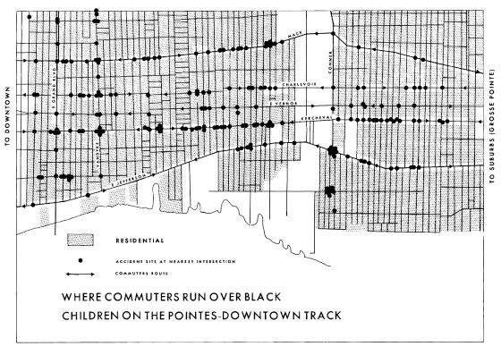
Data Feminism
“The most complete knowledge comes from synthesizing multiple perspectives, with priority given to local, Indigenous, and experiential ways of knowing.”
https://data-feminism.mitpress.mit.edu/ By Catherine D'Ignazio and Lauren F. Klein
Amy Collier, EDUCAUSE Review - Inclusive design https://er.educause.edu/articles/2020/10/inclusive-design-and-design-justice-strategies-to-shape-our-classes-and-communities
Care being taken not to create experiences that harm people https://www.kqed.org/mindshift/58698/how-to-fend-off-educational-numbness-with-experiential-learning

Slide 10
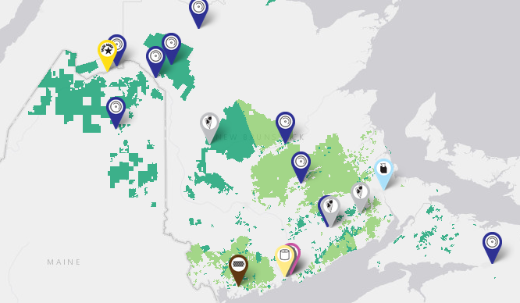
Algorithmic Justice
“Give members of communities most impacted by algorithmic bias more direct democratic power over crucial decisions”
not merely after its deployment, but also at the design stage.
meaningful opportunities for bottom-up democratic deliberation about, and democratic contestation of, algorithmic tools ideally before they are deployed.”
https://www.irvingwoodlands.com/jdi-woodlands-map-of-operations.aspx
(Zimmerman, et.al., 2020)

Slide 11
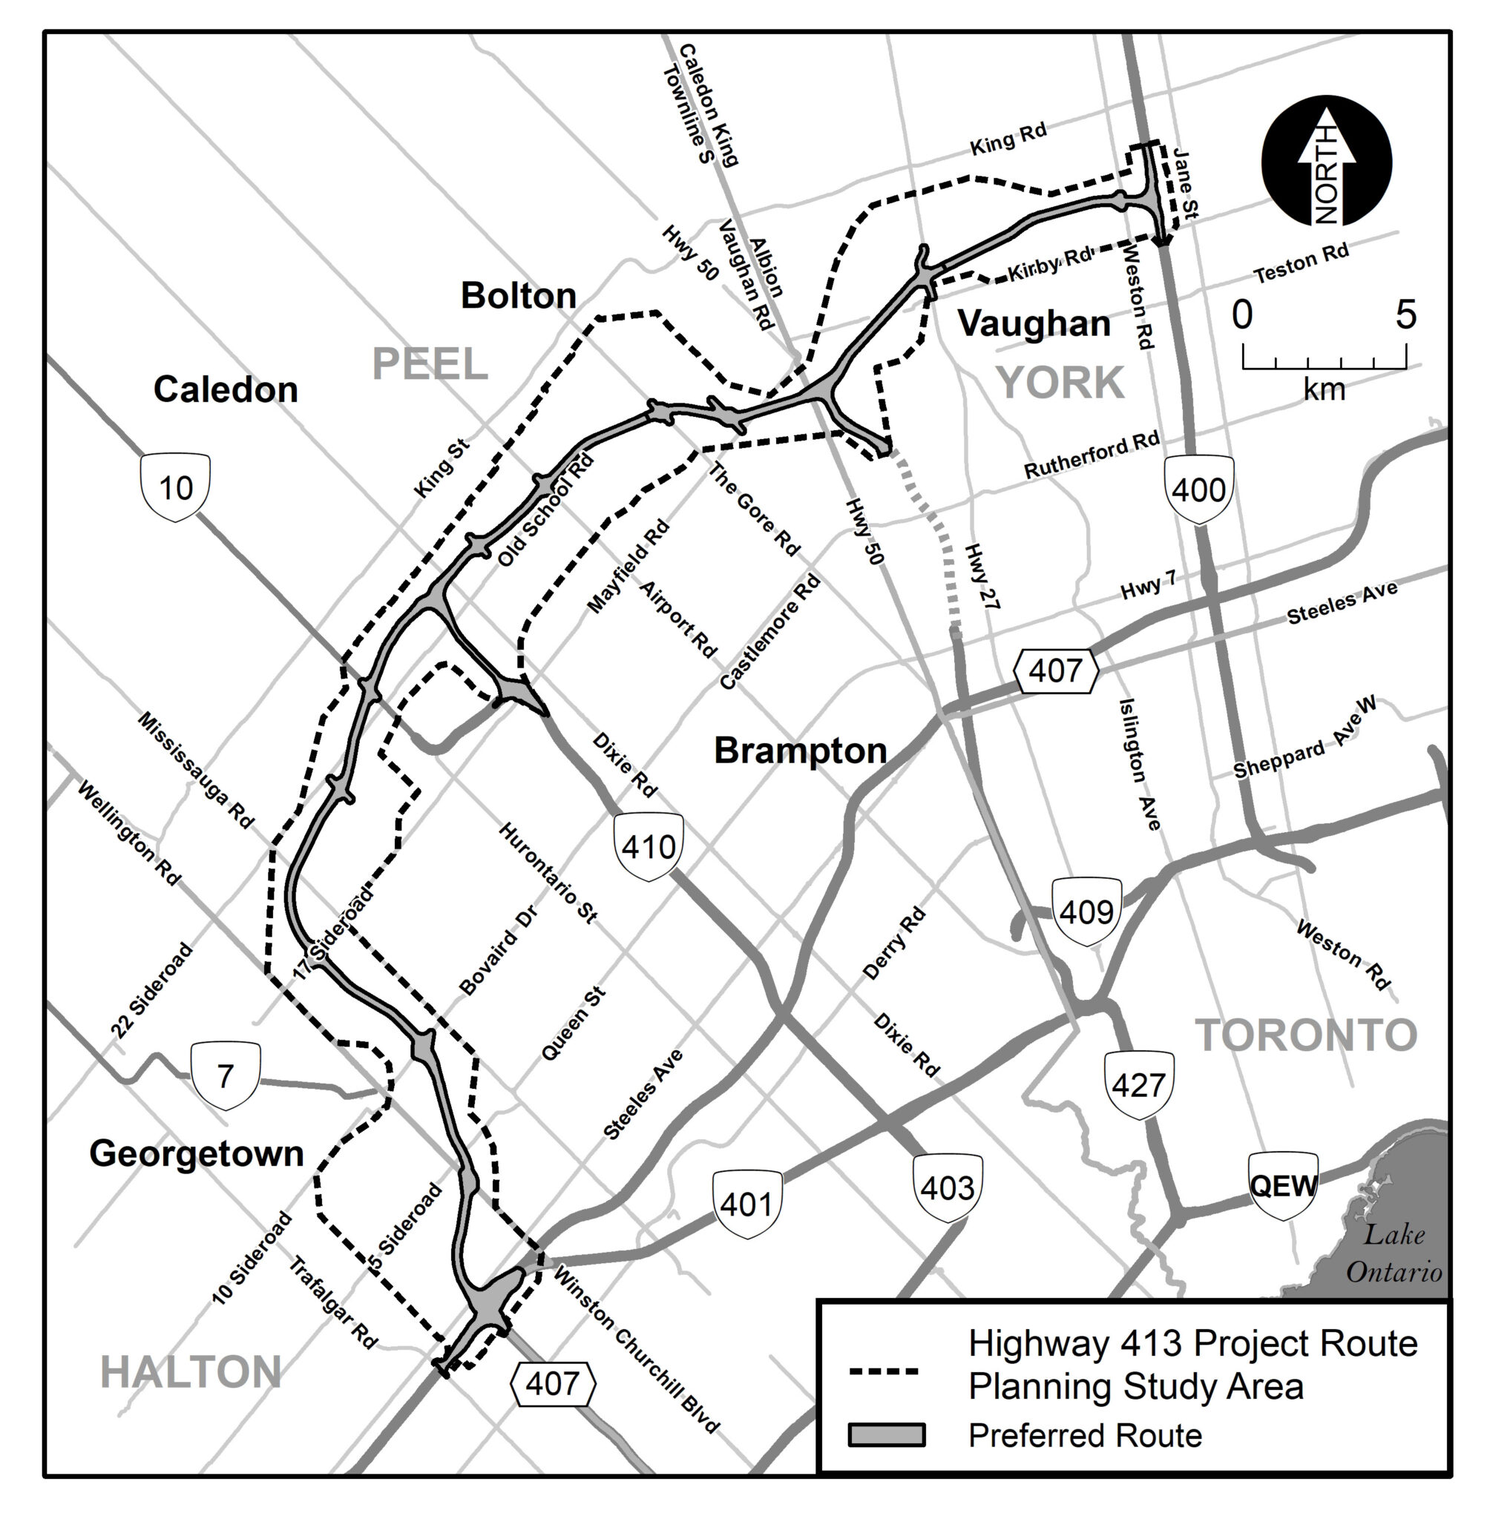
Algorithmic Injustice
“Highway 413 could save you up to 30 minutes.”
“We need to first make it possible for society as a whole, not just tech industry employees, to ask the deeper ex ante questions
“Changing the democratic agenda is a prerequisite to tackling algorithmic injustice, not just one policy goal among many.”
https://www.highway413.ca/
(Zimmerman, et.al., 2020)

Slide 12
The Democratic (Semantic) Condition
https://www.downes.ca/images/The_Semantic_Condition.JPG

Slide 13
Digital Citizenship Frameworks
The Algorithmic Fairness and Opacity Group (AFOG) at Berkeley has written an open letter to Google executives supporting fired ethics researcher Timnit Gebru and the response of AI researchers inside Google.
The telling point is this: "Ultimately change requires that dominant groups cede power. Institutional commitment must be embodied in practices and processes to enact meaningful change."
In this letter dominant groups are defined in terms of position and race, but the same basic equation applies no matter how power is defined, whether it be by income, ethnicity, religion, language, or whatever. Change requires that dominant groups cede power.
And what this means is that no single group or individual has ultimate power - it means moving from a hierarchy to something different. I'm not sure Google has the skills, capacities, or even the legal right to do this. But it's the only way to replace rapaciousness with ethical behaviour. https://www.downes.ca/post/71772
https://uploads-ssl.webflow.com/5f2876f679889c3267ee6dee/5fdd9622618da2c43dd7fffb_support_gebru_ethical_ai.pdf

