Slide 1
Culture and Ethics
Stephen Downes
December 24, 2021

Slide 2
Down the Staircase
Fear
Focused on the good
More personal
Less formal
Regulation
Practices
More formal
More institutional
Focused on wrongs
Culture
Joy

Slide 3
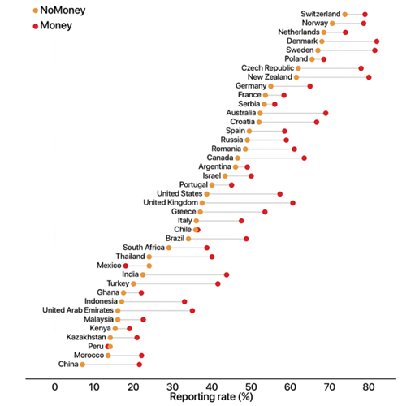
Culture and Ethics?
Max Weber
In capitalism, all that matters is the increased acquisition of wealth. “God helps those who help themselves.” (p. 115)
“Emancipation from economic traditionalism” (p.36) requires “definite and highly developed ethical qualities”, e.g. “scrupulous honesty” (p. 69)
This allows specialization, which leads to skills, and an increase in quality (p. 161)
Avadon: dual morality thesis
So morality is a pre-condition of capitalism…?
Max Weber, 1904: https://archive.org/details/protestantethics00webe
Avadon: https://www.classicalethics.com/
Cover image: https://www.intheblack.com/articles/2017/07/01/how-does-culture-affect-ethics

Slide 4
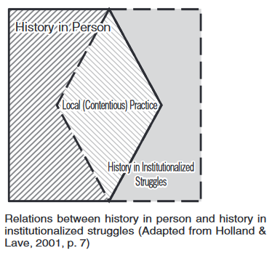
Social Practice Theory
Social practice theory (quoted Holland & Lave, 2009)
E.g. environmentalists, wine merchants in Porto
attends to the integration of emotion, motivation and agency into cultural-historical activity theory
incorporates careful attention to tension, conflict and difference in participation in cultural activities
calls for the close study of the relations of cultural activities to both local and trans-local institutional arrangements and practice
Holland and Lave: https://kansai-u.repo.nii.ac.jp/?action=repository_action_common_download&item_id=783&item_no=1&attribute_id=19&file_no=1 Via https://wiobyrne.com/building-ethical-communities/

Slide 5
Dominant Narratives and Social Change
Julian Stodd: “there is always a conflict boundary: either an uncontrolled social one, or a formalised State one. Social change may happen at the intersection of these systems”
Me: Change happens through growth, birth and death. It happens through movement and inertia. Only some change is caused by friction.
https://julianstodd.wordpress.com/2021/12/21/the-state-and-social-change/ https://www.downes.ca/post/73127

Slide 6
Design
Architectures of Control
Dark Patterns
“a user interface that has been carefully crafted to trick users into doing things, such as buying overpriced insurance with their purchase or signing up for recurring bills.”
Design Justice
“an approach to design that is led by marginalized communities and that aims explicitly to challenge, rather than reproduce, structural inequalities.”
Dan Lockton - http://www.danlockton.co.uk/research/Architectures_of_Control_v1_01.pdf https://architectures.danlockton.co.uk/2005/11/16/welcome/
Harry Brignull - https://www.darkpatterns.org/
Sasha Costanza-Chock https://mitpress.mit.edu/books/design-justice

Slide 7
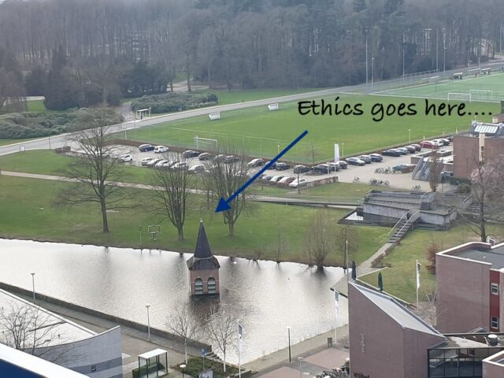
Beyond Design
Ton Zylstra: two things that I have a certain dislike for,:
“The first concerns treating the philosophy of technology, information and data ethics in general as a purely philosophical and scientific debate. It… then has no immediate bearing on the things organisations… do in practice”
“The second concerns seeing ‘Ethics by design’ as a sufficient fix.”
Ton Zylstra, Ethics as a practice #GlobalEthicsDay2020 : Ethics as a Practice (EaaP) (all quoted) https://www.zylstra.org/blog/2020/10/globalethicsday2020-ethics-as-a-practice-eaap/

