Slide 1
What Does It Mean To Enroll in a Course?
Stephen Downes
National Research Council Canada
October 19, 2021

Slide 2
How open is open learning when the first thing a prospective learner encounters is a requirement that they submit some information about themselves: their name, their email, possibly more? This can be seen as a price that course organizers are demanding, one that they convert to currencies of marketing reach, credibility and impact. In the tradition of the early MOOCs, which were designed around the philosophy of an open network, this presentation argues that open learning should enable enrollment without the requirement that information be provided, hence enabling legitimate peripheral participation, with the option of greater engagement entirely at the discretion of the learner. A model of open online enrollment will be shared, and reference implementations of open specifications technology that enables open online enrollment will be demonstrated.

Slide 3
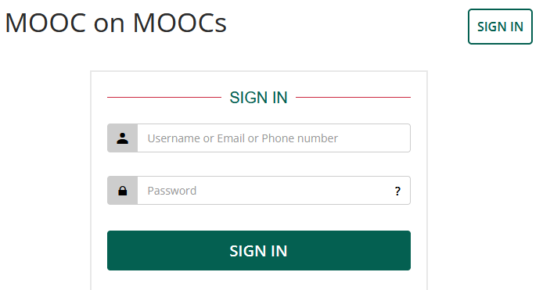
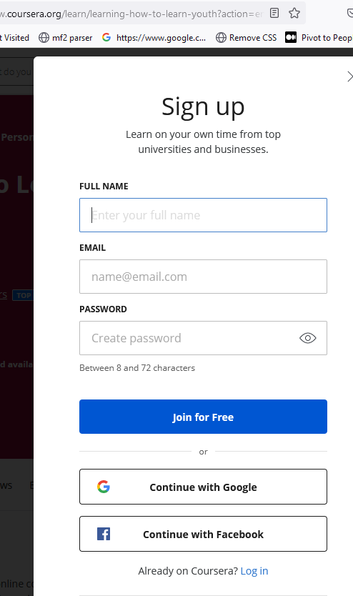
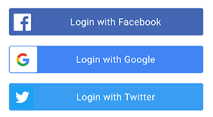
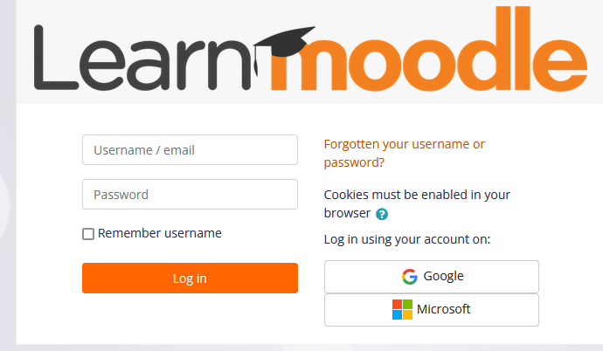
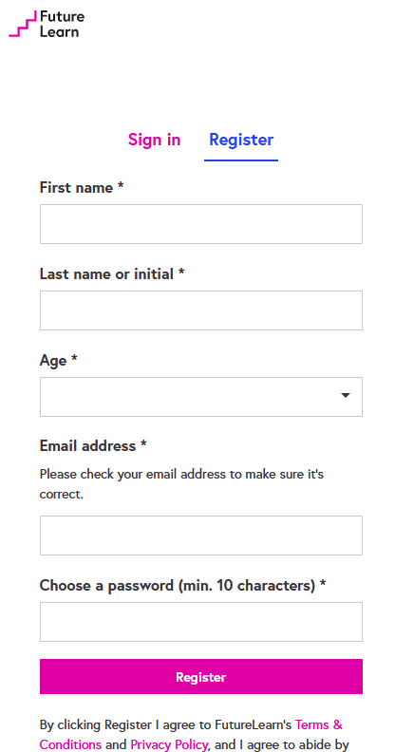
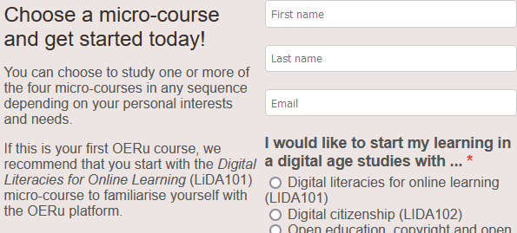
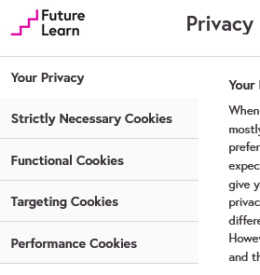
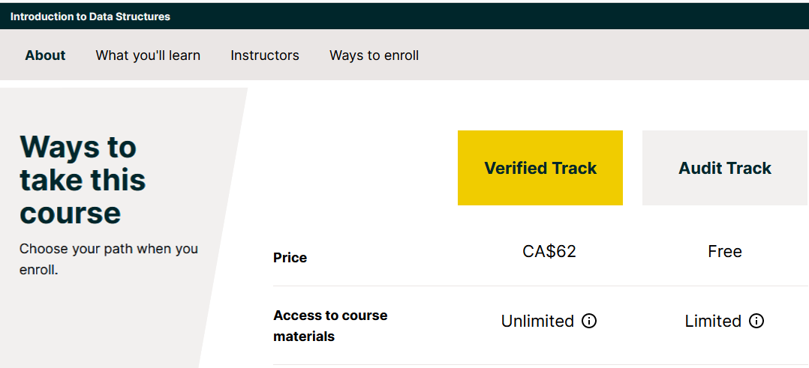
How Open is Open Learning?

Slide 4
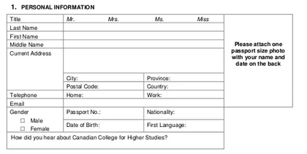
What They Want
Gathering registration information is universal among education providers
https://www.slideshare.net/AbhishekBajaj23/the-canadian-college-international-student-registration-form

Slide 5
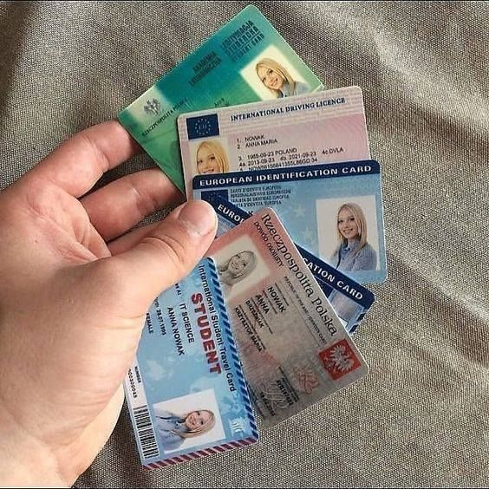
Why They Want It
Qualification and evidence for admissions
Billing information for tuition and fees
Address for course communication
Marketing and upselling
Identity verification for proctoring
Certification and credentialism
Reporting and statistics
In open learning, do we need any of this?

Slide 6
Yes, There Are Other Barriers
Lack of funding
Need for teacher
No classroom
Lack of materials
Exclusion of disabled
Exclusion base on gender
Conflict and war
Distance and Technology
Hunger and poor nutrition
https://www.globalcitizen.org/en/content/10-barriers-to-education-around-the-world-2/

Slide 7
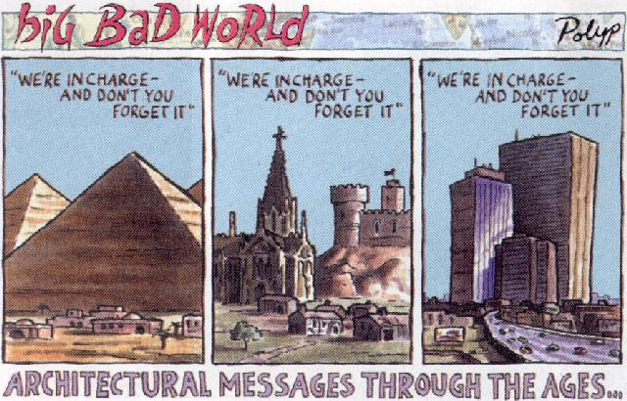
What Sort of Message Does It Send?
We are in charge
Your access is conditional
We are watching
You will be monetized
https://www.amazon.ca/Big-Bad-World-Molotovs-Corporate/dp/0954049934

Slide 8
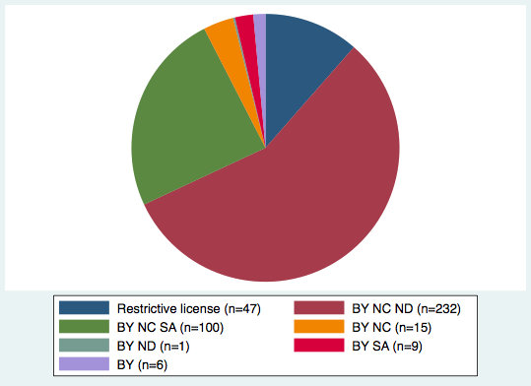
Some Argue It’s About Licensing
“As top institutions have a higher outreach, the sale of such goods also makes for higher potential revenues. Choosing a less open creative commons license bars potential competitors from the reuse of their content. Hence, by creating this barrier of entry, they can protect their monopoly power on these complementary market segments.”
https://www.researchgate.net/publication/329151552_Why_are_some_online_courses_more_open_than_others

Slide 9
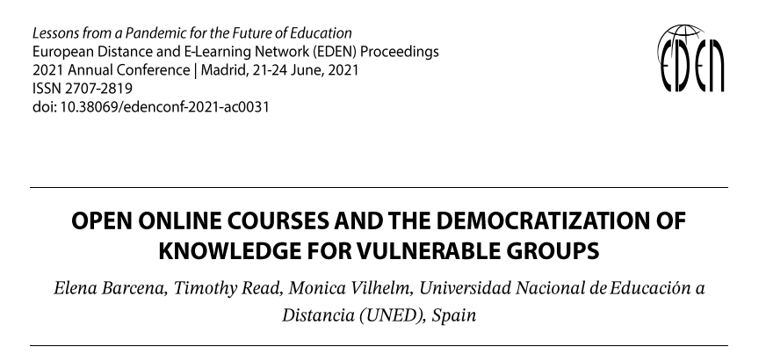
But We Still need to Design for Open
(Ironically, I was not able to copy this text from the PDF; I had to take a screen shot)
https://www.eden-online.org/proc-2485/index.php/PROC/article/view/1884

Slide 10
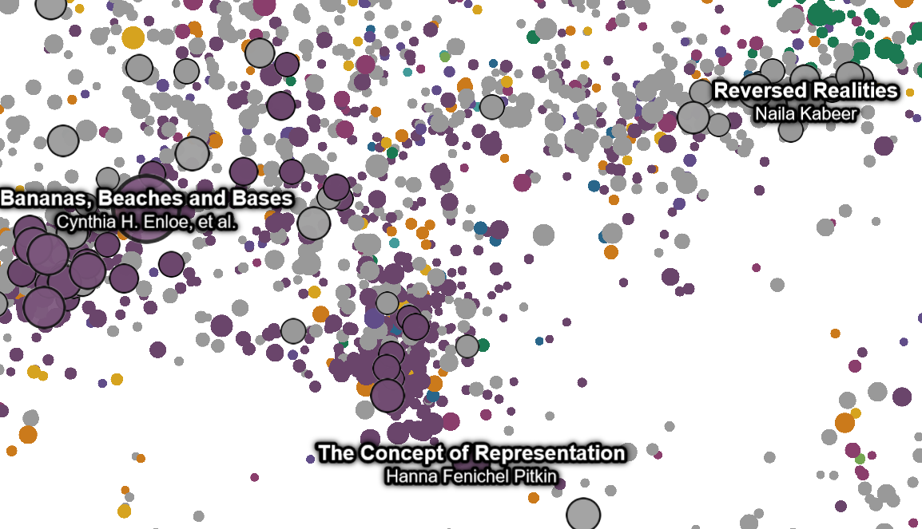
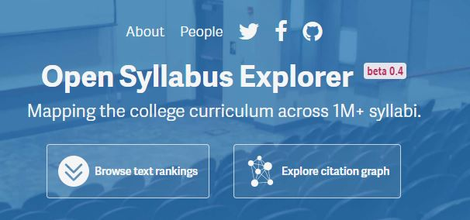
Beyond the Provider-Consumer Model
For example: the open syllabus
The open syllabus format invites students and course leaders to add domain-specific examples. In addition to teaching a conceptual understanding of the principles, the course will guide students to recognize the principles within their own research context and to form communities around the principles of open science.
https://ia601400.us.archive.org/20/items/oe-global-2021-papers/OE_Global_2021_paper_94.pdf
And, the Open Syllabus Explorer
https://opensyllabus.org/

Slide 11
Working Toward Open Everyday Practice
Educating students about the benefits of ‘openness’
Allowing them to contribute through open educational practices
Supporting and empowering “students as public scholars”
https://www.open.edu/openlearncreate/course/view.php?id=2854#

Slide 12
Some Trends…
Learning any time / anywhere: Students will be able to learn where and when they choose.
Personalised learning: Study tools will adapt to the capabilities of the student.
Choice how to learn: Students will be able to modify their learning process.
Project-based learning: Students will learn to apply their skills in a variety of situations.
Hands-on learning: Students will have authentic experiences and gain real-world skills.
Data interpretation: Students will learn to interpret and reason with data.
Assessed differently: Knowledge and skills will be assessed in new ways.
Student ownership of curriculum: Students will have critical input into their courses.
More independent: students will become more independent.
https://www.journals.aiac.org.au/index.php/IJELS/article/view/4616
Some of these still seem pretty prescriptive. But some of these suggest directions we can move for genuine open learning.

Slide 13
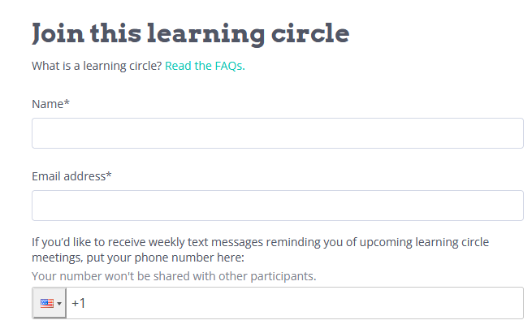
Learning Circles
Learning circles are "free, facilitated study groups for people who want to learn together. Guided by the principles of peer learning, learning circles offer much of the structure and community of formal education without the barriers to access."
https://www.p2pu.org/en/learning-circles/
https://www.p2pu.org/assets/uploads/learning_circle_downloads/facilitator_handbook.pdf

Slide 14
Rethinking Assessment and Statistics
Instead of looking at grades and test scores, attendance and graduation rates, the Street Data method looks at data from the ground up
https://www.cultofpedagogy.com/street-data/

Slide 15
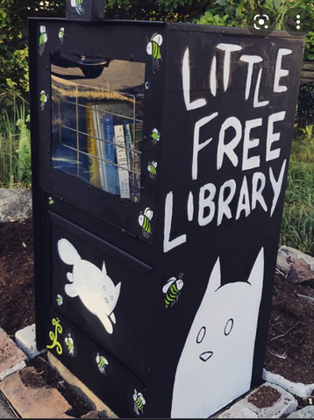
An Imperative
Open learning should enable enrollment without the requirement that information be provided, hence enabling legitimate peripheral participation, with the option of greater engagement entirely at the discretion of the learner.

Slide 16
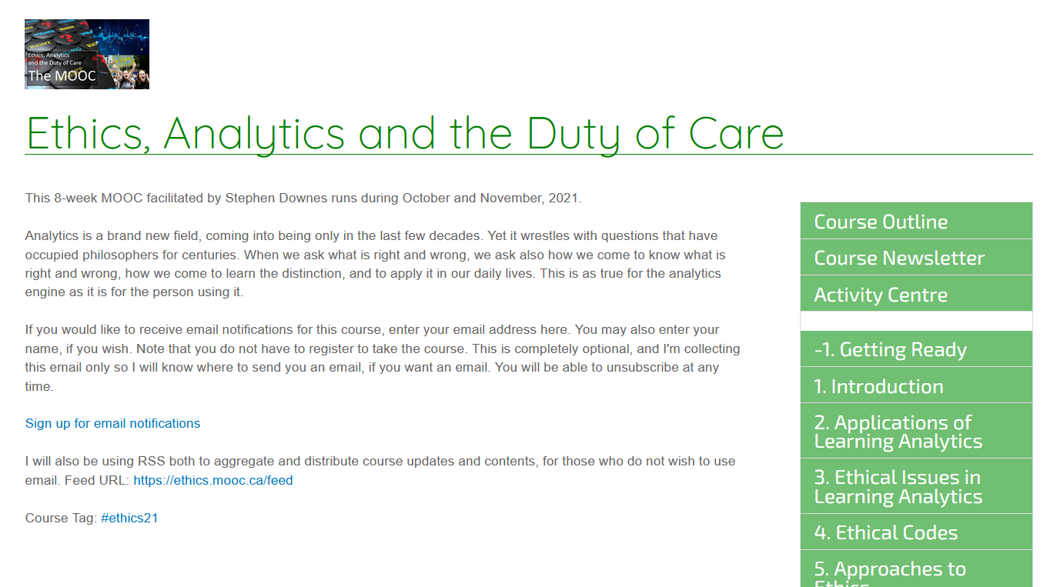
An Ongoing Experiment in Open
Note that you do not have to register to take the course. This is completely optional, and I'm collecting this email only so I will know where to send you an email, if you want an email.
I will also be using RSS both to aggregate and distribute course updates and contents, for those who do not wish to use email. Feed URL: https://ethics.mooc.ca/feed
https://ethics.mooc.ca/

Slide 17
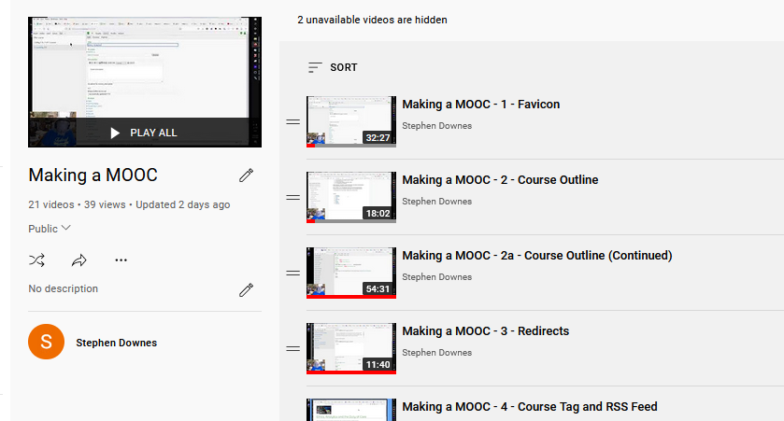
Sharing the Process
18 episodes and counting
https://www.youtube.com/playlist?list=PLeBQHgzQN9x3tanYKR8oLQTYY9vyN3yLs

Slide 18
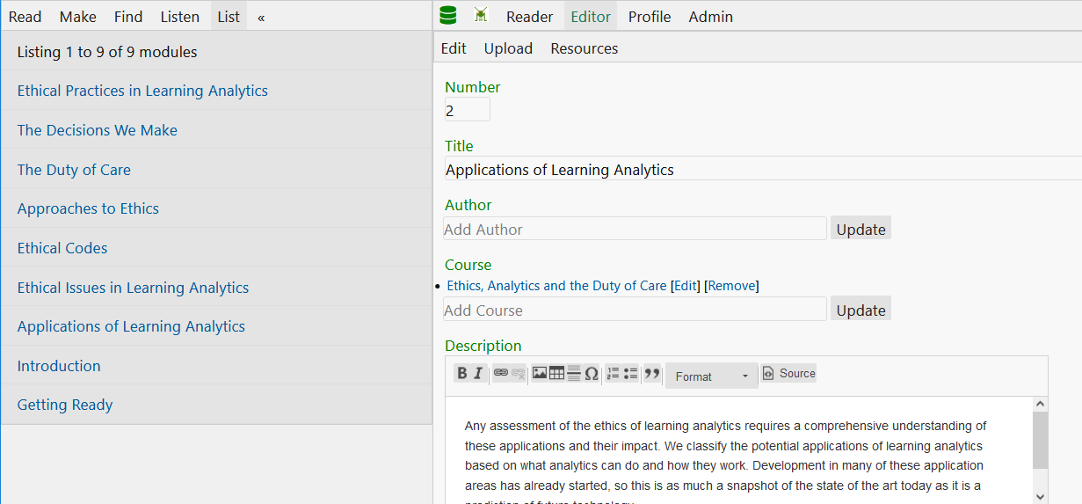
Modules and Course Structure
https://grsshopper.downes.ca/

Slide 19
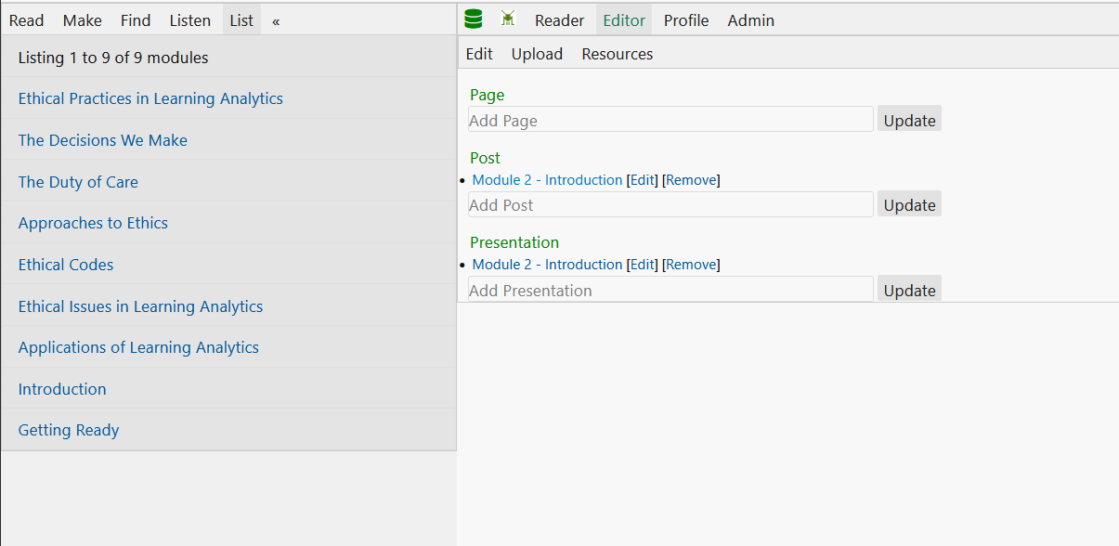
Modules and Course Structure
https://grsshopper.downes.ca/

Slide 20
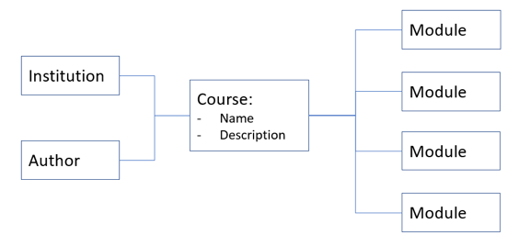
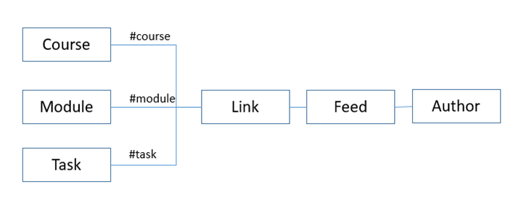
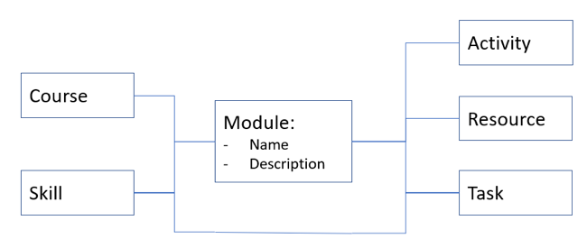
Modules and Course Structure
Three views of course structure
But the idea is that the course environment should support any structure you desire, and to enable people taking the course to create their own structure
Each box is a publicly accessible web page, for example, https://ethics.mooc.ca/module/2
https://jl4d.org/index.php/ejl4d/article/view/348/436
https://www.youtube.com/watch?v=tGRz0Vxd-rY

Slide 21
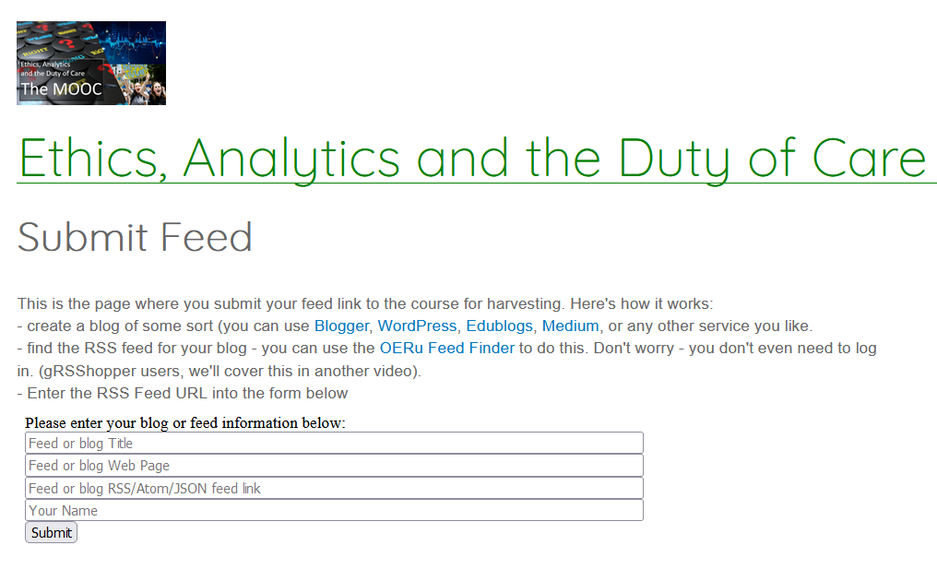
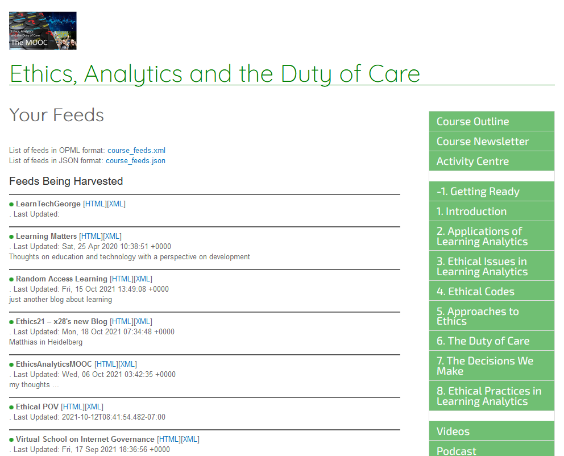
Syndication and Course Tag
https://www.youtube.com/watch?v=ghROceO4TaU
Allows people, if they want, to write in their blog and share
List of feeds in OPML format: course_feeds.xml List of feeds in JSON format: course_feeds.json

Slide 22
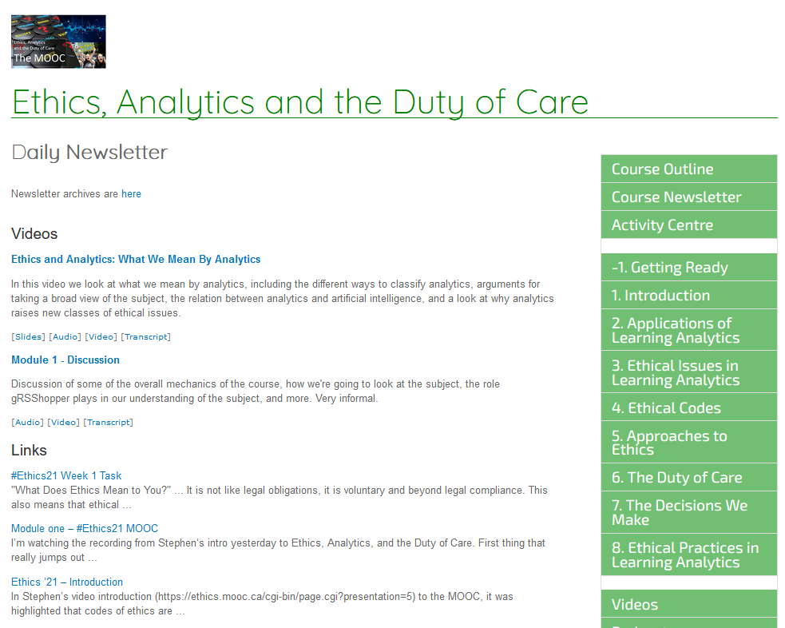
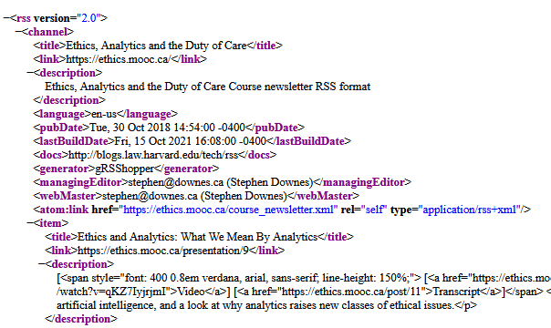
Course Newsletter and Feed
You can read the newsletter on the web (no subscription needed) or use an RSS reader and never even visit the website
https://ethics.mooc.ca/course_newsletter.htm
https://ethics.mooc.ca/course_newsletter.xml

Slide 23
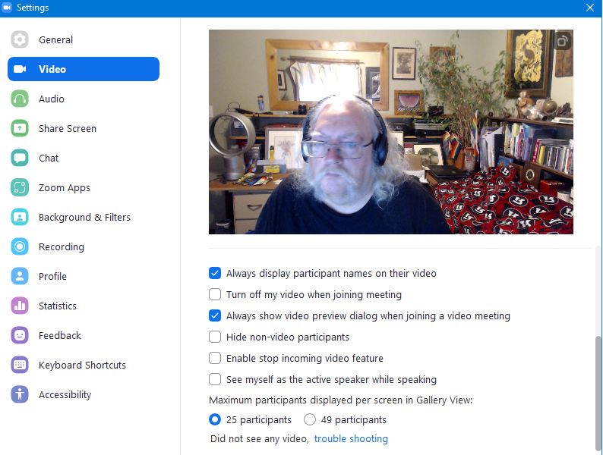
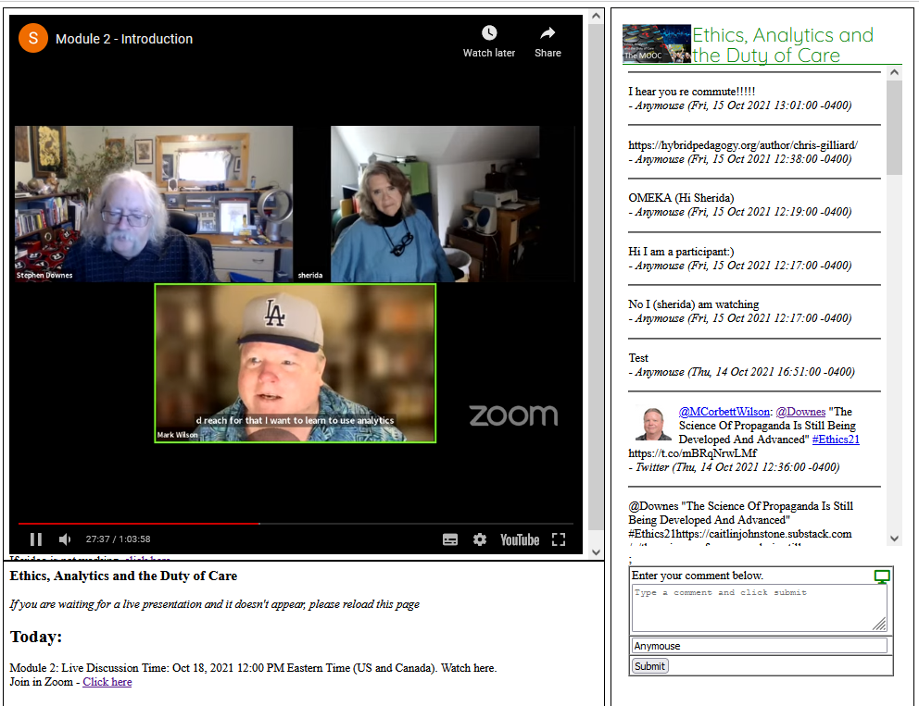
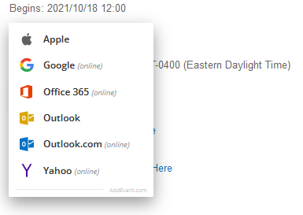
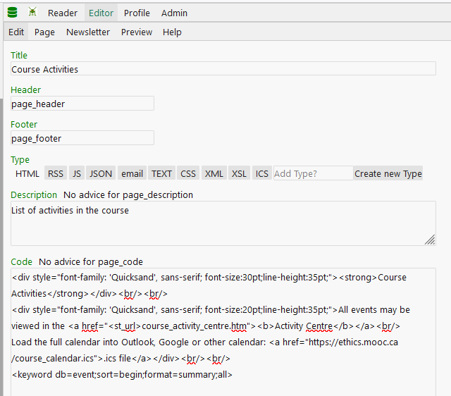
Activities and Events
Zoom options, calendar integrations
https://ethics.mooc.ca/course_activity_centre.htm

Slide 24
Adding and Sharing Media
https://ethics.mooc.ca/presentation/9
https://mozilla.github.io/pdf.js/

Slide 25
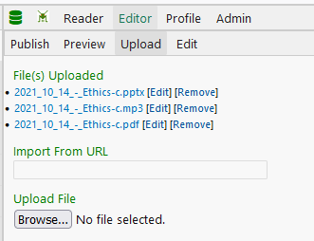
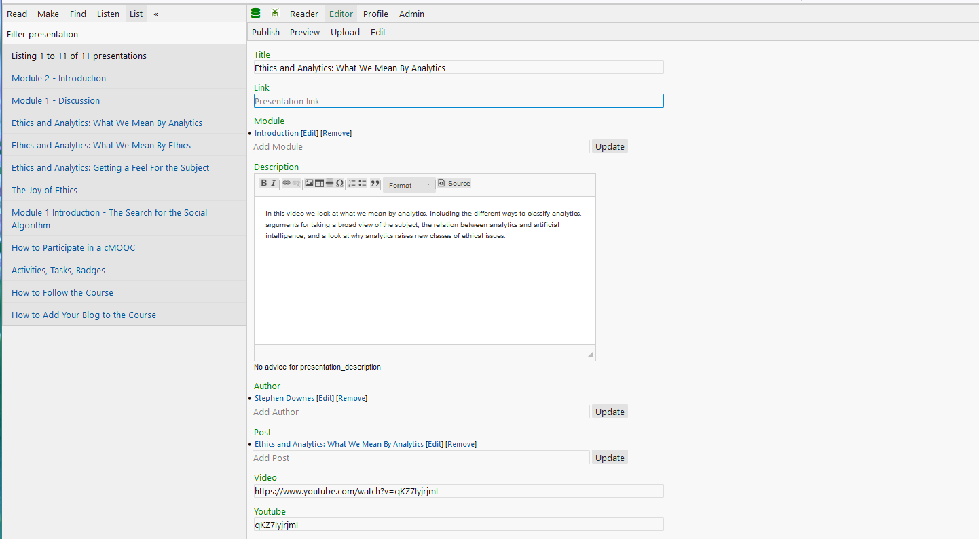
Adding and Sharing Media

Slide 26
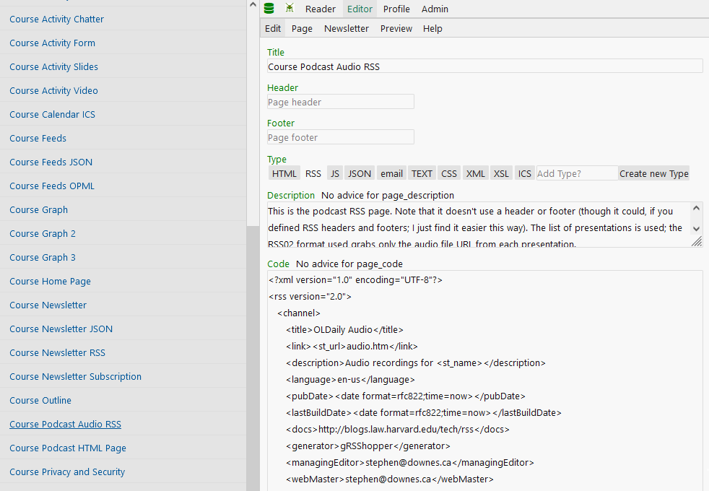
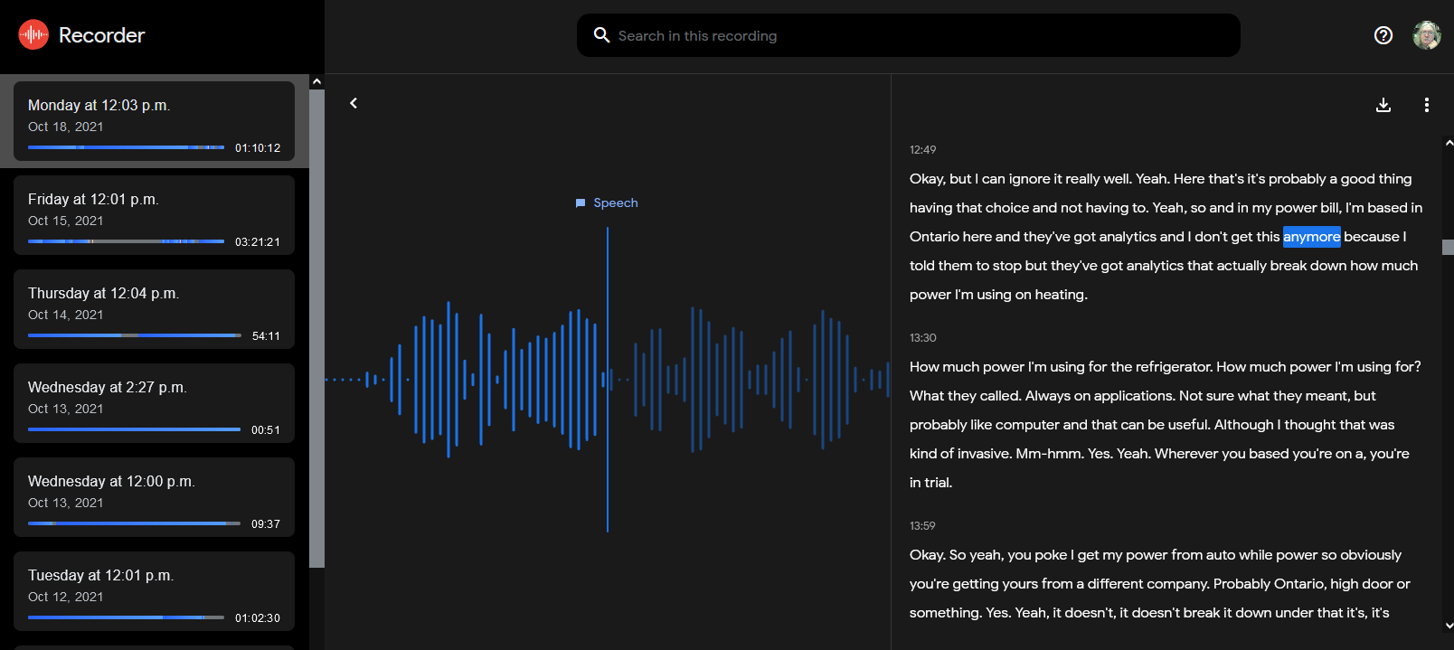
Podcasts and Transcripts
Open means accessible, and so it’s important to provide open access in as many formats as possible, and as low bandwidth as possible

Slide 27
Flow
I prefer to use flow, rather than breadcrumbs, to support navigation, to allow many paths in a non-hierarchal structure

Slide 28
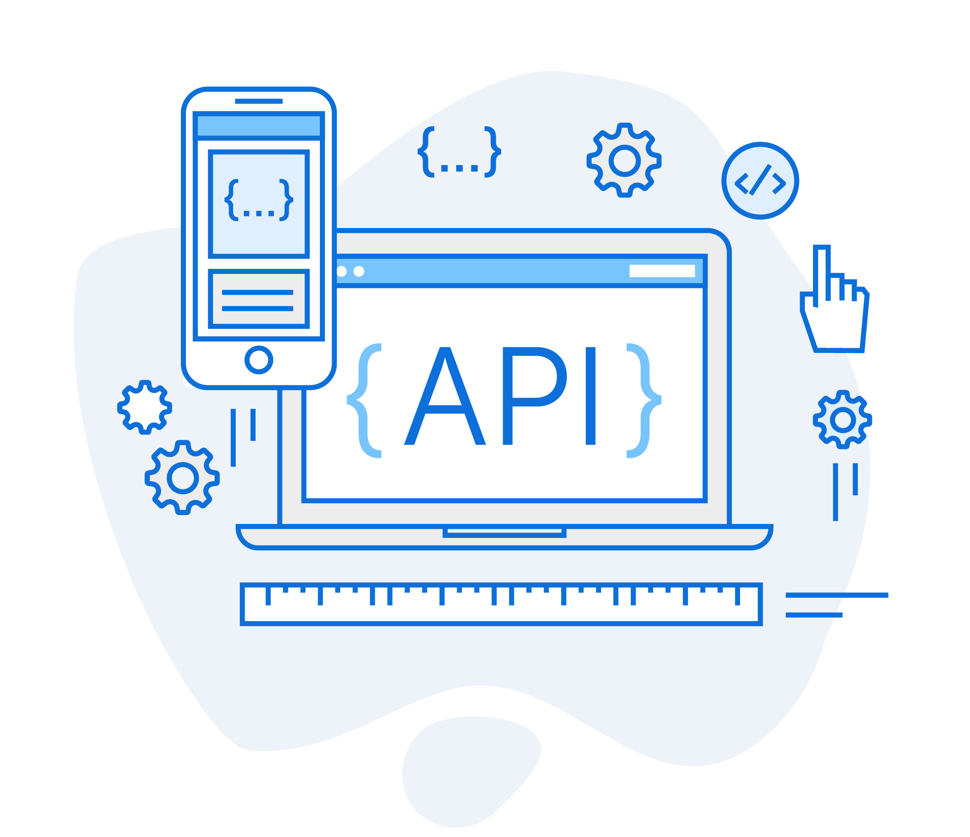
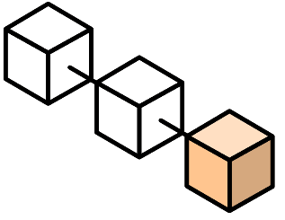
Publishing
email
web
Other applications
ical
MOOC
RSS
JSON
BibTex
Authoring applications
tweet
badge
task
Personal Learning Environment
Breaking the sign-in barrier

Slide 29
Content Types
Ethical Codes
Applications of Analytics
Ethical Theories
Elements of Care
Ethical Issues
Practices
AI Decision Points
Content types are conceptual but fit right into the course graph along with things like links, tasks, etc., and can be imported and exported in the same way

Slide 30
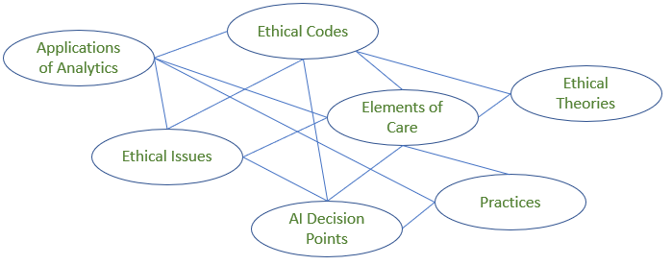
Export
JSON
MOOC
PLE
Courses export part or all of their structure and content as a graph of linked data, which may be imported in whole or in part by a personal learning environment (PLE)

Slide 31
Stephen Downes https://www.downes.ca

