Slide 1
Agency – Part One
Stephen Downes
December 25, 2021

Slide 2
Where We Are
Ethical Practice
Regulation
Frameworks
Culture
Ourselves
Ethical practice as culture
Ethical practice as citizenship
Ethical practice as democracy
Ethical practice as agency

Slide 3
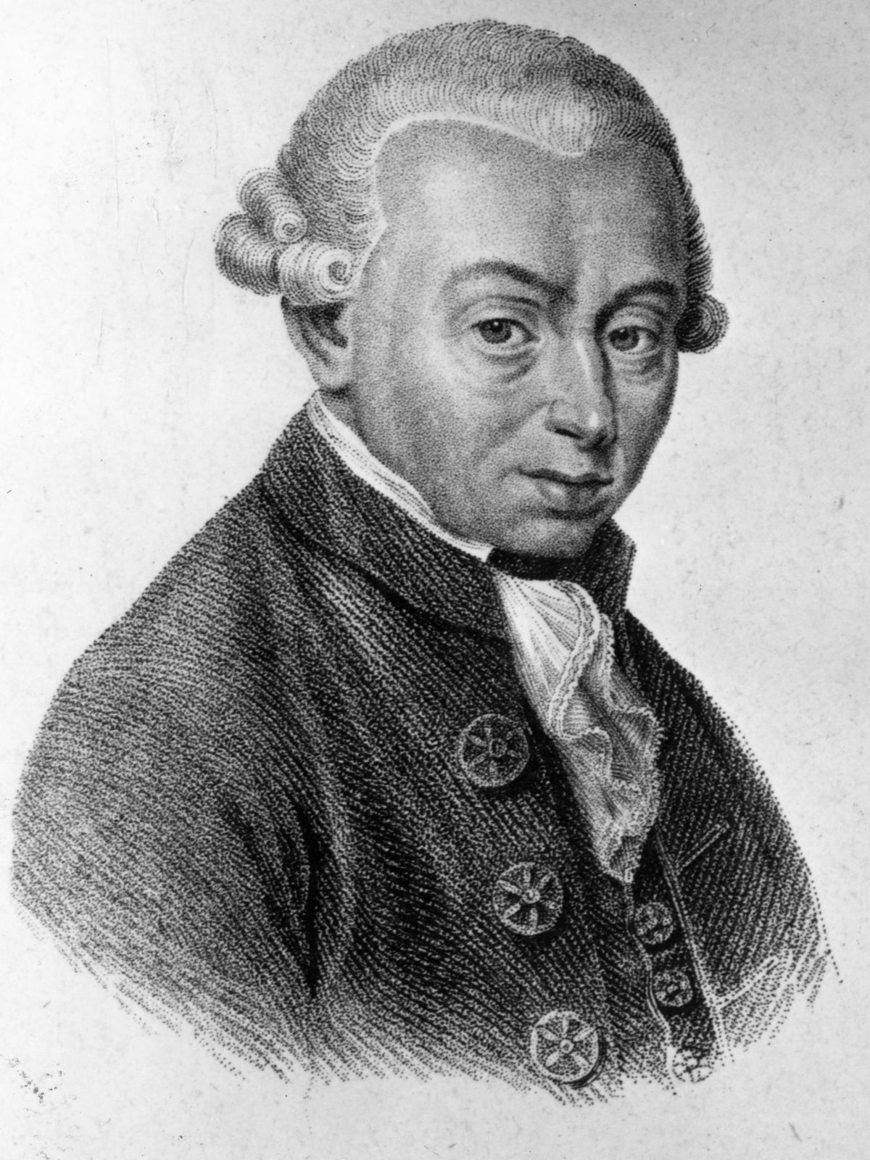
Two Roles of Agency
Ethics requires agency
This is the idea that ‘ought’ entails ‘can’ – that if there is an ethical obligation, then it must be possible for a person to be able to meet that obligation
Agency requires ethics
This is the idea that ‘can’ entails ‘ought’ – that is, our capacities to think, to reason, to act generate in us obligations to think, reason and act correctly
For example: “Kant believed that the shared ability of humans to reason should be the basis of morality, and that it is the ability to reason that makes humans morally significant.” https://en.wikipedia.org/wiki/Kantian_ethics

Slide 4
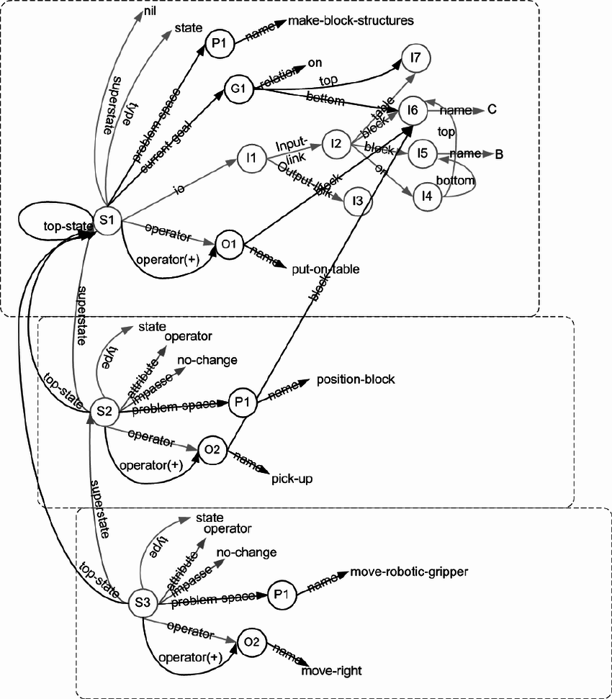
The Idea of Agency
widespread commitment to a desire-belief-intention version of agency, with a close connection between action and reasons
This view carries over into software design, e.g. the belief–desire–intention software model (BDI)
https://plato.stanford.edu/entries/agency/
https://en.wikipedia.org/wiki/Belief%E2%80%93desire%E2%80%93intention_software_model
See also https://link.springer.com/chapter/10.1007/3-540-49057-4_1
And (1970) https://www.researchgate.net/publication/2596320_The_Belief-Desire-Intention_Model_of_Agency
Image: SOAR https://www.researchgate.net/publication/228398068_An_introduction_to_Soar_as_an_agent_architecture

Slide 5
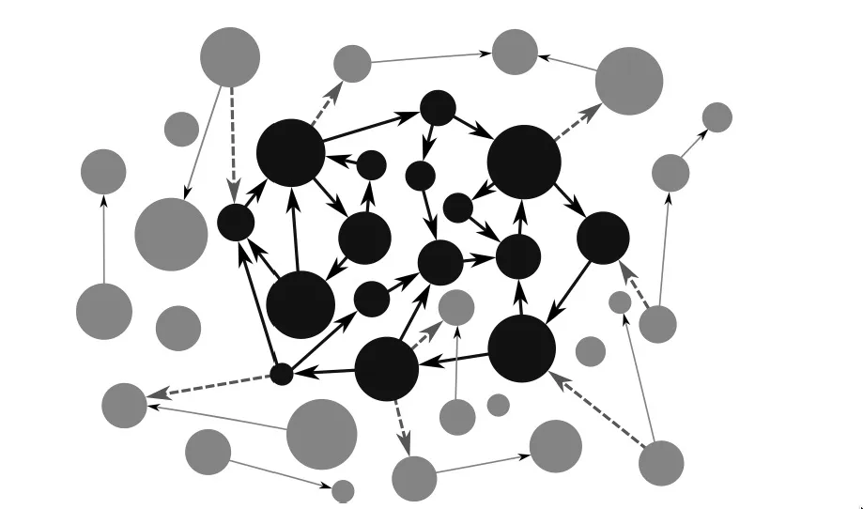
Agency Without Mental Representations
BDI theories usually explain agency in terms of representations
that is, “in terms of intentional mental states and events that have representational contents (typically, propositional contents)”.
But there are beings capable of genuine agency without representational states (e.g. an embodied enactive approach to mind)
Varela, in his 1979 book, Principles of Biological Autonomy, presented autonomy as a generalization of the concept of autopoiesis (cellular self-production).
https://plato.stanford.edu/entries/agency/
https://philosophyofbrains.com/2017/01/27/the-enactive-approach.aspx

Slide 6
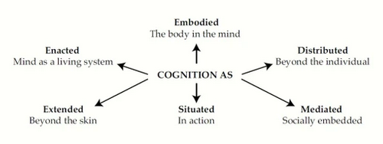
Extended Mind Thesis
The claim that minds or cognitive systems can extend into the environment. Two ways of expressing this:
EMT1: Mental states extend beyond an organism’s physical boundary
EMT2: The right unit of analysis in cognitive science is the entire cognitive system, or at least large parts thereof
Overextension: The Extended Mind and Arguments from Evolutionary Biology
Armin Schulz https://people.ku.edu/~a382s825/Overextension%20PSD%20RDER%20AI.pdf
Also: https://en.wikipedia.org/wiki/Extended_mind_thesis
Image: https://ronbc.wordpress.com/2012/03/30/proposing-an-extremely-embedded-mind/

Slide 7
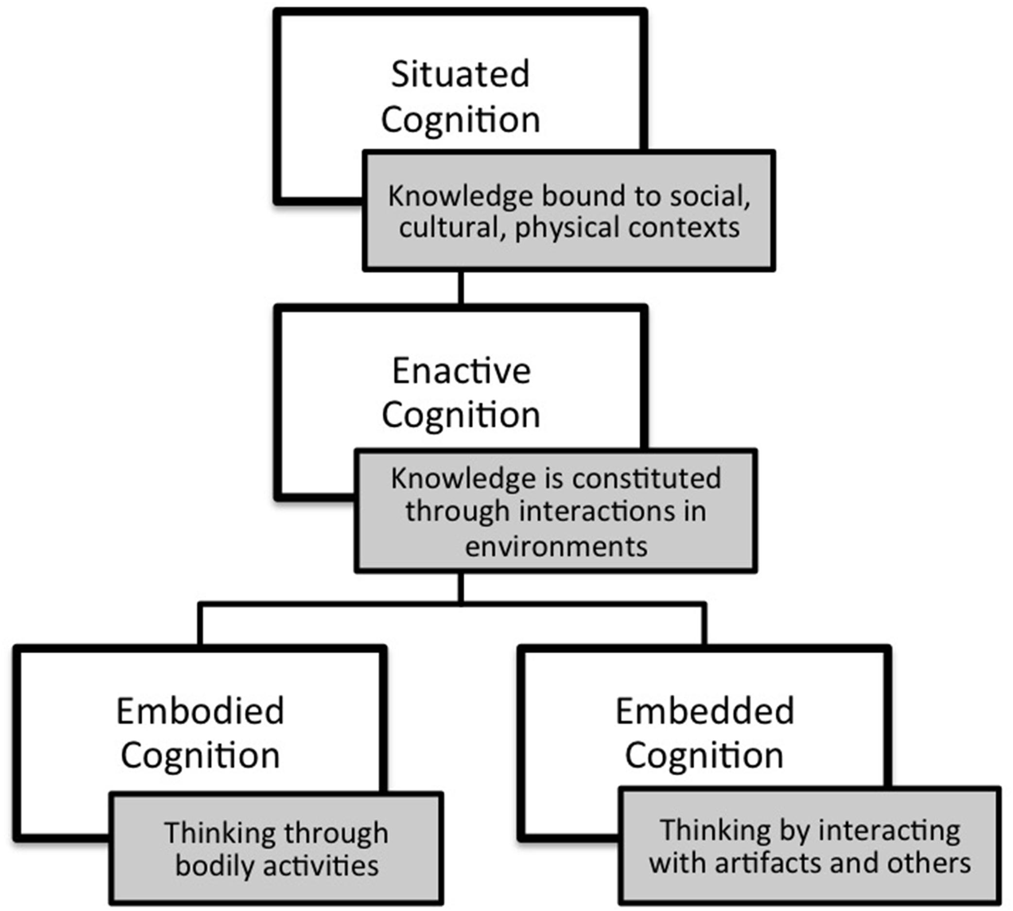
Embodied and Enacted Cognition
As described by Mark Rowlands, mental processes are:
Embodied involving more than the brain, including a more general involvement of bodily structures and processes.
Embedded functioning only in a related external environment.
Enacted involving not only neural processes, but also things an organism does.
Extended into the organism's environment.
Mark J. Rowlands, 2010 The New Science of the Mind: From Extended Mind to Embodied Phenomenology https://books.google.ca/books?id=AiwjpL-0hDgC&pg=PA51&redir_esc=y#v=onepage&q&f=false
Above quoted from https://en.wikipedia.org/wiki/Extended_mind_thesis
Image: https://www.frontiersin.org/articles/10.3389/fpsyg.2015.01978/full

Slide 8
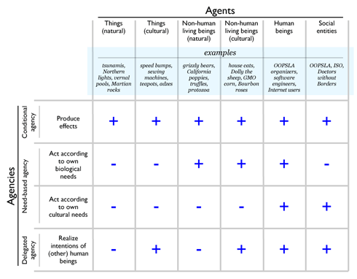
Agency in Non-Human Entities
‘the Stock market wants / reacts / etc’
Eduardo Kohn in How forests think
Anna Tsing: global trade in matsutake mushrooms displays “patterns of unintentional coordination” between multiple actors
Hamilton and Mitchell: sheep, humans, and dogs embedded in a complex web of relations, markets, and terrains
Examples from: https://journals.sagepub.com/doi/10.1177/0731121420921897
See https://anthrosource.onlinelibrary.wiley.com/doi/full/10.1111/aman.13628 for a criticism
Image: http://www.oopsla.org/2005/ShowEvent.do?id=76

Slide 9
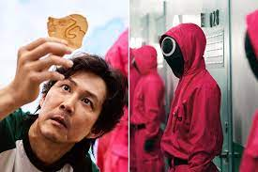
Some Conceptions of Agency
Not an exhaustive survey, but an exploration of some examples of discussions around more traditional conceptions of agency

Slide 10
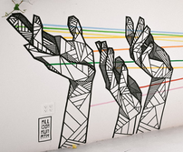
Agency and Power
“There is a need to revise and redefine existing power structures while advocating for ethics and empathy in digital and hybrid spaces. Members of the community need to problematize the complexities of these interactions, and prepare all children to participate in complex democratic discourses using diverse digital tools.
Ian O’Byrne https://wiobyrne.com/building-ethical-communities/

Slide 11
Ethics of Power
This is a theme that will sound familiar to educators. "Data ethics is not only about power—it also is power
“Power for governments, companies, self-proclaimed experts and advisors and even academic disciplines to point out the problems and their solutions, to set the priorities for what role data technologies should play in our human lives and in society.”
Don’t ask if artificial intelligence is good or fair, ask how it shifts power
“Those who could be exploited by AI should be shaping its projects.”
Gry Hasselbalch, Data Ethics of Power https://dataethics.eu/data-ethics-of-power-a-human-approach-to-big-data-and-ai/ Pratyusha Kalluri, 2020 https://www.nature.com/articles/d41586-020-02003-2

Slide 12
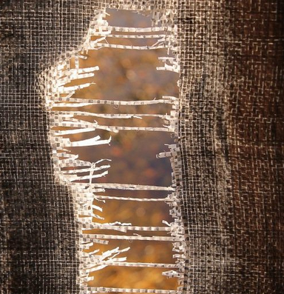
Power as Limitation
Jaron Lanier: "The problem is not the Internet or social media in a broad sense but rather specifically the use of the algorithms... people being directed rather than exploring and that makes the world small."
Small. That's a really good word for it. Like, when I'm looking for something to watch on YouTube, I feel the walls of the algorithm closing in on me.
Jaron Lanier (2021). Was the Internet a Horrible Mistake? Honestly with Bari Weiss. Podcast. https://www.honestlypod.com/podcast/episode/2a738715/was-the-internet-a-horrible-mistake Stefanie Panke, 2021 Social Media: Time for a Break?, AACE Review, https://www.aace.org/review/social-media-time-for-a-break/

Slide 13
Resilience
UNICEF: resilient children—those equipped with skills in areas such as communication, conflict resolution and self-efficacy—are more likely to make appropriate choices when using social media
Fostering resilience: "protective factors" in three major categories:
caring and supportive relationships
positive and high expectations
opportunities for meaningful participation
BUT: “correlates of resilient outcomes are generally so modest that it is not possible accurately identify who will be resilient to potential trauma and who not”
UNICEF: https://www.unicef.org/eap/press-releases/build-resilience-children-help-them-stay-safe-social-media
Bonnie Benard, 1995, Fostering Resilience in Children. ERIC Digest. https://eric.ed.gov/?id=ED386327
George A. Bonanno, 2021: https://www.tandfonline.com/doi/full/10.1080/20008198.2021.1942642

Slide 14
Self-Determination
Self-Determination Theory (SDT) and “basic psychological needs”
competence (feeling one is effective in meeting environmental demands)
autonomy (feeling authentic, acting with volition, having input)
relatedness (feeling connected with and cared for by significant others)
Duda & Appleton
Deci, E. L., & Ryan, R. M. (1985). Intrinsic Motivation and Self-Determination in Human Behavior. Berlin: Springer Science & Business Media. https://doi.org/10.1007/978-1-4899-2271-7 esp. pp 154-160, image p. 139 Joan L. Duda, Paul R. Appleton, in Sport and Exercise Psychology Research, 2016 https://www.sciencedirect.com/topics/social-sciences/self-determination-theory

Slide 15
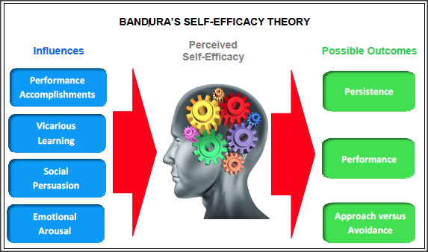
Self-Efficacy
“Self-efficacy refers to an individual's belief in his or her capacity to execute behaviors necessary to produce specific performance attainments (Bandura, 1977, 1986, 1997).”
Mastery experiences
Vicarious experiences
Verbal persuasion and feedback
Physical signals
APA https://www.apa.org/pi/aids/resources/education/self-efficacy
Image: https://www.ovpconsulting.com/weekly/2018/11/16/086p3teoj8d0dbvuwbt51sh7qkc63c
Laura Ritchie, 2016, Fostering Self-Efficacy in Higher Education Students, pp. 25-30

Slide 16
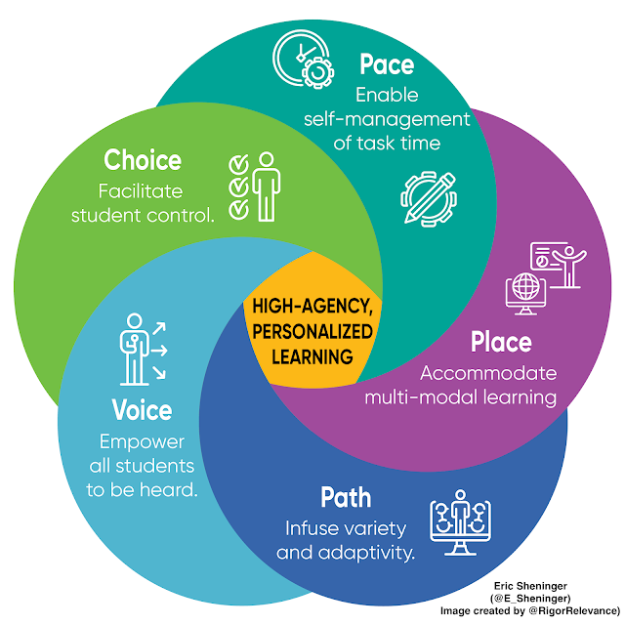
Dimensions of Learner Agency
Eric Sheninger's approach: "There are many strategies that educators were implementing well before the pandemic that hold more value now. Regardless of the terminology used, these represent more personalized pathways that focus on student agency leading to empowerment and more ownership of the learning experience."
http://esheninger.blogspot.com/2020/09/high-agency-in-remote-and-hybrid.html

Slide 17
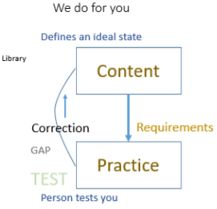
Free Learning and Control Learning
https://www.downes.ca/presentation/172
https://www.downes.ca/presentation/380

Slide 18
Agency – Part Two
Stephen Downes
January 5, 2022

Slide 19
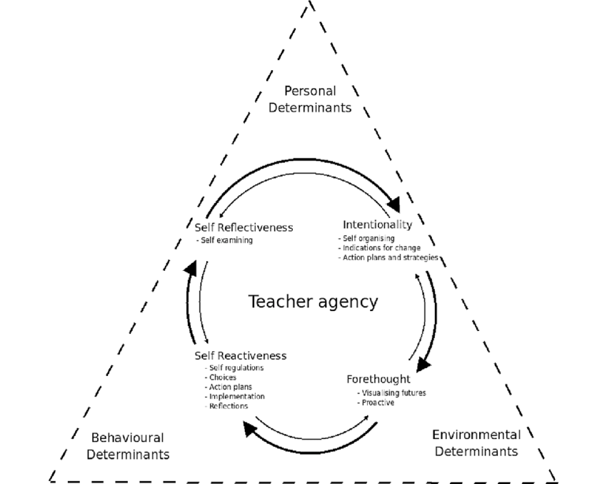
Conceptions of Agency
Power / Outcomes
Competences
Feeling
Ownership
Image: Gayle Jenkins, 2019, Teacher agency: the effects of active and passive responses to curriculum change. Australian Educational Researcher 47(1):1-15 https://www.researchgate.net/publication/333663018_Teacher_agency_the_effects_of_active_and_passive_responses_to_curriculum_change

Slide 20
Free Learning and Control Learning
Ben Werdmüller, 2022, The perfomative demonstration of education https://werd.io/2022/the-perfomative-demonstration-of-education

Slide 21
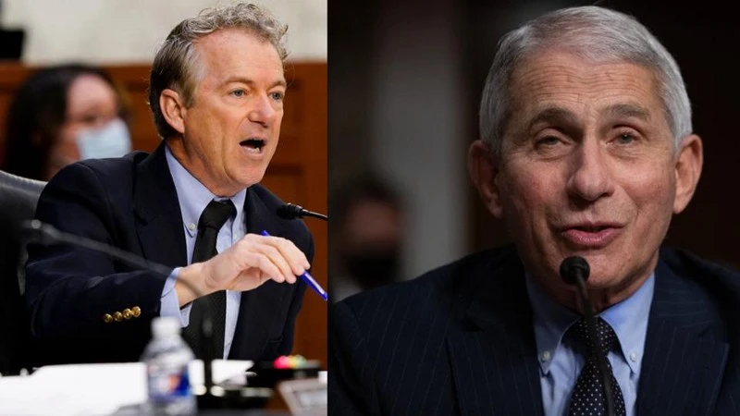
About Science Literacy
“For decades, we've been mistakenly measuring science literacy by measuring which specific facts people have memorized.
“Instead, developing an awareness of and an appreciation for science and what it does for society is a far more impactful approach.
“Science is our best tool for separating what is true from what is not, and we abandon it at our own peril as a society.”
Ethan Siegel, 2021, America’s big mistake about science literacy came back to haunt us in 2021, Big Think https://bigthink.com/starts-with-a-bang/americas-big-mistake-science-literacy/

Slide 22
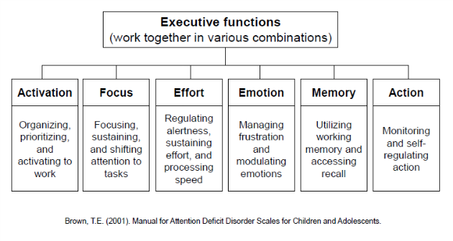
Agency and Biology
Allen Newell – the notion of a ‘control system’ (these days thought of as ‘executive function’)
“There is no actual selection carried out by natural ‘selection’. Nature – in this case the different rates of survival – is simply a passive filter.
Possible role of agency in evolution – Denis Noble
Noble, 2021 https://link.springer.com/article/10.1007/s12304-021-09405-3
Image: https://ldaamerica.org/info/the-reading-brain-executive-function-hard-at-work/

Slide 23
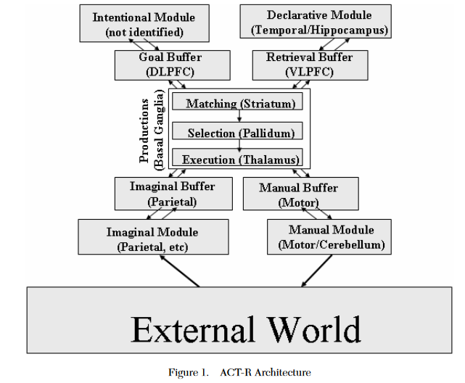
The Newell Test
Any Universal Theory of Control (UTC) must:
Behave flexibly as a function of the environment
Exhibit adaptive (rational, goal-oriented) behavior
Operate in real-time;
Operate in rich, complex, detailed environments
Use symbols and abstractions
Use language
Learn from the environment and from experience
Acquire capabilities through development
Operate autonomously, but within a social community
Be self-aware and have a sense of self
Be realizable as a neural system
Be constructible by an embryological growth process
Arise through evolution
Allan Newell, 1994, Unified theories of cognition, Harvard University Press, p. 19
Image: John R. Anderson & Christian Lebiere, 2003. The Newell Test for a theory of cognition. Behavioral and Brain Sciences, 26(05).p. 594 doi:10.1017/s0140525x0300013x

Slide 24
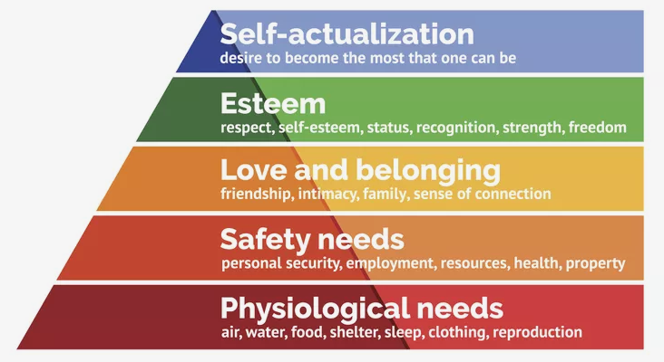
Maslow’s Hierarchy
“The role and importance of safety—physical, emotional, and psychological—cannot be overstated in understanding how human needs are, and sometimes are not, met.”
Bob Bowen (2021) The Matrix of Needs: Reframing Maslow’s Hierarchy. Health, 13, 538-563. https://www.scirp.org/journal/paperinformation.aspx?paperid=109226
Image: https://www.thoughtco.com/maslows-hierarchy-of-needs-4582571

Slide 25
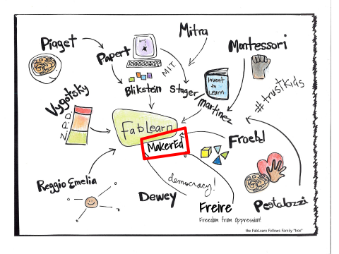
A Constructivist Model of Agency
Coherence
“living organisms have a substantially harmonious anatomic and functional structure”
Autonomy
“living organisms create and maintain an internal environment which follows dynamics of its own”
Brizio & Tirassa, 2016 https://www.ncbi.nlm.nih.gov/pmc/articles/PMC4745100/
Image: https://fablearn.stanford.edu/fellows/blog/constructionism-learning-theory-and-model-maker-education

Slide 26
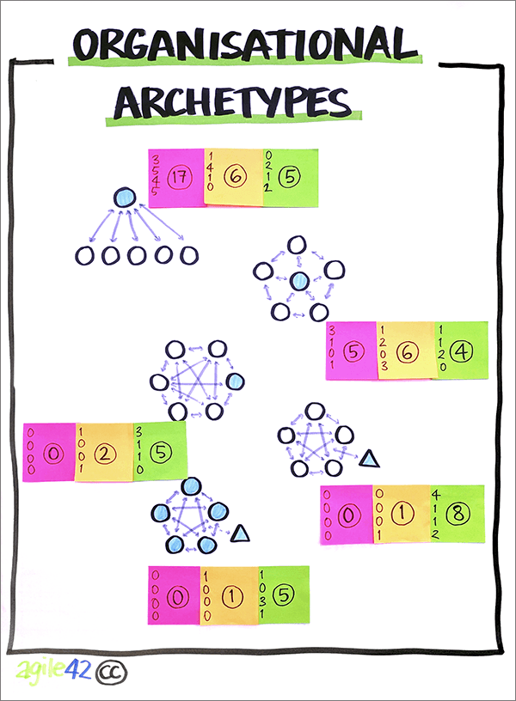
Maintaining Coherence and Autonomy
by creating and maintaining a permeable separation between their internal environment and the external milieu.
by exploiting the features of the environment that are relevant to the organism.
by exploiting the biological, behavioral, etc. features of other individuals
Brizio & Tirassa, 2016 https://www.ncbi.nlm.nih.gov/pmc/articles/PMC4745100/
Image: https://www.agile42.com/en/agile-teams/archetype-assessment/

Slide 27
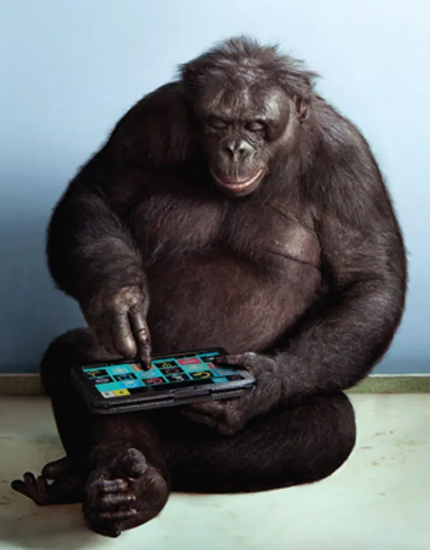
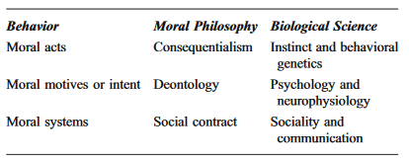
Morality as Social Evolution
Robin Dunbar
The Social Brain Hypothesis and Its Implications for Social Evolution
“Social living puts strong evolutionary selection pressures on acquiring social intelligence”
Ernst Fehr
“Altruism can be accounted for when kin selection and inclusive fitness are taken into account”
https://en.wikipedia.org/wiki/Evolution_of_morality
Image: https://spectrum.ieee.org/apes-with-apps

Slide 28
https://evolution-outreach.biomedcentral.com/track/pdf/10.1007/s12052-009-0173-9.pdf p. 631

Slide 29
Biologized Knowledge
Ben Williamson: two new research projects
"a data-intensive, bioinformatics-driven approach to education remains in development" - basically, using a person's genome to identify their learning needs and potential.
“a set of 'affect-aware’ technologies to gauge and respond to student emotional states that aims to make ‘emotional life machine-readable, and to control, engineer, reshape and modulate human behaviour”
Ben Williamson . 2021. New biological data and knowledge in education. https://codeactsineducation.wordpress.com/2021/09/08/new-biological-data-knowledge-education/

Slide 30
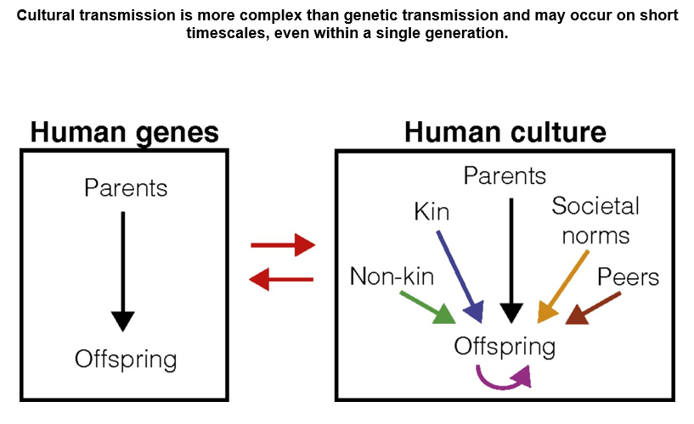
Agency as Evolution of Culture
Kim Sterenly: “human lifeways depend on cognitive capital that has typically been built over many generations. This process of gradual accumulation produces an adaptive fit between human agents and their environments; an adaptive fit that is the result of hidden-hand, evolutionary mechanisms.” p. 137
Kim Sterelny, 2006. The Evolution and Evolvability of Culture. Mind Language, 21(2), 137–165. doi:10.1111/j.0268-1064.2006.00309.x https://www.semanticscholar.org/paper/The-Evolution-and-Evolvability-of-Culture-Sterelny/4130942a5732b58a6872163fda7f42725ce96c5a
Nicole Creanza, Oren Kolodny, and Marcus W. Feldman, 2017. Cultural evolutionary theory: How culture evolves and why it matters . PNAS July 25, 2017. 114 (30) 7782-7789 https://doi.org/10.1073/pnas.1620732114

Slide 31
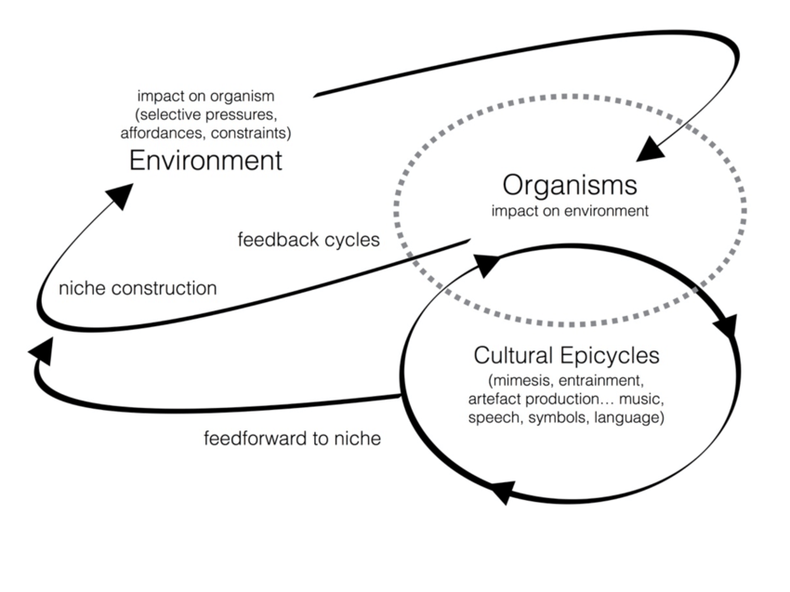
Dual Inheritance Theory
“Dual inheritance theory models cultural evolution closely on genetic evolution, and cultural inheritance closely on biological inheritance. The central idea is that there are features of human psychology—most obviously imitation learning and language—and features of human social environments—most obviously long periods of juvenile dependence—that result in a high fidelity flow of ideas from parents to their offspring.” - Sterelny
Dylan van der Schyff & Andrea Schiavio, 2017, Evolutionary Musicology Meets Embodied Cognition: Biocultural Coevolution and the Enactive Origins of Human Musicality. Frontiers in Neuroscience 11 https://www.researchgate.net/publication/319472389_Evolutionary_Musicology_Meets_Embodied_Cognition_Biocultural_Coevolution_and_the_Enactive_Origins_of_Human_Musicality

Slide 32
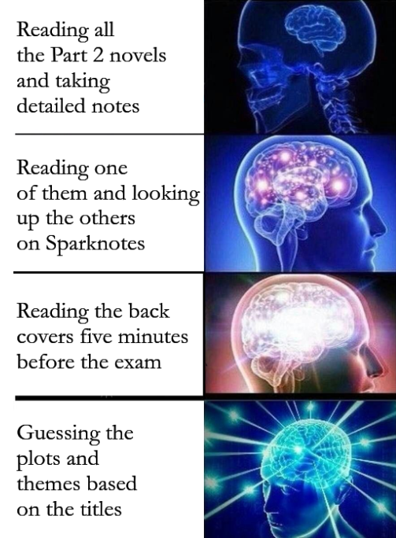
Meme-based Theory
Both dual inheritance and meme-based theories share the idea that cultural transmission is both important and accurate.
Dawkins calls the information that is copied the ‘replicator’ and contrasts this with ‘vehicles’ that carry the replicators
But on the dual inheritance picture it is the biological fitness of the vehicles (human agents) that explains the spread of cultural variants
“What is fitness for a short melody? It is the ability to survive and reproduce?”
Dawkins,R. (1976) The Selfish Gene Oxford, Oxford University Press (new edition with additional material, 1989)
Susan Blackmore, 2010, Memetics Does Provide a Useful Way of Understanding Cultural Evolution https://www.researchgate.net/publication/274706611_Memetics_Does_Provide_a_Useful_Way_of_Understanding_Cultural_Evolution

Slide 33
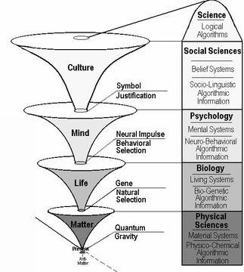
The Evolution of Morality
“The ultra-reductionism and implicit promotion of competition… once dominated the field… yielded to more balanced perspectives and more nuanced interpretations.”
“Reductionistic bias varies, but the texts basically omit the concept of emergent properties or new levels of organization at the psychological and social levels
“They do not describe how social rewards or sanctions can regulate “selfish” behavior or individual “cheating”—for example, as observed in food sharing among vampire bats”
Douglas Allchin, 2009 Teaching the Evolution of Morality: Status and Resources. BioMed Central
https://evolution-outreach.biomedcentral.com/track/pdf/10.1007/s12052-009-0173-9.pdf

Slide 34
Supporting Agency
Agency
Security
Identity
Voice
Opportunity
Based on ‘What Peace Means to Me’ https://www.downes.ca/post/68088

Slide 35
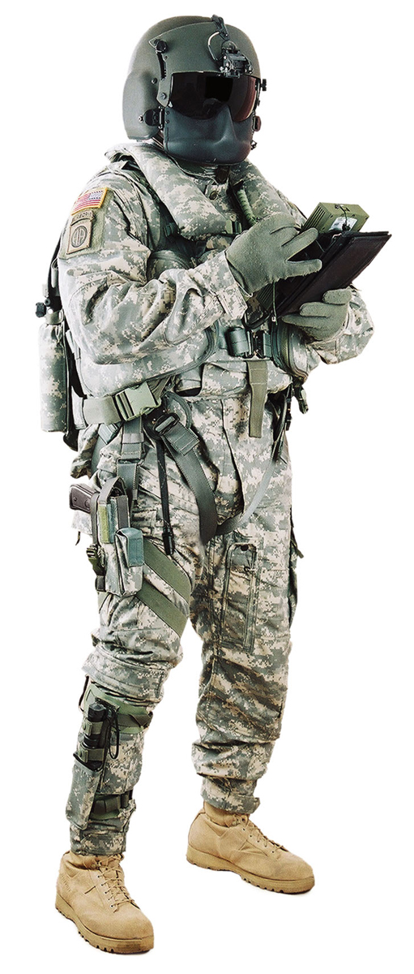
Security
The first thing they take away from you is your sense of security.
The direct threat of violence is the most brutal and the least effective.
A threat against your property, your business, or your love, is more common.
The threat that some other will inflict this violence is the most subtle.
You do not feel secure, and hence feel compelled to comply.
The only response, I think, is to remove the effectiveness of violence. The solidarity of, and trust in, a community is the only effective response.

Slide 36
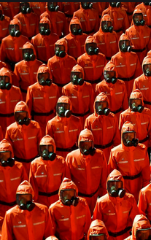
Identity
Identity is the right to define, and to be, who you are. War reduces each and every one of us to one thing: a tool of one side or another fighting the war.
E.g. Read A Long Way Gone, or watch Blood Diamond,
Conformity becomes mandatory
People are expected to dress in certain ways, to speak in certain ways, or in certain languages, to believe the same things, support the same religions.
Obedience is demanded, and expected.
People who seek to deny us our individual identities are people who are endangering the peace
Sally Haslanger: Autonomy, Identity, and Social Justice (pdf, 3718 words) https://sallyhaslanger.weebly.com/uploads/1/8/2/7/18272031/haslanger_autonomy_identity_and_social_justice_-_review_of_appiah.pdf

Slide 37
Voice
Voice is in part the expression of identity but voice is also the way we create community, develop ideas, and create future visions and possibilities.
Voice is the right to a say, the expectation that this expression will have an impact that can be - and is - measured and weighed.
To have voice, people must learn to self-organize, to make decisions and resolve disputes in an open and peaceful manner, to create forums and newspapers and assemblies, to have community groups and societies and special interest groups.
Image: https://www.winemag.com/2020/02/26/activism-wine/

Slide 38
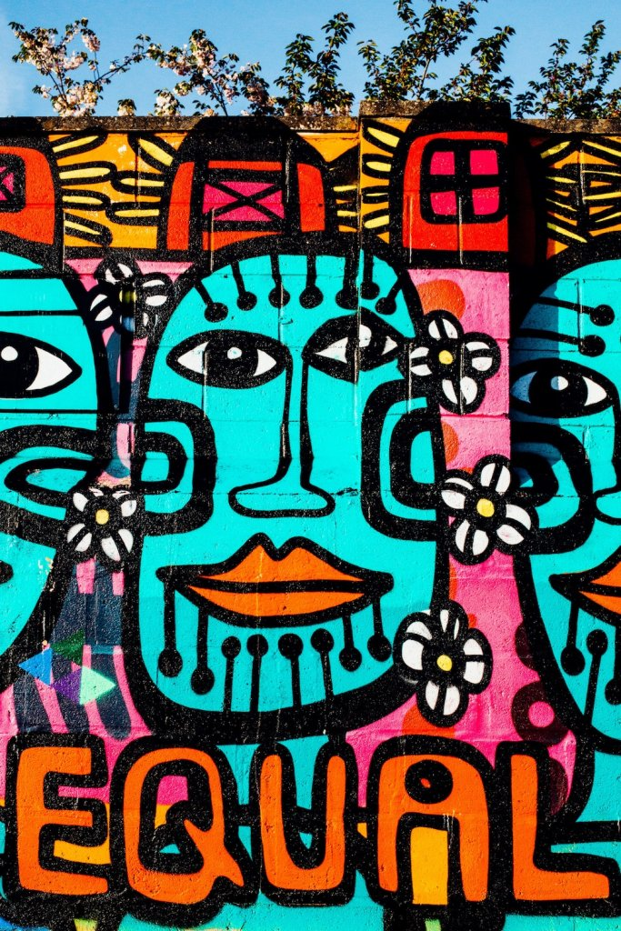
Opportunity
By opportunity what we mean is that there is a path - or the potential of a path - to get from where you are to what you aspire to achieve.
Those who do not have opportunity are not at peace; those who deny opportunity are waging war against them.
Opportunity - especially for those in marginalized or vulnerable groups - requires support.
But it also requires a commercial infrastructure that is robust and trustworthy.
Image: https://werd.io/2018/equality-of-opportunity-vs-equality-of-outcome

Slide 39
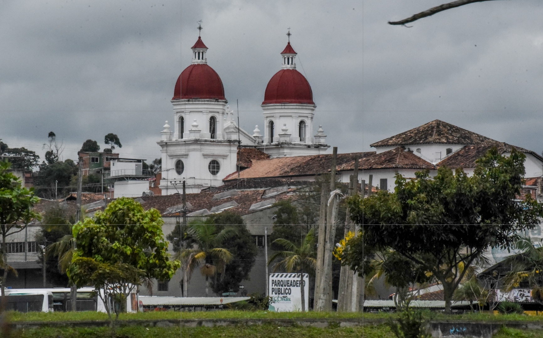
Four Steps to Peace - José Restrepo
See also: https://www.mcgill.ca/msr/volume3/article5
https://www.jstor.org/stable/20707165
https://web.archive.org/web/20171024143227/http://www.bath.ac.uk/management/news_events/news/2017/23-10-jose-restrepo-explains-how-he-is-spreading-peace-in-colombia.html

Slide 40
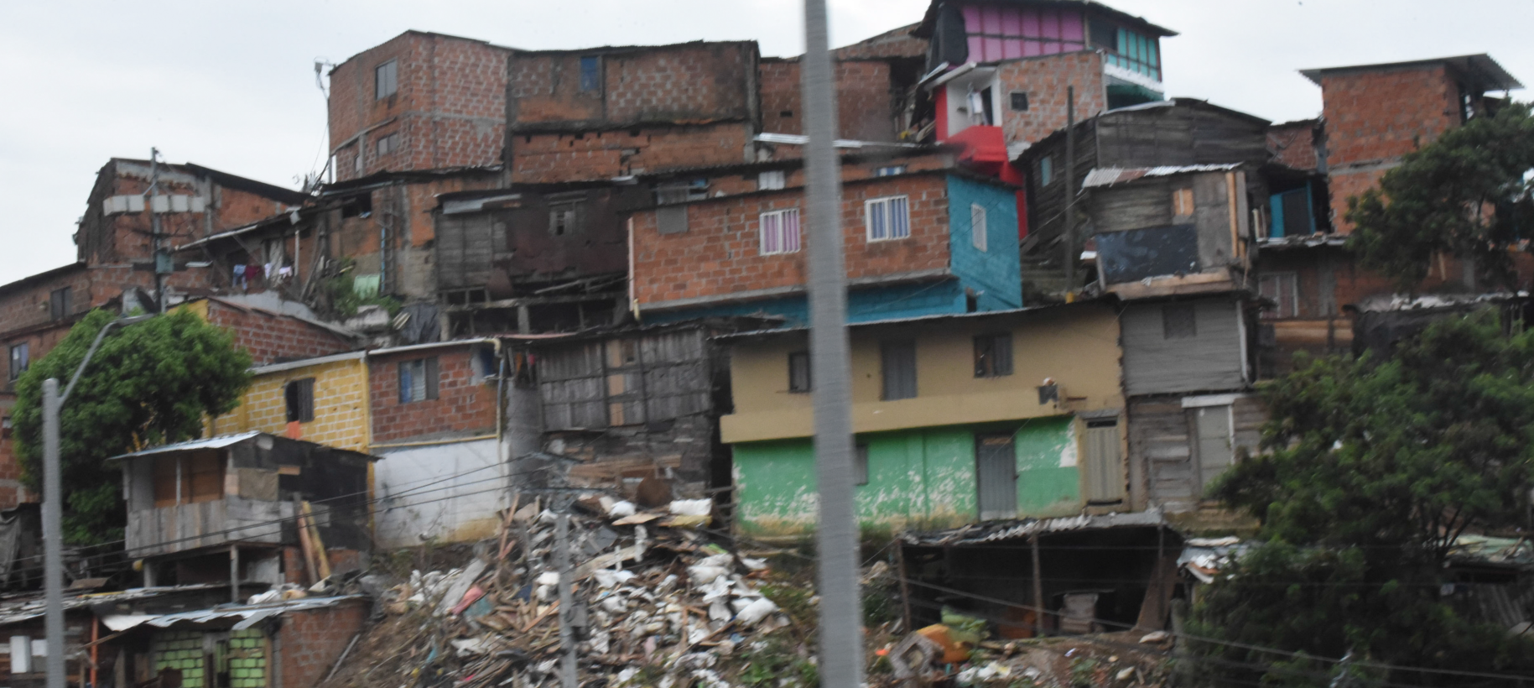
Redistribution
Scholarships for students from low income families and areas of conflict. Increase capacities in communications, information technologies, learning
http://aprende.colombiaaprende.edu.co/pilopaga
SEP: Ethics of Redistribution: “couching discussions of distributive justice in terms implied by redistribution smuggles in associations of forceful takings and rights infringements” https://www.uio.no/studier/emner/sv/sai/SOSANT2210/v15/pensumliste/taylor_the_politics_of_recognition.pdf

Slide 41
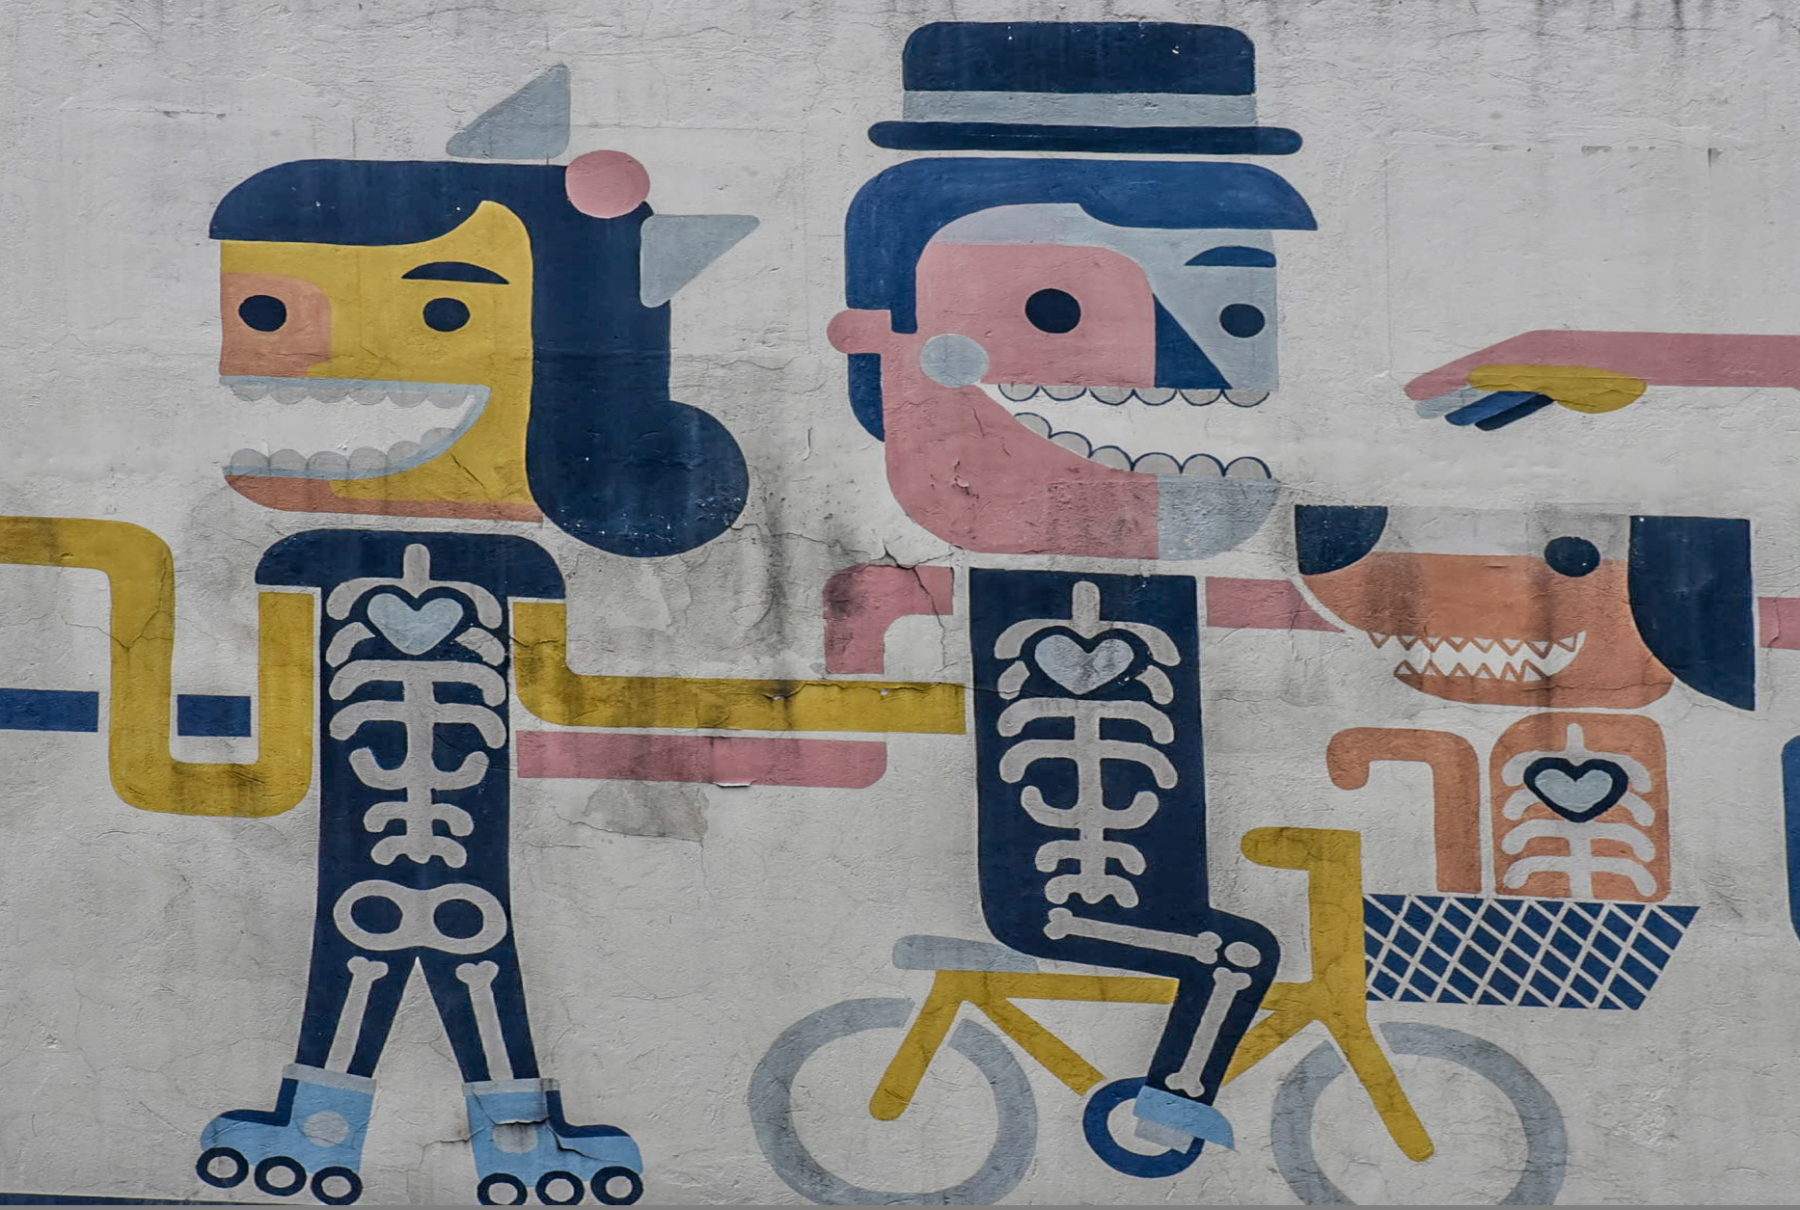
Recognition
Gender equality and diversity while also promoting remembrance, truth and reconciliation. A focus on training of indigenous communities and ex-combatants.
Charles Taylor: recognition of dignity and of difference. ‘The Politics of Recognition’ https://www.uio.no/studier/emner/sv/sai/SOSANT2210/v15/pensumliste/taylor_the_politics_of_recognition.pdf

Slide 42
Representation
Working together to promote interdisciplinary research to develop capacity to rebuild society, sharing curricula on human rights and writing textbooks to teach new generations.
“Who speaks for us?” Issues include media representation, stereotypes, democratic representation, etc. https://ethicsunwrapped.utexas.edu/video/representation
https://www.jstor.org/stable/3561597 http://annettemarkham.com/writing/denzingalleyproofs.pdf

Slide 43
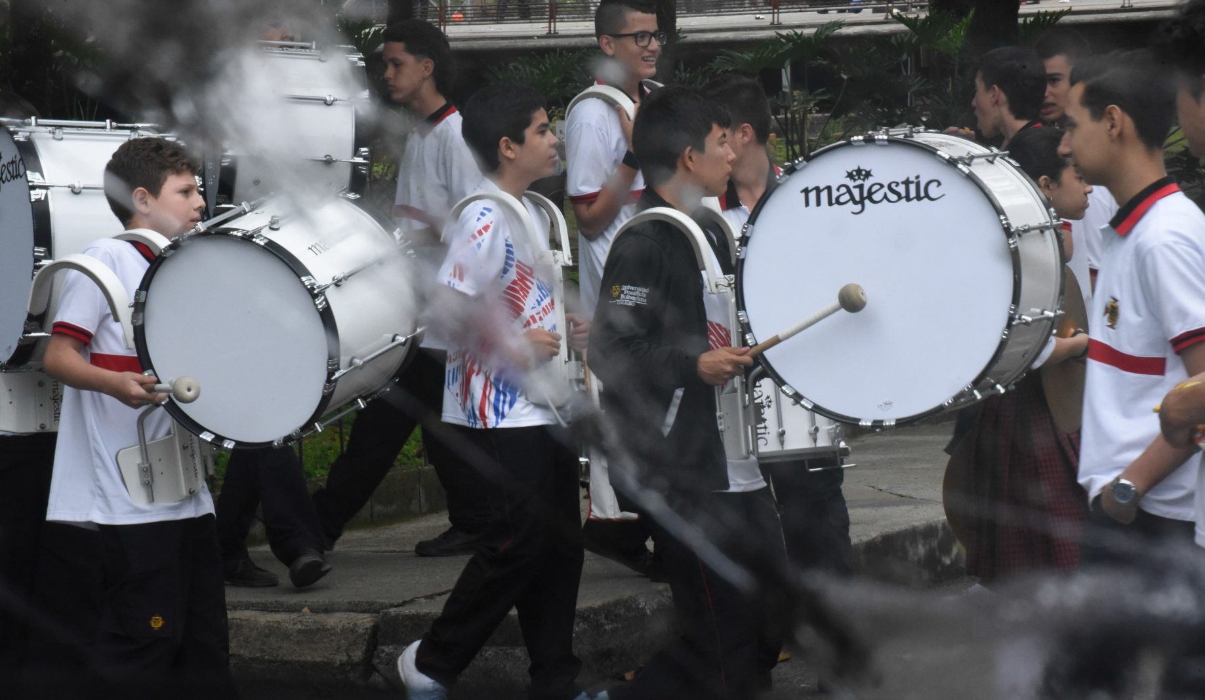
Reconciliation
Processes of reconciliation:
Apologies
Memorials
Truth Telling
Amnesties
Trials and Punishment
Lustration
Reparations
Forgiveness
Participation in Deliberative Processes
https://plato.stanford.edu/entries/reconciliation/
Promoting peaceful conflict resolution and offering alternative paths to success, self-expression, and community support

Slide 44
Shared Agency
"Shared activity is distinguished from a mere aggregation of individual acts by a structure of appropriately related participatory intentions across different individuals. It is a structure that has a distinctive normative significance for those individuals, with an impact most immediately on each individual’s intention-based practical reasoning."
Image: https://www.thestar.com/news/canada/2013/01/28/idle_no_more_activists_resume_protests_against_conservatives.html
Abraham Sesshu Roth, Stanford Encyclopedia of Philosophy, May 03, 2017 https://plato.stanford.edu/entries/shared-agency/
See also: collective intentionality. https://iep.utm.edu/coll-int/

