Slide 1
A Critical Stance
Stephen Downes
January 8, 2022

Slide 2
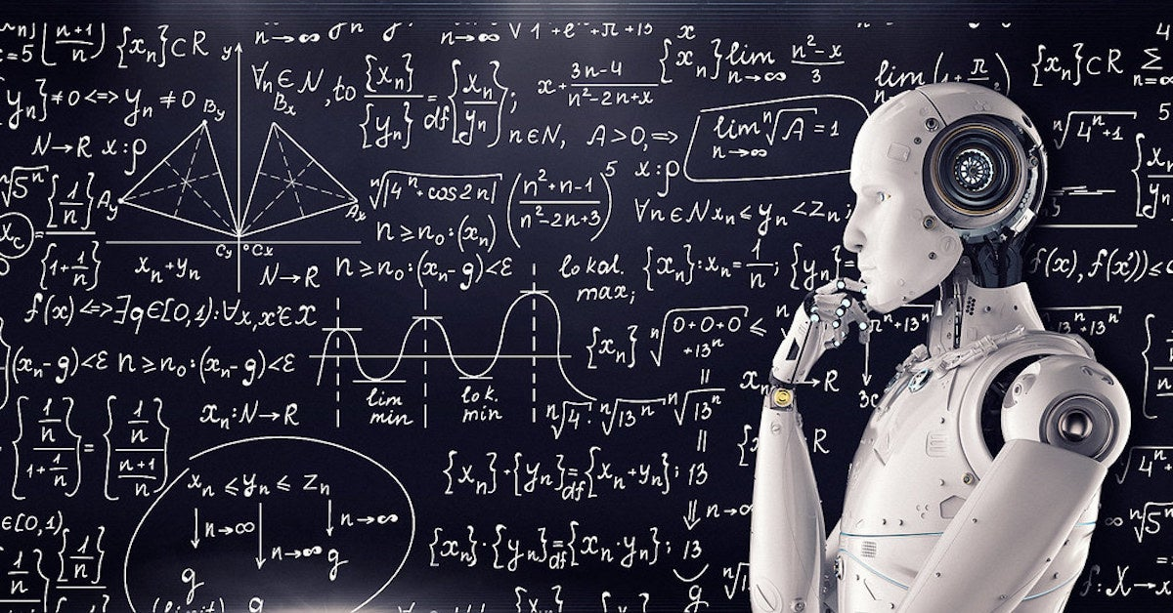
Concluding Unethical Postscript
We can’t just talk about “the ethics of such and such” as though we have solved ethics. There are multiple perspectives on ethics.
Image: https://www.wearethemighty.com/mighty-culture/ai-guidelines-wont-solve-ethics/

Slide 3
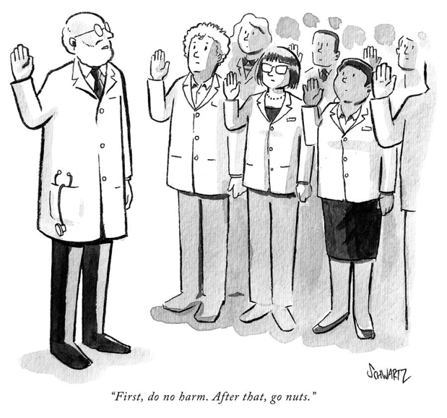
Concluding Unethical Postscript
Ethics based on virtue or beneficial outcomes are not satisfactory in the case of fields like learning analytics
We don’t agree on what ‘the good’ is
We can’t predict what the consequences will be
We can’t repair bad consequences after the fact
Image: https://kenan.ethics.duke.edu/doing-no-harm/

Slide 4
Concluding Unethical Postscript
Ethics – especially in the professions - are typically defined in terms of social contracts, rights or duties - and as such, as statements of rules or principles
But these don’t take into account context and particular situations
They also don’t take into account larger interconnected environment in which all this takes place
And they don’t take into account how analytics themselves work - ie., they are not based on rules or principles, but are statistical (clustering, regression, etc)

Slide 5
Concluding Unethical Postscript
Key point - our analytics are always going to reflect us
(Think Michael Wesch: the Machine is us/ing)
The case of Tay, the racist AI based on Tweets
In which I ask “what make so-and-so think it would be appropriate to post such-and-such?”
The ongoing decision-making required in learning analytics
Belshaw posts - underlying structural causes
https://dougbelshaw.com/blog/2011/08/22/anarchy-in-the-uk-the-reasons-behind-the-breakdown-of-social-order/

Slide 6
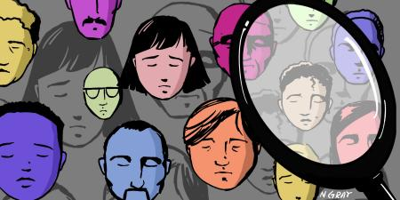
Concluding Unethical Postscript
This leads me to explore the Duty of Care, a feminist philosophical perspective that uses a relational and context-bound approach toward morality and decision making
Based on different objectives - not ‘rights’ or ‘fairness’ but rather things like a sense of compassion
Isn’t a rigid set of principles but rather an attitude or approach
Image: https://journalofethics.ama-assn.org/taxonomy/confidentialityduty-protect-confidential-information

Slide 7
Concluding Unethical Postscript
Ethics are…
derived from one’s own lived experiences
a matter of a community as an entire system, rather than one individual making a decision
We need to keep in mind how we’re all connected
What’s important here is how we learn to be ethical in the first place (as opposed to the specific statement of a set of rules defining what it is to be ethical)
Image: https://www.deviantart.com/intelligentcreations/art/We-are-all-Connected-to-the-Source-856593835

Slide 8
Concluding Unethical Postscript
I also drew out some suggestions as to how this should be approached in practice, in learning, in a workplace, and in society
Creating an ethical culture (rather than emphasis on following the rules)
Diversity of perspective to create a wider sense of community
Encouragement of openness and interaction (art, drama, etc) to develop empathy and capacity to see from the perspective of others
(cf ‘Things you really need to learn’ https://www.downes.ca/cgi-bin/page.cgi?post=38502

Slide 9
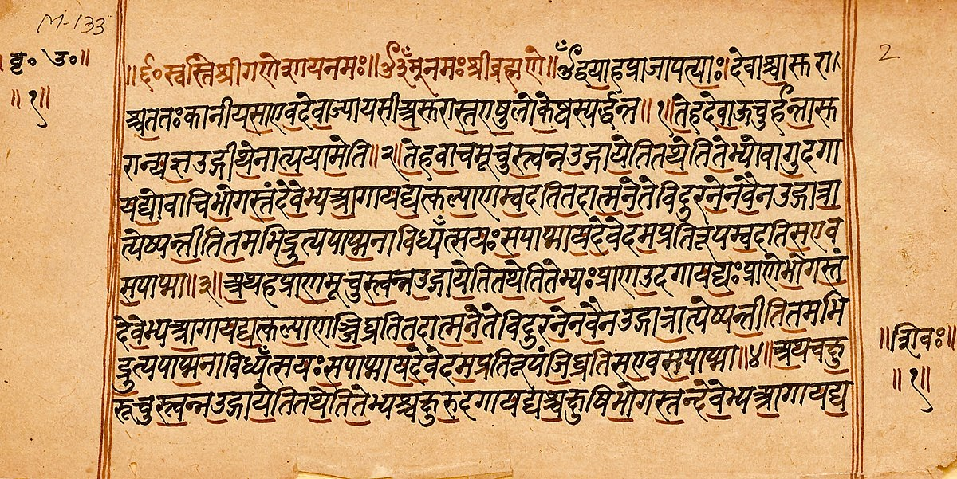
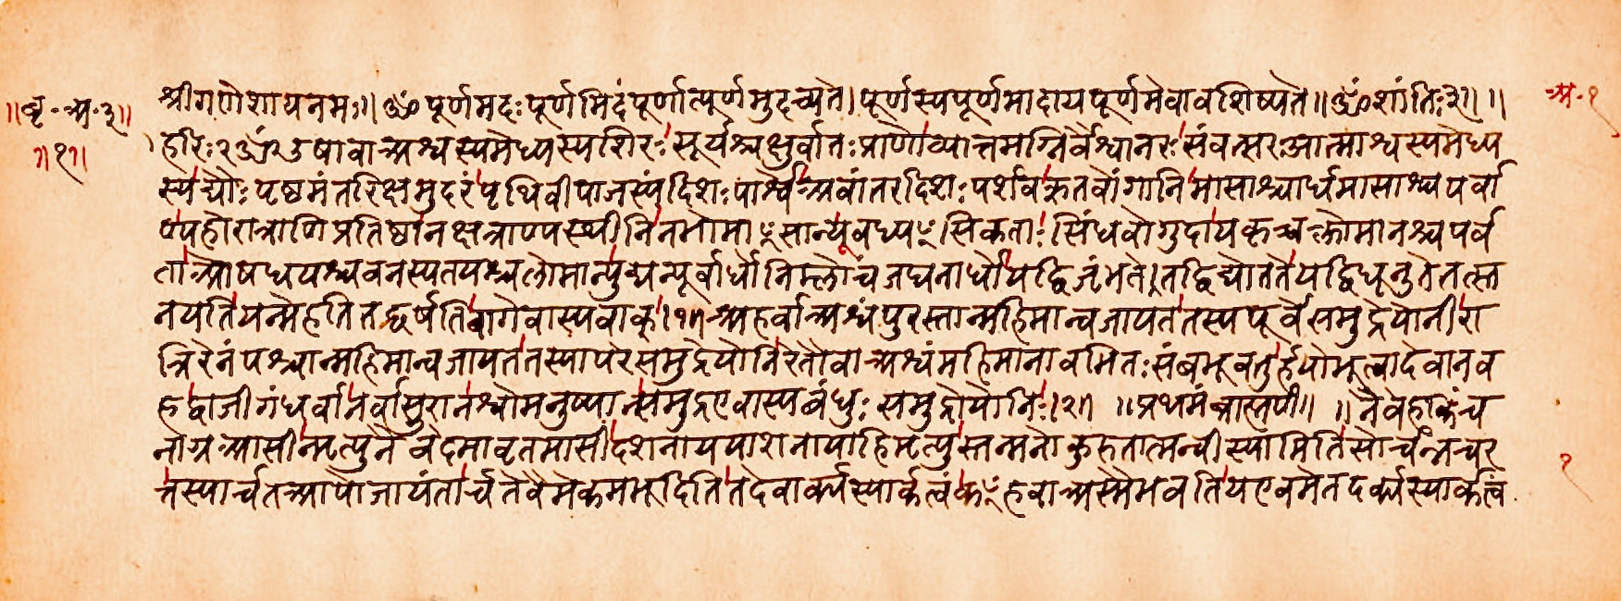
Ourselves
What counts as a ‘self’?
Self as pure subject of experiences
Self as continuing physical existence
Self as self-contained network
Self as function or role
Self as set of intersectional identities
Self as a set of memories
“The Self is the seer, Gargi, though unseen; the hearer, though unheard; the thinker, though unthought; the knower, though unknown. Nothing other than the Self can see, hear, think, or know (BU 3.7.23).”
(Bṛhadāraṇyaka Upaniṣad 3.7.23)
https://gita-society.com/wp-content/uploads/PDF/108upanishads.pdf p. 308 See also https://plato.stanford.edu/entries/personhood-india/
Image https://en.wikipedia.org/wiki/Brihadaranyaka_Upanishad

Slide 10
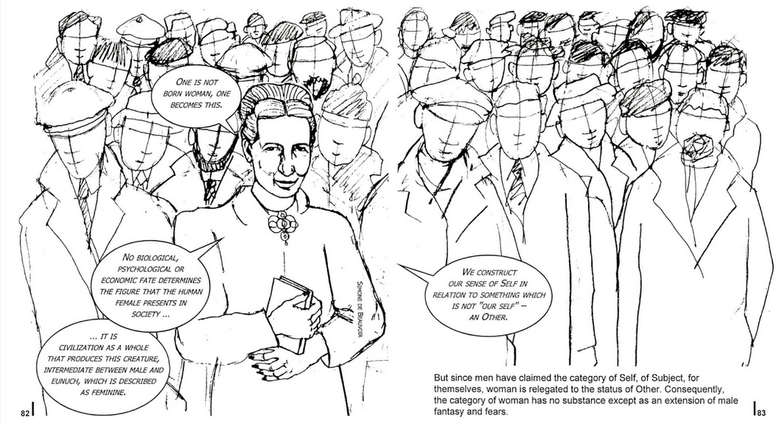
The Social Construction of Self
Our everyday under­standings are culturally and historically situated
“one’s conception of self, and indeed one’s moral integrity, emerges from one’s narrative of self.” (MacIntyre, 1984, p. 205)
“When a fundamental distinction between self and other is established, the social world is constituted in terms of differences.” (Gergen, 2011)
Kenneth J. Gergen, 2011 https://core.ac.uk/download/pdf/80560097.pdf
Alasdair MacIntyre, A. C. (1984). After virtue. A study in moral theory. Notre Dame, IN: University of Notre Dame Press. https://epistemh.pbworks.com/f/4.+Macintyre.pdf
Image citing Simone de Beauvoir’s The Second Sex https://circularsoftware.com/MasterPlan/Client3333/Job4060/?

Slide 11
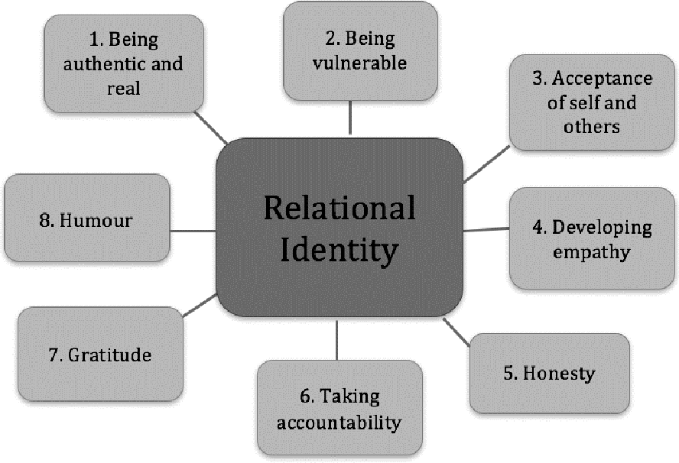
The Relational Self
Aspects of youths’ identity development.
Lev Vygotsky (1978) “also offered a bold alternative to the dominant conception of mind independent from social process. For Vygotsky, individuals are inextricably related, both to each other and to their physical surrounds”
“the question emerges as to whether it is possible to eliminate entirely the ‘thinker behind the words’. Wittgenstein’s Philosophical Investigations (1953) provides the groundwork for such a venture.”
J. Riddell, D. Pepler, Victoria Creighton. 2019. Youths’ Perspectives on Their Relational Identity Development through Residential Treatment. Journal of Therapeutic Schools and Programs. https://static1.squarespace.com/static/555e3952e4b025563eb1c538/t/5c6f2098e5e5f073ef84a85d/1550786719468/Youths%E2%80%99+Perspectives+on+Their+Relational+Identity+Development+through+Residential+Treatment.pdf
Quotes from Gergen, 2011

Slide 12
Social Activism
Critical Pedagogy
Personal Reflection

Slide 13
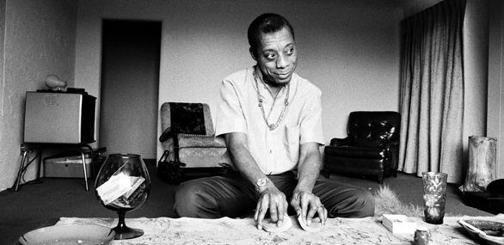
The Purpose of Education
James Baldwin writes “The purpose of education, finally, is to create in a person the ability to look at the world for himself, to make his own decisions…”
He also notes that “no society is really anxious to have that kind of person around.”
James Baldwin (1963) A Talk to Teachers https://richgibson.com/talktoteachers.htm
Image: https://www.thenation.com/article/archive/james-baldwin-guide-dark-times/

Slide 14
Teaching to Transgress
“in Teaching to Transgress, bell hooks urges teachers to contemplate ‘Education as the practice of freedom’ as their point of departure for praxis. A phrase originating from the work of Paulo Freire.”
Julie Fellmayer. (2018). Disruptive Pedagogy and the Practice of Freedom. Hybrid Pedagogy (weblog). Oct 11, 2018. https://hybridpedagogy.org/disruptive-pedagogy-and-the-practice-of-freedom/
Image: https://www.npr.org/2021/12/15/1064509418/bell-hooks-feminist-author-critic-activist-died

Slide 15
Respect and Care
“To teach in a manner that respects and cares for the souls of our students is essential if we are to provide the necessary conditions where learning can most deeply and intimately begin.” - hooks
which works out to be something like "self-actualization", which means to "sacrifice privilege" and " to immerse yourself in the work of as many POC, feminist, activist, and academic writers, bloggers, podcasters and tweeters as possible."
Julie Fellmayer. (2018). Disruptive Pedagogy and the Practice of Freedom. Hybrid Pedagogy (weblog). Oct 11, 2018. https://hybridpedagogy.org/disruptive-pedagogy-and-the-practice-of-freedom/
Image: https://medium.com/human-restoration-project/hrps-books-of-the-month-august-teaching-to-transgress-by-bell-hooks-f2b548ad4b97

Slide 16
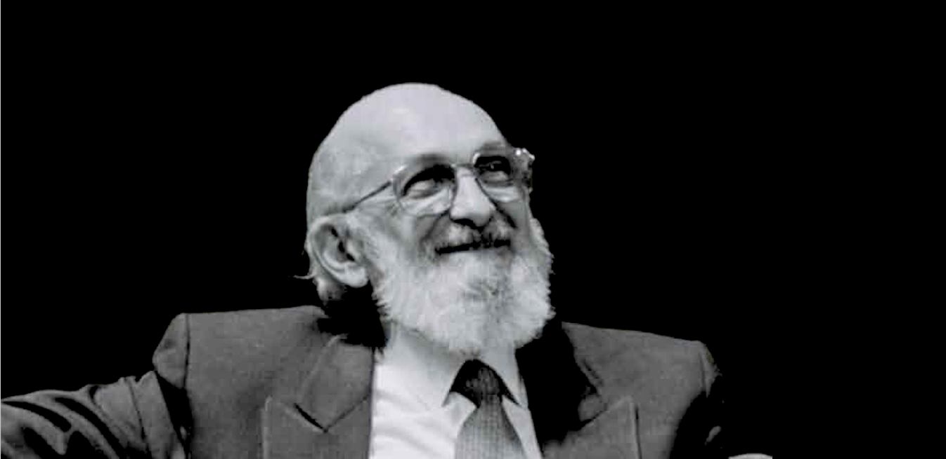
Activism and Identity
Fem ed quilt
Black Likes Matter
Idle No More
“A phrase originating from the work of Paulo Freire, hooks writes that ‘education as the practice of freedom’ will come easiest ‘to those of us…who believe that our work is not merely to share information, but to share in the intellectual and spiritual growth of our students.’” Fellmayer. (2018).
https://quilt.femedtech.net/quilt/
https://ageofrevolutions.com/2017/07/17/paulo-freire-pedagogy-of-the-oppressed-and-a-revolutionary-praxis-for-education-part-i/

Slide 17
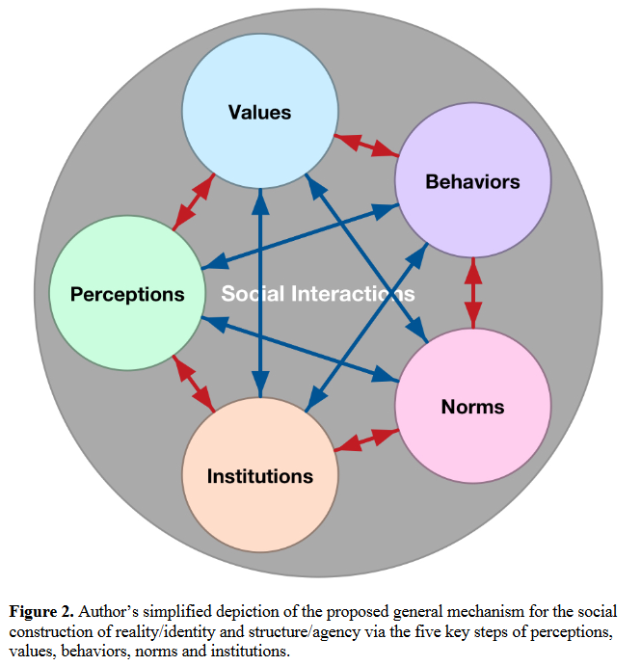
The Construction Of…
(0) | In the present state of affairs, X is taken for granted; X appears to be inevitable.
(1) | X need not have existed, or need not be at all as it is. X, or X as it is at present, is not determined by the nature of things; it is not inevitable.
(2) | X is quite bad as it is.
(3) | We would be much better off if X were done away with, or at least radically transformed.
Ian Hacking. 1999. The Social Construction of What? Harvard University Press. https://www.uio.no/studier/emner/matnat/mn/MNSES9100/h17/literature/introduction/hacking-ian---the-social-construction-of-what-%EF%80%A5-%281999%29.pdf
Image: Yuri Tertillus Jadotte 2020 Shades of Skin, Shades of Power https://www.researchgate.net/publication/342026531_Shades_of_Skin_Shades_of_Power_Social_Constructionism_as_the_Grand_Theory_for_the_StructureAgency_and_RealityIdentity_Conundrums
Three types of construction:
Objects
Ideas
‘Elevator words’

Slide 18
Constructing Virtual Things
“Once you recognize the role that the mind plays in investing things with meaning and with reality, then it’s easier to invest virtual things with meaning, just as much as one can invest physical things with meaning.” – David Chalmers
https://www.vox.com/vox-conversations-podcast/2022/1/12/22868445/vox-conversations-david-chalmers-the-matrix-reality

Slide 19
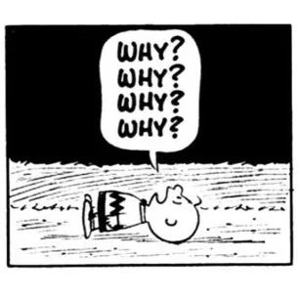
Ethics as a Way of Life
Wittgenstein: “to imagine a language means to imagine a form of life.”
“We embody and exemplify a way of living to children and young people, we perform a tacit affirmation of certain values, arrangements and relationships.” - Mollenhauer
From Norm Friesen - https://www.researchgate.net/publication/320290102_Towards_a_Pedagogical_Hermeneutics_A_Response_to_the_Manifesto_for_a_Post-Critical_Pedagogy p. 2
Ludwig Wittgenstein, Philosophical Investigations I.14 https://static1.squarespace.com/static/54889e73e4b0a2c1f9891289/t/564b61a4e4b04eca59c4d232/1447780772744/Ludwig.Wittgenstein.-.Philosophical.Investigations.pdf
Klaus Mollenhauer, Forgotten Connections: On Culture and Upbringing. (Norm Friesen, transl.) Routledge, New York, p. 8.
Image: https://learnethics.wordpress.com/2016/04/02/220/

Slide 20
Toward Moral Sentiment
This (in my view) is a perspective of an ethics that is learned through experience
Similar to Hume’s moral sentiment
Often experienced at a subsymbolic level - ethics is not (contra Kant) not a matter of rationality but rather one of sympathy - cf. the post ‘The Failure of Reason’ I wrote last June https://halfanhour.blogspot.com/2019/06/the-failure-of-reason.html
How we react in a particular case depends on our ethical background and is the result of multiple simultaneous factors, not large-print key statements

