Slide 1
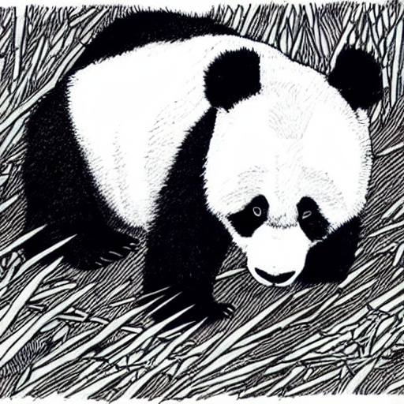
Introduction to AI
Stephen Downes
October 12, 2023

Slide 2
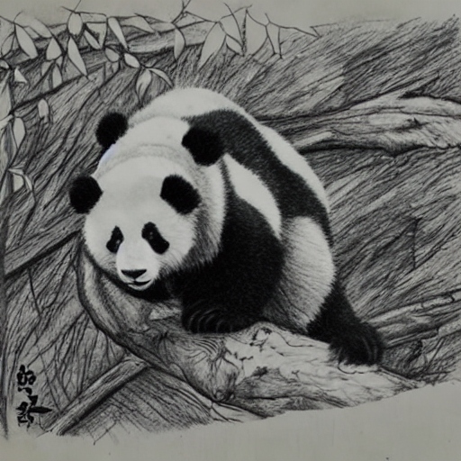
Applications of AI
Descriptive – what happened
Diagnostic – why it happened
Predictive – what will happen
Prescriptive – what should happen
Generative – make it happen
Deontic – the right thing to happen
All applications
https://ethics.mooc.ca/all_applications.htm

Slide 3
Automated Translation
https://support.google.com/chrome/answer/173424?hl=en&co=GENIE.Platform%3DDesktop
https://support.mozilla.org/en-US/kb/how-add-translate-feature-firefox
https://www.adobe.com/acrobat/hub/translate-a-pdf.html
https://www.deepl.com/translator

Slide 4
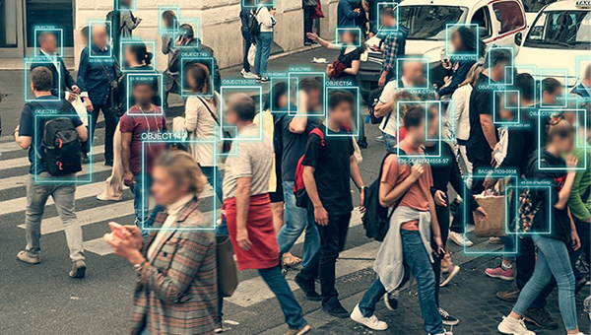
Face Recognition
Example: your phone or computer signs you in by face recognition or thumbprint scan
https://www.contec.com/support/blog/2023/230215_ai/

Slide 5
Character Recognition
https://www.shutterstock.com/video/clip-1083335428-animation-convolutional-neural-network-teaching-computer-recognize

Slide 6
Layers of Neurons
https://www.youtube.com/watch?v=C6JdeZEkNHs

Slide 7
Activation of Neurons
https://www.youtube.com/watch?v=C6JdeZEkNHs

Slide 8
Raw Numbers
https://www.youtube.com/watch?v=C6JdeZEkNHs

Slide 9
K-Means Clusters
https://www.youtube.com/watch?v=qX-rm_Ike30

Slide 10
The Projection Game
What word comes next?

Slide 11
The Projection Game
What word comes next?
Bacon and _____

Slide 12
The Projection Game
What word comes next?
Bacon and _eggs_
Wayne _____

Slide 13
The Projection Game
What word comes next?
Bacon and _eggs_
Wayne _Gretzky_
American ______

Slide 14
The Projection Game
What word comes next?
Bacon and _eggs_
Wayne _Gretzky_
American _Idol_
Justin _________

Slide 15
The Projection Game
What word comes next?
Bacon and _eggs_
Wayne _Gretzky_
American _Idol_
Justin _Trudeau_
Tried and ______

Slide 16
The Projection Game
What word comes next?
Bacon and _eggs_
Wayne _Gretzky_
American _Idol_
Justin _Trudeau_
Tried and _true_

Slide 17
Predicting the Next Word
https://www.youtube.com/watch?v=hgpIOduCED0

Slide 18
Scaling to ChatGPT
https://www.youtube.com/watch?v=hgpIOduCED0

Slide 19
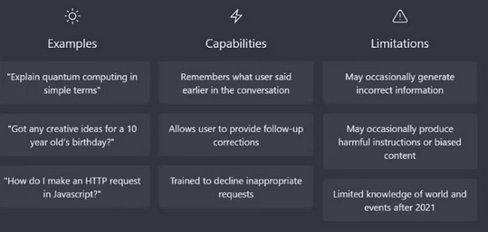
ChatGPT
https://chat.openai.com/
https://www.domusweb.it/en/news/2023/01/17/what-is-chatgpt-and-why-its-so-relevant.html

Slide 20
ChatGPT Prompts
Some good advice:
talk to it as if it were a person
set the stage and provide context
have the AI assume an identity or profession
iterate with multiple attempts
keep it on track
specify output format
explicit constraints on responses
https://www.downes.ca/cgi-bin/page.cgi?post=75667

Slide 21
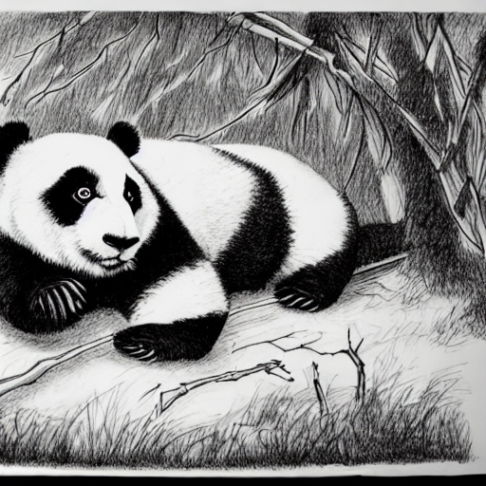
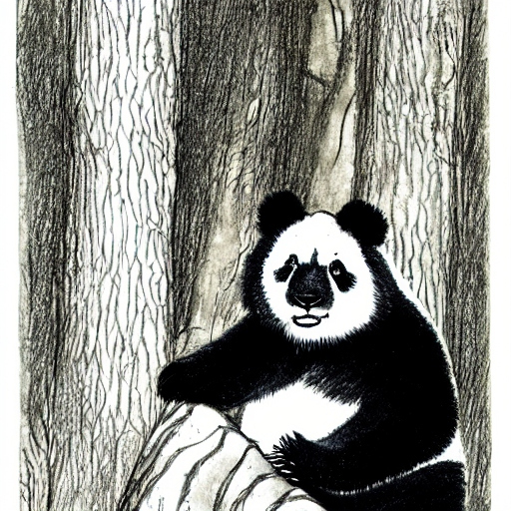
Creating Images
https://deepai.org/machine-learning-model/text2img

Slide 22
AI and Accuracy
How accurate is AI?
It depends on what you’re doing.
If it’s just a creative act (like removing speckles from photos) it’s fine
For many recognition tasks, it performs very well
If the output needs to be factually correct, it’s not reliable
If it is asked to manage or direct, it’s untrustworthy
The real questions are:
How do you evaluate AI for accuracy
How do you correct AIU and make it more accurate?

Slide 23
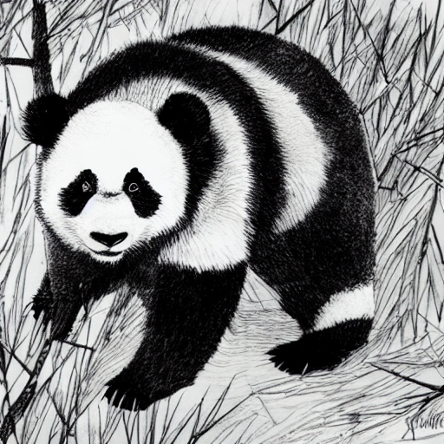
AI ‘Hallucinations’
AI can be creative and will make things up
It’s not relying on a fact-based database
If explicitly asked for something, it will make a ‘best effort’
This includes making fake references
Also, assertions of fact that are untrue
https://teche.mq.edu.au/2023/02/why-does-chatgpt-generate-fake-references/
https://blogs.library.duke.edu/blog/2023/03/09/chatgpt-and-fake-citations/

Slide 24
AI Ethics
Building ethical AI
https://www.pewresearch.org/internet/2021/06/16/experts-doubt-ethical-ai-design-will-be-broadly-adopted-as-the-norm-within-the-next-decade/
Ethical AI use
https://www.canada.ca/en/government/system/digital-government/digital-government-innovations/responsible-use-ai.html

Slide 25
Guiding Principles for Teachers and Educators
Protect student privacy: Teachers need to understand how this data is collected, stored and used to ensure that student privacy is protected.
Ensure Fairness: Teachers need to ensure that these systems are fair and do not discriminate against certain groups of students.
Foster digital citizenship: Teach students about the ethical considerations of AI, including bias and privacy concerns.
https://ced.ncsu.edu/news/2023/02/27/3-things-k-12-educators-should-know-about-the-ethics-and-use-of-ai-in-education/
https://teaching.cornell.edu/generative-artificial-intelligence/ethical-ai-teaching-and-learning

Slide 26
Guiding Principles for Government
To ensure the effective and ethical use of AI the government will:
understand and measure the impact of using AI by developing and sharing tools and approaches
be transparent about how and when we are using AI, starting with a clear user need and public benefit
provide meaningful explanations about AI decision making, while also offering opportunities to review results and challenge these decisions
be as open as we can by sharing source code, training data, and other relevant information, all while protecting personal information, system integration, and national security and defence
provide sufficient training so that government employees developing and using AI solutions have the responsible design, function, and implementation skills needed to make AI-based public services better
https://www.canada.ca/en/government/system/digital-government/digital-government-innovations/responsible-use-ai.html#toc1

