Slide 1
Introduction to Open Online Learning
Stephen Downes
Maskwacis Cultural College
January 26, 2024
https://www.downes.ca/presentation/578

Slide 2
Outline
What is open online learning
The motivations for its development
The history of open online learning
Open learning tools and resources
The future of open online learning.

Slide 3
Open Online Learning
Based in a combination of open learning and free software
Refers to educational resources, tools, and programs that are freely available on the internet for anyone to access, use, modify, and share
Intent is to remove barriers to learning and make high-quality educational experiences as widely accessible as possible.

Slide 4
Dimensions of Open Online Learning
Open Enrollment: few or no barriers to class, course or program enrollment
Open Educational Resources (OER): teaching, learning, and research resources that can be freely used and re-purposed by others
Open Pedagogy: teaching methods that leverage open technologies and high levels of learner participation including collaborative projects, peer-to-peer teaching, and the creation of open resources by learners themselves.
Open Credentials: a system of certificates or badges leading toward recognition of open online learning for formal academic credit.

Slide 5
Features of Open Learning
Accessibility: open access to anyone with an internet connection; accessibility also refers to the design of learning materials that are accessible to people with disabilities.
Flexibility: learners define their own learning objectives choose when, where, and how they learn.
Diversity: varied learning pathways, subject areas, and languages, reflecting the diversity of learners worldwide.
Quality: methods of assessing and recognizing open education resources and providers.

Slide 6
Open Online Learning and Scale
Community and Collaboration: Open online learning often includes community-based components, such as forums and group projects, to enhance the learning experience through collaboration.
Scalability: The digital nature of the resources allows them to be scaled to serve a large number of learners without significant additional costs.
Innovation: Open online learning often serves as a testbed for innovative educational practices and technologies, which can then be adopted more broadly throughout the educational sector.

Slide 7
Why Open Online Learning?
Access: address social need for education regardless of geographic location or economic status.
Flexibility: address needs of learners who require flexible scheduling.
Lifelong Learning: to support continuous professional development outside of traditional education systems.
Cost Reduction: especially relevant in low-income countries.
Innovation in Education: Experimenting with new pedagogical models and technologies.

Slide 8
Quality and Effectiveness
Is online learning as effective as in class scenario?
How to meaningfully engage students in online learning?
How to evaluate OERs including in video format?
What is a good instructional design framework for open online learning?

Slide 9
History of Open Online Learning (1)
1951 Distance Education: correspondence courses, School of the Air (Australia)
1960 University of Illinois: PLATO would be a “book with feedback.”
1969 Open Access: UK’s Open University, offering distance learning courses through the mail, radio, and later television broadcasts.
1985 Indira Gandhi National Open University (IGNOU)
1989 GNU Public License – Free/Libre and Open Source Software
Notes:
School of the Air - https://www.assoa.nt.edu.au/
Plato - https://grainger.illinois.edu/news/magazine/plato
Open University - https://en.wikipedia.org/wiki/Open_University
IGNOU - http://ignou.ac.in/
GPL - https://en.wikipedia.org/wiki/GNU_General_Public_License
UNESCO - https://unevoc.unesco.org/home/Open+Licensing+of+Educational+Resources
Cape Town - https://www.capetowndeclaration.org/read/

Slide 10
History of Open Online Learning (2)
2001 MIT OpenCourseWare (OCW): free access to course materials
2001 Creative Commons: Open Licensing
2008 Massive Open Online Courses (MOOC): Coursera, edX, Udacity and others began offering mass courses from universities at no cost.
2008 Open Pedagogies: Cape Town Declaration
2020: Remote Learning and the Pandemic

Slide 11
Open Online Learning in Canada
1970 Athabasca University
1970 Caribou College and 2005 Thompson Rivers University (TRU) Open Learning Division (TRU-OL)
1972 TelUQ and 1984 Canal Savoir
1978 Open Learning Agency
1986 Contact North
2003 BCcampus – online programs, resources, shared services
2015 eCampus Ontario
Notes:
Teleq https://www.teluq.ca/site/en/
https://en.wikipedia.org/wiki/Open_Learning_Agency
Contact North https://contactnorth.ca/about-us/services/
TRU https://www.tru.ca/
Bccampus https://bccampus.ca/2018/05/25/bccampus-15th-anniversary/
Ecampus ontario https://www.ecampusontario.ca/ecampusontario-expands-virtual-learning-impact-with-two-new-members/

Slide 12
International Open Online Learning
Commonwealth of Learning (CoL) – learning for sustainable development
University of the People - online, tuition-free, accredited degree programs
OERu - connects learners around the world with defined pathways to education
Khan Academy - mission to provide a free, world-class education for anyone
UNESCO online courses
World Bank
Notes:
https://www.col.org/
https://www.uopeople.edu/
https://oeru.org/
https://www.khanacademy.org/
https://openlearning.unesco.org/

Slide 13
OER and Creative Commons Licensing
https://foter.com/blog/how-to-attribute-creative-commons-photos/

Slide 14
Issues Around Content Use
What impact does Fair Use / Fair Dealing and Creative Commons have for educators as it pertains to content for MOOCs?
“Teachers, instructors, professors and staff members in non-profit universities may communicate and reproduce, in paper or electronic form, short excerpts from a copyright-protected work for the purposes of research, private study, criticism, review, news reporting, education, satire or parody.”
https://libraries.dal.ca/services/copyright-office/fair-dealing.html

Slide 15
Massive Open Online Courses
Notes:
https://en.wikipedia.org/wiki/Massive_open_online_course

Slide 16
History of the MOOC
https://stephenp.net/2015/06/13/revisiting-our-moocs-and-open-education-timeline/

Slide 17
Open Educational Practices
Production, management, use & reuse of open educational resources.
Developing and applying open/public pedagogies in teaching practice.
Open learning and gaining access to open learning opportunities.
Practicing open scholarship, to encompass open access publication, open science and open research.
Open sharing of teaching ideas and know-how.
Using open technologies (web-based platforms, applications and services) in an educational context.
https://minnstate.pressbooks.pub/openeducationpractices/chapter/introduction-to-open-education-practice/
https://www.irrodl.org/index.php/irrodl/article/view/3096/4301
Notes:
https://minnstate.pressbooks.pub/openeducationpractices/chapter/introduction-to-open-education-practice/
https://www.irrodl.org/index.php/irrodl/article/view/3096/4301

Slide 18
Supporting Open Online Learning
Technology:
Server-based: either in-house or cloud hosted
Free online tools
Download and install desktop tools
Apps: based on mobile devices
Non-Technology:
Community-based learning centres, help lines, etc
Policy Frameworks
Learning and Community of Practice

Slide 19
Tools for Open Online Learning
Platforms: Coursera, edX, Khan Academy, and FutureLearn
OER Repositories: such as those found on OER Commons.
Learning Management Systems (LMS): Moodle, Canvas
Collaborative Tools: Wikis, Google Classroom, and Microsoft Teams facilitate collaborative learning.
Specialized Learning Tools: Duolingo for language learning, Codecademy for coding skills, and LabXchange for science education.

Slide 20
The Quick Tools Guide
Cloud only - if you have to set up a web server, it doesn’t belong on the list. If you are required to download an application, it doesn’t belong.
No apps (no Play Store, Apple Store, etc.,)
Free (or Nearly Free) - ideally, the tool has a free tier that lets you try it out. Your total costs to do everything should be less than $100/month
No credit cards - doesn’t ask you for a credit card unless you’re actually paying them money
https://docs.google.com/document/d/1ux3lTnUTpzZRuvxE3rAsSQ4Ihub96S8_OYECNh8wv-A/edit?usp=sharing

Slide 21
Models for Sustaining Open Learning
Public funding: government support for open learning
Internal funding: open learning as part of institutional mandate
Endowments and donations: funding from trusts, foundations
OER Networks: aa co-op resource development model
Offering services to learners: eg. tutorial support, applications
Relying on OER authors: eg. Wikipedia, YouTube videos
Community-based model: eg. Community of practice
https://www.unesco.org/en/articles/post-pandemic-learning-exploring-sustainable-open-education-resources-oer-business-models

Slide 22
The Future – Underlying Technology
Cloud and Data – free and open information in the ether
Graph and Networks – connections and relations
Learning Experience – immersive and experiential learning
Identity and Recognition – eg. Distributed ID
Community and Agency – open learning communities
Notes:
https://el30.mooc.ca/course_outline.htm

Slide 23
The Future– The Big Three
Artificial Intelligence (and Open AI)
Learning Analytics
Generative AI
The Metaverse – Object Persistence and the Open Graph
Virtual Reality and Simulations
Augmented Reality
Blockchain and Crypto
Directional Acyclic Graphs (DAG)
Content Addressing
Notes:
https://teachonline.ca/tools-trends/vision-future-online-learning-age-ai

Slide 24
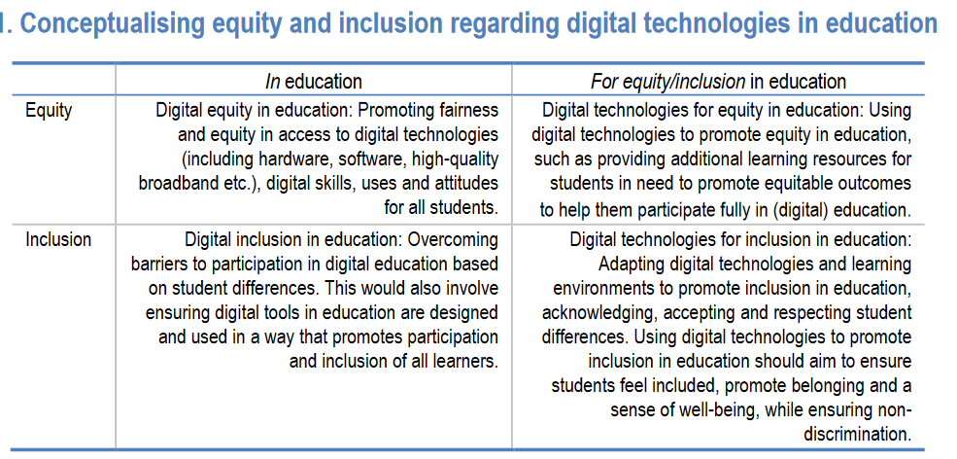
The Future – Ethics and Social Justice
Digital Equity and Inclusion in Education
Pedagogies of Care – the personal versus the procedural
AI Ethics
Decolonization and Social Justice
https://www.oecd.org/publications/digital-equity-and-inclusion-in-education-7cb15030-en.htm
https://hybridpedagogy.org/pedagogy-of-care-gone-massive/ https://ethics.mooc.ca https://opentextbc.ca/indigenizationfrontlineworkers/chapter/decolonization-and-indigenization/
http://www.oneca.com/IndianControlofIndianEducation.pdf
Notes:
https://www.oecd.org/publications/digital-equity-and-inclusion-in-education-7cb15030-en.htm
https://hybridpedagogy.org/pedagogy-of-care-gone-massive/
https://opentextbc.ca/indigenizationfrontlineworkers/chapter/decolonization-and-indigenization/
http://www.oneca.com/IndianControlofIndianEducation.pdf

