Slide 1
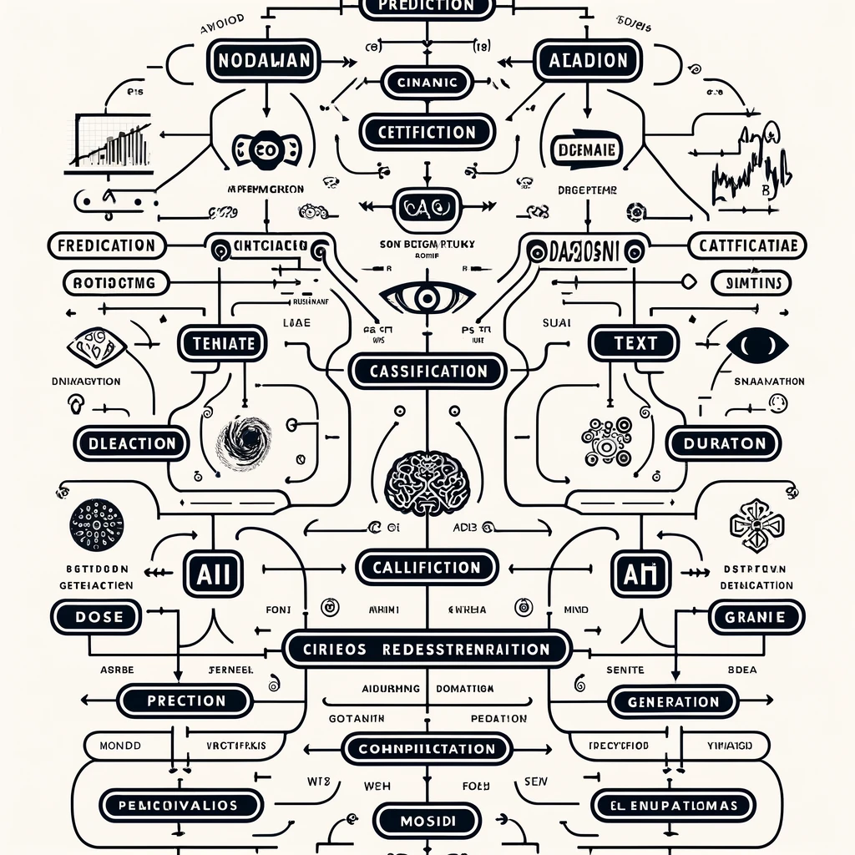
AI in Enterprise Learning Systems
Stephen Downes
May 27, 2024
Concordia University Summer Institute on AI and Education
https://www.downes.ca/presentation/582
Notes:
Cover image: ChatGPT 4 attempting: “Please create a diagram for me depicting different types of AI classified by what they do (eg. prediction, classification, generation) with some subtypes for each function. Make sure the text is clear and easy to read. Image should be white background with black content.”

Slide 2
Abstract
Description: This presentation will provide a general perspective on the use of AI in enterprise learning systems like Learning Experience Platforms, Learning Management Systems, and Talent Management Systems, and what that might mean for learning. We will explore uses including learning and performance analytics, learning and competencies assessment, content and learning path recommendations, and similar types of work. We will also consider how various standards, such as xAPI, facilitate 'intelligence' in enterprise systems, and consider wider issues such as data management and analytics, the enterprise AI workflow, and evolving needs in enterprise learning and development.

Slide 3
What to Expect
A Technology Overview
What AI Does
Enterprise Learning Systems
Interlude: How We Predict
Some Predictions
What The Pros Do
Wider Issues
It’s not rocket surgery

Slide 4
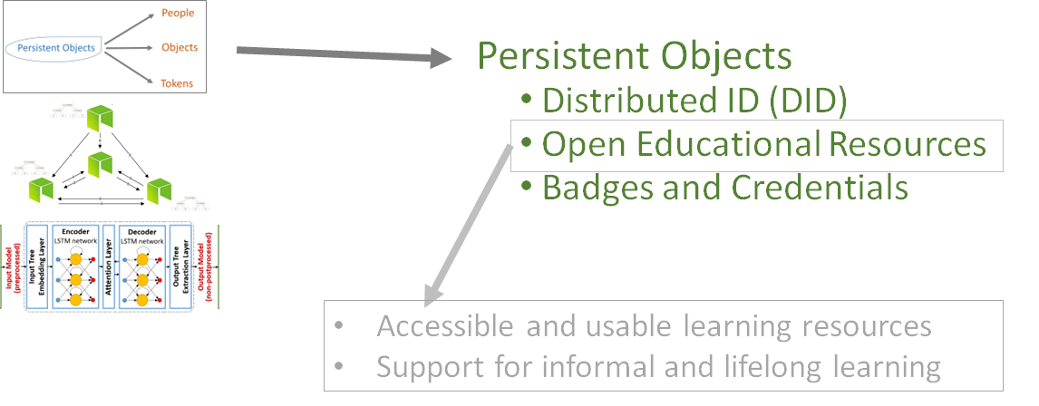
Metaverse

Slide 5
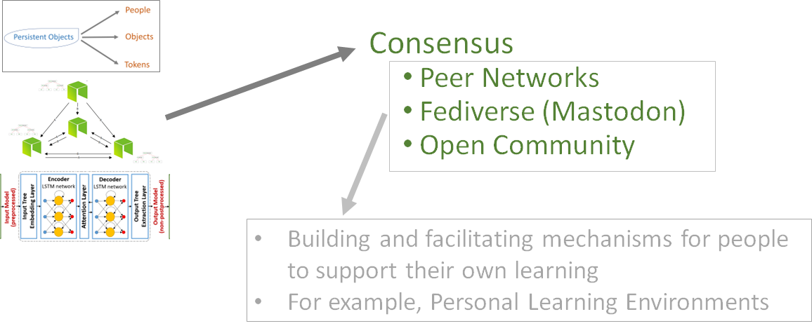
Blockchain

Slide 6
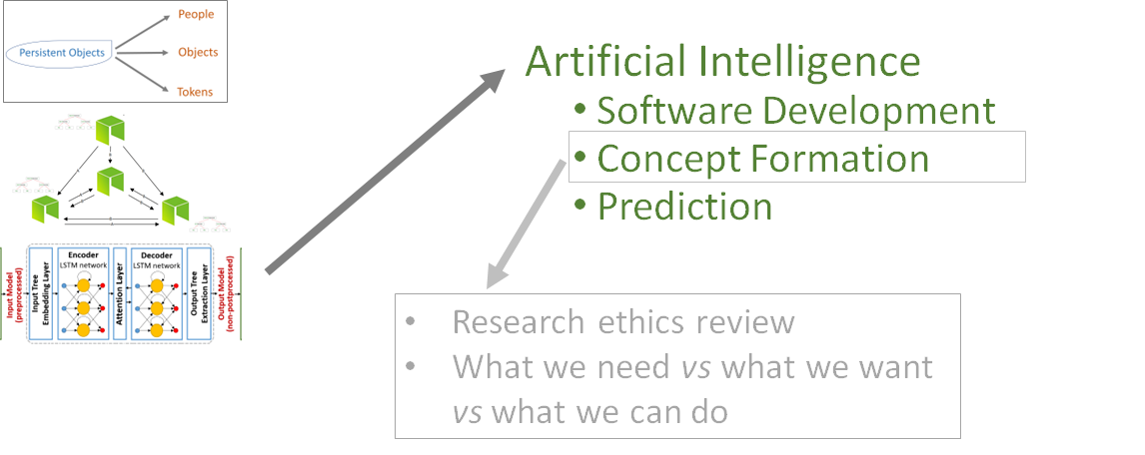
Artificial Intelligence
https://www.downes.ca/cgi-bin/page.cgi?presentation=568

Slide 7
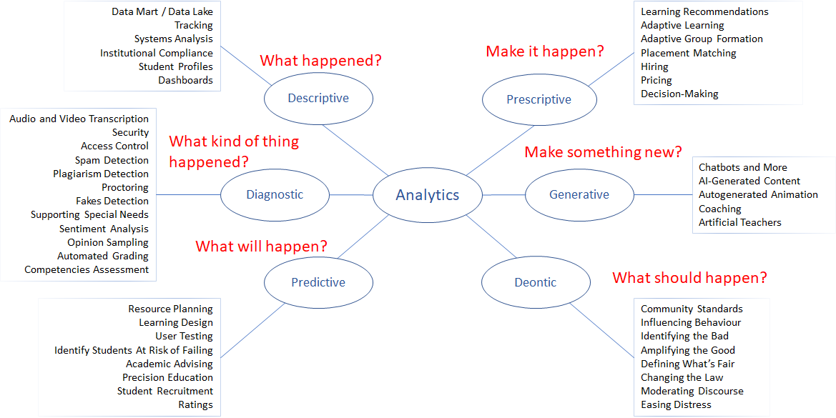
Applications of AI - A Taxonomy
https://ethics.mooc.ca/cgi-bin/page.cgi?presentation=12

Slide 8
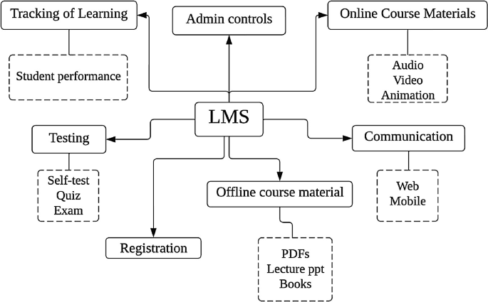
Learning Management System
Image: https://link.springer.com/chapter/10.1007/978-981-99-7216-6_10

Slide 9
Learning Experience Platform
Image: https://www.l-ten.org/learning-executive-series/building-the-right-learning-technology-architecture/

Slide 10
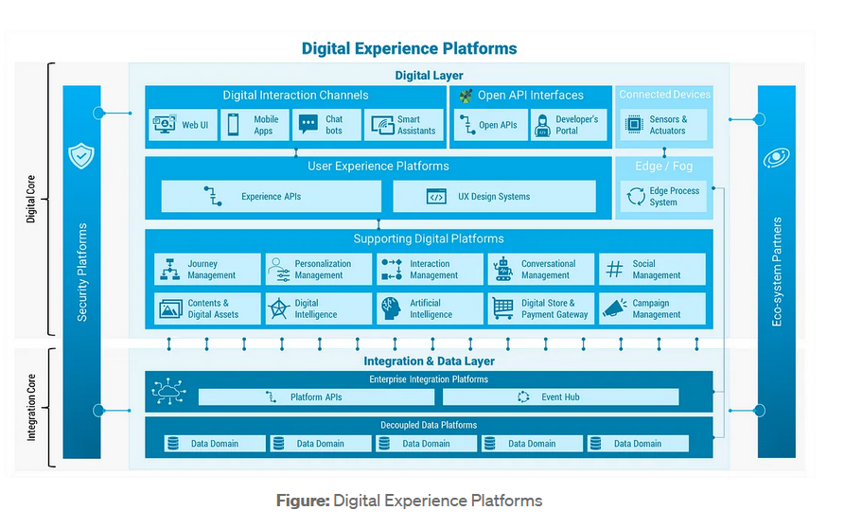
Learning Experience Platform
https://medium.com/@razi_chaudhry/explaining-the-blueprint-for-digital-experience-platforms-e6fe5a088701

Slide 11
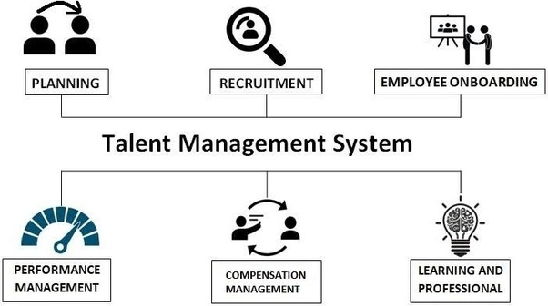
Talent Management System
Image: https://www.quora.com/How-can-I-confirm-if-Talent-management-system-Europe-and-recruitment-is-a-scam/answer/On-Demand-Journalism

Slide 12
Combining Enterprise Systems
Learner - IAM
OAuth
LMS
LXP
TMS
SCORM
API
xAPI
API
LRS
CS
Learning Record Store: https://xapi.com/learning-record-store/
Credential Store (CS): https://www.techopedia.com/definition/23914/credential-store

Slide 13
How We Predict - the Wider Context
 | Artificial Intelligence | Metaverse | Blockchain
Learning Management
Learning Experience
Talent Management

Slide 14
How We Predict - the Narrower Context
 | Artificial Intelligence
 | Descriptive | Diagnostic | Predictive | Prescriptive | Generative | Deontic
LMS
LXP
TMS

Slide 15
How We Predict - the Narrower Context
 | Artificial Intelligence
LMS | Descriptive | Diagnostic | Predictive | Prescriptive | Generative | Deontic
Course Materials
Testing of Learning
Tracking of Learning

Slide 16
Predictions
Course Materials | Descriptive
 | Diagnostic
 | Predictive
 | Prescriptive
 | Generative
 | Deontic
Count words, word frequencies, how many reads, upvotes
Classify, identify topics, extract keywords, rate quality
Assess readability
Content recommendations, learning path planning
Create novel content, images, videos, custom content
Define what content is needed, best pedagogical method

Slide 17
Beyond Predictions
Who or what is harmed?
Course Materials
Count words, word frequencies, how many reads, upvotes
What would make it impossible?
What problem does this solve?
What needs to exist to make this possible?
What new thing can we do?

Slide 18
Your Turn

Slide 19
Topics
LMS | LXP | TMS
Registration | Digital Interaction | Recruitment
Course Materials | User Experience | Onboarding
Testing of Learning | Data Management | Performance
Tracking of Learning | Enterprise Integration | Compensation

Slide 20
LMS
Registration | List of registration data collected, transcript data, counts
 | Application success rates, registrar demographics
 | How many next year, where from, success rate
 | How to improve success rate, change demographics
 | Create new registration forms
 | Redefine acceptance logic, recommend target groups
Descriptive | Diagnostic | Predictive | Prescriptive | Generative | Deontic

Slide 21
LMS
Testing | List of test questions, scores, grading curve
 | Classification of responses, automated grading
 | Projected success rate for a given assessment
 | How to improve success rate, change demographics
 | Create new tests, assessment rubrics
 | Determine what should be assessed
Descriptive | Diagnostic | Predictive | Prescriptive | Generative | Deontic

Slide 22
LMS
Tracking | List of attendance, test scores, interaction frequency
 | Identify areas of strengths, weaknesses, topic preferences
 | Projected program success, projected discipline choice
 | Learning path recommendations, career recommendations
 | Create resumé or c.v., write letters of recommendation
 | What career should this person choose?
Descriptive | Diagnostic | Predictive | Prescriptive | Generative | Deontic

Slide 23
LXP
Digital Interaction | Track messages, contacts, message frequency & time
 | Diagnose types of comments; filter harmful comments
 | Predicted role in conversation, predicted areas of success
 | Identify compatible discussion lists, correspondents
 | Autogenerate comments, auto-summarize discussions
 | Offer advice on improving social skills
Descriptive | Diagnostic | Predictive | Prescriptive | Generative | Deontic

Slide 24
LXP
User Experience | Keyboard logging, eye tracking, task success
 | Identify areas of focus, identify disabilities
 | Predicted responses to specific experience designs
 | Identify optimal presentation styles, digital modalities
 | Generate personal user interface design
 | Recommend accessibility adaptations
Descriptive | Diagnostic | Predictive | Prescriptive | Generative | Deontic

Slide 25
LXP
Data Management | Data contents, types, source, associated metadata
 | Classify data according to content, type, function
 | Predict incoming data, requirements for data
 | Recommend metadata profile, data requirements
 | Generate test data
 | Define metrics for data trustworthiness
Descriptive | Diagnostic | Predictive | Prescriptive | Generative | Deontic

Slide 26
LXP
Enterprise Integration | List enterprise systems, transit protocols, logs
 | Identify data format requirements, orchestration patterns
 | Predict incoming requests, demand load
 | Recommend external data services, sources of truth
 | Generate requests for external services (agents)
 | Define ideal network configuration for enterprise
Descriptive | Diagnostic | Predictive | Prescriptive | Generative | Deontic

Slide 27
TMS
Recruitment | Job descriptions, openings, application data, requirements
 | Match role to credentials and experience required
 | How long it takes to fill, likely quality of applicants
 | Assess and pre-screen incoming applications
 | Match openings with potential applications and invite
 | Create job profiles, define screening criteria
Descriptive | Diagnostic | Predictive | Prescriptive | Generative | Deontic

Slide 28
TMS
Onboarding | New staff, credentials, role descriptions
 | Match with special interest groups, teams
 | Project length of employment, career path
 | Recommend training materials, forms, policies, goals
 | Create personal welcome, list of contacts, expectations
 | Define new onboarding practices
Descriptive | Diagnostic | Predictive | Prescriptive | Generative | Deontic

Slide 29
TMS
Performance Management | Key performance indicators, performance review data
 | Identify areas of strength, weakness
 | Project future performance path, issues, staffing needs
 | Suggest performance indicators, recommend tasks
 | Generate performance assessments, formative training
 | Define performance metrics, relevant goals
Descriptive | Diagnostic | Predictive | Prescriptive | Generative | Deontic

Slide 30
TMS
Compensation | Compensation grid, employment data, time or task records
 | Rate performance (by results, consistency, etc)
 | Project future compensation rates, incentives needed
 | Recommend compensation profile for past/future work
 | Generate performance assessment reports
 | Define new definition of value, create compensation grid
Descriptive | Diagnostic | Predictive | Prescriptive | Generative | Deontic

Slide 31
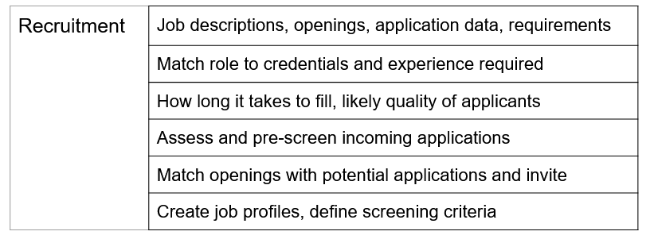
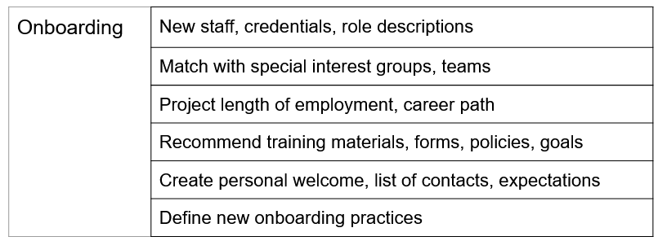
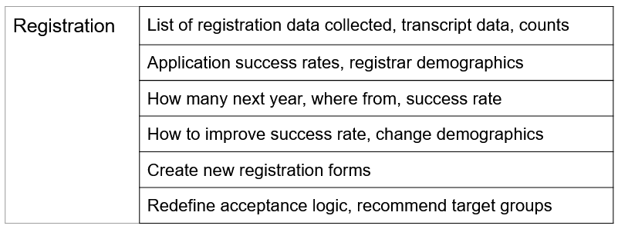
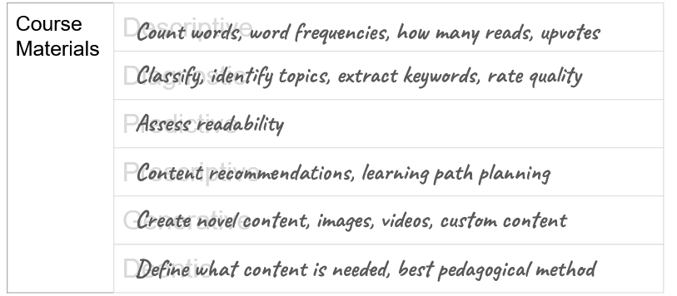
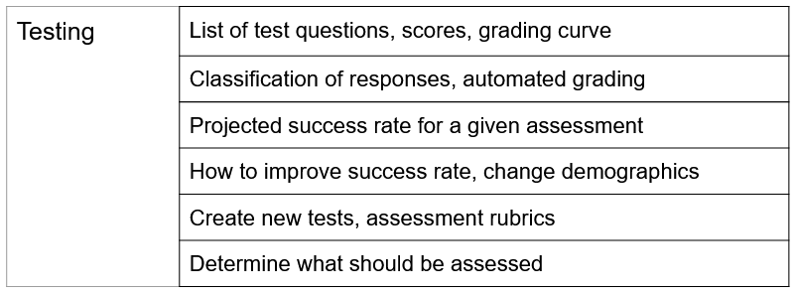
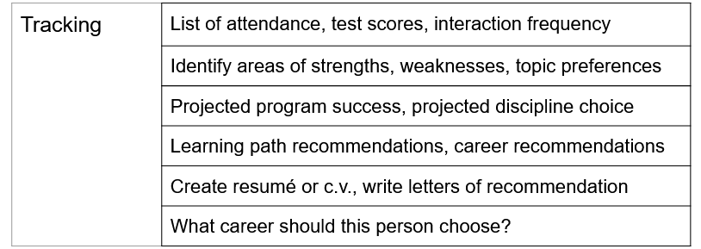
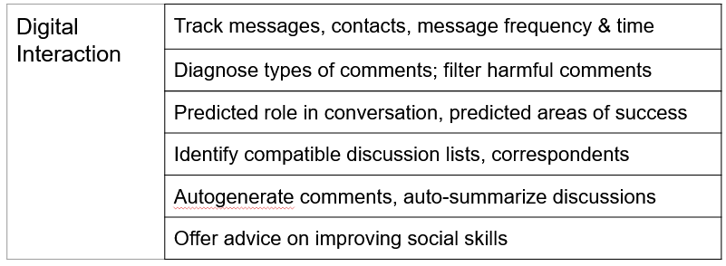
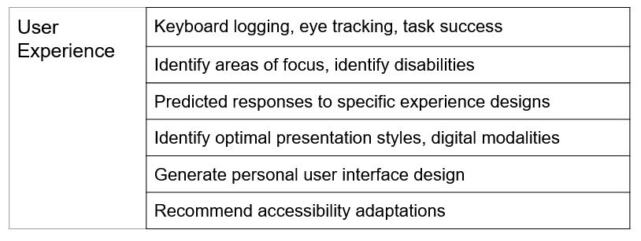
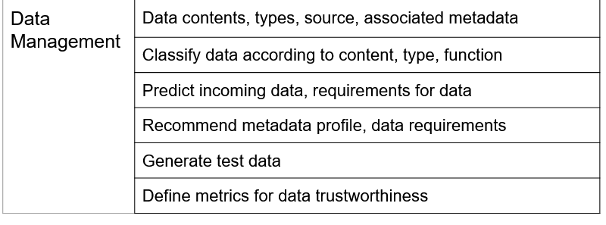
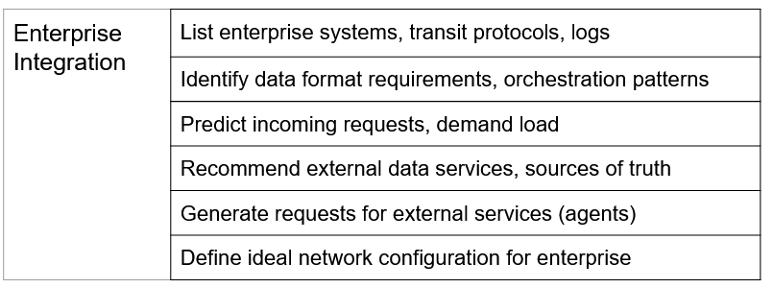
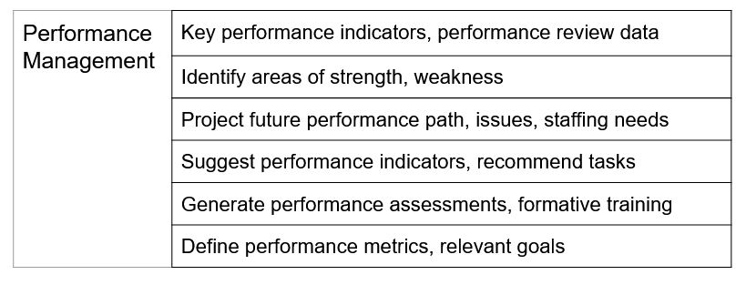
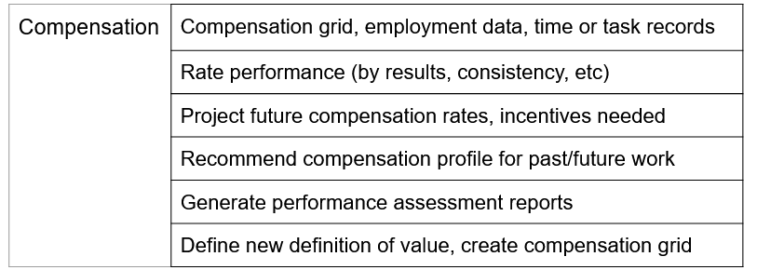
What the Pros Do - Tell the Story
Using AI to Support Staff Diversity at Institution P
Recruit
Connect
Enrol
Adapt
Assess
Strengths
Engage
Assist
Metrics
Recommend
Compensate Fairly
Support

Slide 32
Wider Issues
Data management and analytics
Data Management - Data Lakes, Data Marts
Data Literacy - https://www.downes.ca/cgi-bin/page.cgi?presentation=574
The enterprise AI workflow
DevOPs
AI Workflkow - https://ethics.mooc.ca/cgi-bin/page.cgi?module=11
Evolving needs in enterprise learning and development
Identity and Access Management (IAM)
The future is decentralized

Slide 33
Thank You
Stephen Downes
https://www.downes.ca

