Slide 1
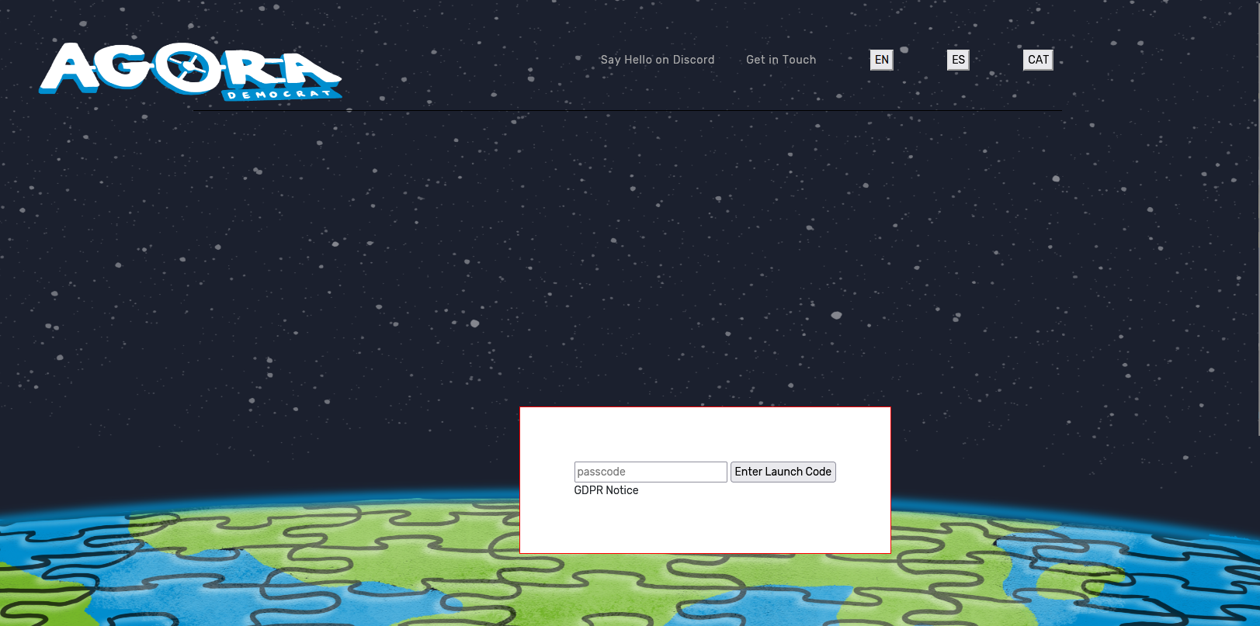
Step by Step for Participants
Access Agora https://agora.democrat-horizon.eu/ub
Separate Agora for each national team
Participants enter launch code (provided)
We need a contact from each national team to coordinate the set-up for team Agora environments – send to stephen@downes.ca

Slide 2
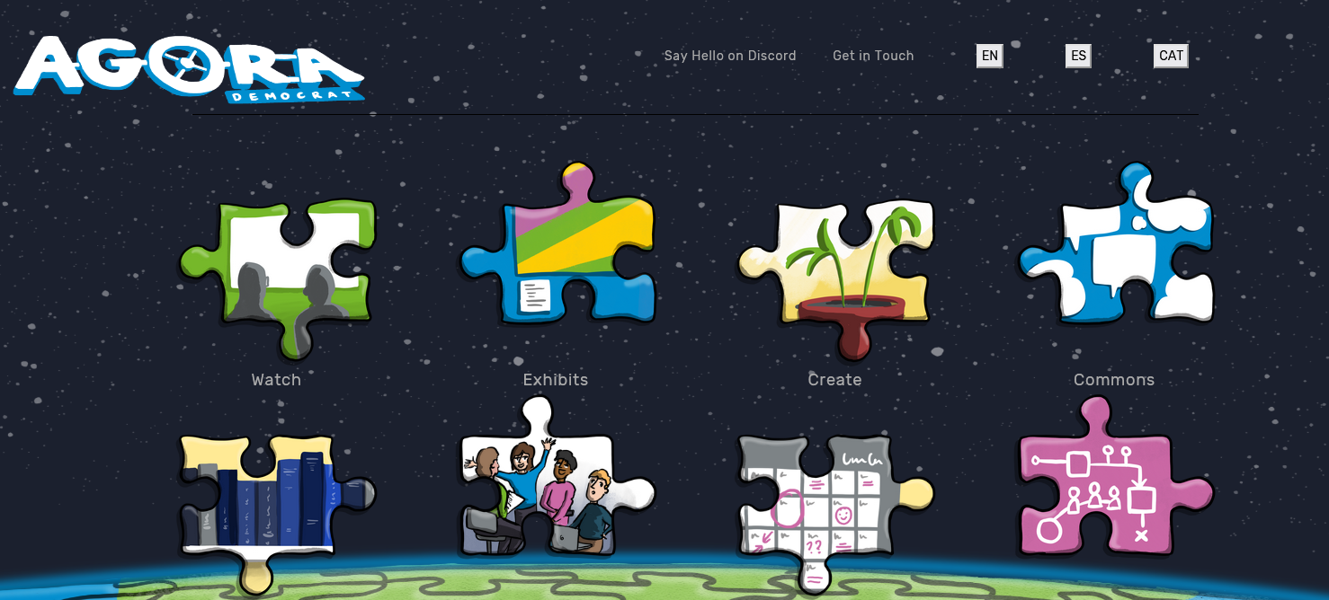
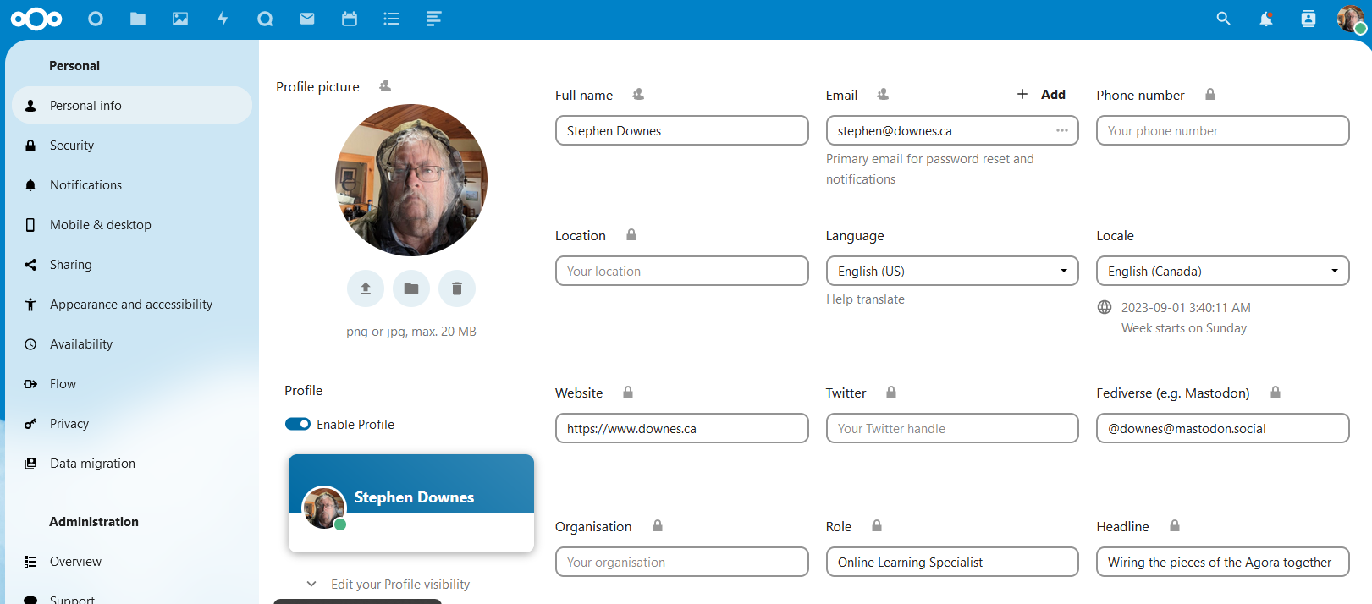
2. Create and share Profile
Enter profile in Nextcloud - https://nextcloud.democrat-horizon.eu/settings/user
Login with provided credentials
Select Language
Configure Details

Slide 3
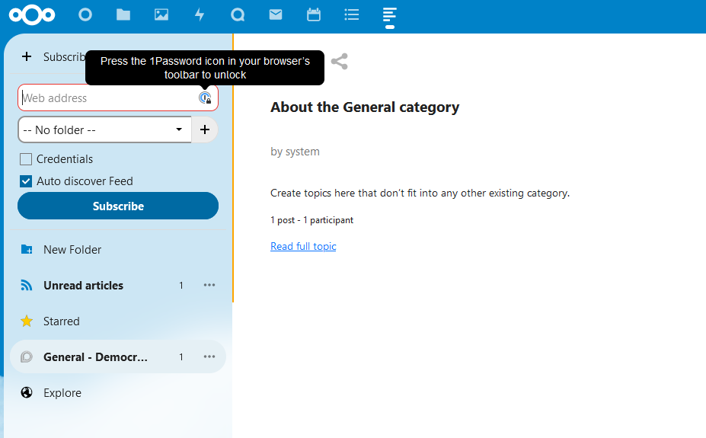
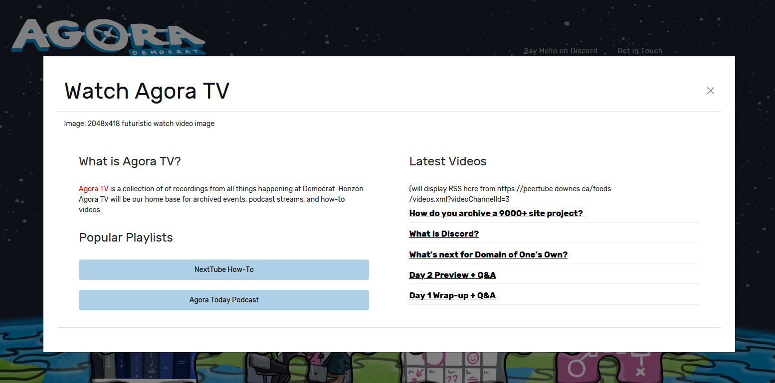
3. Register for Feeds (URLs provided)
Blog feed (specific to national team)
Community Feed (specific to national team)
Videos feed (specific to national team)
Podcast?
Feed contents from Agora services also appear on Agora pages

Slide 4
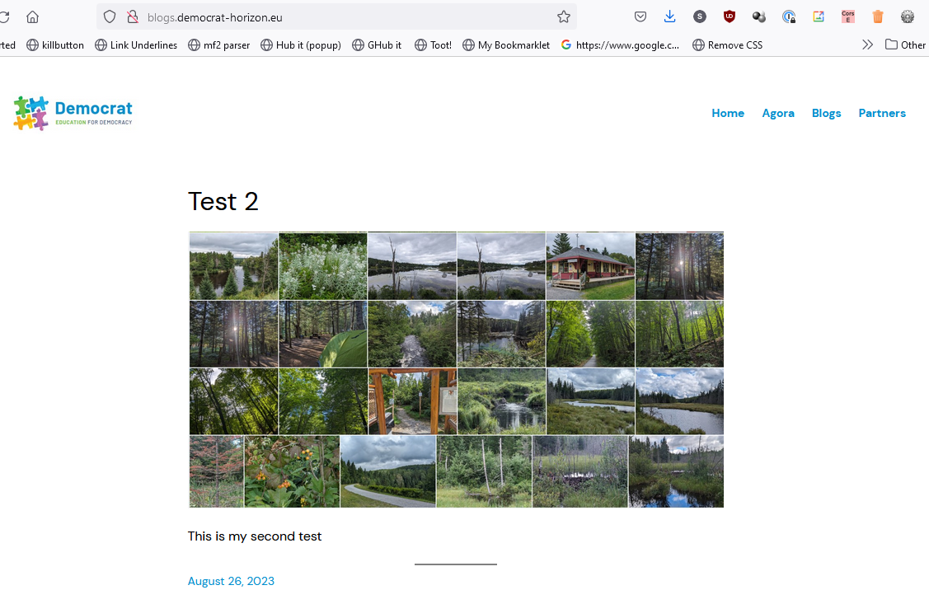
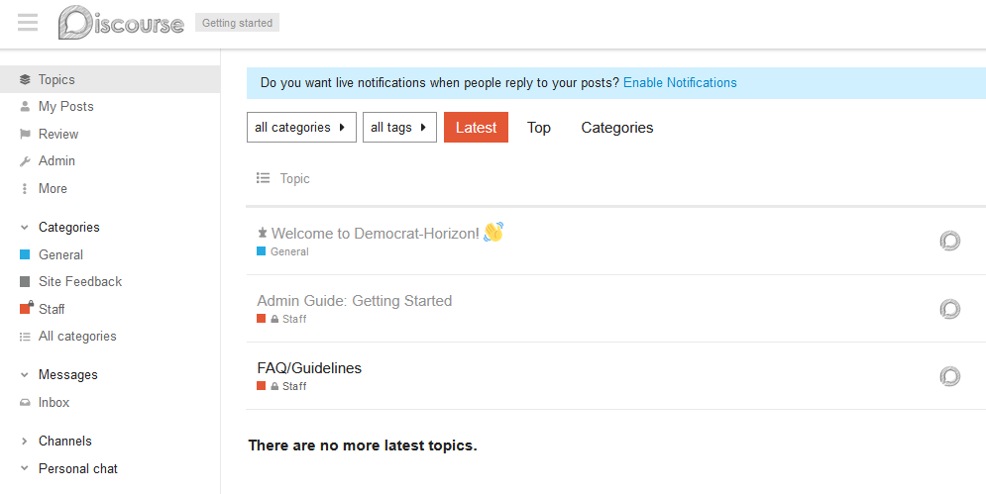
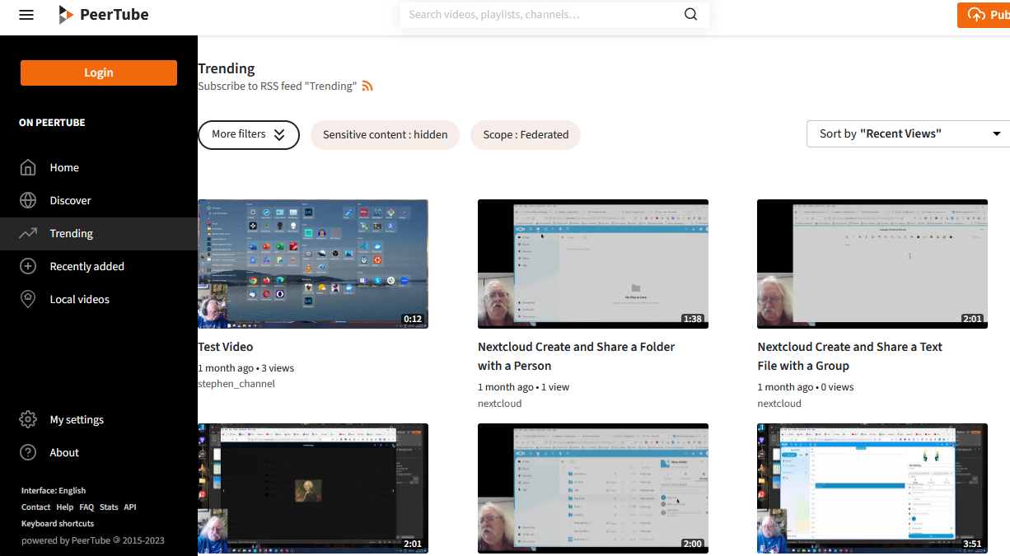
Blog feed
Community Feed
Videos feed

Slide 5
4. Discourse Community - Enter site (from feed)
Login to account with provided credentials
Each national team has a private group
Set up profile – selecting language
We have a community organizer, Vanina Morrison, who will help with these

Slide 6
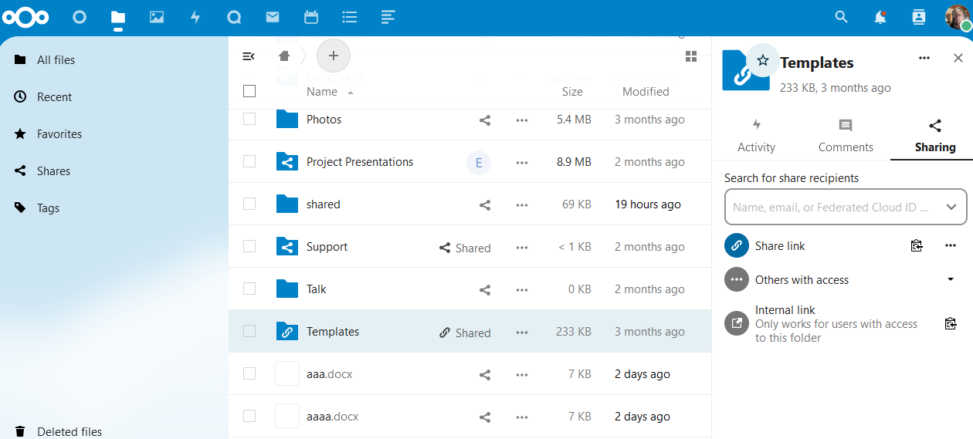
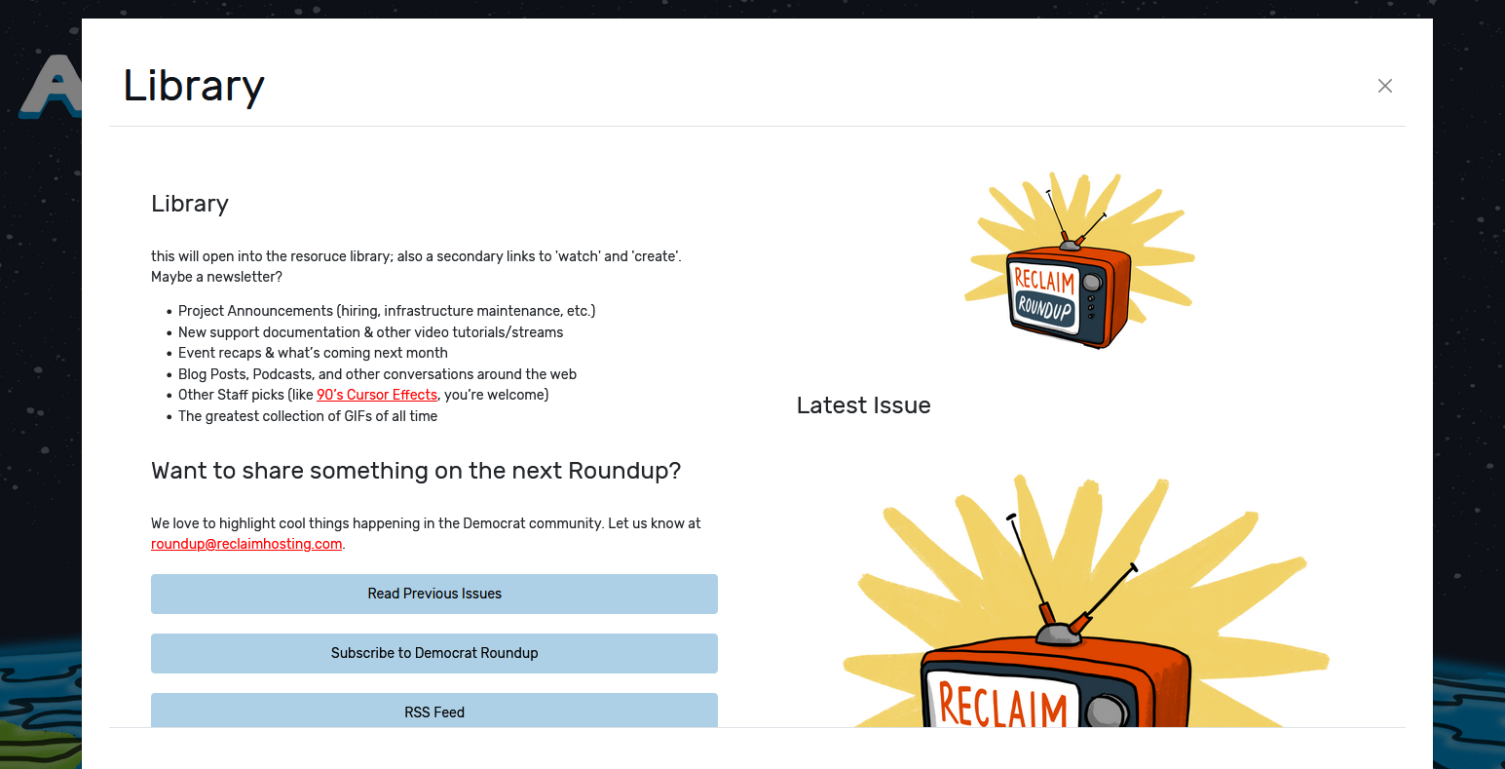
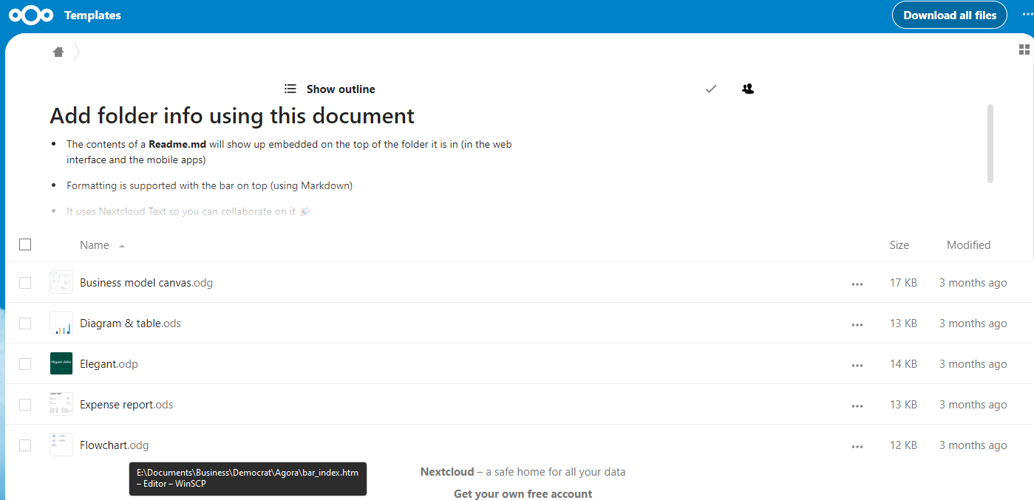
Share
National Team contact shares files publicly or privately with national participants only

