Slide 2
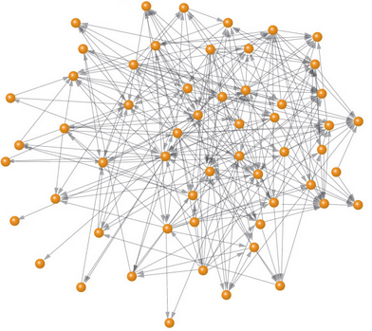
You have imagined the Fediverse
Instance
Instance
Protocol

Slide 3
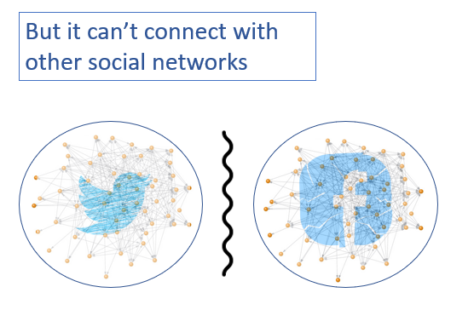

Slide 4
