Slide 1
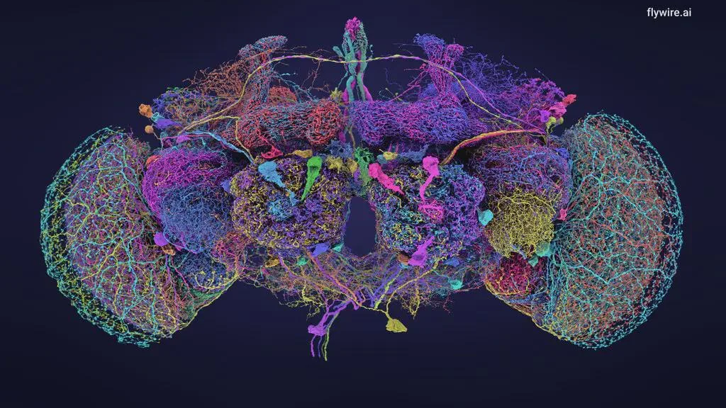
Just In Time: Creating Dynamic Open Learning Resources Using GAI
Stephen Downes
2024 Open Education Conference
October 8, 2024

Slide 2
Static Open Learning Resources
Historically, the development of open learning resources has been based on creating a library of static open learning resources (SOLR) that can be discovered, adapted and applied in a learning environment. This approach has suffered from numerous well-documented weaknesses: out-of-date content, obsolete technology, discoverability, context-sensitivity, localization and accessibility, up-front cost and storage overhead, and a general failure to adapt and reuse the learning materials.
Image: https://www.everylearnereverywhere.org/blog/how-oer-can-support-equity-practices-in-higher-education-lessons-from-a-3-year-study/

Slide 3
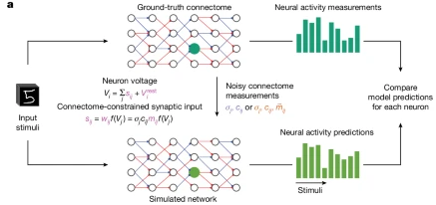
The Fly Brain Simulator
“We built a computational model of the fly visual system that is consistent with available connectome data, has biophysically plausible neural dynamics, and can be computationally trained to solve an ethologically relevant behavioural task, namely the estimation of optic flow.”
https://www.nature.com/articles/s41586-024-07939-6-3

Slide 4
Flywire Connectome Data Explorer
“FlyWire is a human-AI collaboration for reconstructing the full brain connectome of Drosophila. It is made possible by contributions from hundreds of scientists around the globe… we can now make significant advances in our understanding of how the brain works by ultimately linking neuronal wiring with brain function.”
https://flywire.ai/consortium
https://codex.flywire.ai/

Slide 5
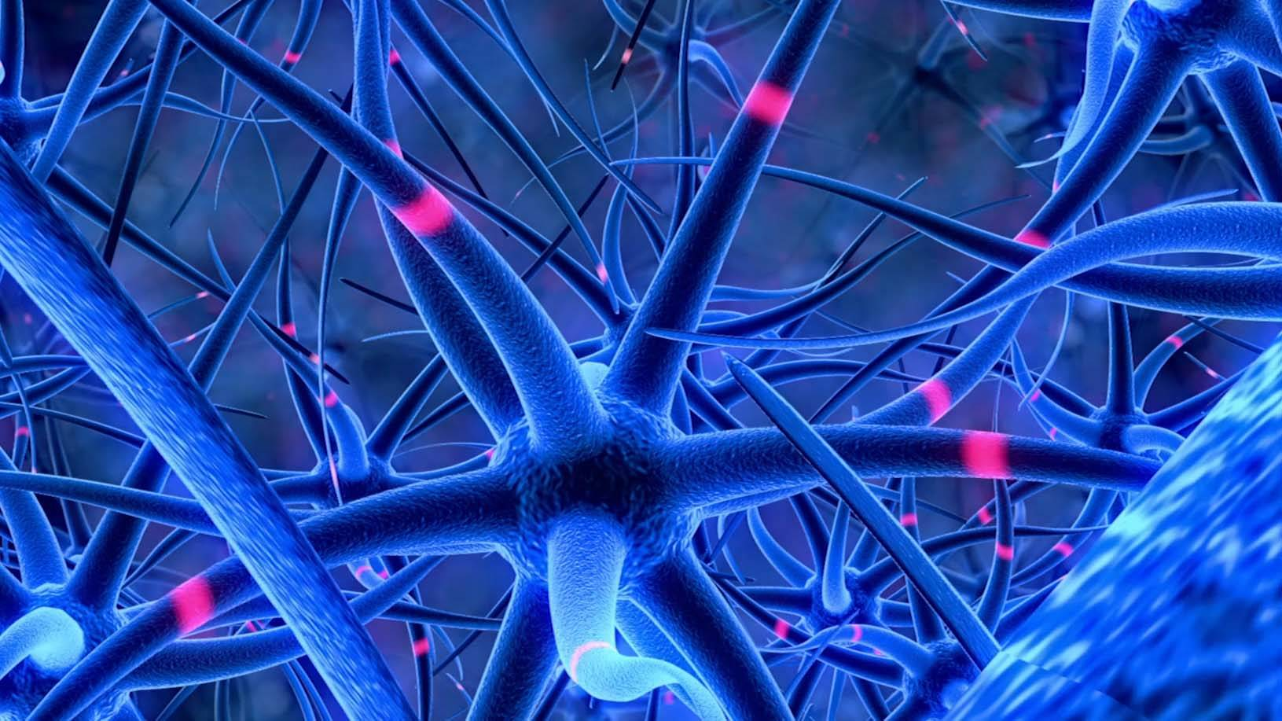
Why I Love This Project
“Using an AI model built by the Seung lab, the lumps and blobs in those images were turned into a labeled, three-dimensional map by the FlyWire Consortium — an unlikely collaboration among gamers, professional tracers, and neuroscientists who are collectively listed as last author on the flagship paper.”
https://www.princeton.edu/news/2024/10/02/mapping-entire-fly-brain-step-toward-understanding-diseases-human-brain

Slide 6
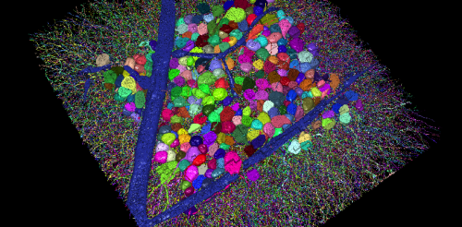
The EyeWire Game
“FlyWire took inspiration from the earlier EyeWire project, a crowdsourced gamer project that mapped neurons in a mouse retina… gamers painstakingly assembled millions of tiny puzzles to solve the 3D structure of each mouse neuron, revealing each point of connection between them. ”
https://wiki.eyewire.org/Main_Page
https://www.princeton.edu/news/2018/05/17/princeton-researchers-crowdsource-brain-mapping-gamers-discover-six-new-neuron

Slide 7
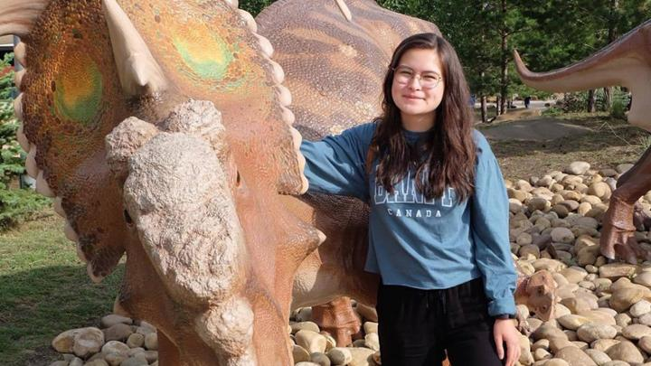
Dynamic Open Learning
“Dynamic learning is fuelled by research-inspired insights and hands-on experiences. The interplay of ideas and action gives our students a powerful edge of expertise.”
https://www.uvic.ca/about-uvic/about-the-university/dynamic-learning/index.php
Notes:
Uses real data
Interactive and constructive
Addresses real-world problems

Slide 8
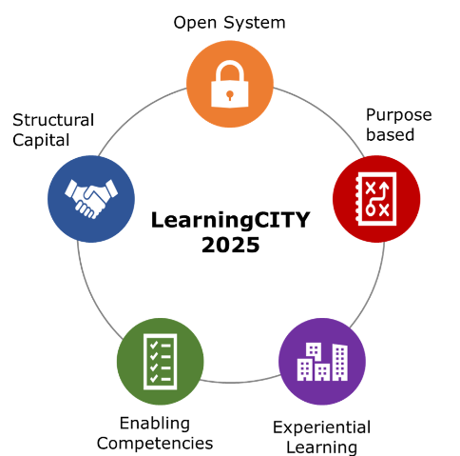
Community Connections
“A dynamic open learning system will require active involvement from key members of the learning system, namely learners, educators, and employers.”
https://www.calgaryeconomicdevelopment.com/assets/Reports/Research/Calgary-on-the-Precipice-LearningCITY-2020.pdf p. 15
Notes:
Uses real data
Interactive and constructive
Addresses real-world problems

Slide 9
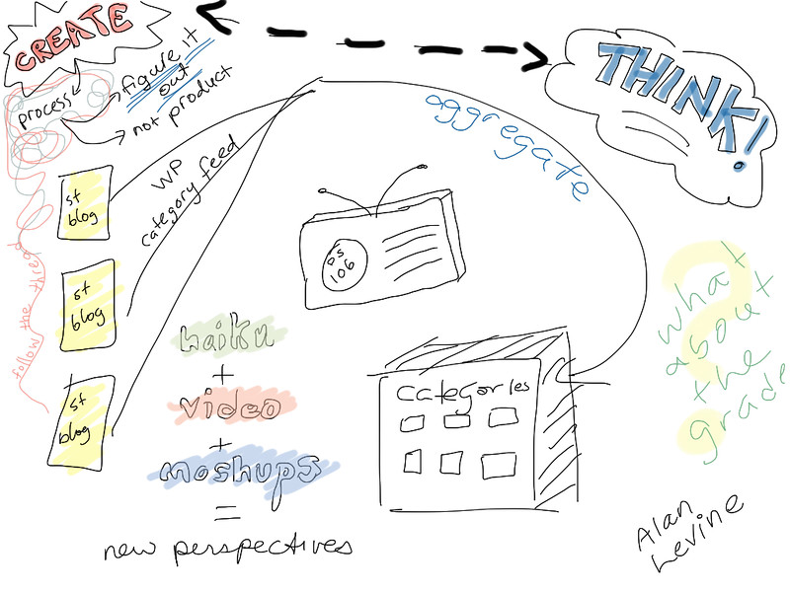
Characteristics
Dynamic Open Learning:
Uses real data
Transparent processes
Collaborative & Cooperative
Interactive and constructive
Addresses real-world problems
https://www.flickr.com/photos/38795936@N00/8095663350/
Notes:
Uses real data
Interactive and constructive
Addresses real-world problems

Slide 10
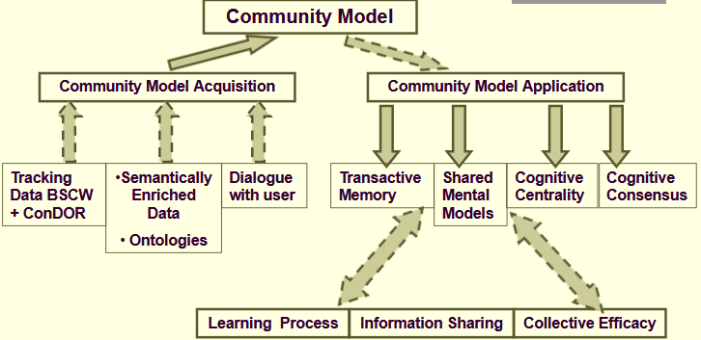
Issues for Dynamic Open Learning
Transactive memory
Shared models
Dynamic network formation
Consensus-building Processes
Edukalibra/ConDOR Project (2005: https://www.academia.edu/3388237/Towards_Community_Driven_Development_of_Educational_Materials_The_Edukalibre_Approach
Image: https://slideplayer.com/slide/794938/ See also: https://folia.unifr.ch/documents/317958/files/1_2005_edmedia_MileEdukalibre.pdf
Notes:
Uses real data
Interactive and constructive
Addresses real-world problems

Slide 11
Roles for AI
Data collection and interpretation
Dynamic content creation
Translation logging and summarization
Dynamic network formation
Consensus identification
Image: https://www.contentstack.com/blog/all-about-headless/content-management-artificial-intelligence-content-ops
Notes:
Uses real data
Interactive and constructive
Addresses real-world problems

Slide 12
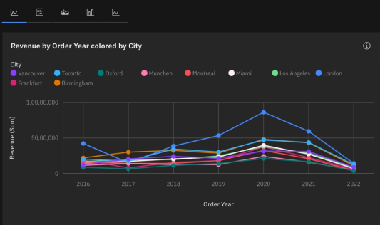
Data collection and interpretation
Examples:
Data cleaning and analysis
https://cognos-demo.17f48735.public.multi-containers.ibm.com/component1
content analysis and categorization
https://cloud.google.com/vision?hl=en#demo
automatic image analysis
https://aistudio.google.com/app/prompts/1FrgNHqpYgjoflSxdYbTP_TcELi0XbhRJ
Notes:
Uses real data
Interactive and constructive
Addresses real-world problems

Slide 13
Dynamic content creation
Examples:
Content discovery
https://halfanhour.blogspot.com/2024/05/perplexity-on-connectivism.html
Automated summarizing podcasts
https://www.downes.ca/post/77053
Automated course creation
https://halfanhour.blogspot.com/2024/08/a-100-page-textbook-on-logic.html
Image: AI Game Generation Tools https://msbu.co.id/blog/highly-recommended-ai-game-generator-tools-for-2024
Notes:
Uses real data
Interactive and constructive
Addresses real-world problems

Slide 14
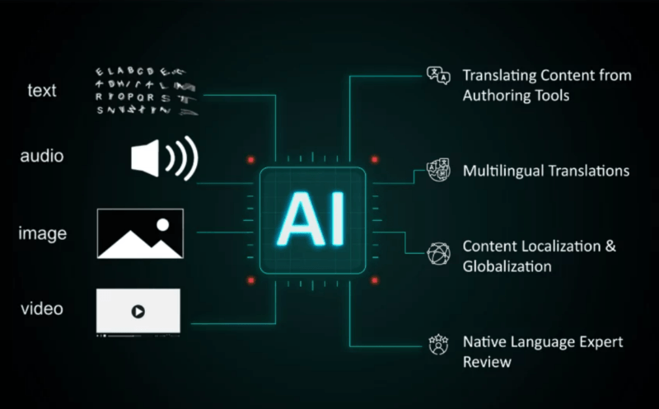
Translation logging and summarization
Examples:
Translation
https://libretranslate.com/
Transcription
https://support.google.com/accessibility/android/answer/9158064?hl=en
Summary
https://quillbot.com/summarize
Image: https://elearningindustry.com/generative-ai-based-automated-translation-what-you-need-to-know
Notes:
Uses real data
Interactive and constructive
Addresses real-world problems

Slide 15
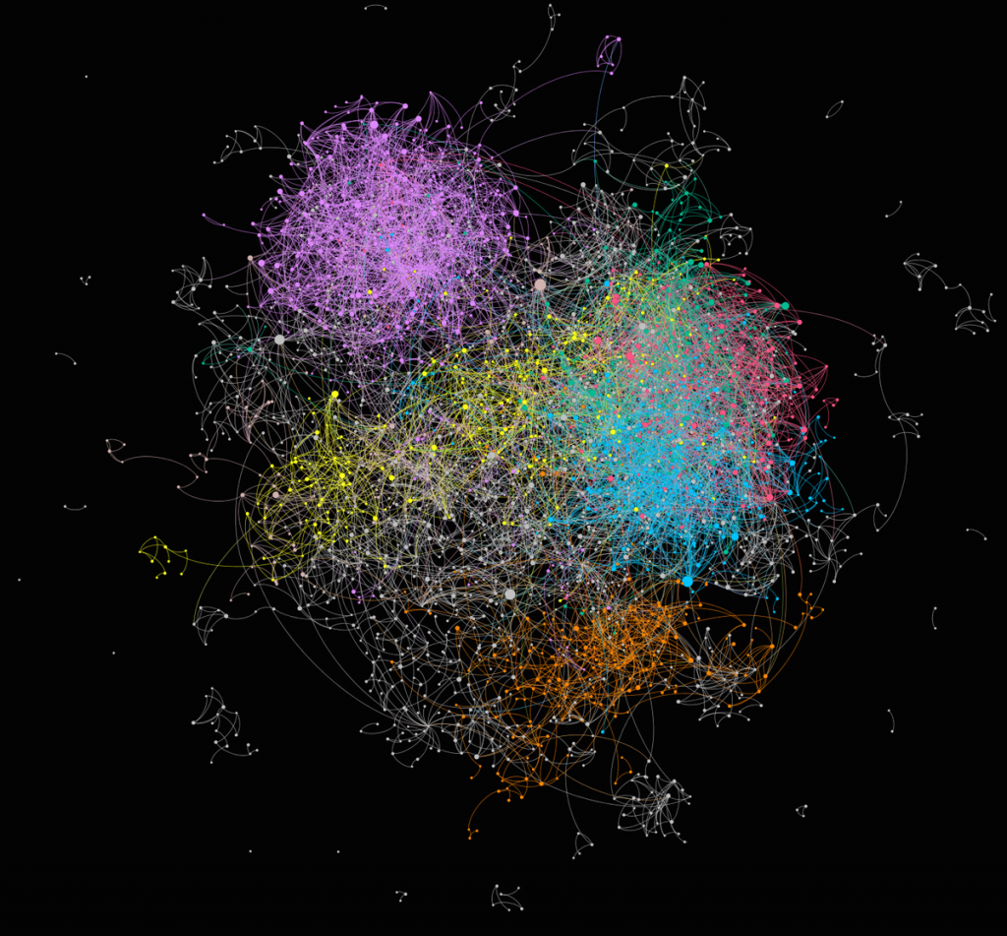
Dynamic network formation
Examples:
Team Formation
https://pandos.io/pandos-team-generator-a-smart-virtual-team-building-tool/
Social Network Visualization
https://socnetv.org/
AI Chat
https://deepai.org/chat Do you know of a social network or community siute that has AI bots participating?
Notes:
Uses real data
Interactive and constructive
Addresses real-world problems

Slide 16
Consensus building
Examples:
AI-Based Project Management
https://downes-squad.monday.com/
Collaborative Intelligence
https://slack.com/blog/collaboration/collaborative-intelligence-people-and-ai-working-smarter-together and https://slack.com/marketplace/search?q=AI
Collaborative authoring support
https://medium.com/@Phannuman/ai-as-a-co-author-exploring-collaborative-writing-with-technology-42bd0bea789a
Notes:
Uses real data
Interactive and constructive
Addresses real-world problems

Slide 17
Meeting the Objections
Does AI improve access to learning?
Is AI an environmental nightmare?
Does generative AI misrepresents members of marginalized communities?
Does AI steal content?
Does AI violate the spirit of open access?
Notes:
Uses real data
Interactive and constructive
Addresses real-world problems

Slide 18
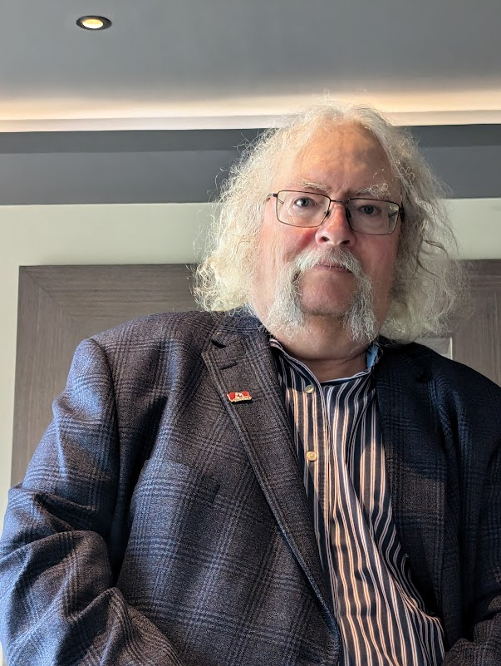
Stephen Downes
https://www.downes.ca/

